Slide 1

Differential Expression Analysis of TCGA Breast Cancer Data
Vaidehi Gupta
BS 845 Final Project Presentation
May 1st, 2026

Slide 2
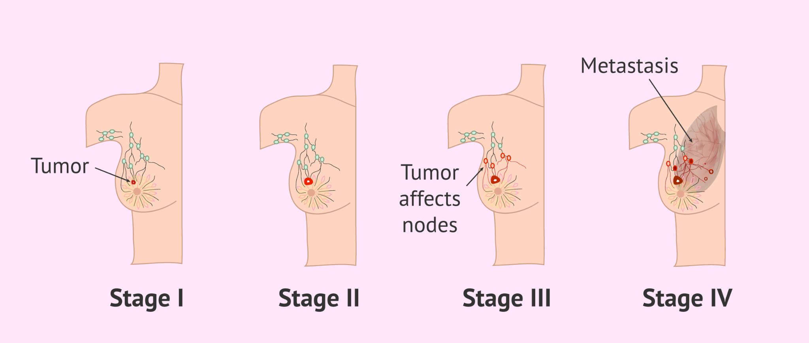
Background
Breast cancer is one of the most prevalent and biologically complex diseases globally, affecting 1 in 8 women (ACS, 2026).
It is highly heterogeneous, which makes diagnosis and targeted treatment a significant clinical challenge.
Identifying differentially expressed genes (DEGs) can reveal candidate biomarkers for more accurate diagnosis and treatment.
Goal:
Determine which genes are most significantly dysregulated between primary tumor and healthy adjacent tissue in the TCGA-BRCA cohort.
Notes:
Heterogeneity in breast cancer means that no two tumors are genetically identical, making it hard to find universal biomarkers for diagnosis and treatment

Slide 3


Data
Source: The Cancer Genome Atlas (TCGA), Breast Invasive Carcinoma (BRCA) cohort
From the Genomic Data Commons (GDC) Portal
Package: TCGAbiolinks (Bioconductor)
Used to query and download directly into R
Data type
RNA-sequencing raw counts (reads mapped to the genome via STAR alignment tool)
Clinical metadata (PAM50 subtype, staging, vital status)
Size: 1,111 primary tumor and 113 solid tissue normal samples
60,660 genes across 1,224 samples
Notes:
STAR is an alignment tool that maps raw RNA sequencing reads to the human reference genome and counts how many reads land on each gene.
There are 60,660 genes and 1,224 samples (this is the full transcriptomic profile for the BRCA cohort).

Slide 4
Methods
Data wrangling/filtering: tidyverse (dplyr, tidyr)
Pre-filtering: Removed low-count genes (rowSum < 10) to reduce noise and improve power.
Modeling: DESeq2 (differential expression modeling)
Handles overdispersion in count data via negative binomial model, normalizes across samples automatically
Thresholds for DEGs: adjusted p-value < 0.01 and | log₂ fold change | > 2
Transformation: Variance Stabilizing Transformation (VST) for downstream visualizations
Volcano Plot (EnhancedVolcano), Heatmap (ComplexHeatmap + viridis), Boxplots and PCA (ggplot2)
ID mapping: converted Ensembl IDs to gene symbols for interpretability (org.Hs.eg.db)

Slide 5
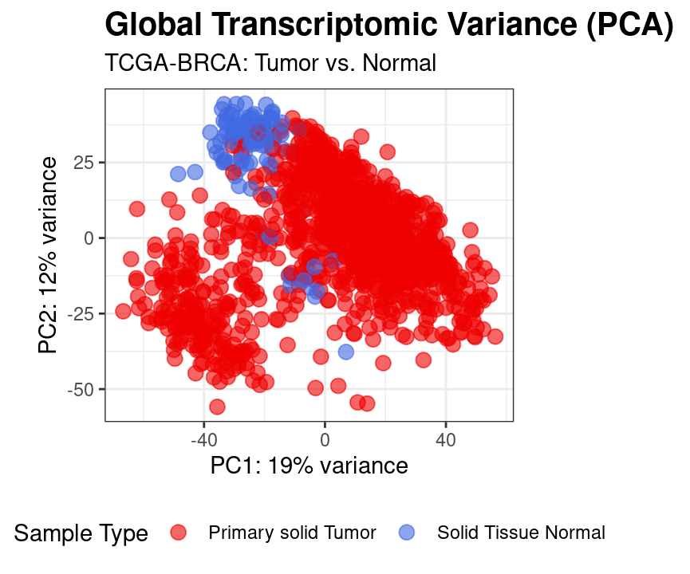
Results
Figure 1: PCA Plot
Shows that the data is high quality and biologically consistent.
PC1 and PC2 together explain nearly a third of total variance.
Normal samples (blue) cluster tightly
Tumor samples (red) show wide spread → reflects tumor heterogeneity
Few blue dots “drifted” toward the red cluster.
Means that a small # of normal samples showed tumor-like expression profiles.

Slide 6
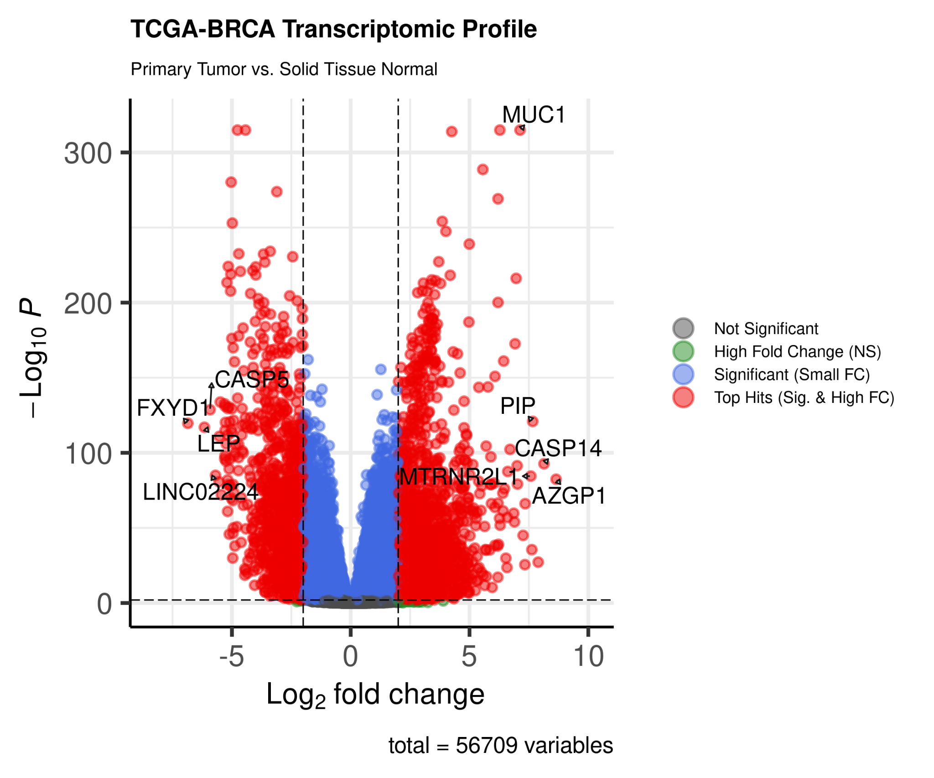
Results
Figure 2: Volcano Plot
Visualizes the differential expression of over 56,000 genes.
Top hits were defined by p-adj < 0.01 and |log₂FC| > 2
Most significantly upregulated genes
MUC1: a known oncogene
PIP: tissue marker, associated with tumor proliferation
Most significantly downregulated genes
FXYD, LEP, CASP5: Genes associated with normal tissue function
Upregulated genes
Downregulated genes

Slide 7
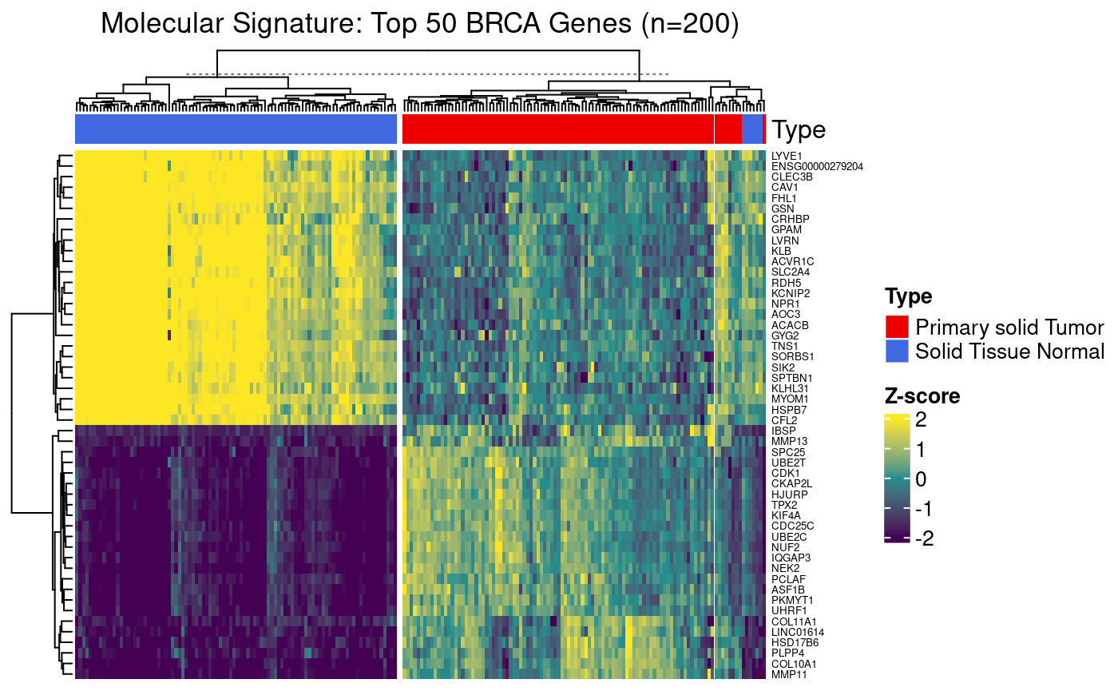

Results
Figure 3: Top 50 DEGs Heatmap
Shows the top 50 differentially expressed genes across a random subsample of 200 samples (100 for tumor, 100 for normal) for visual clarity.
Hierarchical clustering cleanly separates tumor from normal with two distinct gene expression blocks.
Bright yellow = high expression (upregulation)
Deep purple = low expression (downregulation)

Slide 8
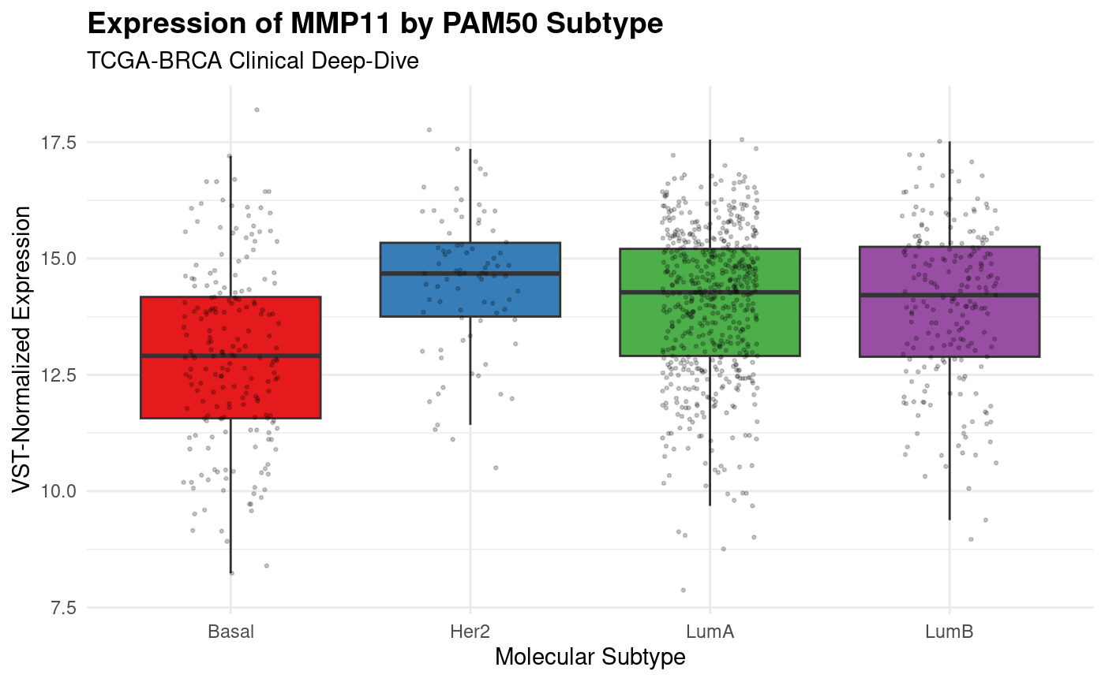
Results
MMP11: Matrix Metalloproteinase, an enzyme that dissolves extracellular matrix (‘glue’ that holds cells in place)
Figure 4: MMP11 Boxplots
MMP11 expression stratified by PAM50 molecular subtype (Basal, Her2, LumA, LumB)
Highest median expression in Her-2 subtype.
Basal subtype shows notably lower MMP11 expression vs. Her2/LumA/LumB, suggesting subtype-specific regulation.
Broad distribution across all groups suggests that matrix remodeling is a fundamental feature of the malignant phenotype in breast cancer.
Notes:
PAM50: the standard molecular classification for breast cancer.
Stands for Prediction Analysis of Microarray 50 (a 50 gene signature assay used to classify breast cancer into subtypes)
I picked MMP11 because it was one of the top hits for breast cancer on my heatmap
I wanted to see how the gene expression of MMP11 would differ across these clinical subtypes My hypothesis was that it would have the highest expression in Basal, which is the most aggressive form of breast cancer.

Slide 9
Conclusion
Successfully identified thousands of statistically robust DEGs between tumor and normal tissue.
Tumor vs. Normal status was the primary driver of gene expression differences, regardless of individual patient backgrounds.
Identified MMP11 as a candidate biomarker for breast tumor vs. normal tissue.
Expression varied across PAM50 subtypes, suggesting that it’s subtype dependent.
Limitation
Imbalanced cohort (1,111 tumor vs. 113 normal)
Future Directions
Perform Kaplan-Meier survival analysis to see if patients with the highest MMP11 expression have lower overall survival rates.

Slide 10
References
American Cancer Society. (2024). How common is breast cancer? https://www.cancer.org/cancer/types/breast-cancer/about/how-common-is-breast-cancer.html
Colaprico, A., Silva, T. C., Olsen, C., Garofano, L., Cava, C., Garolini, D., Sabedot, T. S., Malta, T. M., Pagnotta, S. M., Castiglioni, I., Ceccarelli, M., Bontempi, G., & Noushmehr, H. (2016). TCGAbiolinks: An R/Bioconductor package for integrative analysis of TCGA data. Bioconductor. https://bioconductor.org/packages/release/bioc/html/TCGAbiolinks.html
Silva, T. C., Colaprico, A., Olsen, C., D'Angelo, F., Bontempi, G., Ceccarelli, M., & Noushmehr, H. (2016). TCGAbiolinks: Searching, downloading, and preparing TCGA data. Bioconductor. https://bioconductor.org/packages/release/bioc/vignettes/TCGAbiolinks/inst/doc/query.html

