Slide 1
HCI Technologies: Ethical, Social & Cultural Implications
A Deep Dive into Emerging HCI Impact
BY-
Vaidehi Rathore(21BCS4723)
Shreya Choudhary(21BCS4680)

Slide 2
Introduction
Human-Computer Interaction (HCI) is rapidly transforming the way users communicate with and control machines. From voice assistants to gesture-based controls and AI-driven interfaces, HCI innovations are making technology more accessible and efficient. However, these advancements bring significant challenges. Ethically, there are concerns about privacy, consent, and algorithmic transparency. Socially, HCI impacts how people work, learn, and connect, potentially widening the digital divide. Culturally, technologies risk reflecting biased norms if not designed with global diversity in mind. Addressing these concerns is essential to ensure HCI benefits everyone fairly.

Slide 3
What is HCI?
HCI stands for Human-Computer Interaction. It involves the study, planning, and design of how people interact with technology, including computers, mobile devices, and smart systems. HCI focuses on creating user-friendly interfaces and experiences by combining knowledge from computer science, psychology, design, and human behavior. The goal is to make technology more accessible, efficient, and enjoyable for all users.

Slide 4
Ethical Implications
Data Privacy: As HCI systems collect user data to improve experiences, concerns arise about how securely that data is stored and whether users have control over their personal information.
Algorithmic Bias: AI-driven systems may unintentionally favor certain groups over others due to biased training data, leading to unfair or discriminatory outcomes.
AI Misuse: Advanced HCI technologies like facial recognition and predictive algorithms can be used for surveillance or manipulation if misused by governments or corporations.
Lack of Transparency: Many systems operate as “black boxes,” making it hard for users to understand how decisions are made, which reduces accountability and trust.

Slide 5
Social Implications
Job Displacement: Automation and intelligent systems are replacing certain manual or repetitive tasks, raising concerns about unemployment and the need for workforce reskilling.
Accessibility Gaps: Not all users have equal access to advanced technologies due to physical, cognitive, or financial limitations, which can lead to exclusion.
Digital Divide: Unequal access to the internet and digital devices across regions and socio-economic groups creates a gap between those who benefit from HCI advancements and those who are left behind.
Changing Communication Norms: HCI technologies like chatbots, virtual reality, and remote collaboration tools are reshaping how people communicate, often reducing face-to-face interaction and altering social dynamics.

Slide 6
Cultural Implications
Western Tech Dominance: Many leading HCI technologies are developed in Western countries, often embedding Western values and design assumptions that may not align with other cultures.
Loss of Cultural Identity: As global users adapt to mainstream technologies, there's a risk that local languages, customs, and traditions may be overlooked or lost.
Globalization of Norms: Technologies tend to standardize user behavior and expectations worldwide, potentially diluting cultural diversity and promoting a one-size-fits-all approach.
Tech Adapting to Local Cultures: On the positive side, there’s growing recognition of the need to design culturally responsive systems—ones that consider language, symbols, and user habits unique to specific regions.

Slide 7
Recommendations
Ethics-by-Design: Ethical considerations should be integrated from the very beginning of the design process, not treated as an afterthought. This includes fairness, privacy, and transparency in all stages of development.
Inclusivity in Development: Diverse teams lead to more inclusive technologies. Involving people of different genders, backgrounds, and abilities ensures the final product meets a wider range of user needs.
Cross-Cultural Design: Designing with cultural sensitivity is essential. Interfaces, language, colors, and features should reflect the values and expectations of various user groups across the globe.
Policy-Making with Stakeholders: Governments, tech developers, ethicists, and users must collaborate in shaping policies that guide ethical and responsible HCI development and deployment.

Slide 8
Real-World Example
Voice assistants like Alexa and Siri have demonstrated bias in speech recognition, particularly struggling to accurately understand users with diverse accents, dialects, or non-standard speech patterns. This highlights a critical gap in how training datasets are collected and used, often favoring dominant languages or accents. Such bias not only affects usability but also raises concerns about equity and inclusivity in HCI systems. To address this, developers must prioritize diverse, representative datasets and test systems across global user groups.

Slide 9
Conclusion
HCI technologies hold immense potential to revolutionize the way we live, work, and communicate. However, this potential must be harnessed responsibly. The development and deployment of these systems should be guided by strong ethical frameworks, with a commitment to privacy, transparency, and fairness. Additionally, ensuring cultural sensitivity and inclusivity is essential to create technologies that truly serve diverse global communities. Only by balancing innovation with responsibility can we build a future where HCI benefits everyone equally.

Slide 10
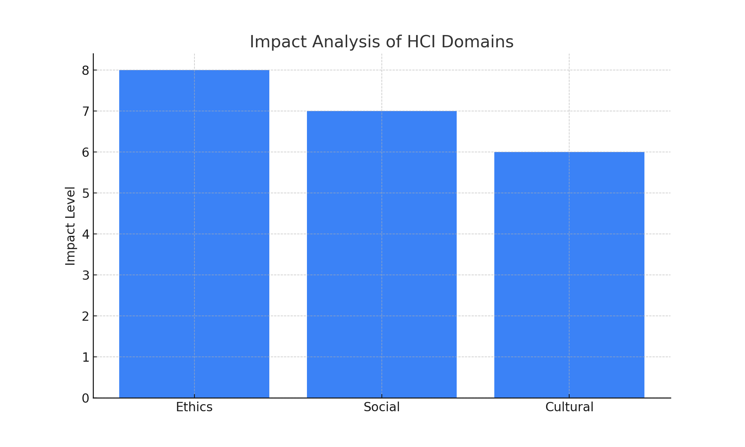
Impact Analysis Chart

Slide 11
THANK YOU!

