Slide 1



AI Powered, Resume Generator
Presented By:
1. Vaidhav - 136
2. Sachin - 130
3. Chandrapal - 118
4. Shreerenu - 151
5. Tanmayee - 134
www.vidyashilpuniveísity.com

Slide 2
Introduction
In today’s competitive job market, job seekers struggle with resume creation, interview preparation, and identifying suitable companies. Our AI-powered chatbot simplifies this process by:
1. Generating well-structured resumes based on user input.
2. Predicting 20 relevant interview questions.
3. Suggesting companies categorized as safety, moderate, and reach, with hiring probability.
Built using Gemini API, Jupyter Notebook, Streamlit, and MySQL.

Slide 3
Problem Statement
Fresh graduates face challenges in transitioning to the professional world, including:
Resume Formatting Issues – Uncertainty in structuring and presenting skills.
Interview Preparation Challenges – Lack of awareness about expected questions.
Job Opportunity Awareness – Difficulty in identifying suitable companies.
Traditional job resources offer generic guidance, leading to trial-and-error job searches. ResumeAI leverages AI & ML to automate resume generation, personalized interview preparation, and job recommendations with probability analysis—enhancing job readiness and confidence

Slide 4
Objective
The objective of this project is to build an AI-powered chatbot that streamlines the resume creation and job preparation process..
AI-Powered Resume Builder – Auto-generates structured, professional resumes.
Personalized Interview Prep – Predicts questions based on skills & job roles.
Job Recommendations – Categorizes companies into Safety, Moderate, and Reach with hiring probabilities.
Database Storage – Saves user data for easy edits & future use.
User-Friendly Interface – Streamlit-based, ensuring accessibility.
AI & ML Integration – Uses Gemini API for automated resume and job analysis.
Efficient Job Search – AI-driven insights to streamline applications

Slide 5
Solution Workflow
User Interaction and Input Collection
2. Data Processing and AI Integration
Audio-Based Input Option
Database Storage and Export Options
Exit & Future Accessibility

Slide 6
User Interaction & Input Collection
This will provide a clear and concise representation of the user journey
Open Website Language and Template Selection Personal Information Collection
Educational Background Collection
Work Experience Collection
Skills & Certifications Collection
Projects & Publications Collection
Languages & Hobbies

Slide 7
Data Processing and AI Integration
1. Data Validation & Processing 2. Resume Generation (Gemini API):
Correct Data Formating . Structures user data into resume based on selected template
Checks Missing Fields . AI-enhanced resume suggestions refine content based on industry standards.
Invalid prompt , request user correction
3. Interview Question Generation
. Gemini API analyzes skills, experience, job preferences & generates 20 Ques.
4. Company Recommendation & Probability Assessment:
. ​AI evaluates job market trends to recommend companies aligning with the user's profile. It classifies these companies into three categories:
. Safety: High probability of selection, Moderate: Balanced probability., Reach: Lower probability but aspirational

Slide 8
Audio-Based Input Option
User Uploads Audio Recording Speech-to-Text Conversion:
. NLP techniques to transcribe the audio input into text format
Data Structuring and Analysis: . The transcribed text is then structured into predefined categories, such as personal information, educational background, and work experience
Resume Generation: Utilizing
.The system uses structured data to generate a professional resume based on users information

Slide 9
Database Storage and Export Options
1. User Data Input 2. Data Storage in MySQL Database
. Through manually or video . Stores the collected user data, generated resumes, interview questions.
3. Resume Generation
. Based on the stored data, the system generates a professional resume
4. Editing and Refinement
. Users have the options to review & edit specific section of the resume. AI provides suggestions to enhance resume.
5. Export Options
. users can export it in their preferred format, such as PDF or Word document.
6. Future Access
. Allows users to revisit and modify their information, facilitating easy updates and re-generation of resumes as needed.

Slide 10
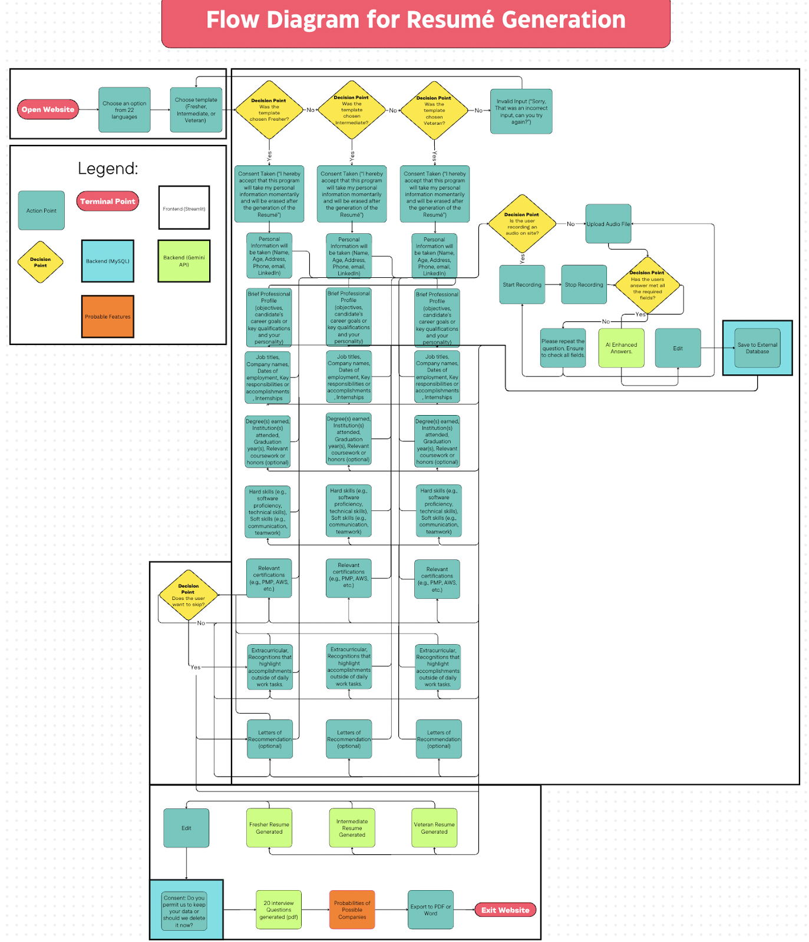

Slide 11
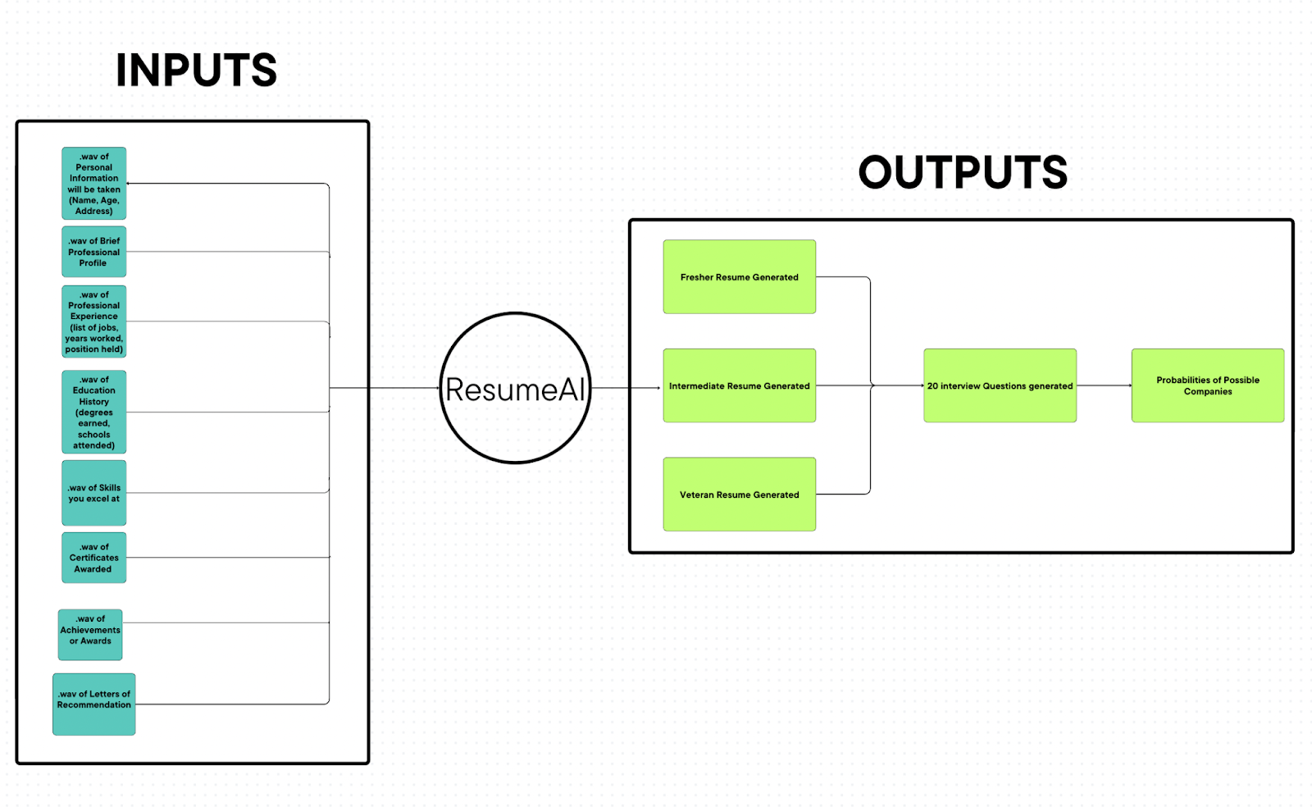
Inputs & Outputs Diagram

Slide 12
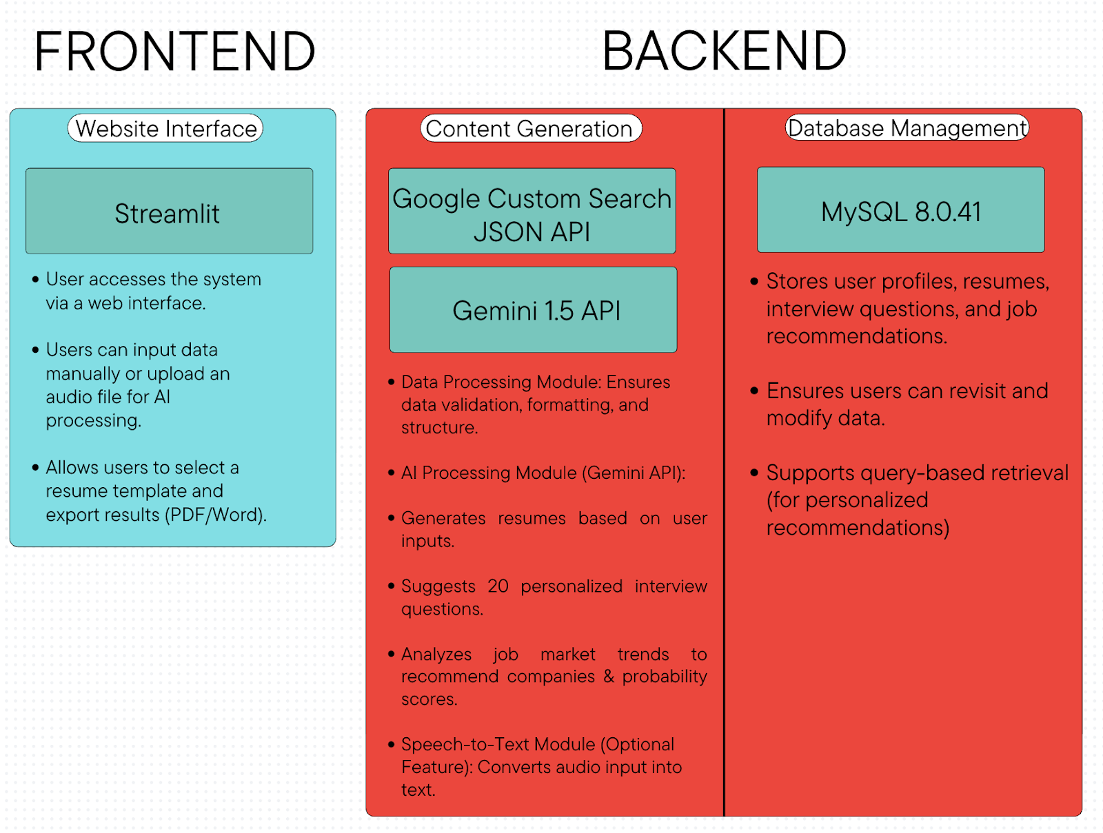
Tech stack to implement ResumeAI

Slide 13
Kay Benefits and Impact
1. Automates Resume Creation – Saves time and ensures professional formatting.
2. AI-Powered Interview Preparation – Prepares candidates for real-world job interviews.
3. Job Market Insights – Helps users target the right companies with probability estimates.
4. User-Friendly & Accessible – No prior knowledge of resume writing is required.
5. Storage & Reusability – Allows users to edit, update, and refine resumes.

Slide 14
System Component Interaction & Flow
1. User Interaction (Frontend) → Backend Communication
User opens the Streamlit-based web application
selects a preferred language & resume template.
The system guides the user through structured questions for resume-building.
or
Alternatively, the user can upload an audio file that is processed by the Speech-to-Text module.
Once data is collected, the frontend sends structured input data to the backend for processing.

Slide 15
System Component Interaction & Flow
2. Backend Processing (Data Validation & Formatting)
The backend validates the input, ensuring no essential fields are missing
If errors exist, the system prompts the user for corrections.
Once validated, data is stored in MySQL for further processing..

Slide 16
System Component Interaction & Flow
3. AI-Powered Resume Generation (Gemini API)
The backend sends structured resume data to the Gemini API.
The API analyzes and generates a formatted resume based on the chosen template.
The response is returned in structured JSON format, which the backend converts into human-readable content.

Slide 17
System Component Interaction & Flow
4. AI-Generated Interview Questions
The system extracts key skills, job roles, and experience from the user profile.
This information is sent to the Gemini API, which generates:
HR-related interview questions (soft skills, behavior, and goals).
Technical questions based on the user’s domain expertise.
Scenario-based & problem-solving questions.
These 20 interview questions are displayed on the frontend and stored in the database for later retrieval.

Slide 18
System Component Interaction & Flow
5. AI-Powered Job Recommendation & Probability Analysis
The system analyzes user skills & experience to find matching job roles.
The Gemini API compares the user's profile with job market trends.
Companies are categorized into three hiring probability levels:
Safety (High Probability)
Moderate (Balanced Probability)
Reach (Challenging but possible)
A probability score (%) is calculated based on:
Skill & job role match percentage.
Industry hiring trends.
Past job placements (if historical data is available).

Slide 19
System Component Interaction & Flow
6. File Generation & Export System
The resume and interview questions are formatted for download.
Users can export their resume in PDF or Word format.
A Letter of Intent (optional) is generated for job applications.

Slide 20
System Component Interaction & Flow
7. Database Management (User Data Storage & Retrieval)
The MySQL database stores:
User profiles (personal details, skills, experience).
Generated resumes (for future modifications).
Interview questions (tailored for the user).
Company recommendations & probability scores.
Users can retrieve and update their information in later sessions.

Slide 21
Implementation Details
1. Steps Followed to Build the Solution:
Developing the Base Skeleton Code
Establish core chatbot logic to capture and process user inputs.
Implementing Resume Autofill System
Map user-provided information into a standardized resume format
Integrating Audio Transcription Module
Enable speech input by converting voice to text for resume generation
Testing Individual Components
Validate each module separately in Jupyter Notebook, addressing errors in string processing and formatting
Incorporating the Gemini API
Utilize the Gemini API for AI-driven resume generation, job probability predictions, and personalized interview questions
Database Integration with MySQL
UI/UX Implementation Using Streamlit
Develop an interactive interface with features like form submissions and dynamic output display

Slide 22
Implementation Details
2. Innovations or Unique Approaches Used:
Job Categorization by Probability: Classifies job opportunities into Safety, Moderate, and Reach categories based on user qualifications and job market data for better clarity on job prospects.
Google Search API for Real-Time Job Matching: Integrates Google Search API to find real companies for each category, providing specific employer names instead of generic job titles.
AI-Optimized Resume Formatting: Fine-tunes the Gemini API to generate structured, professional resumes, ensuring clarity, readability, and a well-organized format

Slide 23
Implementation Details
3. Challenges Faced and How They Were Overcome:
UI/UX Constraints in Streamlit: Limited UI customization required external CSS tweaks and multiple design adjustments for a better interface.
String Parsing & Formatting Errors: Inconsistent resume autofill formatting was fixed through structured text processing and careful debugging.
Building Probability-Based Job Categorization: Developing a custom scoring algorithm based on user skills, experience, and industry trends required extensive data analysis and fine-tuning.
Google Search API Implementation: Filtering relevant company listings while structuring queries and cleaning data ensured high-quality job matches.
AI Consistency in Resume Generation: Used prompt engineering and testing to maintain a standardized, professional resume format.
Final Integration & Testing: Combined all features into a cohesive system, refining UI, fixing bugs, and optimizing performance for a smooth user experience.

Slide 24
LLM and AI Integration
1. Large Language Model (LLM) Used:
Gemini API: Powered resume generation, interview questions, and job recommendations with advanced NLP.
Why Gemini?
Chosen for structured formatting, context-aware responses, professional tone, ease of troubleshooting, and free availability

Slide 25
LLM and AI Integration
2. Integration of AI Components:
Voice Input & Speech-to-Text
Natural Language Processing (NLP) for Resume Content Structuring:
AI-Based Job Recommendation System:
AI-Generated Interview Questions:

Slide 26
Impact of the Solution
1. Who Benefits from This Project?
Students and Fresh Graduates
Job Seekers Looking for Career Transitions
Recruiters and Hiring Managers
Universities and Career Guidance Centers

Slide 27
Execution Guide
Overview
ResuWhisper AI is a voice-based resume-building tool built with Python and Streamlit.
It leverages Google’s Gemini API for transcription and content generation, records audio, and exports resumes as Word or PDF files. This guide provides a beginner-friendly setup process for running the app locally.

Slide 28
Execution Guide
Prerequisites:
Python 3.8+: Install from python.org. Verify: python --version or python3 --version.
Git (Optional): Install from git-scm.com. Verify: git --version.
Text Editor/IDE: Jupyter Notebook (used in this guide), VS Code, or similar.
Google API Key: Obtained from Google Cloud Console by enabling the Gemini API.
System: Microphone and internet connection required.

Slide 29

Execution Guide
Steps:
1. Clone the Repository
2. Set Up Project Files
3. Set Up Virtual Environment
4. Install Libraries with Jupyter Notebook
5. Configure API Key
6. Add Logo Image
7. Run the App
8. Troubleshooting
9. Shutdown
Fig.1 Logo

Slide 30
Performance Matrics
An Analysis Using a 2x2 Confusion Matrix
Key Functionalities Tested:
User authentication (Sign-up & Login)
Live Resume Editor
Resume Content Generation
Interview Preparation

Slide 31
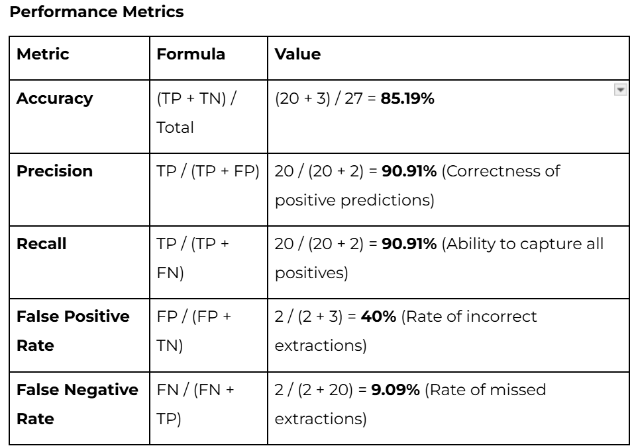
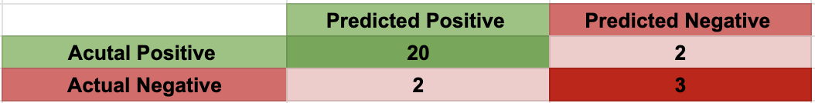
Performance Matrics
Key Matrix Summary
Total Events Tested: 27
Breakdown:
TP = 20
FN = 2
FP = 2
TN = 3

Slide 32
Performance Matrics
Key Findings and Improvements
Strengths: High TP rate, successful interview question & resume generation
Areas for Improvement:
Enhance field extraction accuracy (degree & email fields)
Improve error handling for incorrect extractions (address & spelling errors)

Slide 33
Future Enhancements
1. Enhanced AI Personalization for Resumes
Dynamic Resume Templates – Tailored for different industries (tech, finance, healthcare).
LLM Fine-Tuning – Generates resumes optimized for job descriptions & ATS compatibility.
AI-Powered Cover Letter Generation
. Auto-Generated Cover Letters – AI creates customized cover letters alongside resumes.
. Job-Specific Content – Users enter a target job description, and AI highlights key strengths
3. Advanced Job Recommendation System
. Machine Learning Integration – Improves job categorization using real-world job trends. . Job Board API Integration – Fetches real-time job openings from LinkedIn, Indeed, Glassdoor. . User Feedback Loop – Refines recommendations based on applications & interview outcomes.
4. Resume Performance Analytics
. AI-Powered Resume Review – Evaluates readability, formatting, and keyword optimization. . Scoring System – Provides a score-based assessment with improvement suggestions

Slide 34
Conclusion & Key Learnings
AI Integration: Hands-on with Gemini API, Streamlit, MySQL.
. Project Structuring: Early planning streamlined development.
. Technical Challenges: Solved UI/UX issues, formatting errors, debugging.
. Real-World Insights: Learned adaptability & modular development.
. Future Impact: Stronger foundation for AI-driven projects.

Slide 35



THANK YOU

