Slide 1
REAL-TIME AND CHAT COMMUNICATION
Overview
The Real-Time Chat and Communication System is a dynamic, scalable platform designed to facilitate seamless, instant messaging and communication between users. The system supports text, voice, and video messaging, providing an engaging and interactive experience for individuals or groups. Whether it's for personal, professional, or educational use, the platform ensures low-latency communication, rich media sharing, and robust security features.
Name
K.Vaidhegi
k.Arulmozhi
D.Sridharan
S.Sasikumar

Slide 2
Technology Stack
Frontend:
01
Backend:
02
Real-Time Communication:
03
React.js / Vue.js / Flutter (for mobile)
Node.js / Django / Java Spring Boot
WebSockets, WebRTC (for voice/video), MQTT
Database:
04
Cloud Infrastructure:
05
Authentication:
06
PostgreSQL / MongoDB (for message storage), Redis (for real-time cache)
AWS / Google Cloud / Microsoft Azure
OAuth, JWT (JSON Web Tokens), 2FA

Slide 3
USES CASES
Enterprise Communication:
Teams within organizations can use the system for internal communication, collaboration, and project management.
Integration with existing CRM and project management tools.
Social Networks:
Provide real-time messaging capabilities to users within a social media platform.
Group and private chats, media sharing, and notifications.
Customer Support
Integration with customer service platforms to enable real-time chats between customers and support agents.
Automated bots for initial inquiries, with handoff to live agents when necessary.

Slide 4
Benefits
Low Latency Communication: Near-instantaneous messaging and video calling with minimal delay.
Security & Privacy: End-to-end encryption ensures that all messages and calls are protected from unauthorized access.
Cross-Platform Accessibility: Users can seamlessly interact across devices, ensuring flexibility and convenience.
Scalability: The platform is built to handle high volumes of messages and calls without sacrificing performance.
User-Centric: A clean, intuitive interface that adapts to the needs of various user types (individuals, businesses, support teams).

Slide 5
Key Features
Real-Time Messaging
Instant, bidirectional communication for one-on-one or group chats.
Message status indicators (sent, delivered, read).
Typing indicators and online status visibility.
Voice and Video Calling
Peer-to-peer (P2P) voice and video calling with high-quality audio and video.
Group calls and conferencing with up to multiple participants.
Screen sharing during calls for collaboration.
Multimedia Support
Support for sending images, videos, audio clips, documents, and other media types.
Media preview and inline display for rich content.

Slide 6
Challenges & Considerations
Latency & Network Performance: Ensuring smooth operation across different network conditions (e.g., low bandwidth, intermittent connections).
Security Compliance: Adhering to privacy laws such as GDPR, HIPAA (for healthcare), and others.
Multi-device Synchronization: Ensuring messages are consistently synced across devices, including handling offline modes.
Scalability & Server Load: Managing thousands of concurrent users and preventing server overload

Slide 7
mainactivity
package com.example.realtimechatandcommunicationapp
import android.os.Bundle
import androidx.activity.ComponentActivity
import androidx.activity.compose.setContent
import androidx.activity.enableEdgeToEdge
import androidx.compose.foundation.layout.fillMaxSize
import androidx.compose.foundation.layout.padding
import androidx.compose.material3.Scaffold
import androidx.compose.material3.Text
import androidx.compose.runtime.Composable
import androidx.compose.ui.Modifier
import androidx.compose.ui.tooling.preview.Preview
import com.example.realtimechatandcommunicationapp.ui.theme.RealtimeChatAndCommunicationAppTheme

Slide 8
cl@Composable
fun Greeting(name: String, modifier: Modifier = Modifier) {
Text(
text = "Hello $name!",
modifier = modifier
)
}
@Preview(showBackground = true)
@Composable
fun GreetingPreview() {
RealtimeChatAndCommunicationAppTheme {
Greeting("Android")
}ass MainActivity : ComponentActivity() {
override fun onCreate(savedInstanceState: Bundle?) {
super.onCreate(savedInstanceState)
enableEdgeToEdge()
setContent {
RealtimeChatAndCommunicationAppTheme {
Scaffold(modifier = Modifier.fillMaxSize()) { innerPadding ->
Greeting(
name = "Android",
modifier = Modifier.padding(innerPadding)
)
}
}
}
}
}
}

Slide 9
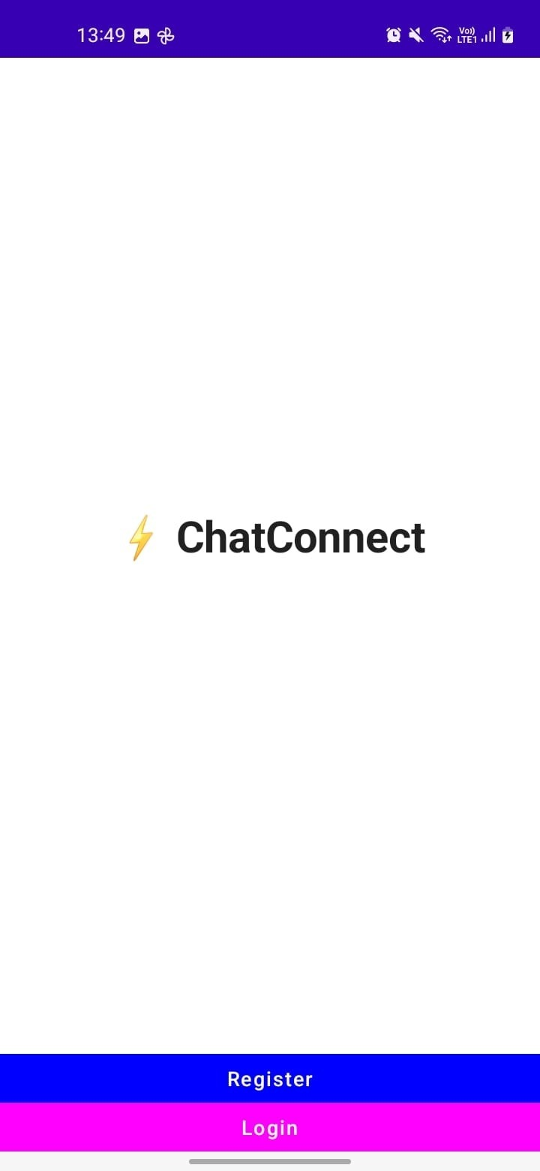

Slide 10
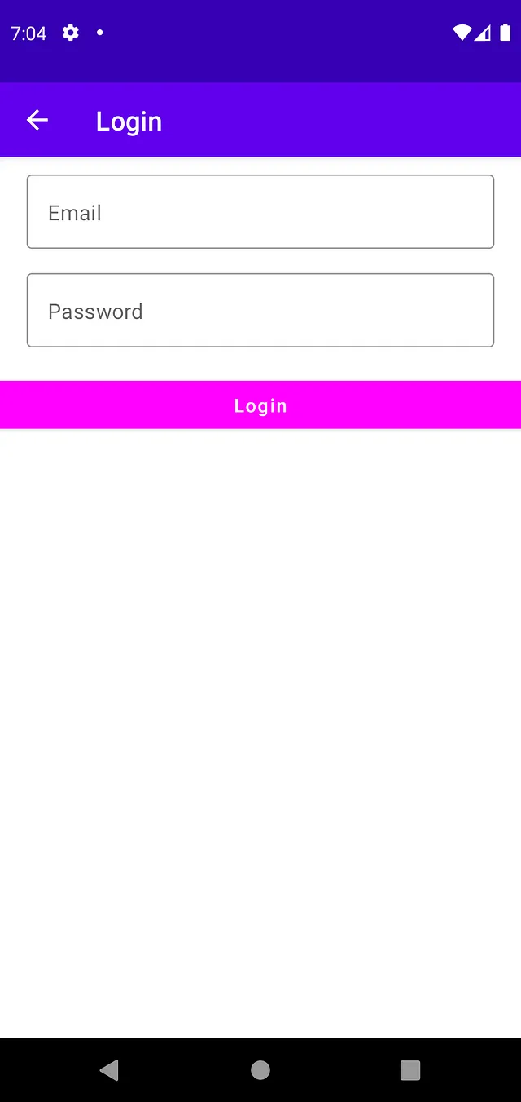

Slide 11
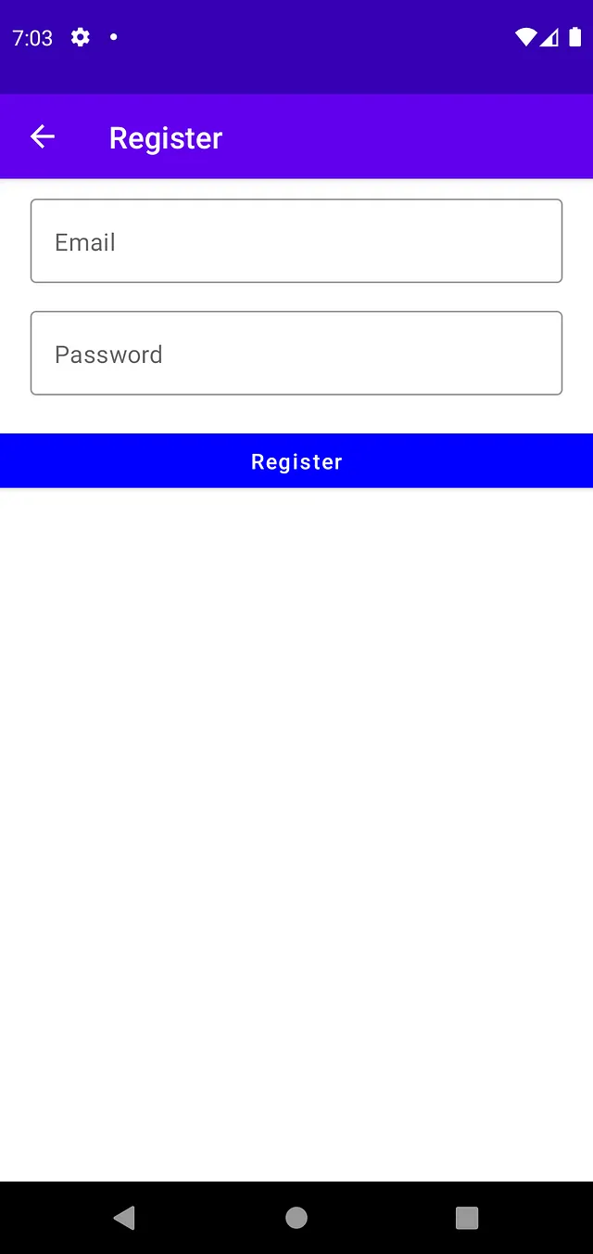

Slide 12
