Slide 1
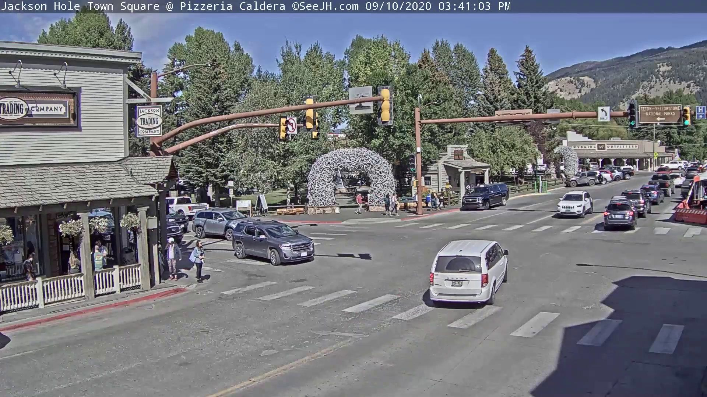
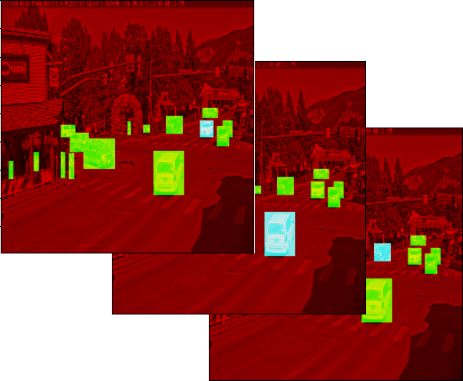
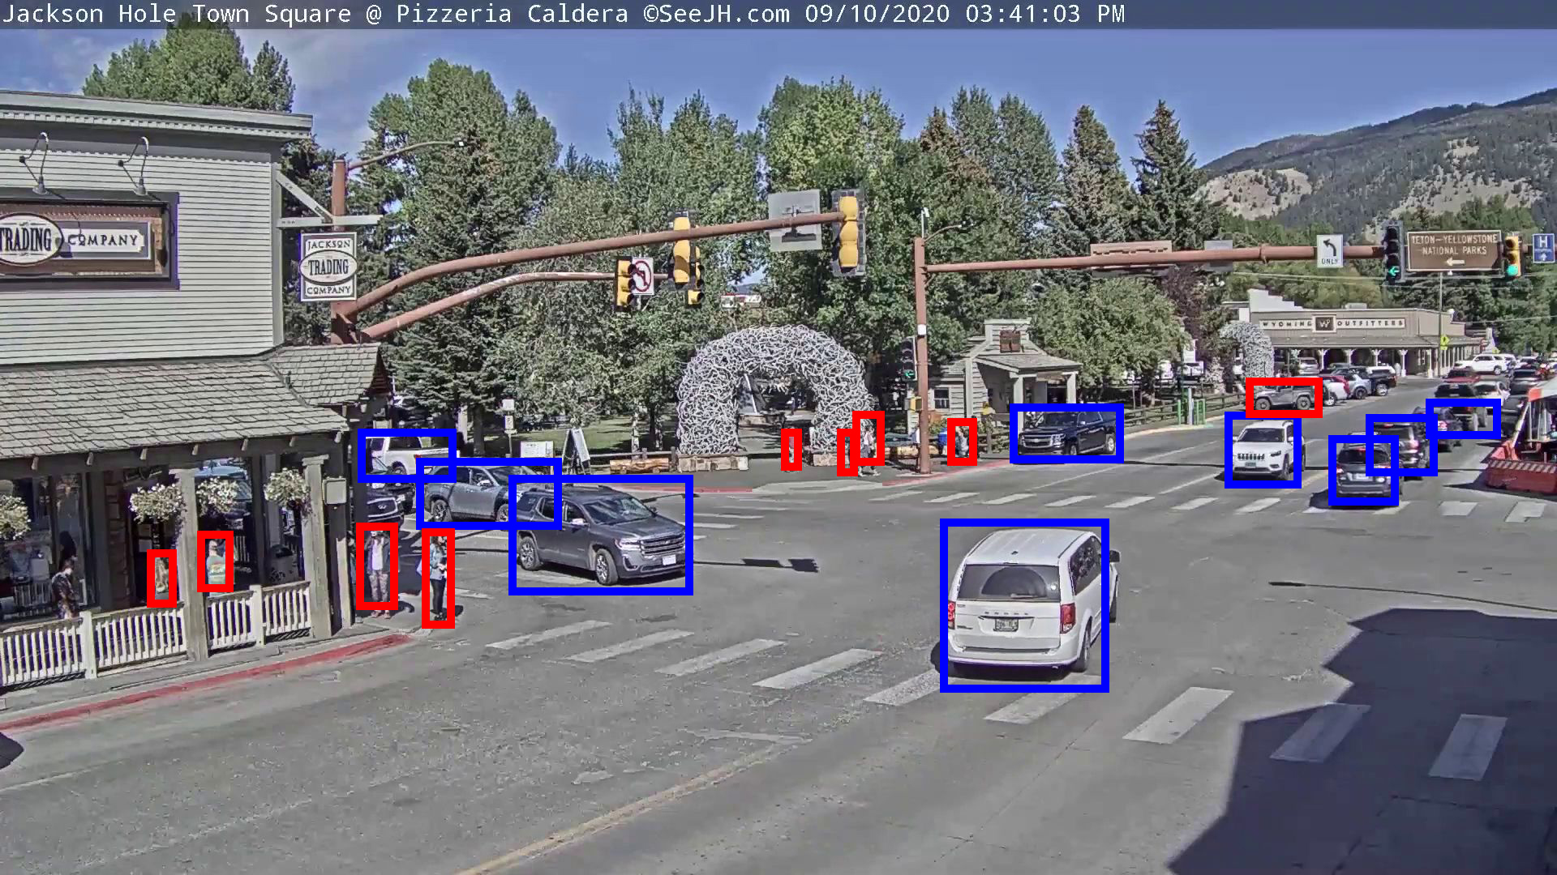



forward
forward & backward network module feature map averaged loss weighted loss
ROI
RPN
proposals
roi maps
image feature
weight
estimator
bbox loss
input image
$$α_{1}$$
objectness
loss
$$α_{2}$$
bbox loss
$$α_{3}$$
classification
loss
heatmap
feature
FPN
object heatmap
pseudo boxes

Slide 2
(a) Faster-RCNN
(c) Mid Fusion
proposal loss 2
proposal loss
proposal loss 1
roi loss
roi loss 1
roi loss 2
ROI
ROI1
ROI2
RPN
can be:
average pool
max pool
convolution
attention
RPN1
RPN2
FP
FP1
FPN
FPN
FP2
FP1
copied
RGB
conv
RGB
conv
M
(b) Early Fusion
(d) Late Fusion
proposal loss
roi loss
proposal loss
roi loss 1
roi loss 2
ROI
ROI1
ROI2
copied
RPN
FP
RPN
FP1
FPN
FP2
FP1
FPN
copied
RGB
conv1
conv2
M
RGB
conv
M

Slide 3
proposal loss fusion
proposal loss
proposal loss I
roi loss
roi loss I
roi loss fusion
ROI
ROI1
ROI2
RPN
RPN1
RPN2
FP
FP1
FPN
FPN
FP2
FP1
copied
I
conv
I
conv
M^{O}
proposal loss
roi loss
proposal loss
roi loss I
roi loss fusion
ROI
ROI1
ROI2
copied
RPN
FP
RPN
FP1
FPN
FP2
FP1
FPN
copied
I
conv1
conv2
M^{O}
I
conv
M^{O}

