Slide 1













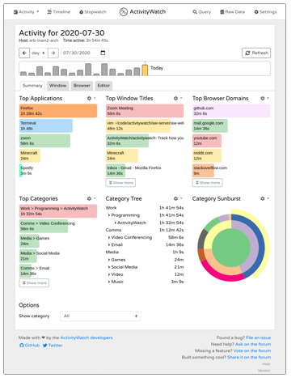












Project Managers
Data scientists
HR recruiters
Smart Workers
My2SecDApp
My2Sec
REST API
Task manager
Log Time
Ontochain Adapter
MySQL Adapter
Events
Events Logger
Classifier
Stars
Pub
Sub
Producer
Aggregator
Consumer

