Slide 1













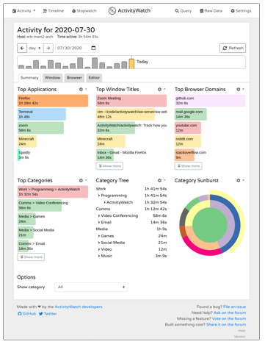












Project Managers
Data scientists
HR recruiters
Smart Workers
My2SecDApp
My2Sec
REST API
Task manager
Log Time
Ontochain Adapter
MySQL Adapter
Consumer
Events
Events Logger
Producer
Aggregator
Classifier
Stars

Slide 3


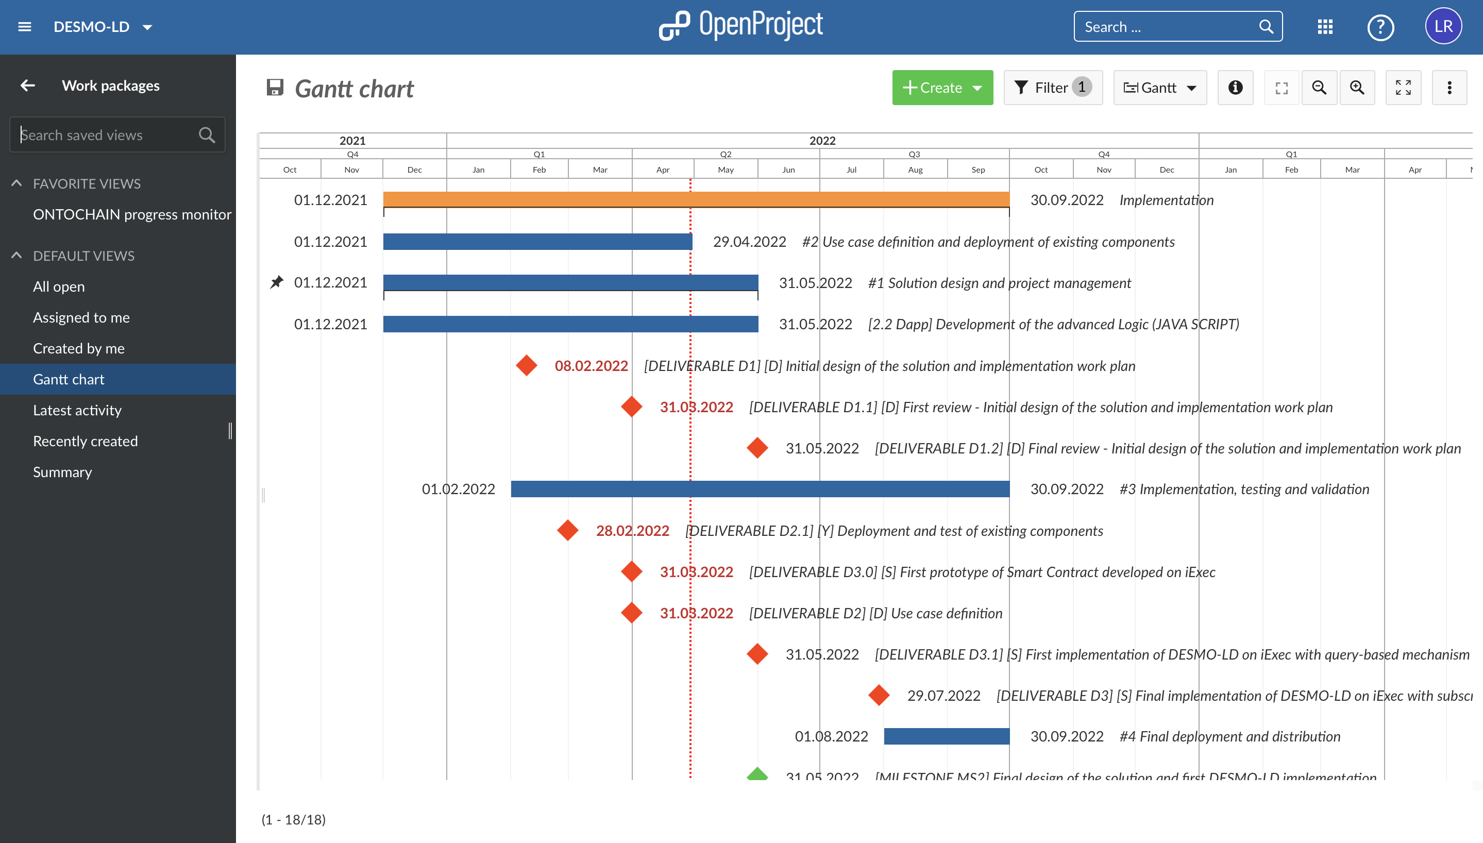
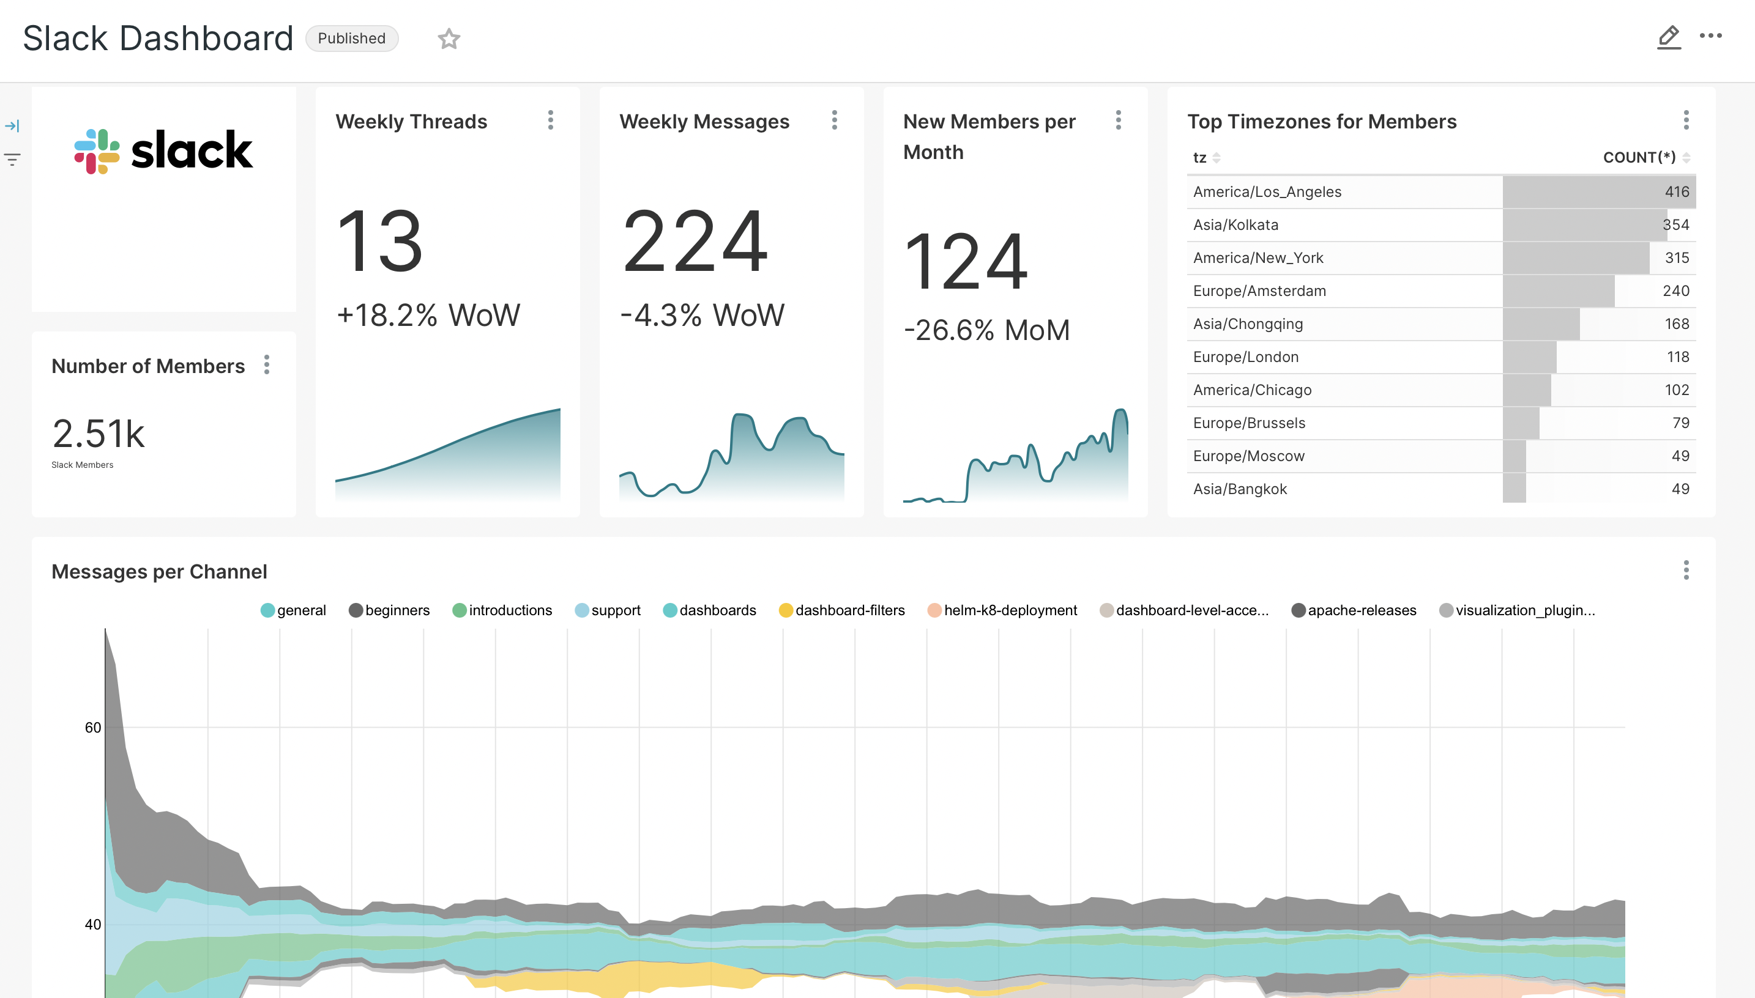









Project Managers
My2Sec
Project Management
Business Intelligence (KPI)
AI tools
Open Source
Time Tracking
GDPR compliant
Smart Workers
Notes:
Let me give you two examples. Managing projects in a fully remote context like the one imposed by COVID-19 required us to adapt and design a tool to support smart working. My2Sec composes several open source solutions to provide a GDPR compliant activity tracker to log the time spent by smart workers on different projects.

