Slide 1













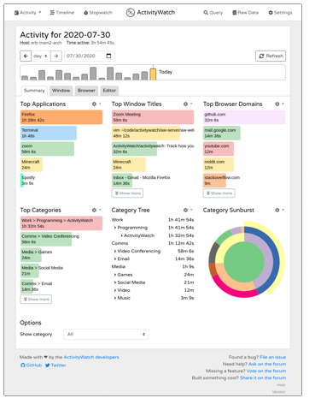












Project Managers
Data scientists
HR recruiters
Smart Workers
My2SecDApp
My2Sec
REST API
Task manager
Log Time
Ontochain Adapter
MySQL Adapter
Tasks Logger
Events
Events Logger
Classifier
Stars
Pub
Sub
Producer
Aggregator
Consumer

