Slide 1

AW-ADAPTER 4 MY2SEC
By Gregorio Monari

Slide 2
DOCUMENT DETAILS
NAME: aw-adapter presentation
DATE: 09-08-2022
AUTHOR: Gregorio Monari
ABSTRACT:
A general overview of the Activity Watch ADAPTER architecture, logic and key features, preceded by a brief explanation of the Activity Watch api and data-model.

Slide 3
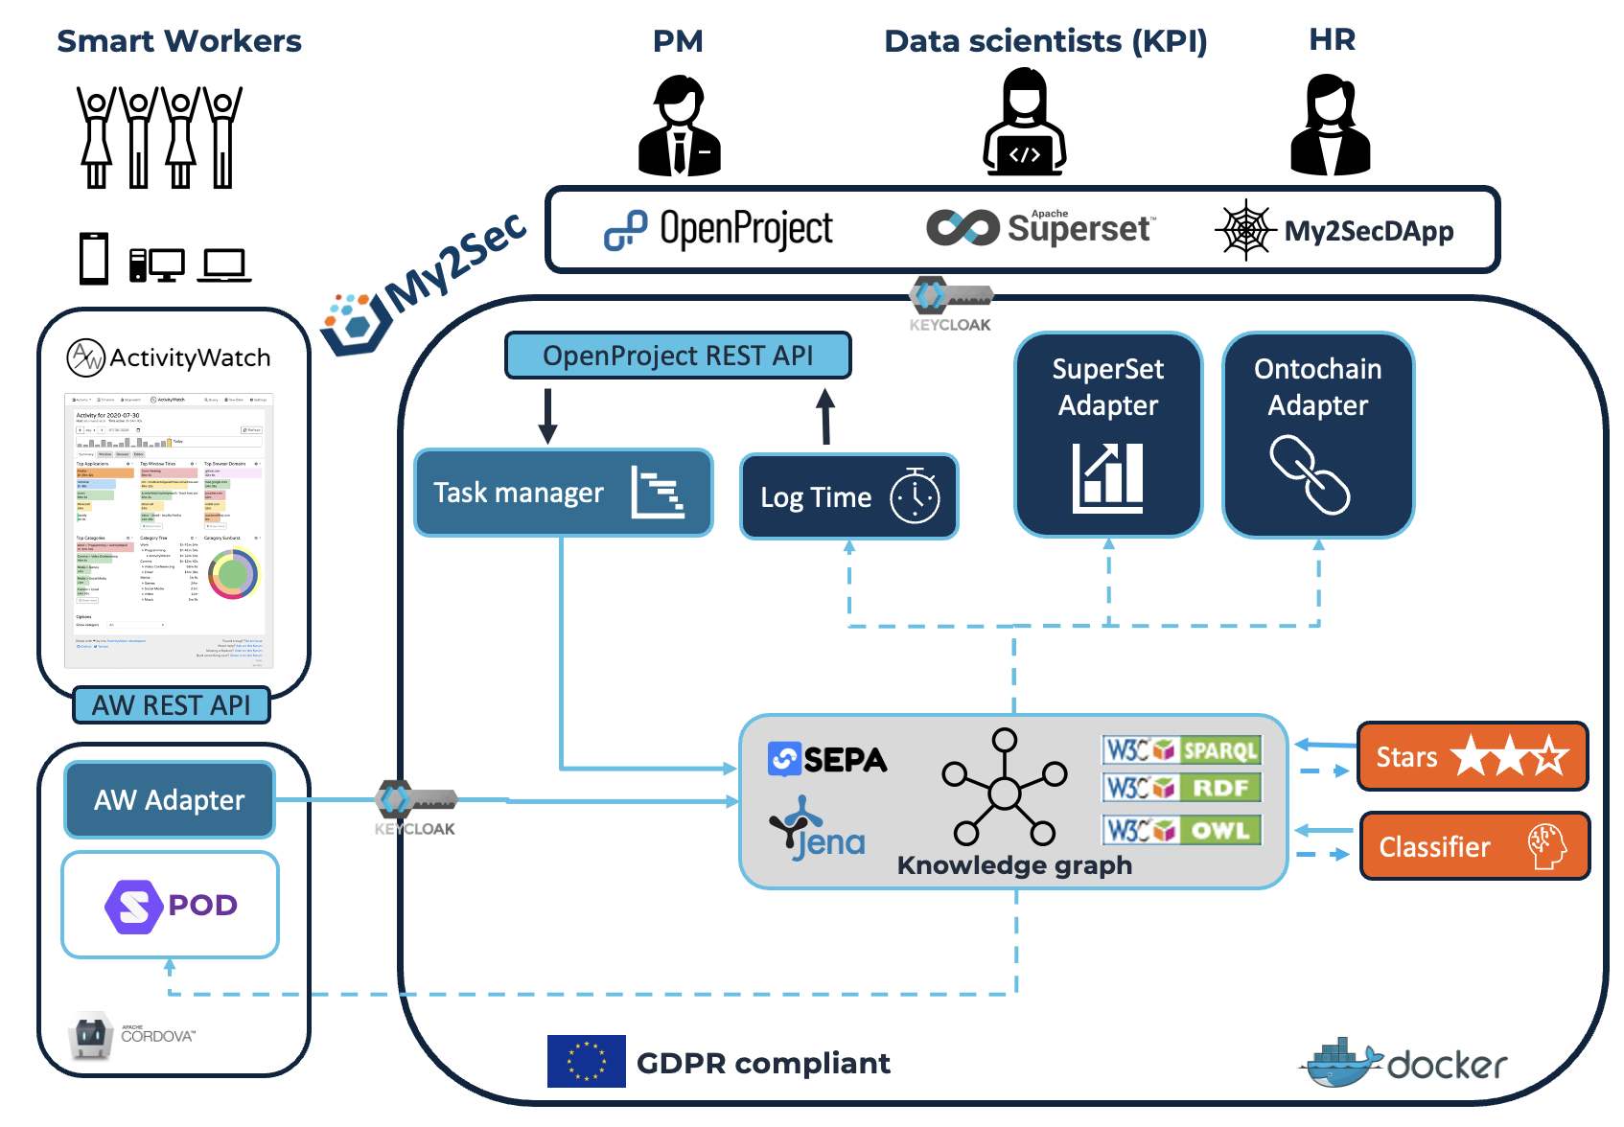
ABSTRACT VIEW

Slide 4
INDEX
0- INTRO
ACTIVITY WATCH
1- THE BEGINNING: ACTIVITY WATCH ARCHITECTURE
1.2- DATA MODEL
1.3- CONNECTING WITH THE OUTSIDE WORLD: REST API
PRODUCER
2- PRODUCER LOGIC
2.1- init_app(): GETTING AND VISUALIZING AW DATA
2.2- send_data(): UPLOADING DATA TO SEPA
MAPPER
3- MAPPING: AW-MAPPER
ADAPTER
4- ADAPTER ARCHITECTURE
TO IMPLEMENT

Slide 5
0- INTRO
Built on top of the Activity Watch tracking app, the AW ADAPTER allows to expand said app functionalities making it a "CLOUD-APP".
In general, an ADAPTER allows not only to upload data produced by a generic local app to a remote server, but also to "map" that data into "semantic data".
My2sec Servers run a semantic event processor, the SEPA, which allows to take all the advantages of a semantic based architecture, while maintaining speed and scalability of the system.

Slide 6
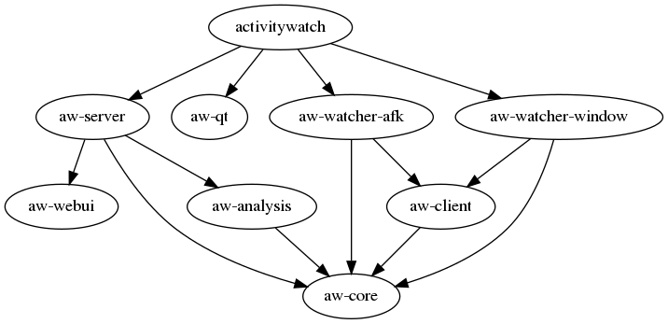
1- THE BEGINNING: ACTIVITY WATCH ARCHITECTURE
Activity Watch is an open-source github project: its purpose is to track and store user data into a local database. AW is divided in modules and allows new modules to be written. This are the default modules:
- The aw-qt script: launches all the modules (python watchers and vue.js webui)
- The watchers write events on the server, while the webui reads from the server
- The aw-core handles all the events between modules

Slide 7
1.2- DATA MODEL
- “BUCKETS”: data describing a module (es. watcher)
bucket = {
"id": "aw-watcher-test_myhostname",
"created": "2017-05-16T13:37:00.000000",
"name": "A short but descriptive human readable bucketname",
"type": "com.example.test", // Type of events in bucket
"client": "example-watcher-test", // Identifier of client software used to report data
"hostname": "myhostname", // Hostname of device where data was collected
}
- “EVENTS”: the raw data collected
event = {
"timestamp": "2016-04-27T15:23:55Z", // ISO8601 formatted timestamp
"duration": 3.14, // Duration in seconds
"data": {"key": "value"}, // A JSON object, the schema of this depends on the event type
}

Slide 8
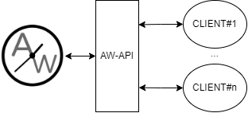
1.3- CONNECTING WITH THE OUTSIDE WORLD: REST API
Communication between applications can be done in many different ways, one of these is by implementing an intermediary between these applications: an API.
ActivityWatch uses a REST API for all communication between the aw-server and other applications, which in this case can be called “clients”.
Clients can communicate with the API via HTTP GET and POST requests to fetch or write data: here we are talking about user-tracking data
REST REFERENCE
- GET localhost:5600/api/0/buckets/ ----→ RETURNS BUCKETS
- GET localhost:5600/api/0/buckets/<bucket_id>/events ----→ RETURNS EVENTS
SECURITY
CORS is configured such that request origins can only be “localhost:5600”

Slide 9
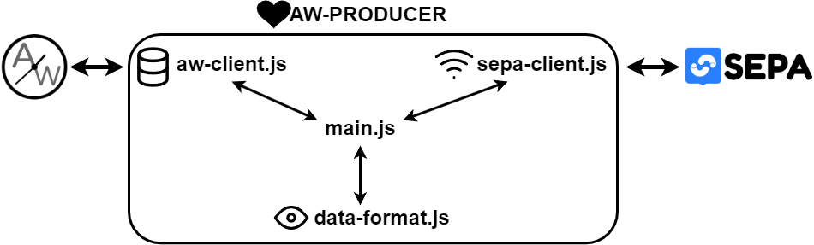
2- PRODUCER LOGIC
Now that we know how to get data, let’s get it.
The Producer code is splitted into modules: each one adds functionalities to the app, and together they create a bridge from Activity Watch to the SEPA Engine, where data can flow under the User control.
In the main.js script mainly two functions are defined: init_app() and send_data().
- At startup the init_app function is called: using the methods defined in aw-client and data-format, data is fetched and displayed to the user.
- If init_app succeeds, the send button is displayed. Pressing this button calls the send_data function, uploading data to the SEPA Engine using the methods defined in sepa-client.

Slide 10
2.1– INIT_APP(): FETCHING AND VISUALIZING AW DATA
# GET WATCHERS AND EVENTS
1- Create client and load configuration
2- Get watchers
3- if aw-producer bucket does not exist, create producer bucket
4- if last_update timestamp does not exist, fetch all the events from the beginning
4.1- else, fetch events from last_update to current time
# UPDATE HTML ELEMENTS
1- update watcher info
2- delete and create events table
#SEPA PREFLIGHT
1- echo_sepa
2- Subscribe to user events

Slide 11
2.2 – send_data(): UPLOADING AW DATA TO SEPA
1- Get global variable events_json
2- Try to update message, catch error
3- If update succeeds, create update event in aw-server
4- Alert the user of success

Slide 12
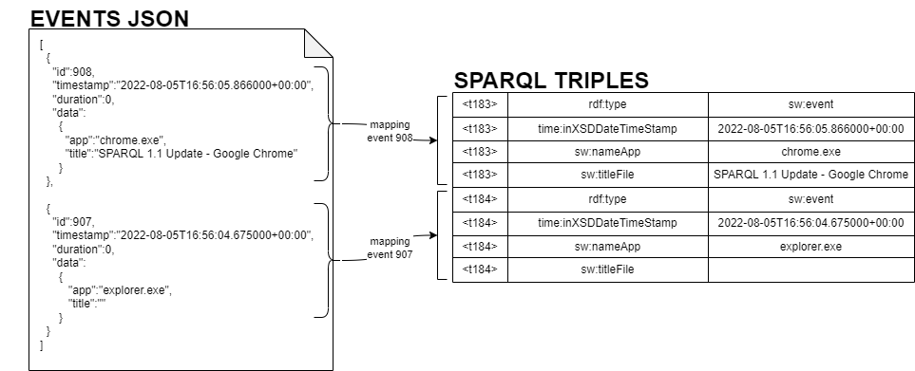
4 - MAPPINGS: AW-MAPPER
- SAME DATA, DIFFERENT METADATA

Slide 13
4 - MAPPINGS: AW-MAPPER
- SAME DATA, DIFFERENT METADATA

Slide 14
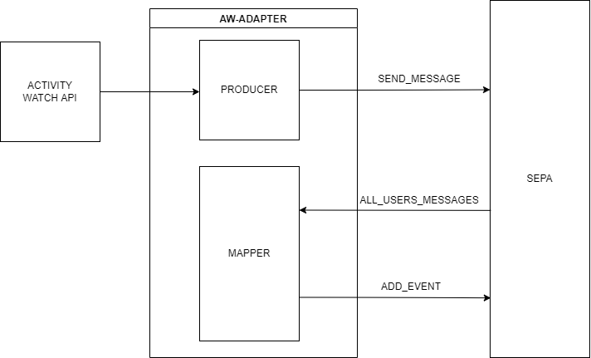
ADAPTER ARCHITECTURE – SIMPLIFIED OVERVIEW

Slide 15
TO IMPLEMENT
- Keycloack user management
- Better comments and clean code
- Better UI and UX

