Slide 1















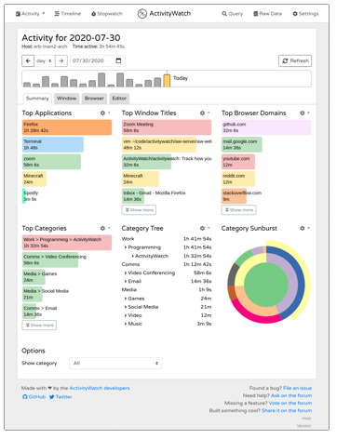













Project Managers
Data scientists (KPI)
HR
Smart Workers
Smart Workers
My2SecDApp
POD
My2Sec
OpenProject REST API
Ontochain Adapter
SOLID Adapter
MySQL Adapter
Task manager
Log Time
Tasks Logger
AW REST API
Events Logger
AW Adapter
Classifier
Stars
Pub
Sub
Producer
Aggregator
Consumer

Slide 2




Smart Workers
PM
Data scientists (KPI)
HR
My2SecDApp
My2Sec
OpenProject REST API
SuperSet Adapter
Ontochain Adapter
Task manager
Log Time
AW REST API
Stars
AW Adapter
Classifier
+
Knowledge graph
POD
GDPR compliant

Slide 3
Smart Workers
PM
Data scientists (KPI)
HR
My2SecDApp
My2Sec
OpenProject REST API
SuperSet Adapter
Ontochain Adapter
Task manager
Log Time
AW REST API
Stars
AW Adapter
Classifier
+
Knowledge graph
POD
GDPR compliant

