Slide 1
WoT Robot Arm
Controller
-
Architecture overview

Slide 2
Sections
1. Overview
2. Handling asynchronous signals
3. Orchestrator Processing pipeline
4. Ugrade with non-linear model
5. Examples with different damping and inertia

Slide 3
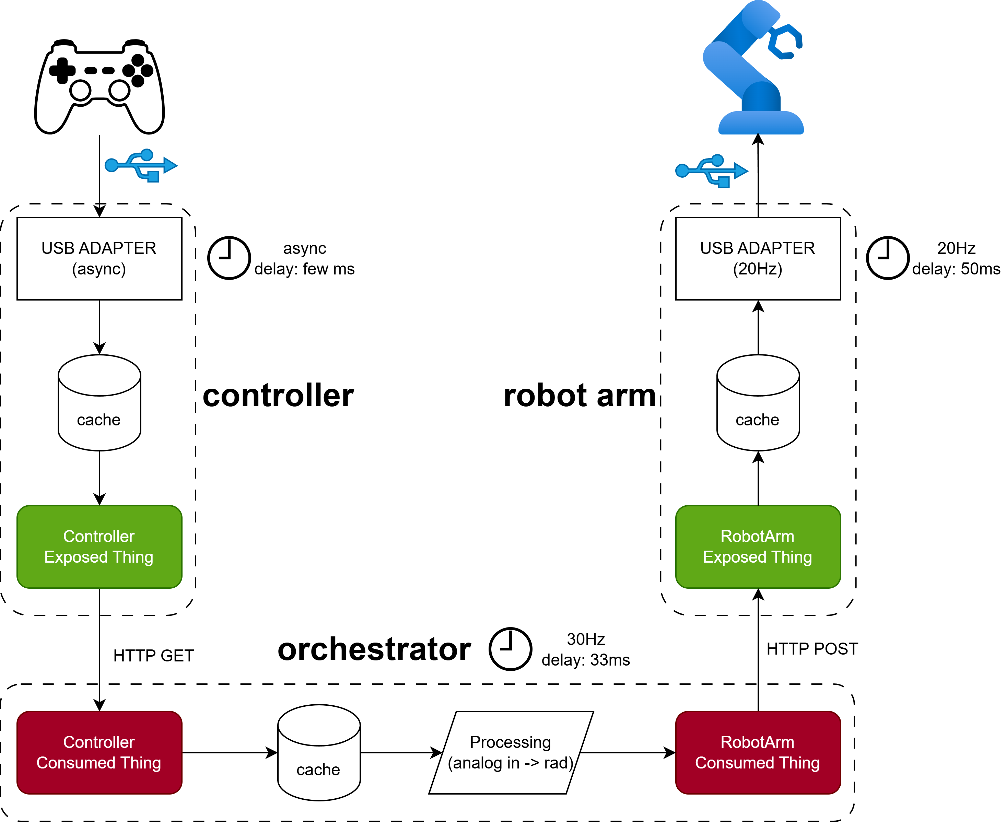
1. Overview

Slide 4
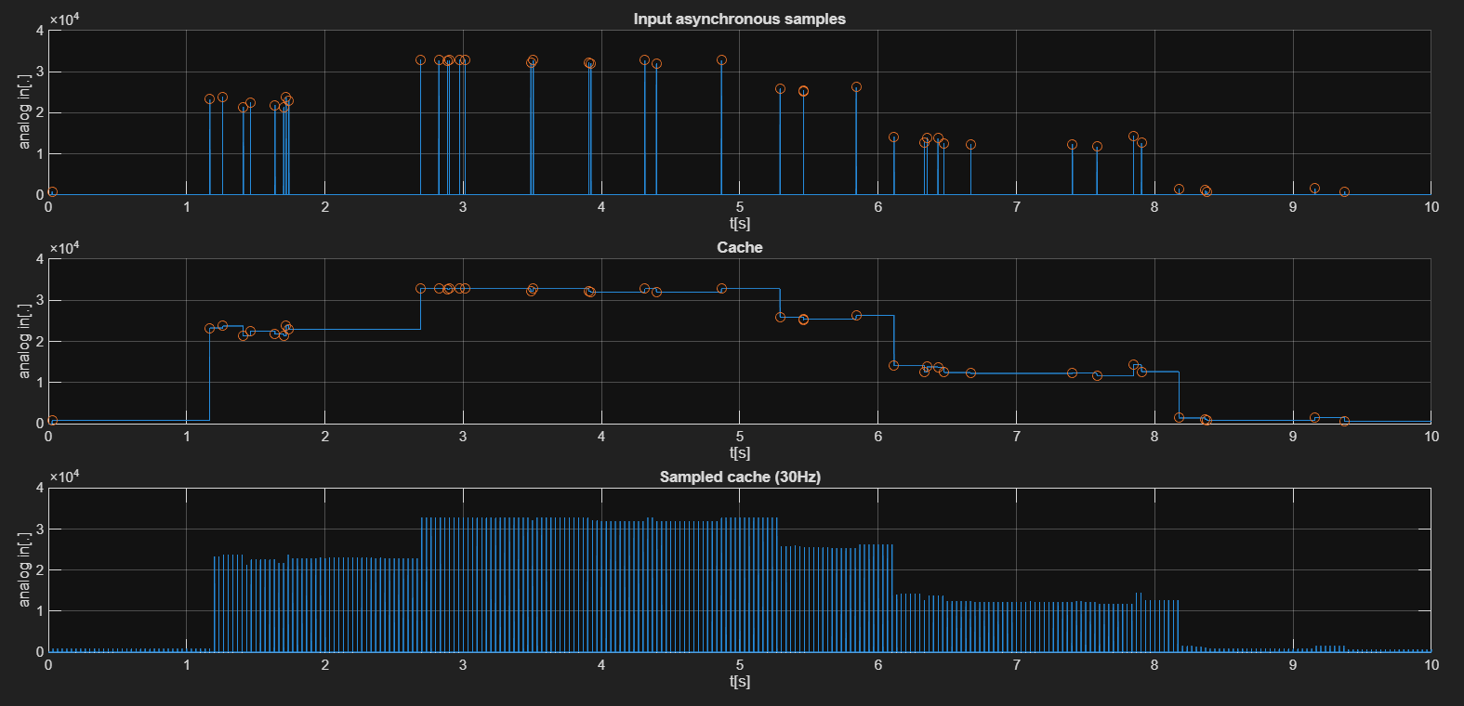
2. Asynchronous signals and caches

Slide 5
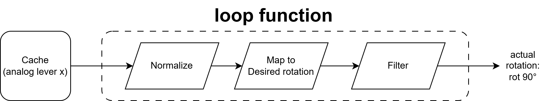
3. Processing
Inputs can be normalized to maintain flexibility, es. [128,255,…,0] -> [0.5,1,…,0]
Conversion to desired rotation must be done taking into account the range of both «sensors» (we want analog input with more definition than analog output)
Filtering can make movement smoother to reduce stress on the rotors, can be turned off
Input can refer to the desired rotation or desired velocity, using a velocity system is ideal but more complex to implement

Slide 6
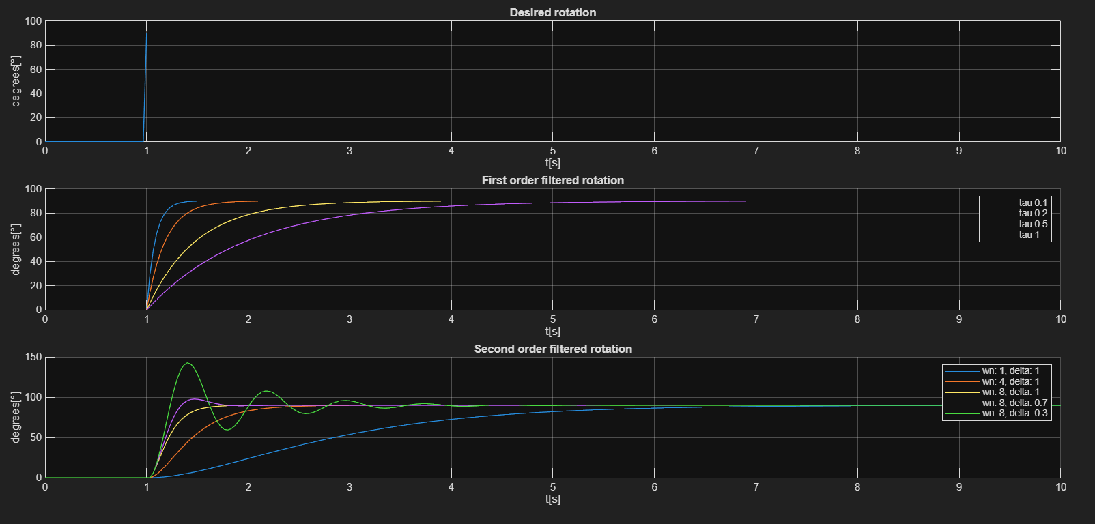



4. Filtering
First order filters cannot replicate a «biological» behaviour
Introducing non linearities allows for more sophisticated movement
A basic example can be simulated using a spring with damping dynamics: w, wn, delta
Delta=0.3 oscillations, delta=0.7 smooth, 1.0 critical, >1.0 too slow
1°st order
2°nd order

Slide 7
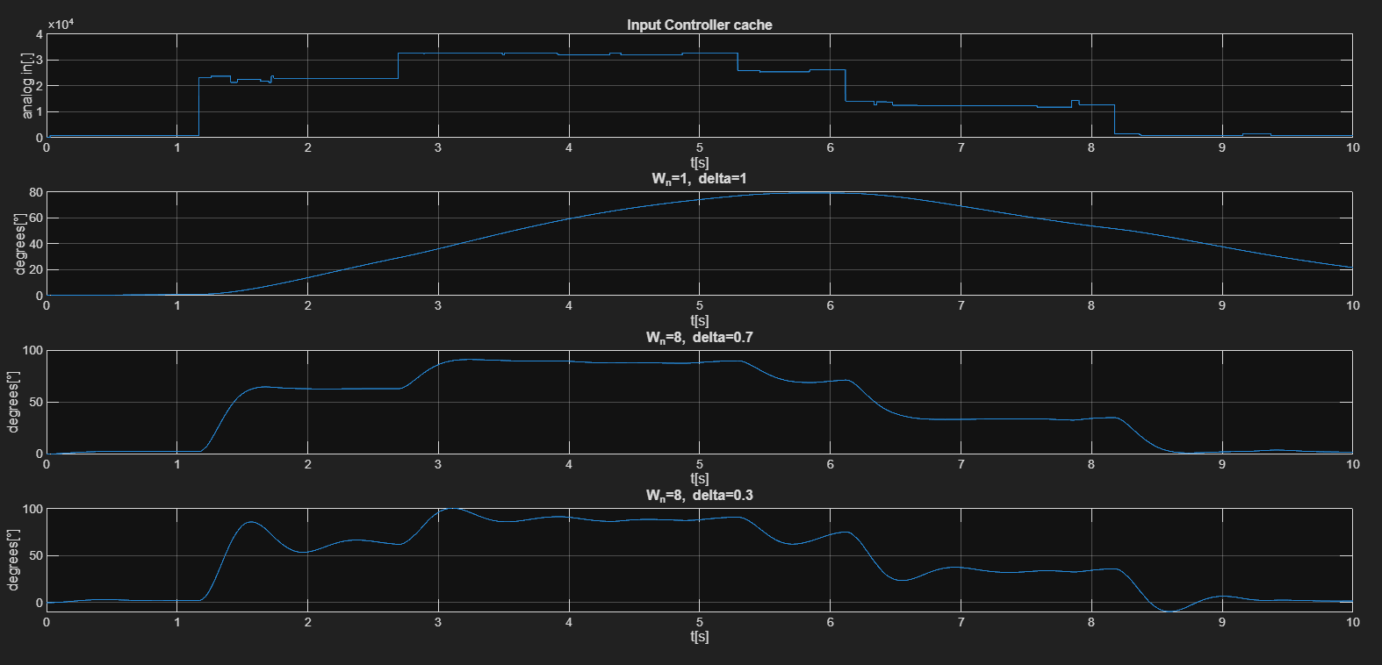
5. Effects of varying damping and inertia

