Slide 1
WOT LAB 2025-10-28

Slide 2
Definitions
Some base definitions:
- The device represents the Physical Thing.
- The laptop behaves as an Edge Gateway, implementing a WoT Servient that exposes an Exposed Thing with its Thing Description.
- The client in the cloud consumes that TD as Consumed Thing, interacting with the standardized WoT interfaces.”

Slide 3
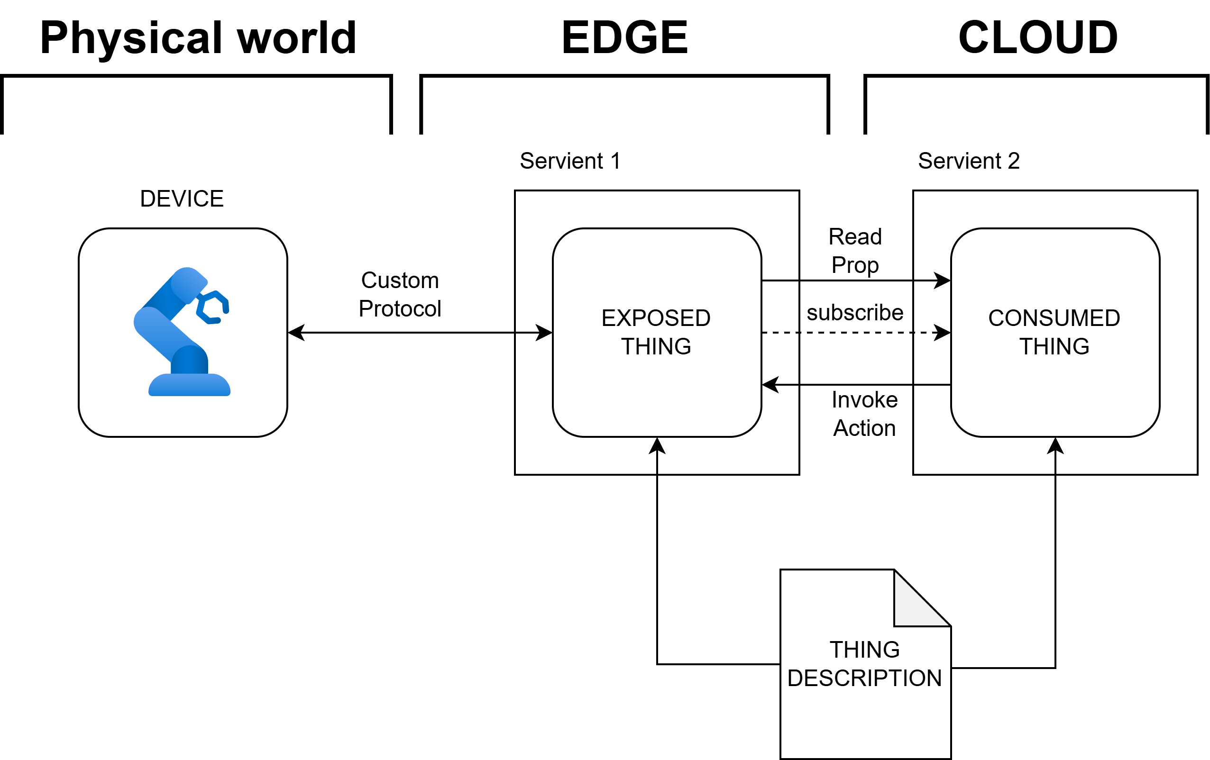
Architecture scheme

Slide 4
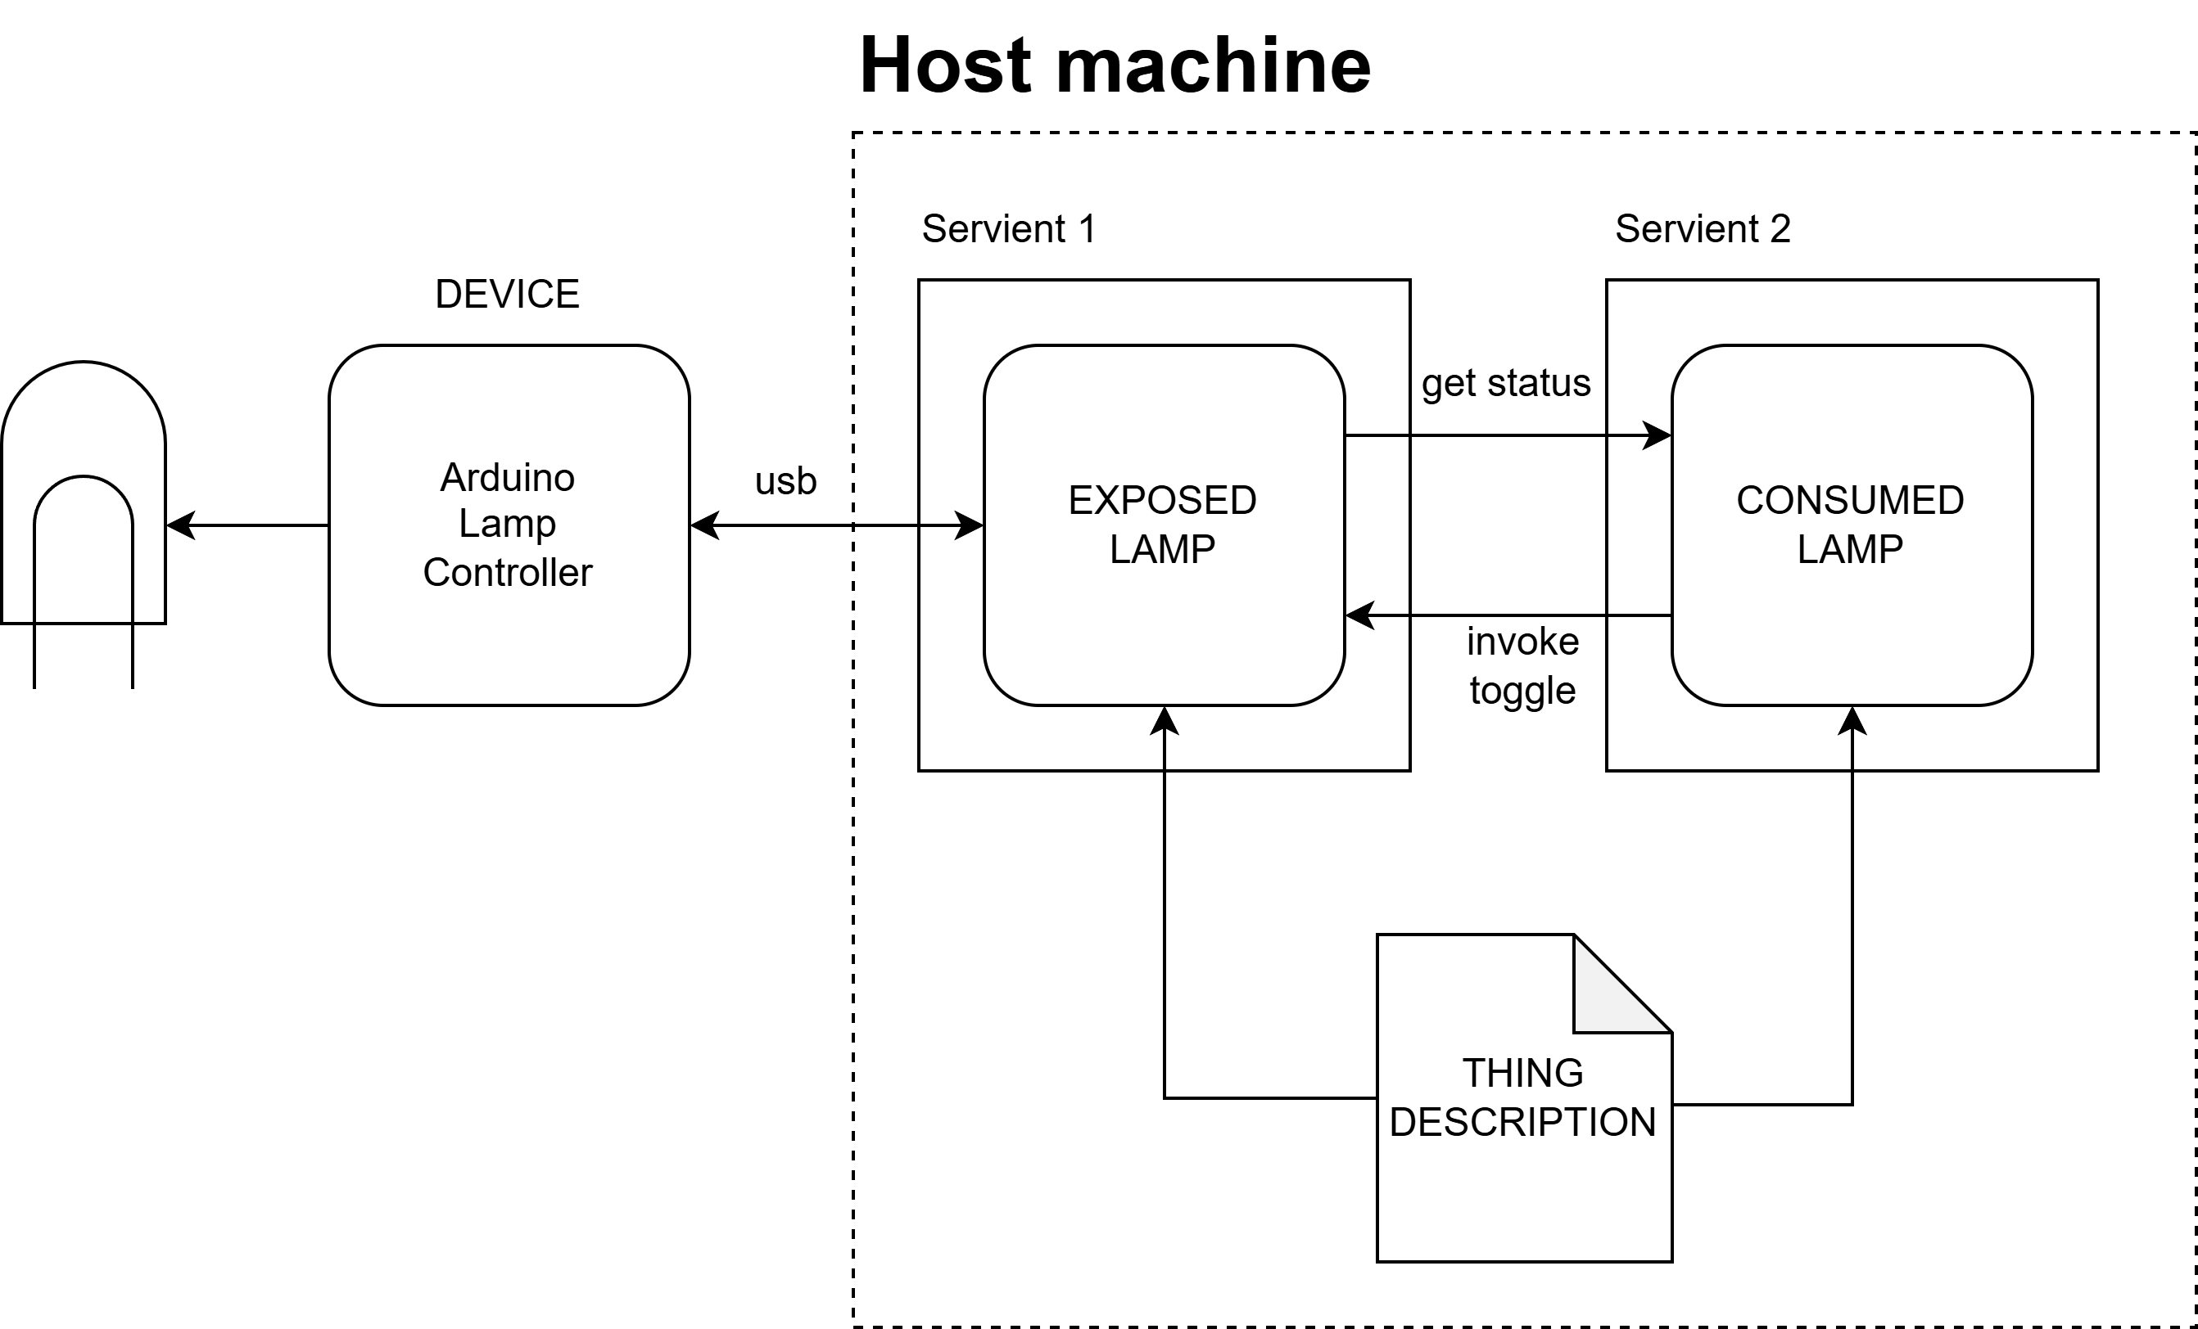
Wot lamp

