Slide 1

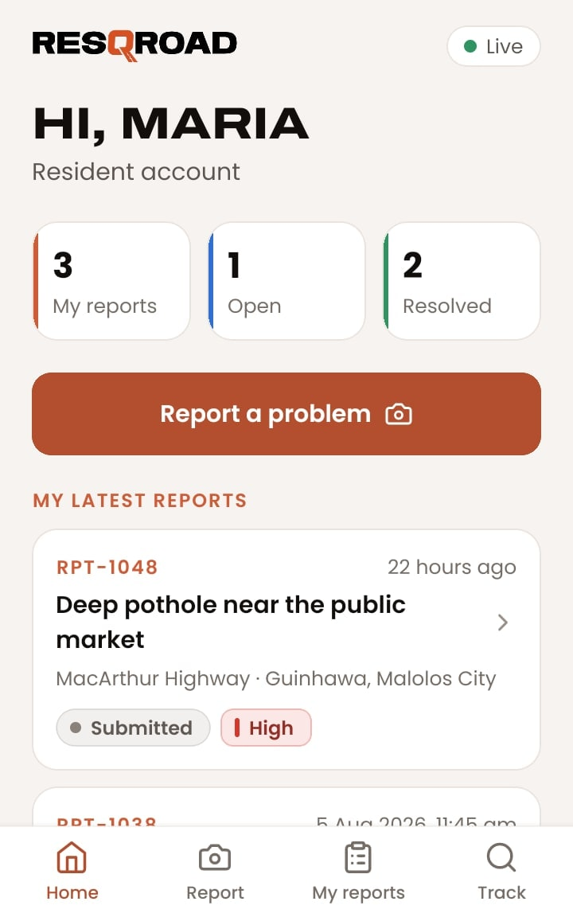
USER GUIDE
Report road damage, follow every repair, and manage the work: a guide for residents, maintenance crews, and the Road Maintenance Office.
resqroad.onrender.com · Android app
Bulacan State University · IT 305 · October 2026
Notes:
ResQRoad is a road damage reporting and repair tracking system for the LGU's Road Maintenance Office in Bulacan. This guide shows how each kind of user works with it, on the website and in the Android app.

Slide 2




One system for reporting and repairing roads
OVERVIEW
Residents report road damage with photos and a map pin. The Road Maintenance Office checks each report, sends a crew, and confirms the repair. Everyone sees the same status on the website and in the Android app, updated live.
Residents
Maintenance crews
Administrators
Report road damage, add photos and a map pin, and follow every repair from submitted to resolved.
See assigned jobs, get directions, and send repair notes with before-and-after photos.
Review reports, assign crews, verify repairs, and manage accounts for the Road Maintenance Office.
Live updates: when anyone makes a change, every open page and phone shows it within a moment.
Notes:
Three kinds of users share one system. Residents report, the administrator at the Road Maintenance Office checks and assigns, and maintenance crews repair. Everyone sees the same status, live.

Slide 3



Every report follows the same seven steps
THE WORKFLOW
1
2
3
4
5
6
7
Submitted
Resident files the report
Under Review
Admin starts checking
Verified
Admin confirms the damage
Assigned
Admin picks a crew
In Progress
Crew starts the repair
Repair Submitted
Crew sends notes and photos
Resolved
Admin verifies the repair
Rejected
Duplicate
More work requested
Not a valid report. The administrator can add a reason, which the resident sees.
Already reported nearby. The resident is pointed to the existing report.
The administrator sends a repair back with a note; it returns to the crew.
Notes:
A report moves through seven steps. The resident submits it; the administrator reviews, verifies, and assigns it; the crew repairs it and submits the work; the administrator verifies the repair and resolves it. A report can also be closed as rejected or duplicate.

Slide 4

Open ResQRoad on any device
GETTING STARTED
1
Website
Go to resqroad.onrender.com on a computer, Android phone, or iPhone.
2
Android app
Install the ResQRoad app for the same features on the go (see Mobile app).
3
Accounts
Residents create their own. Crew accounts are made by the administrator. Everyone signs in on one page; the account opens the right workspace.
If nobody has used the site for a while, the first page can take up to a minute to open.
Notes:
ResQRoad runs in any browser at resqroad.onrender.com, and as an Android app. Residents make their own account; crew accounts come from the administrator. One sign-in page opens the right workspace for each account.

Slide 5
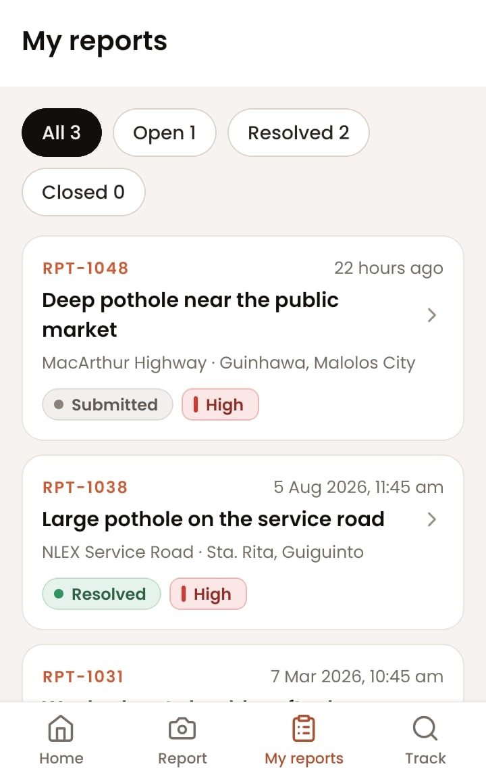
FOR RESIDENTS
SECTION 1
Create an account, report road damage, and follow the repair.
Notes:
This section is for residents: creating an account, filing a report in three steps, and following it until it's fixed.

Slide 6
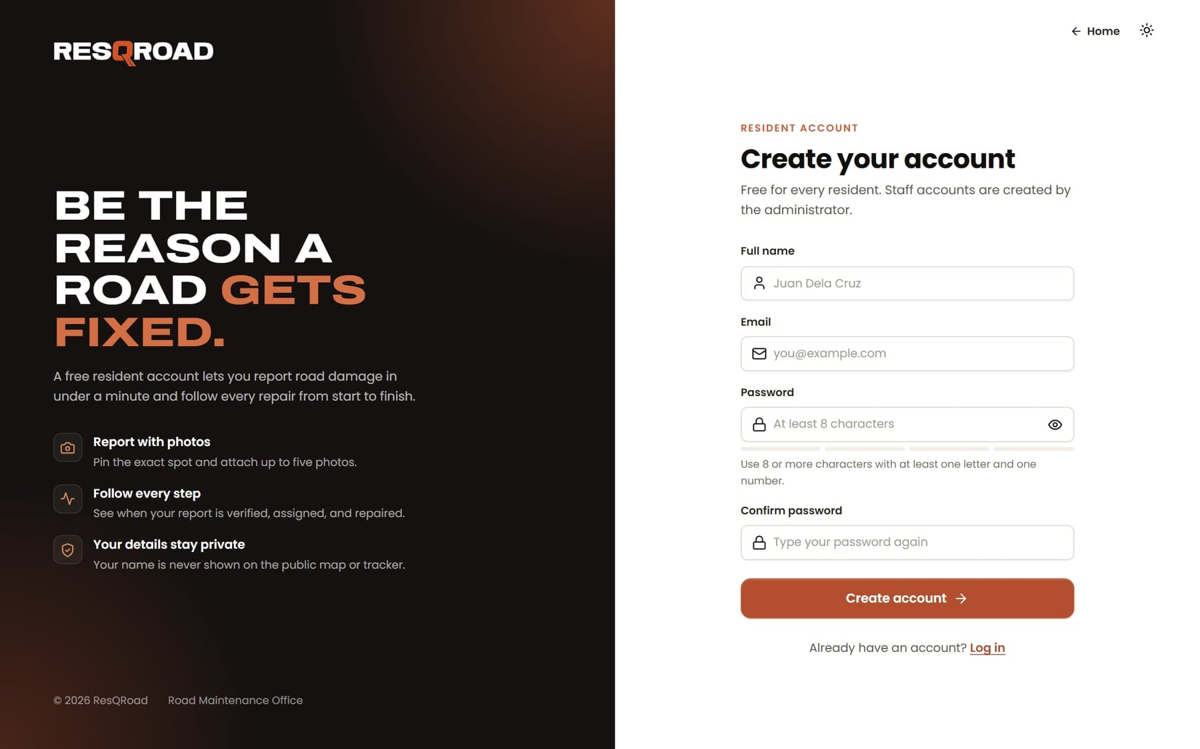
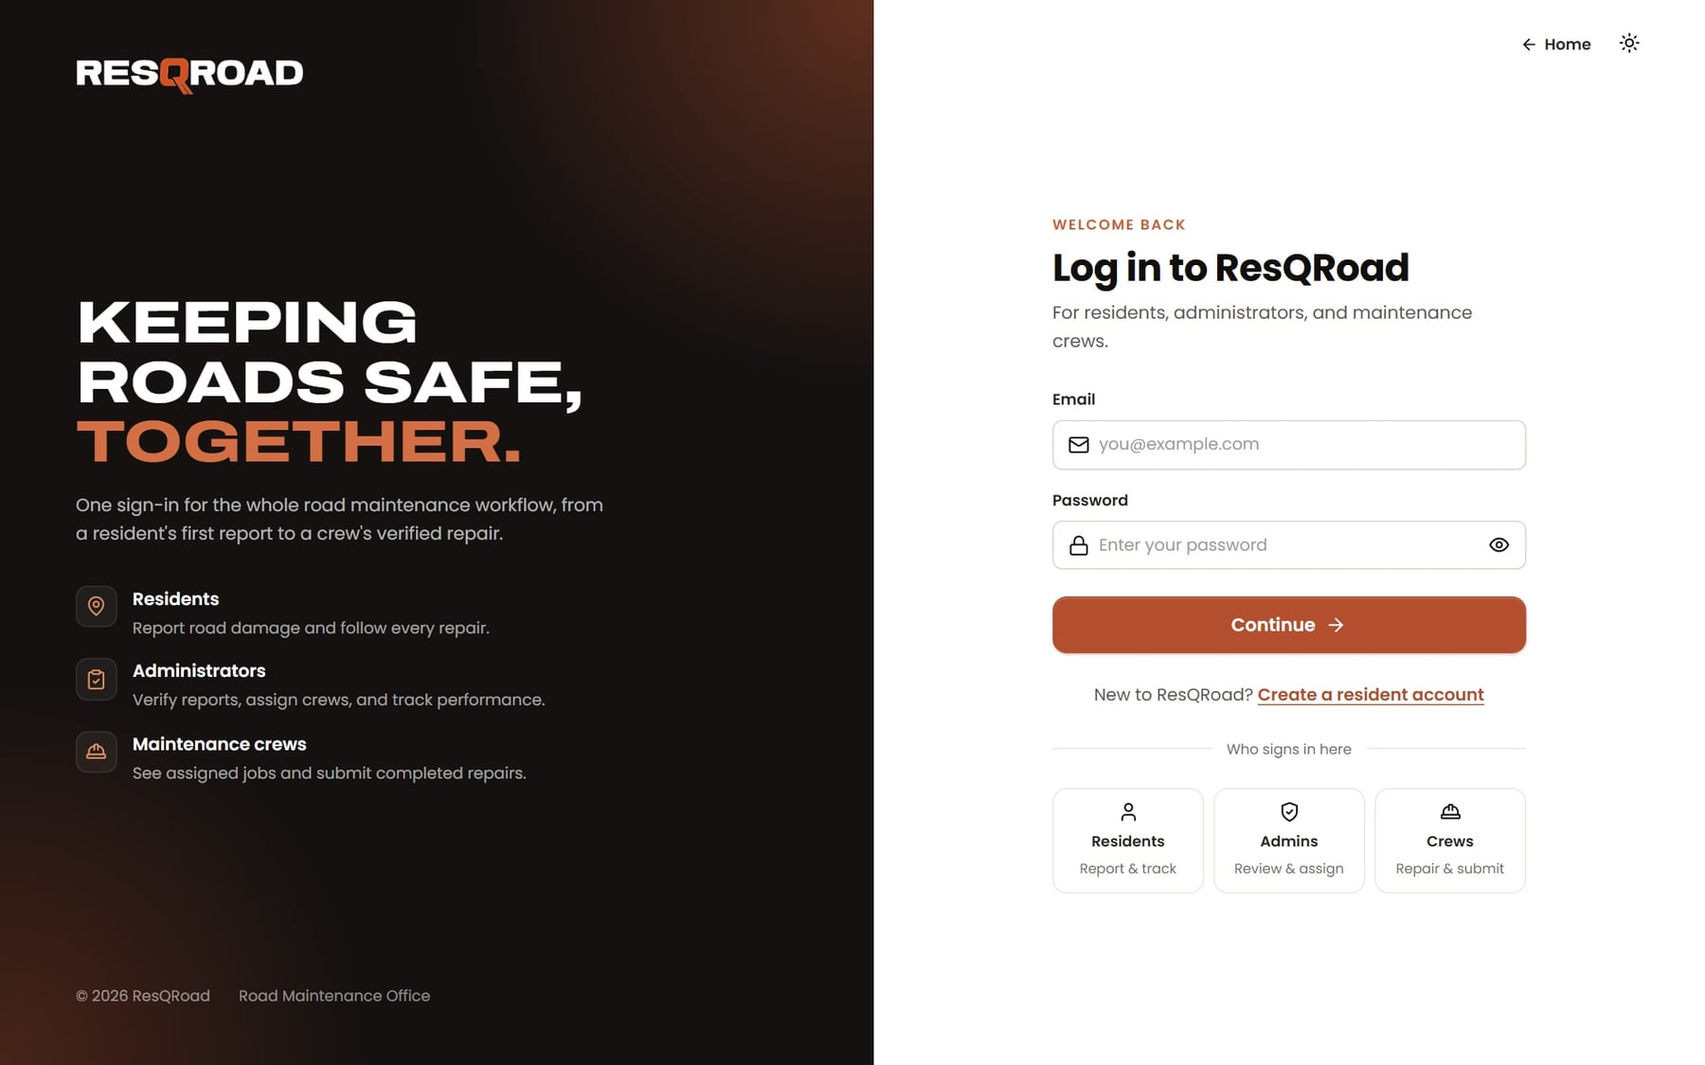
Create an account and sign in
RESIDENTS
1
Start on the home page
Click Report a problem or Sign in at the top right.
2
Create a resident account
Enter your name, email, and a password of at least 8 characters with a letter and a number.
3
Sign in next time
Use the same email and password. You stay signed in for 30 days, or until you log out.
Notes:
New residents click Create a resident account and fill in their name, email, and password. After that they sign in with the same email and password on the website or in the app.

Slide 7
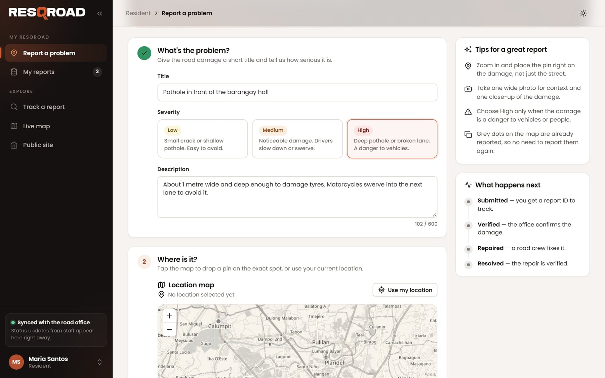

Describe the problem
REPORT A PROBLEM · STEP 1 OF 3
1
Title
A short name for the damage, like “Deep pothole near the public market”.
2
Severity
Low: easy to avoid. Medium: drivers slow down or swerve. High: a danger to vehicles.
3
Description
Its size, depth, and anything that makes it dangerous (up to 600 characters).
Choose High only when the damage is a danger to vehicles or people.
Notes:
The report form has three parts. First, give the damage a short title, choose how serious it is, and describe it.

Slide 8
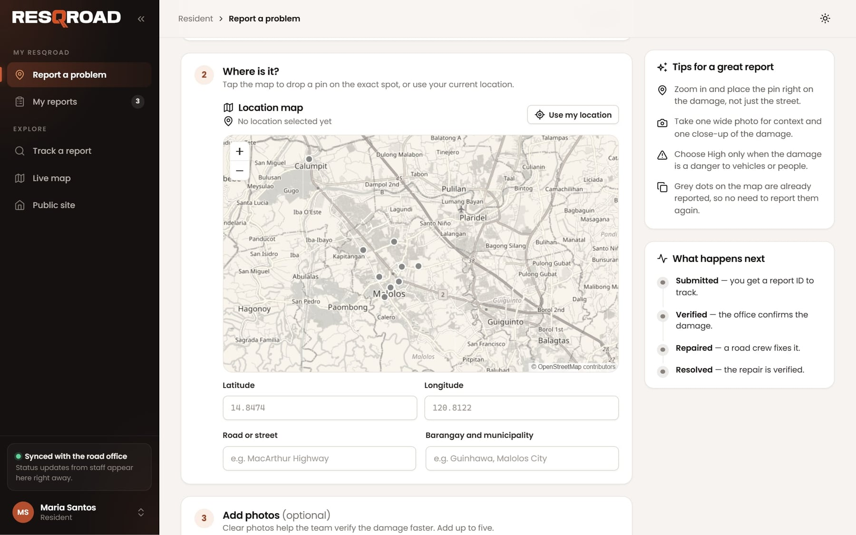
Pin the exact location
REPORT A PROBLEM · STEP 2 OF 3
1
Tap the map
Drop a pin on the exact spot, then drag it to adjust.
2
Or use your location
Press Use my location and allow location access when asked.
3
Check the grey dots
They are reports already filed. If one is right there, the damage is already reported.
4
Add the road and area
Type the road or street and the barangay and municipality.
Notes:
Second, show where the damage is: tap the map or use the phone's location. Grey dots are reports that already exist.

Slide 9
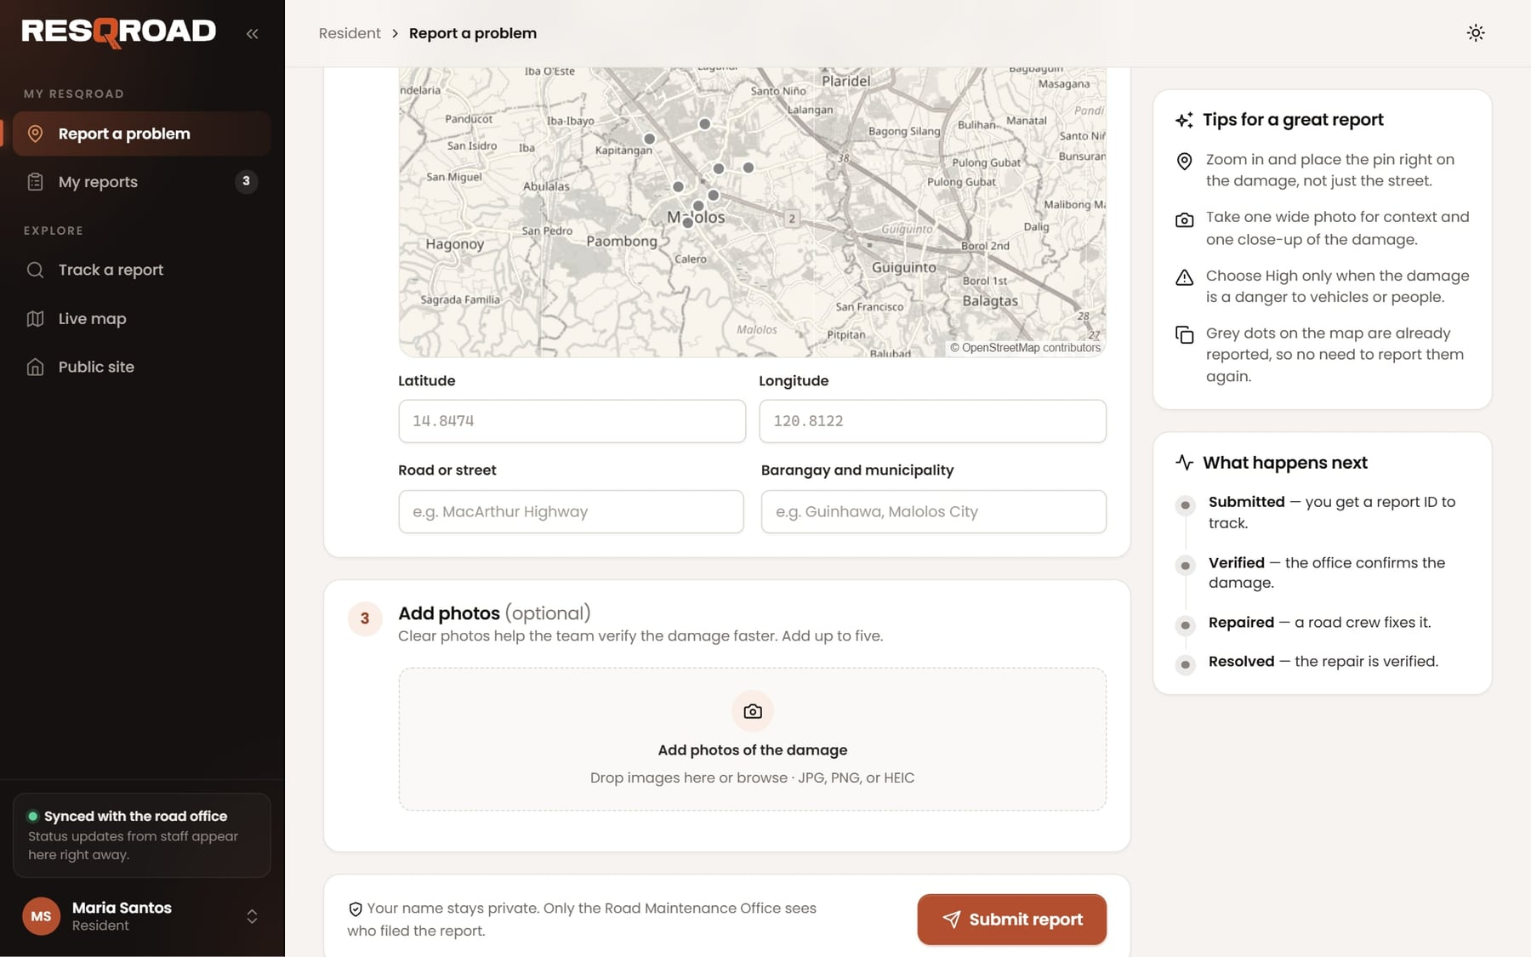

Add photos and submit
REPORT A PROBLEM · STEP 3 OF 3
1
Add photos
Up to five JPG, PNG, or HEIC photos under 8 MB each: one wide shot and one close-up.
2
Press Submit report
Your name stays private; only the Road Maintenance Office sees who filed it.
3
Keep your report ID
You get an ID like RPT-1048. Use it to track the report.
A report within about 100 m of an open report is stopped as a likely duplicate.
Notes:
Third, add up to five photos and submit. The resident gets a report ID to track it. A report very close to an open one is stopped as a likely duplicate.

Slide 10
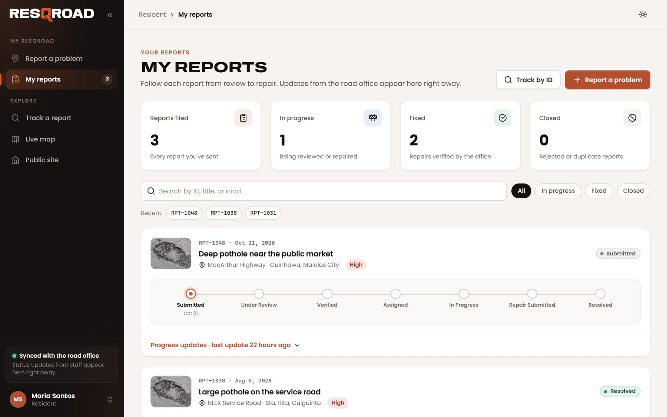
Follow your reports
RESIDENTS
1
Open My reports
See counts for reports filed, in progress, fixed, and closed.
2
Filter or search
Choose All, In progress, Fixed, or Closed, or search by ID, title, or road.
3
Read the progress
Each report shows its progress bar and every update from the road office.
4
No need to refresh
New updates appear by themselves while the page is open.
Notes:
My reports lists everything the resident has filed, with progress and every update from the road office. It updates by itself.

Slide 11
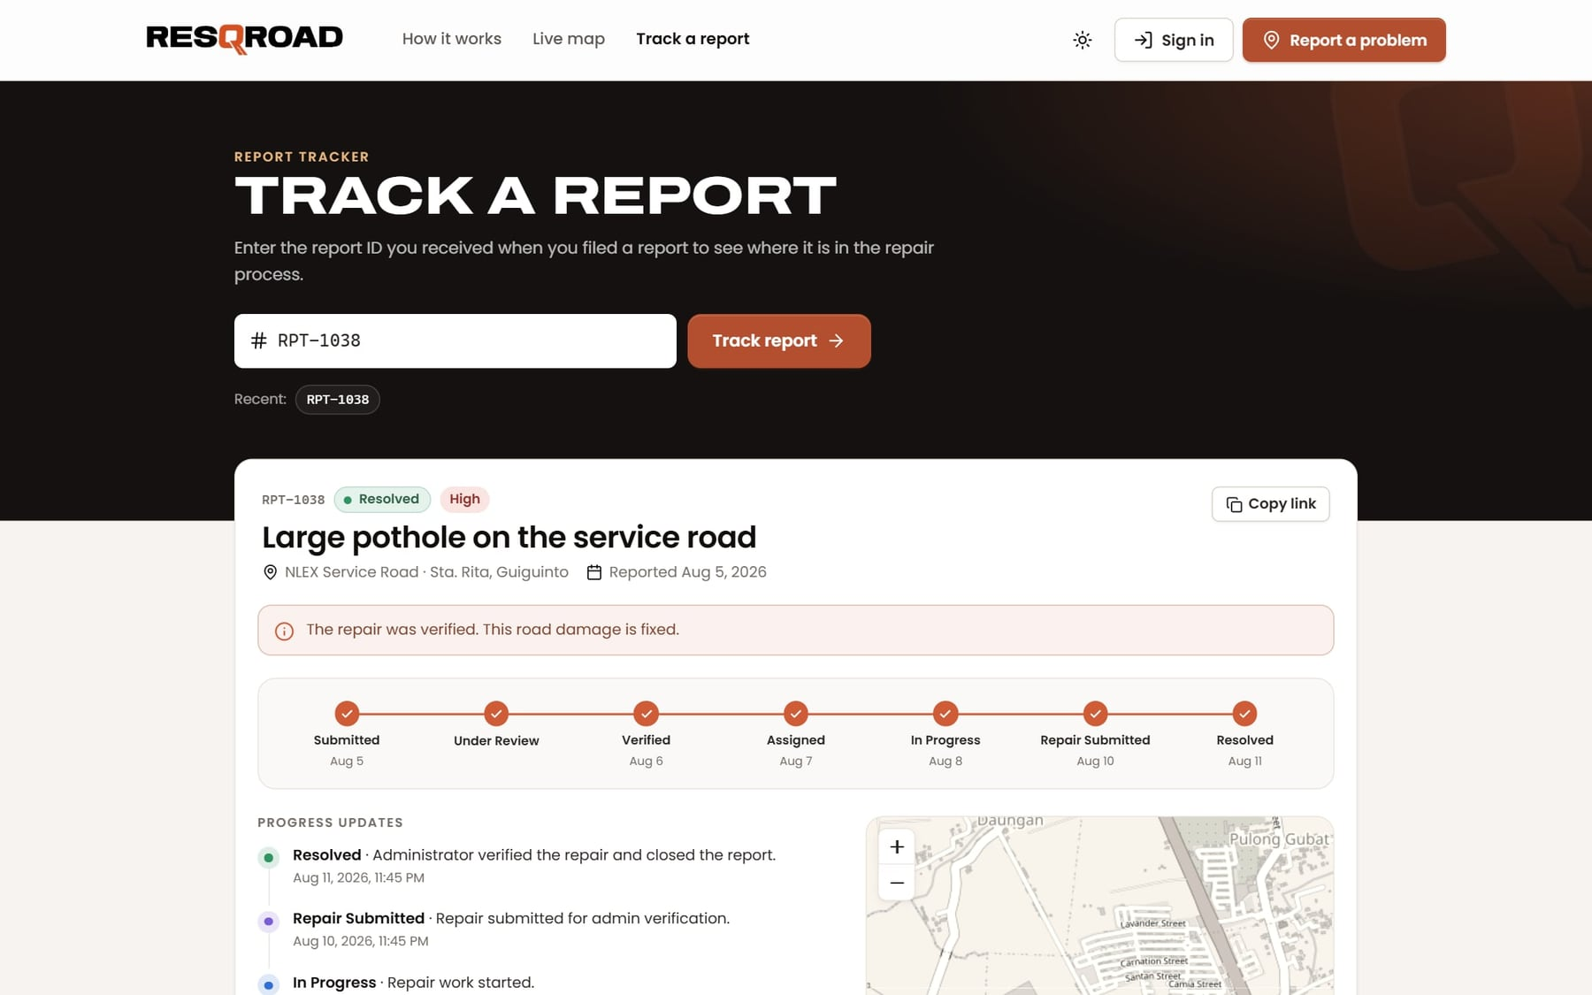
Track any report by its ID
EVERYONE
1
Open Track a report
It's on the home page menu. No sign-in needed.
2
Enter the report ID
For example RPT-1038, then press Track report.
3
See where it stands
Status, progress, map location, and every decision with its date.
4
Share it
Copy link gives you an address that opens this report directly.
Notes:
Anyone can track a report without signing in. Enter the report ID to see its status, progress, location, and history.

Slide 12
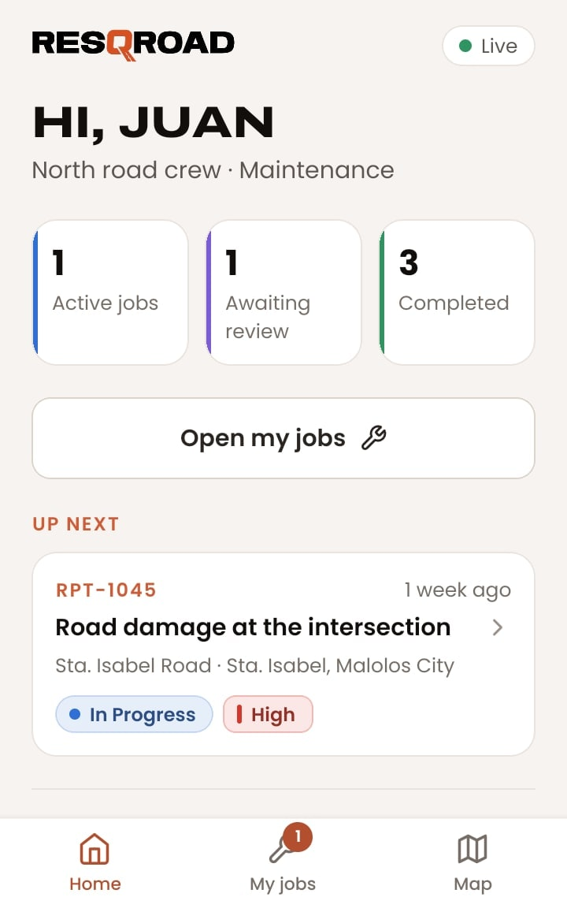
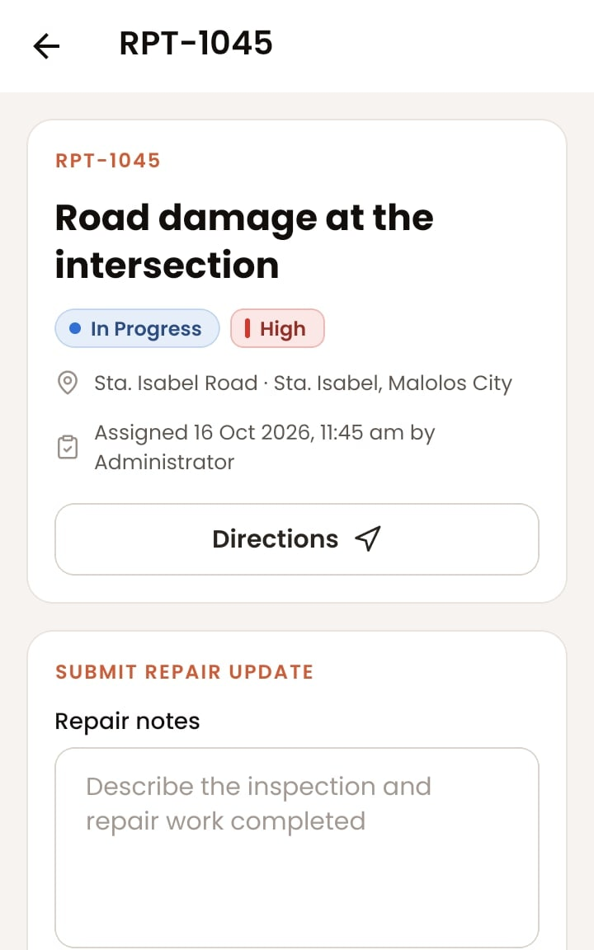
FOR MAINTENANCE CREWS
SECTION 2
Find your jobs, get directions, and send the finished repair for checking.
Notes:
This section is for maintenance crews: finding assigned jobs, getting to the site, and submitting the repair with photos.

Slide 13
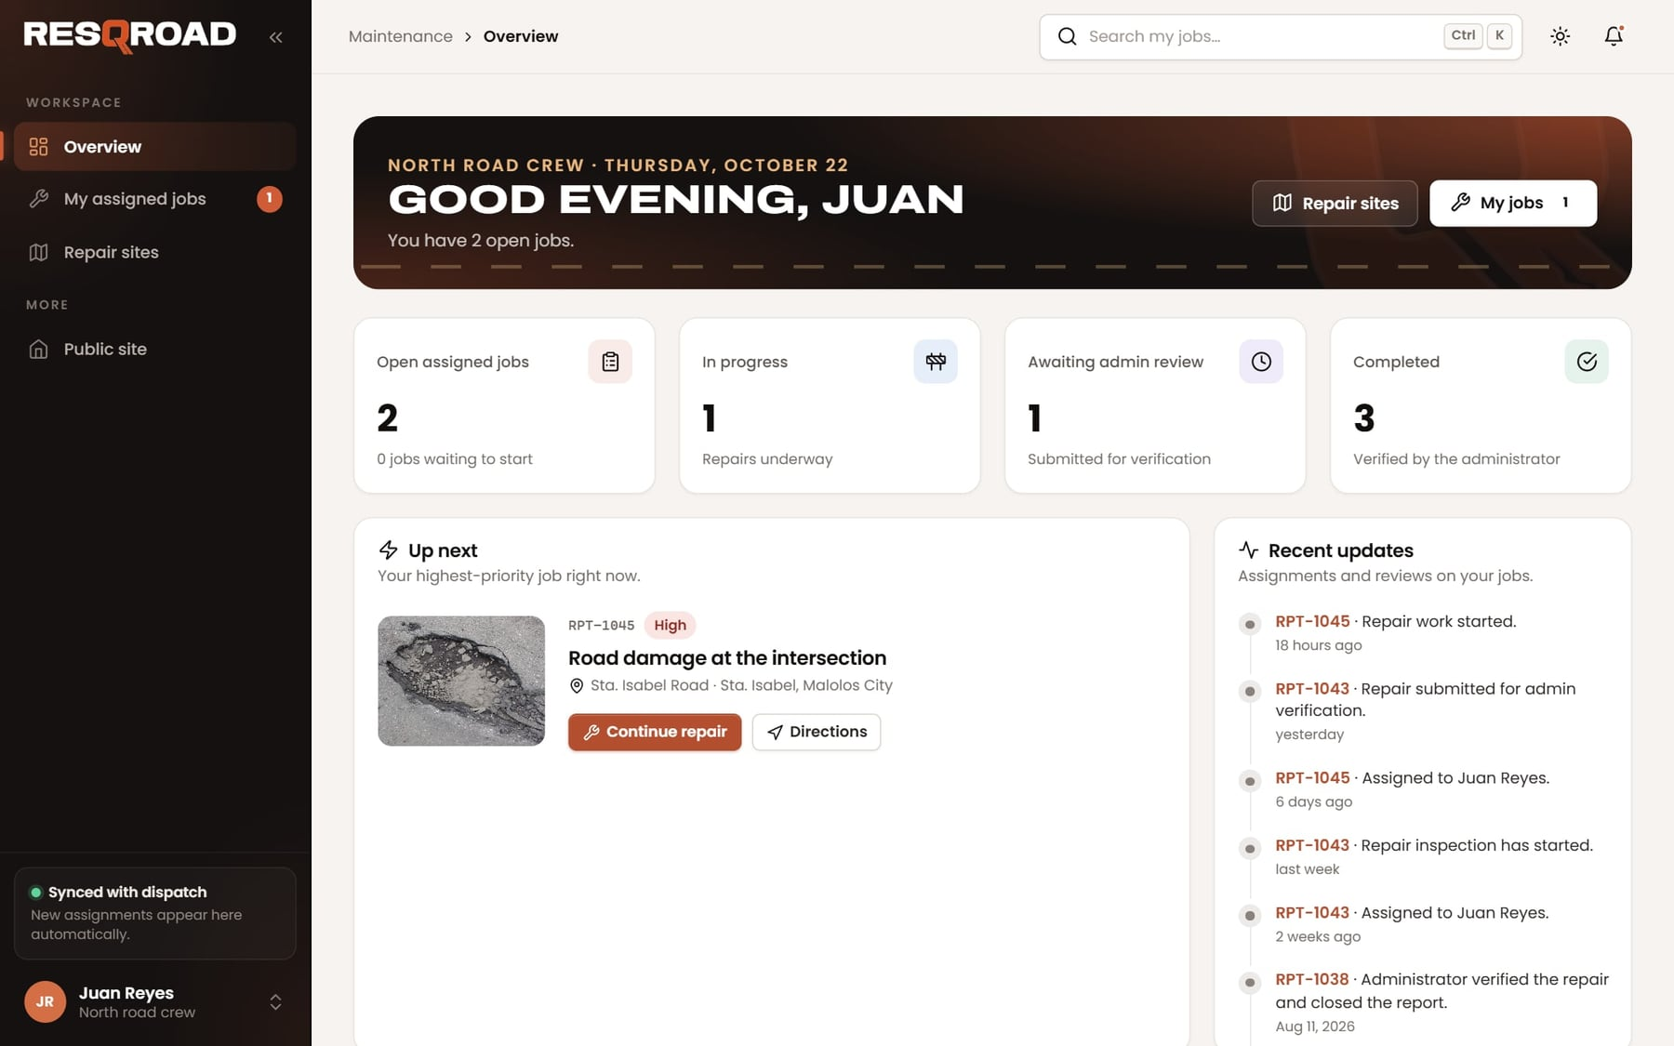
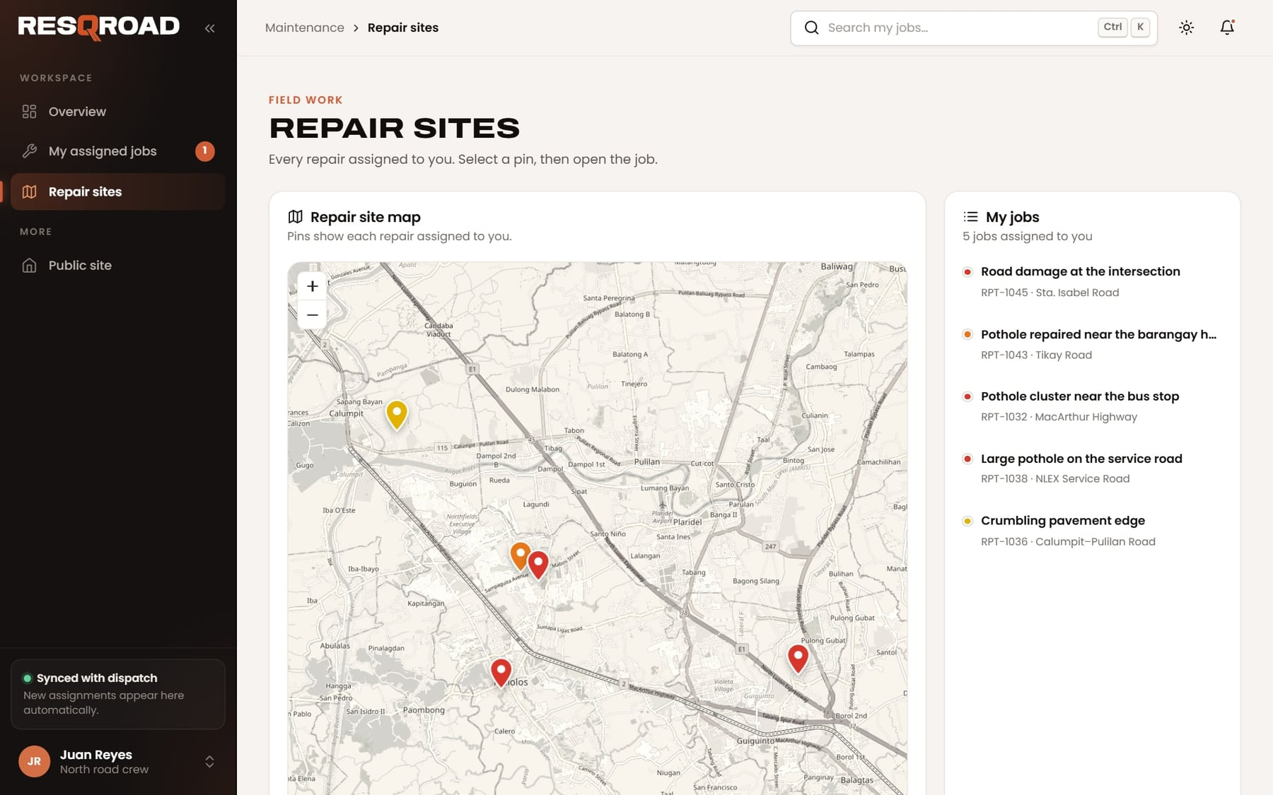

Your workspace
MAINTENANCE CREWS
1
Overview
Your open, in-progress, awaiting-review, and completed jobs, and what's up next.
2
My assigned jobs
Tabs for Active, Awaiting review, Completed, and All.
3
Repair sites
A map of every job. Select a pin to open it.
New assignments appear here automatically, and the bell shows what changed.
Notes:
The crew workspace has three views: Overview, My assigned jobs, and Repair sites. New assignments appear automatically.

Slide 14
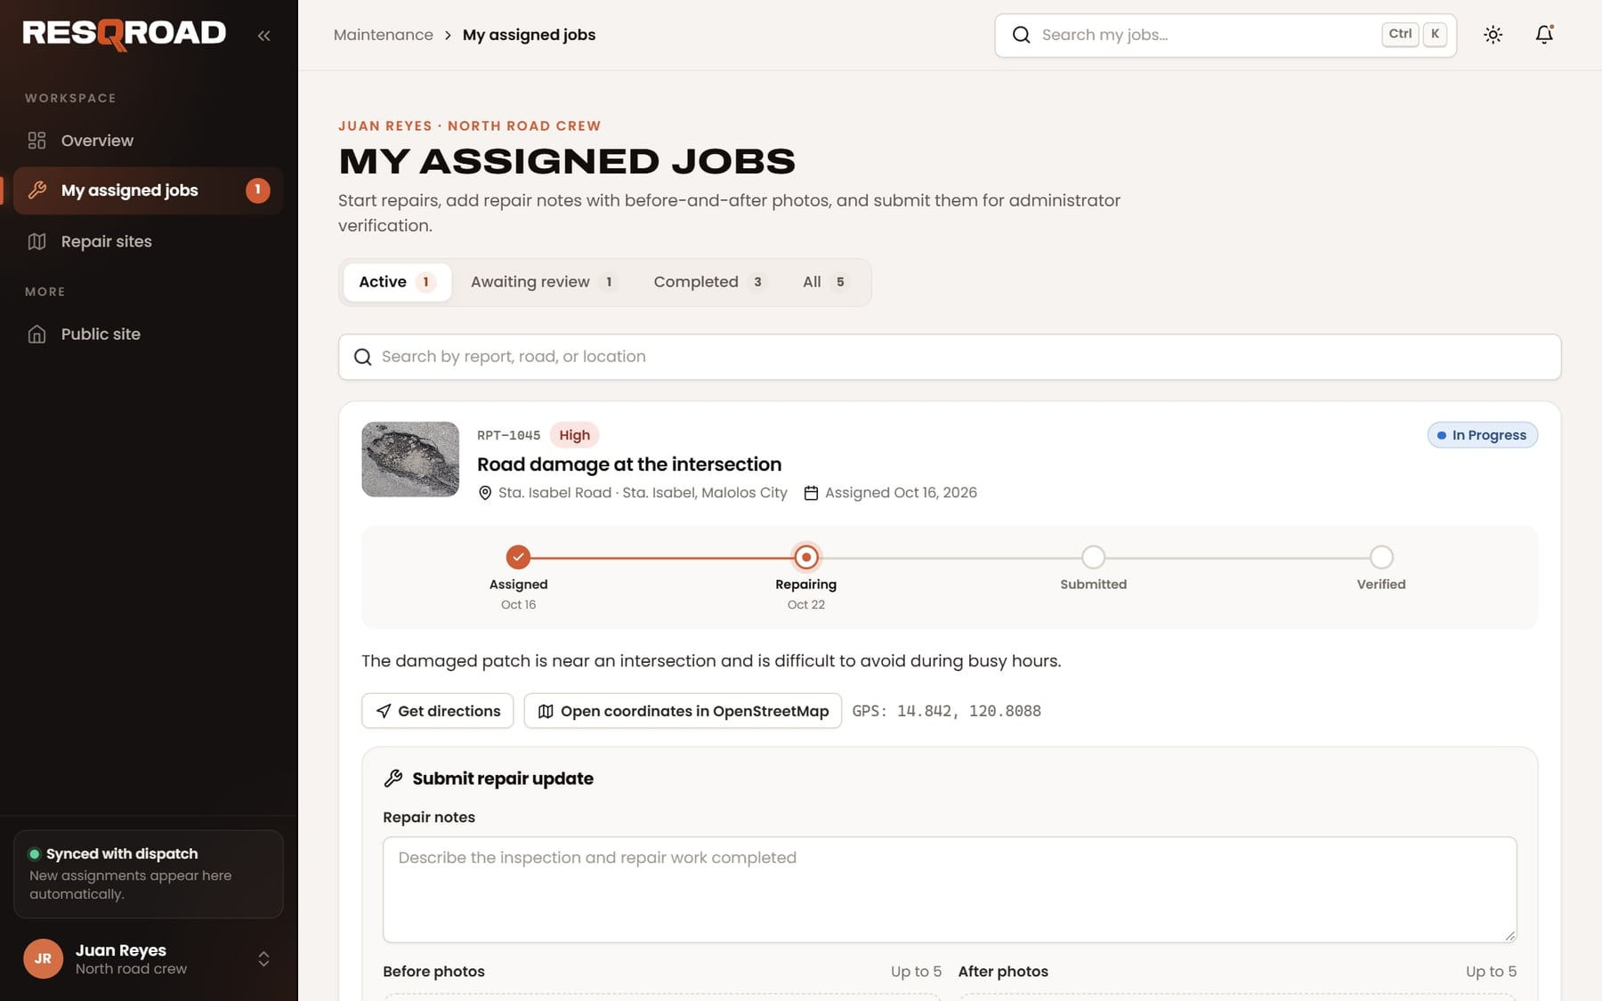
Work on a job
MAINTENANCE CREWS
1
Open the job
From My assigned jobs, open the report you were given.
2
Get directions
Opens Google Maps to the site. The GPS coordinates are shown too.
3
Start the repair
Press Start repair when work begins. The report becomes In Progress.
4
Check the details
Read the description and look at the resident's photos before you go.
Notes:
Open a job to read the resident's description and photos, get directions, and start the repair.

Slide 15
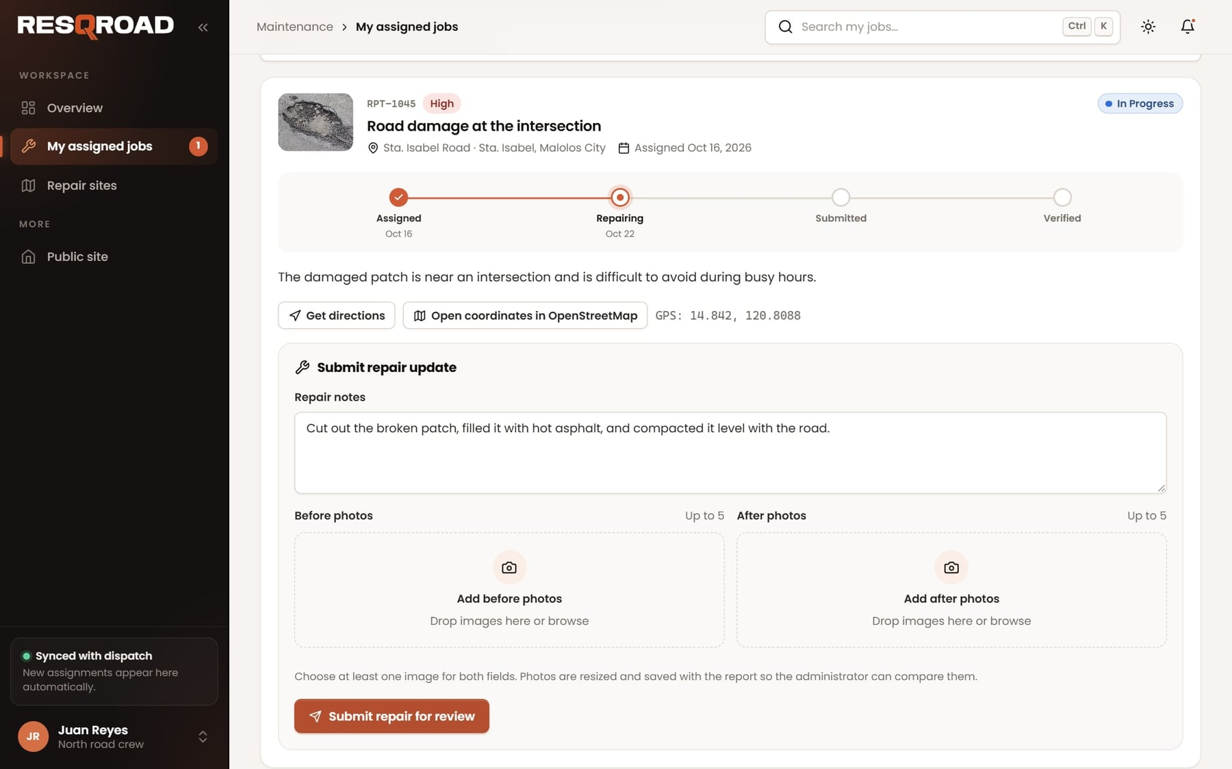
Submit the finished repair
MAINTENANCE CREWS
1
Write repair notes
What you inspected and what you fixed.
2
Add before and after photos
At least one of each, up to five each.
3
Press Submit repair for review
The report becomes Repair Submitted and goes to the administrator.
4
If more work is requested
The administrator's note appears on the job. Fix it and submit again.
Notes:
When the work is done, the crew writes repair notes, adds before and after photos, and submits the repair for the administrator to verify.

Slide 16
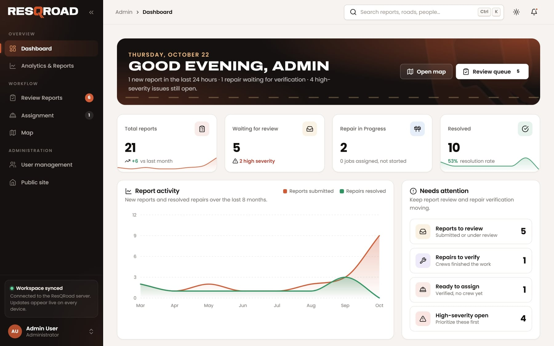
FOR ADMINISTRATORS
SECTION 3
Review new reports, assign crews, verify repairs, and manage accounts.
Notes:
This section is for the Road Maintenance Office administrator: the dashboard, reviewing reports, assigning crews, verifying repairs, and managing accounts.

Slide 17
The dashboard at a glance
ADMINISTRATORS
1
Totals
All reports, waiting for review, repairs in progress, and resolved.
2
Report activity
New reports and resolved repairs over the last eight months.
3
Needs attention
Reports to review, repairs to verify, ready to assign, and high-severity open.
4
Live
The bell shows new activity, and every number updates by itself.
Notes:
The dashboard shows totals, a chart of report activity, and a Needs attention list so nothing is missed.

Slide 18
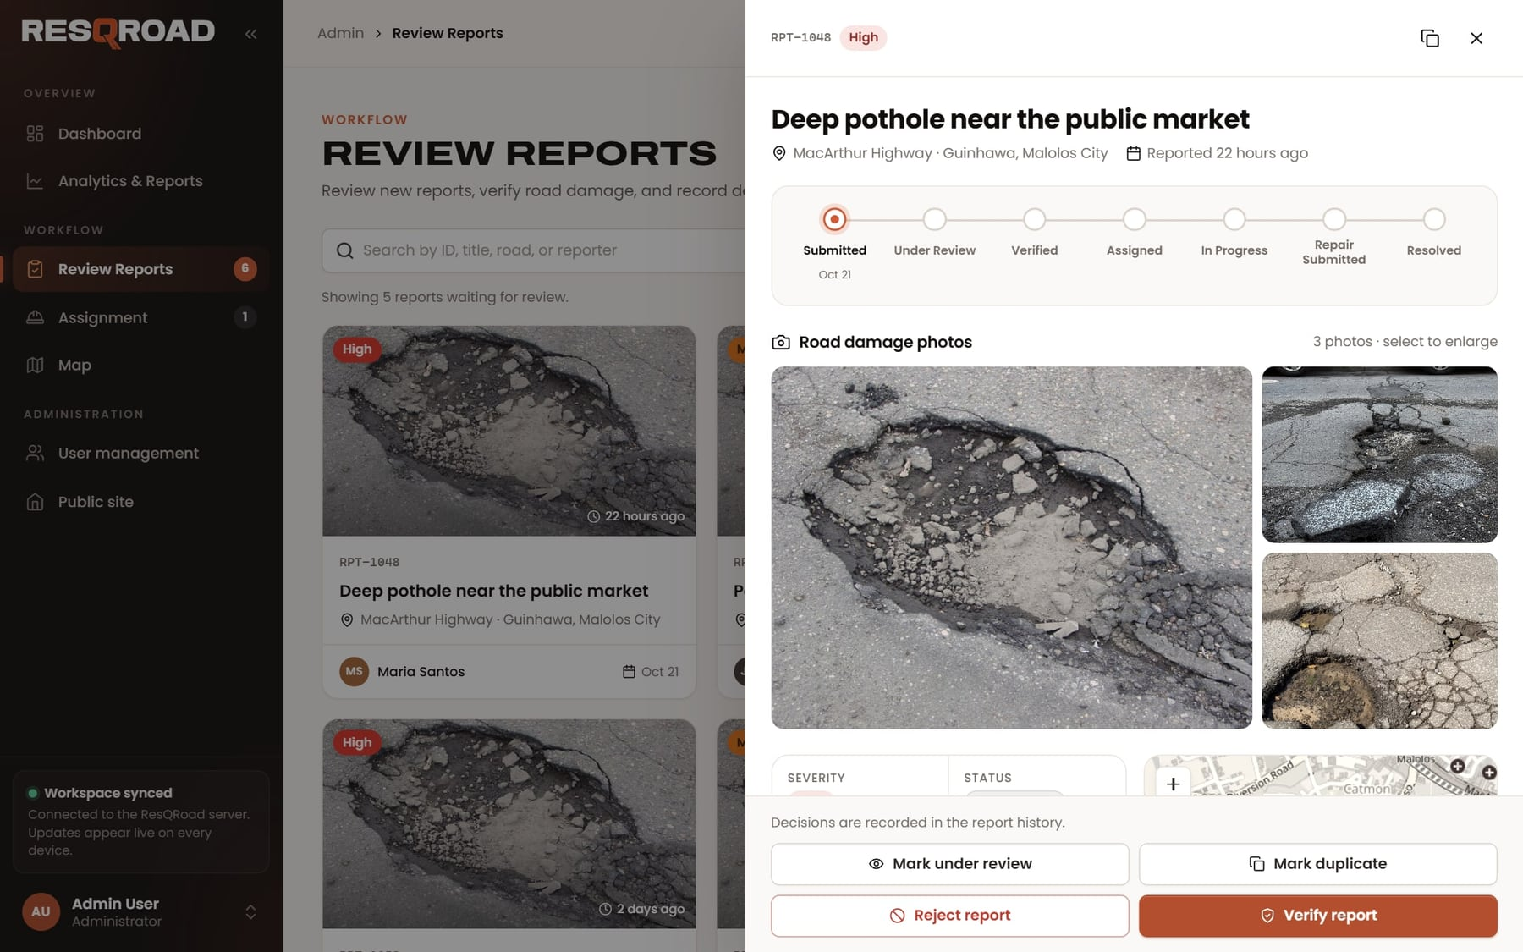
Review new reports
ADMINISTRATORS
1
Open Needs review
In Review Reports, select a report to open its details.
2
Check it
Look at the photos, the map location, and the description.
3
Decide
Mark under review, Verify report, Reject report (with a reason the resident sees), or Mark duplicate.
4
It's on record
Every decision is saved in the report's history with your name.
Notes:
Open a new report to check its photos, location, and description, then record a decision. Every decision is saved with the administrator's name.

Slide 19
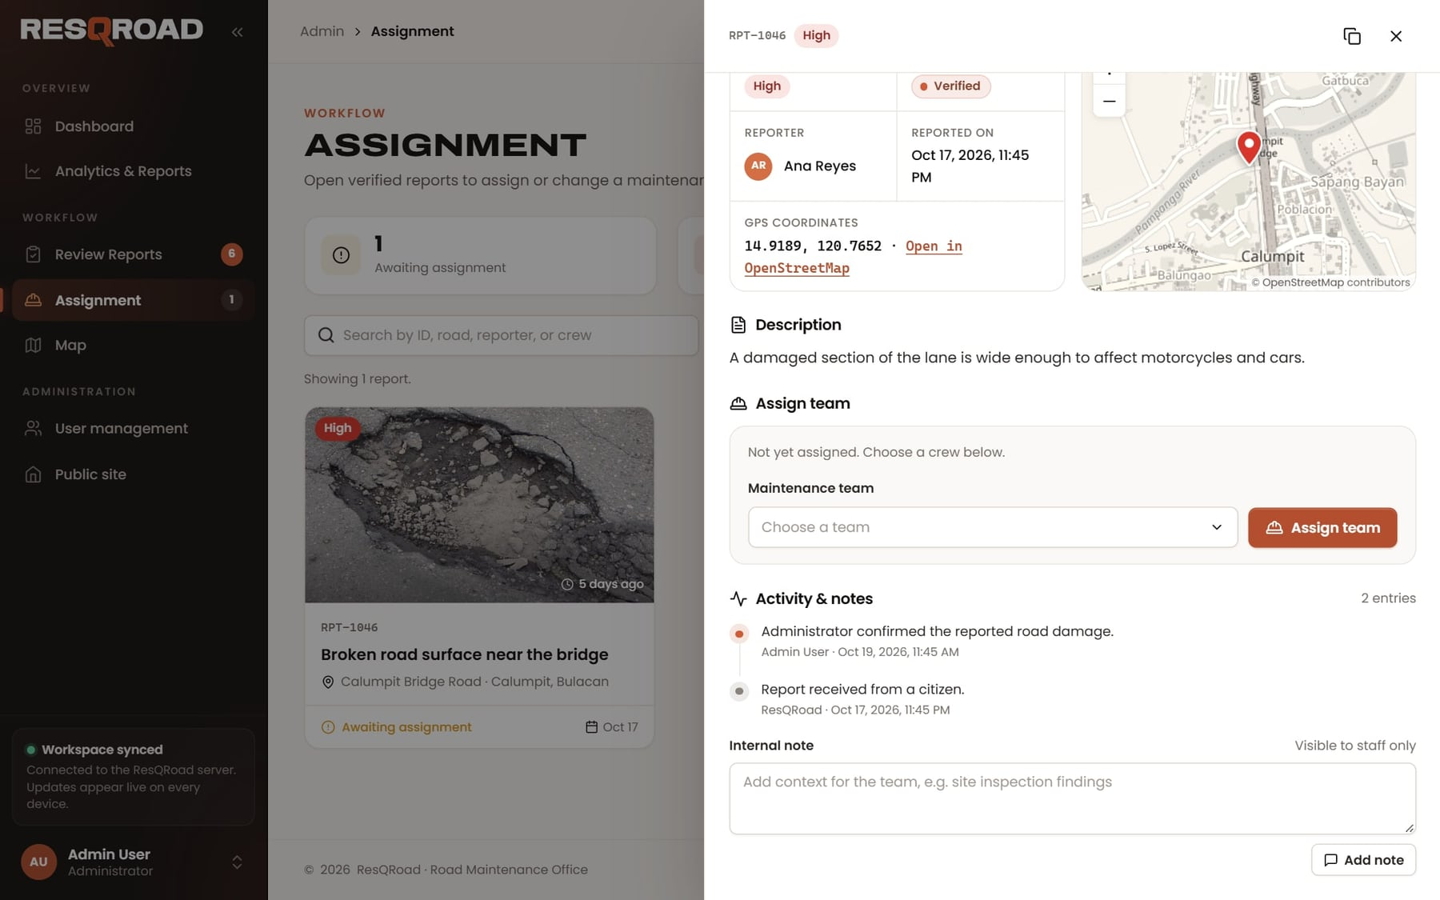
Assign a crew
ADMINISTRATORS
1
Open Assignment
Verified reports that need a crew are listed here.
2
Choose a team
Open a report, pick a Maintenance team, and press Assign team.
3
Balance the work
The crew workload panel shows how many open jobs each crew has.
4
Add an internal note
For staff only, e.g. site inspection findings. Residents never see these.
Notes:
Verified reports wait under Assignment. Choose a maintenance team and press Assign team. Internal notes are only for staff.

Slide 20
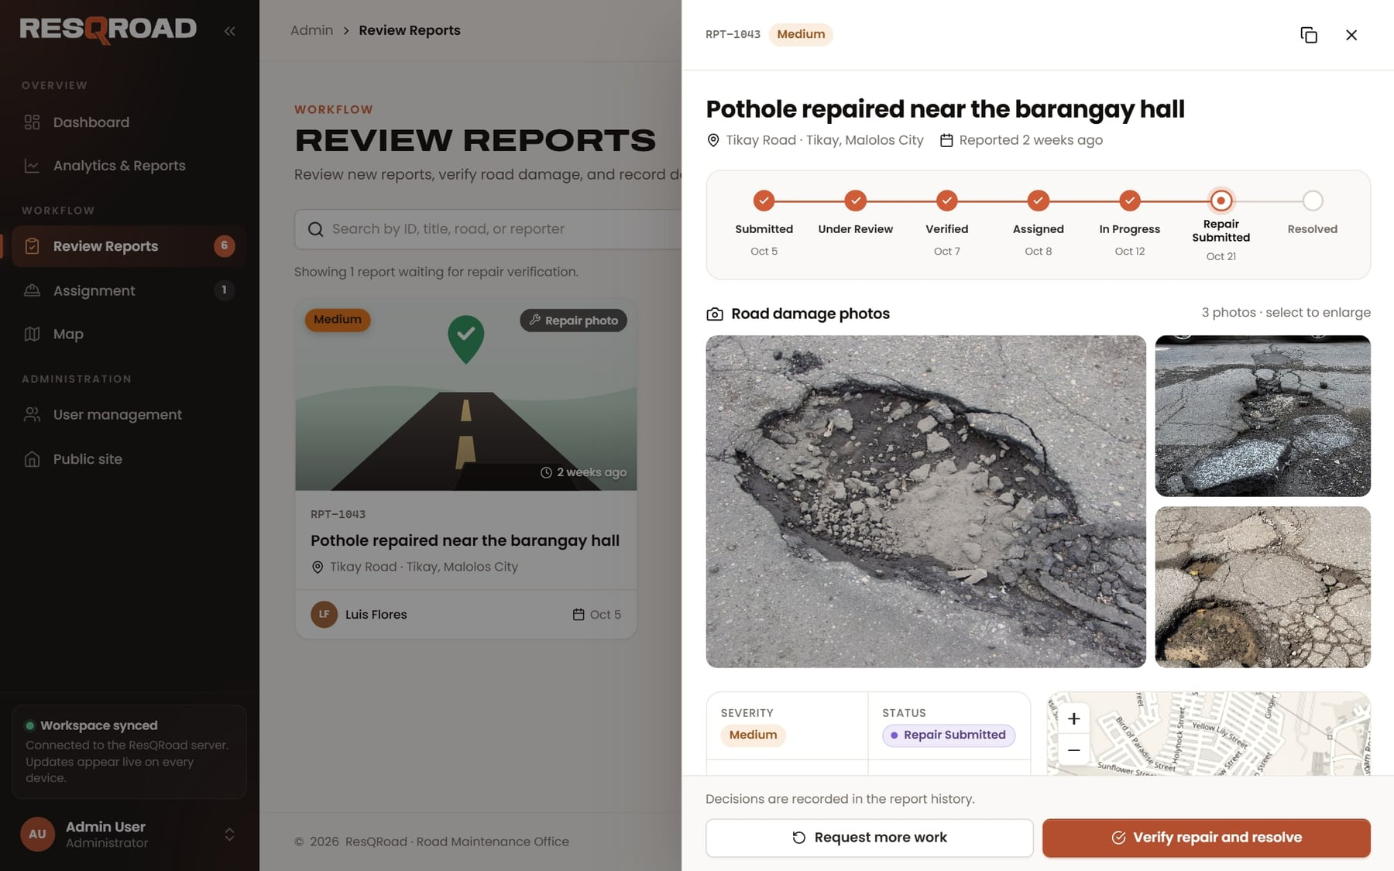
Verify the repair
ADMINISTRATORS
1
Open Repairs to verify
In Review Reports, select a submitted repair.
2
Compare the photos
Look at the crew's before and after photos and read the notes.
3
Resolve or send back
Verify repair and resolve closes it. Request more work sends it back with your note.
4
The resident sees it
The result appears on the resident's report right away.
Notes:
When a crew submits a repair, compare the before and after photos and either resolve the report or request more work.

Slide 21
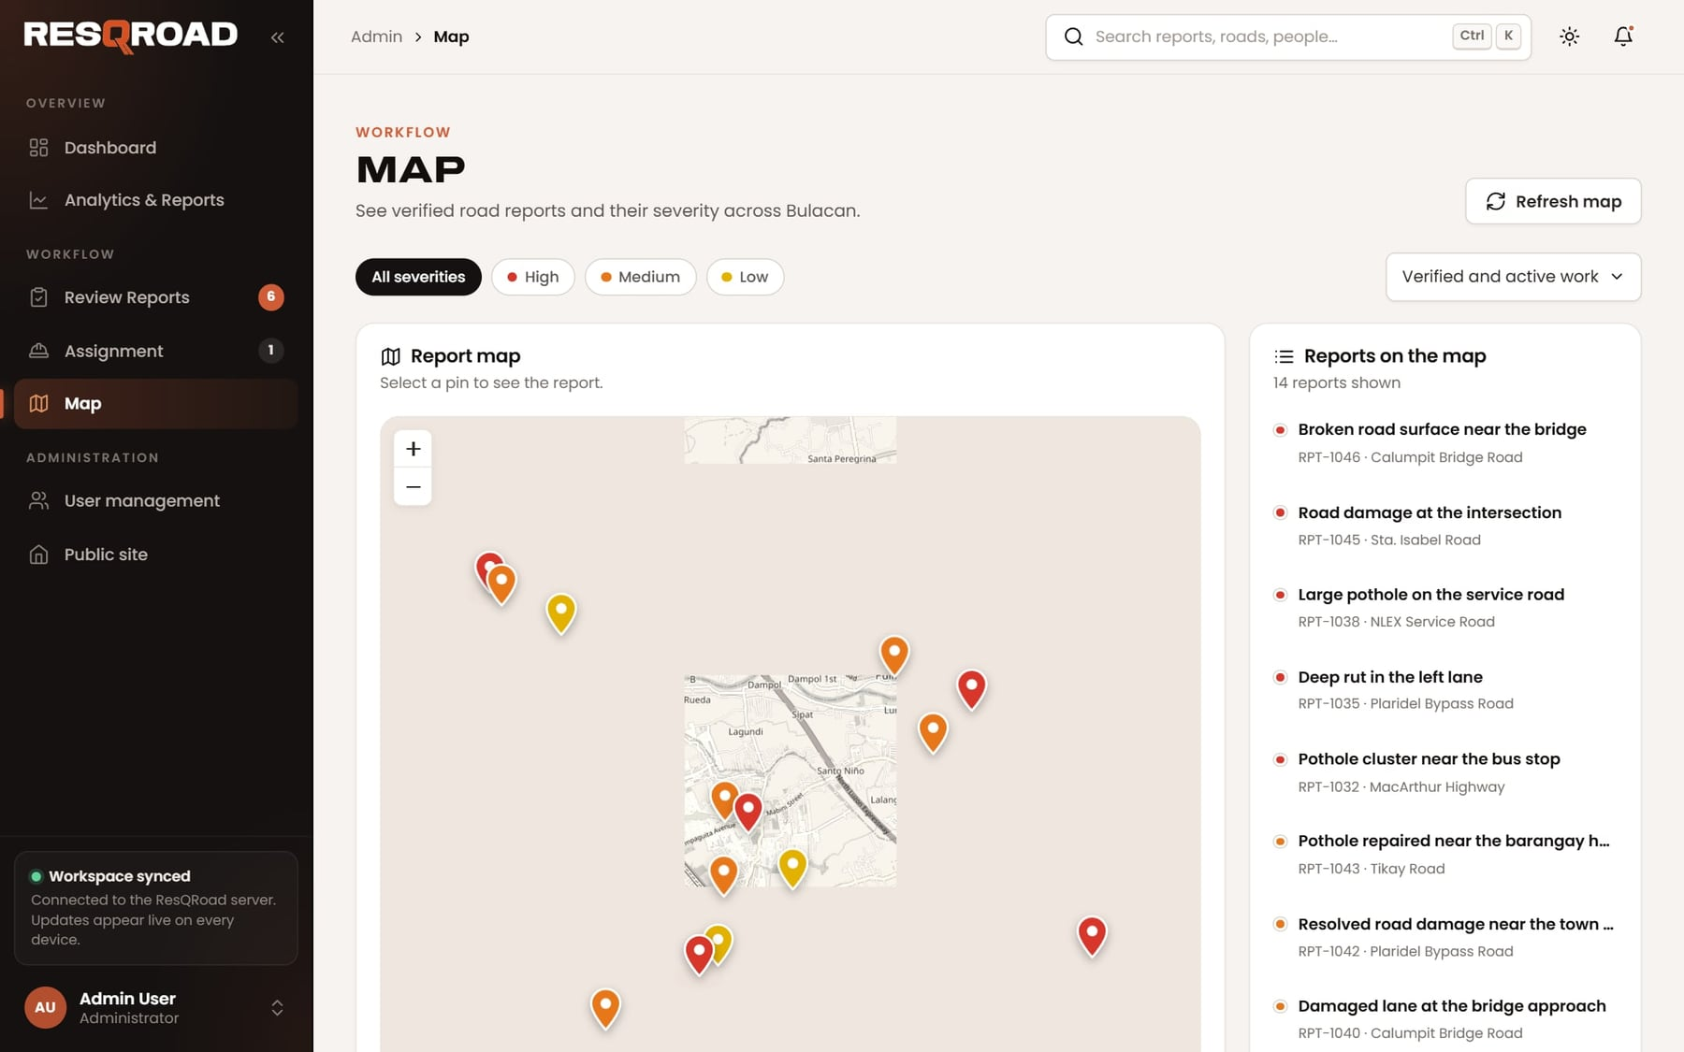
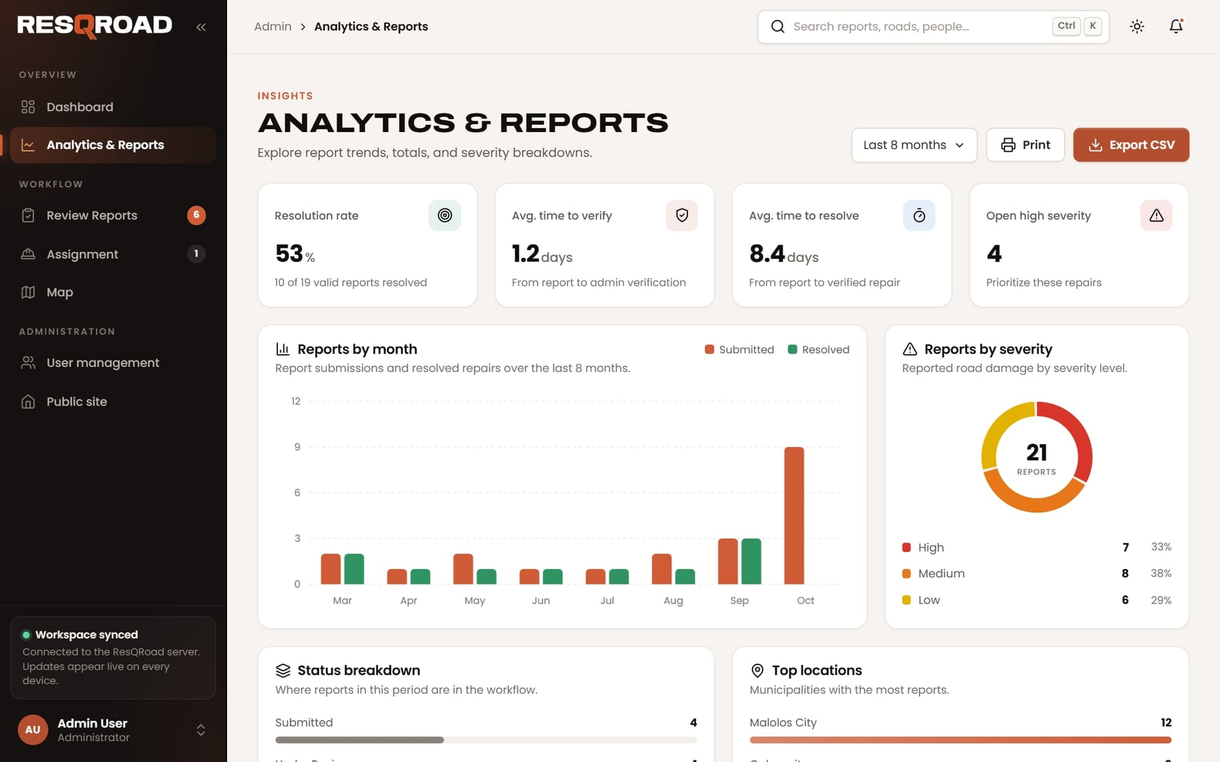
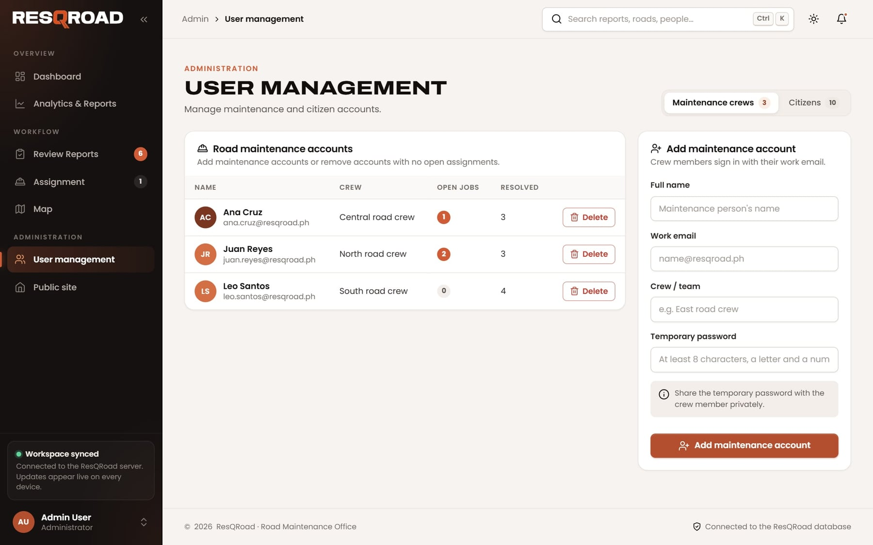
Map, analytics, and user management
ADMINISTRATORS
Map
Every report on one map. Filter by severity and select a pin for details.
Analytics & Reports
Trends, severity, and top locations. Print or Export CSV for reports.
User management
Add crew accounts with a temporary password; deactivate or reactivate residents.
Notes:
Three more tools: the map of all reports, analytics with printing and CSV export, and user management for crew and resident accounts.

Slide 22
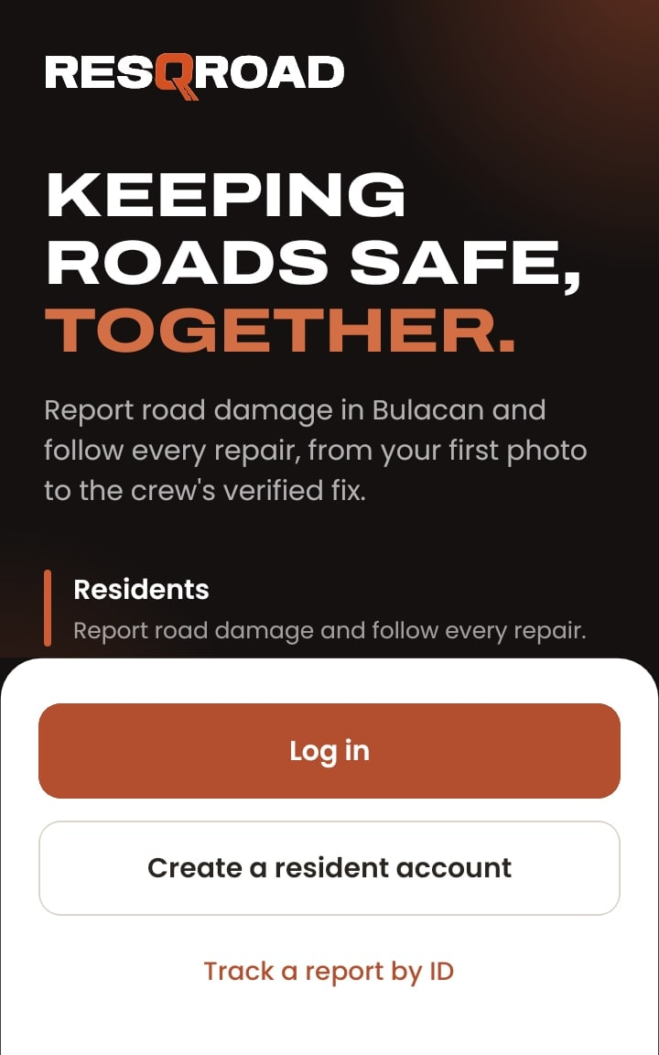
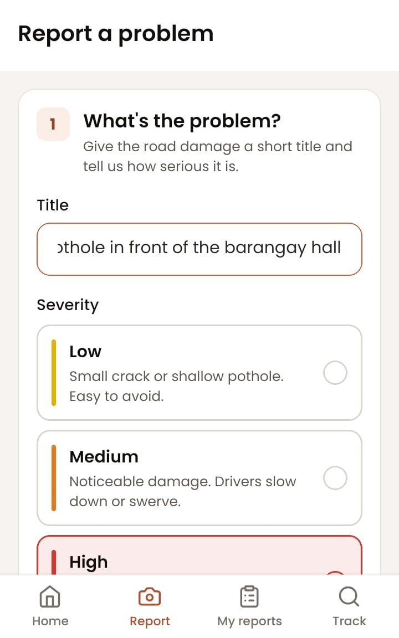
THE MOBILE APP
SECTION 4
The Android app for residents and maintenance crews, with the same accounts and live updates as the website.
Notes:
The Android app gives residents and crews the same features on their phones. Administrators keep using the website.

Slide 23
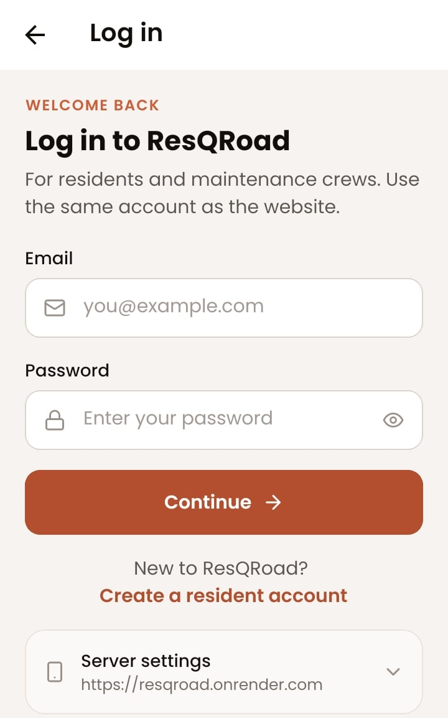

Install the Android app
MOBILE APP
1
Open the download link
On the Android phone, open the ResQRoad link and download the APK.
2
Allow the install
If Android asks, allow Install unknown apps for your browser, then tap Install.
3
Sign in
Use your website account, or create a resident account. Administrators use the website.
iPhone: open resqroad.onrender.com in Safari, then Share → Add to Home Screen.
Notes:
Install the APK from the download link, allow installing from the browser if Android asks, then sign in with the website account. iPhone users use the website.

Slide 24
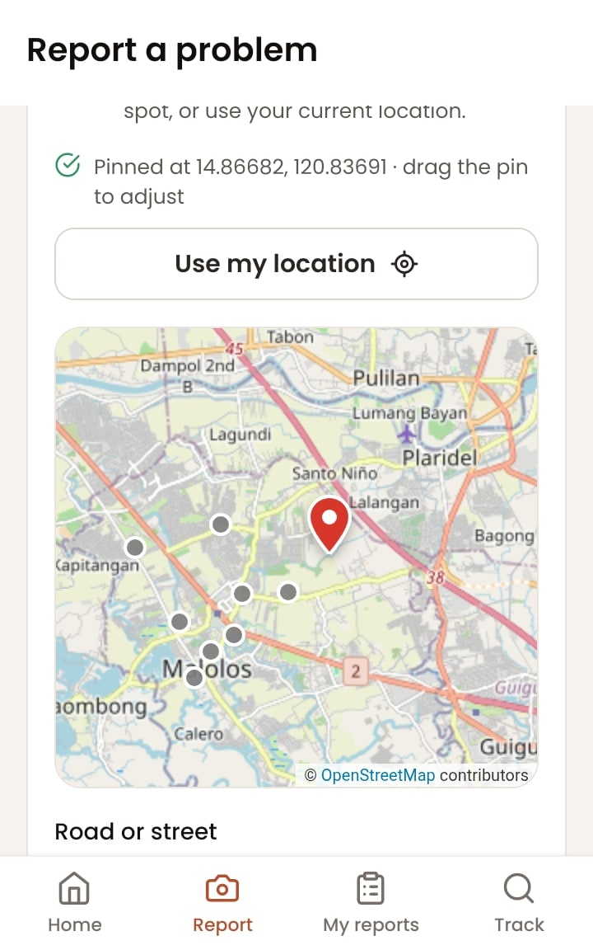
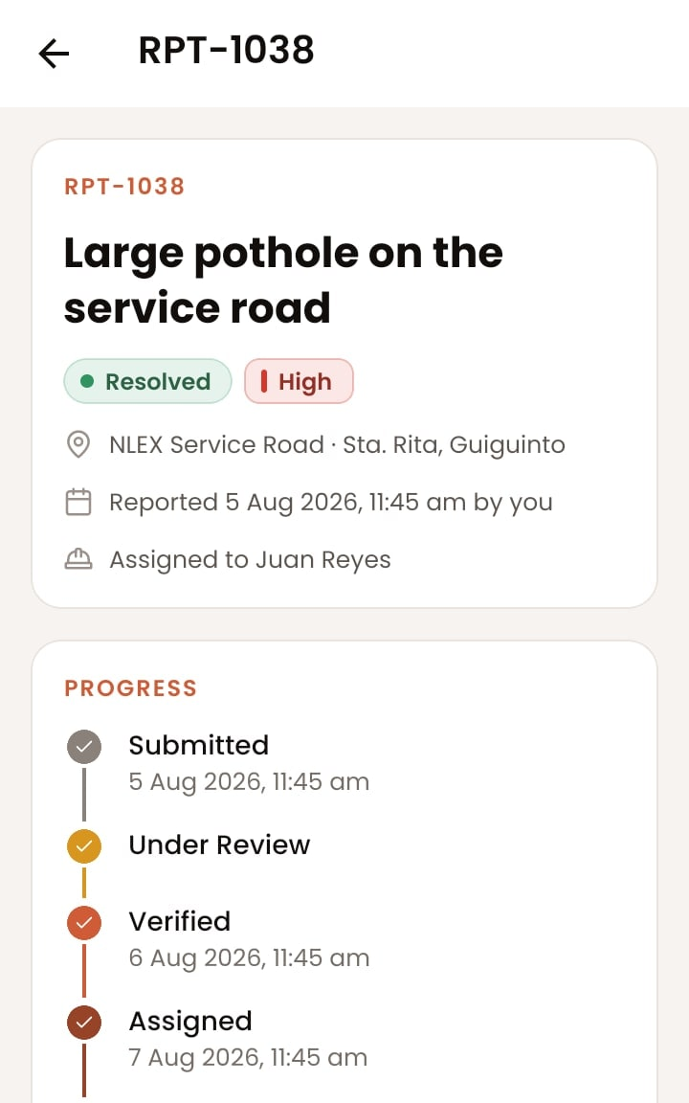
Report and follow repairs from your phone
MOBILE APP · RESIDENTS
Home
Your numbers and latest reports.
Report
The same three steps as the website.
Pin the spot
Tap the map or Use my location.
Report details
Progress and every decision.
Notes:
Residents have four tabs: Home, Report, My reports, and Track. The report form has the same three steps as the website, and photos can come straight from the camera.

Slide 25
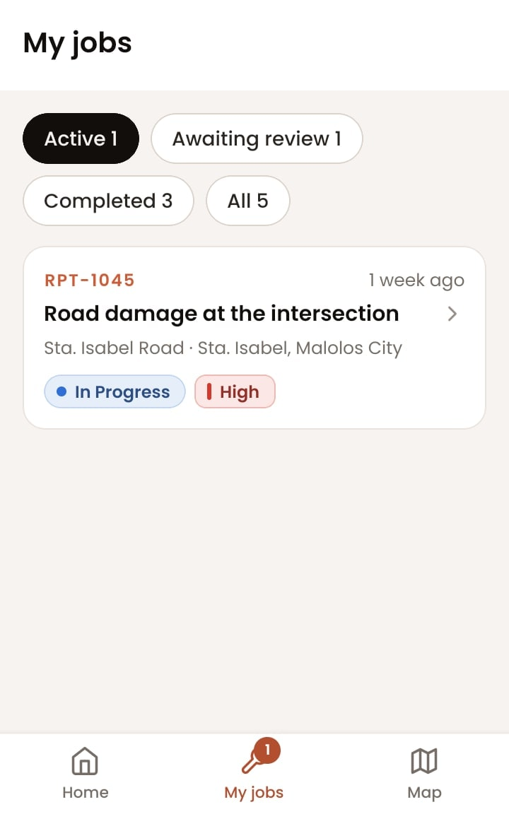
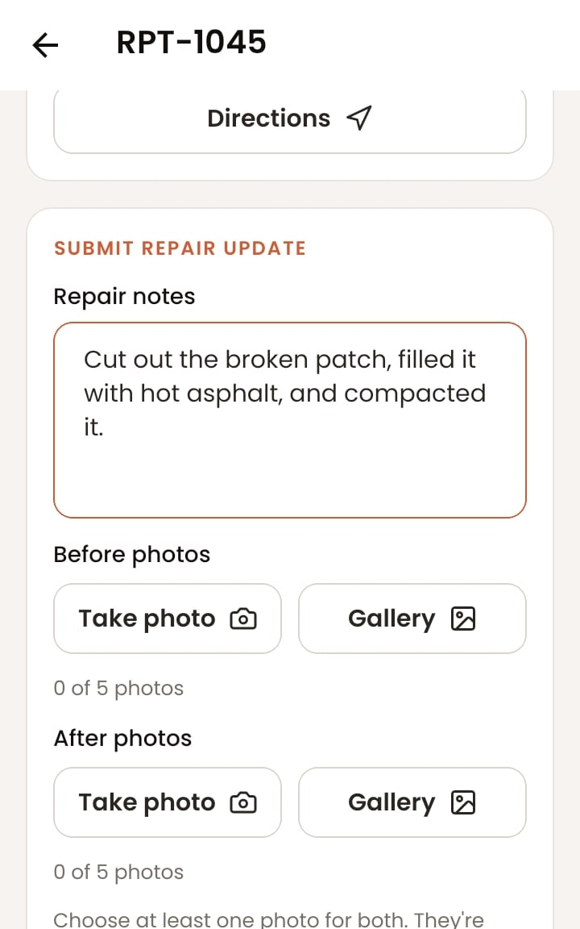
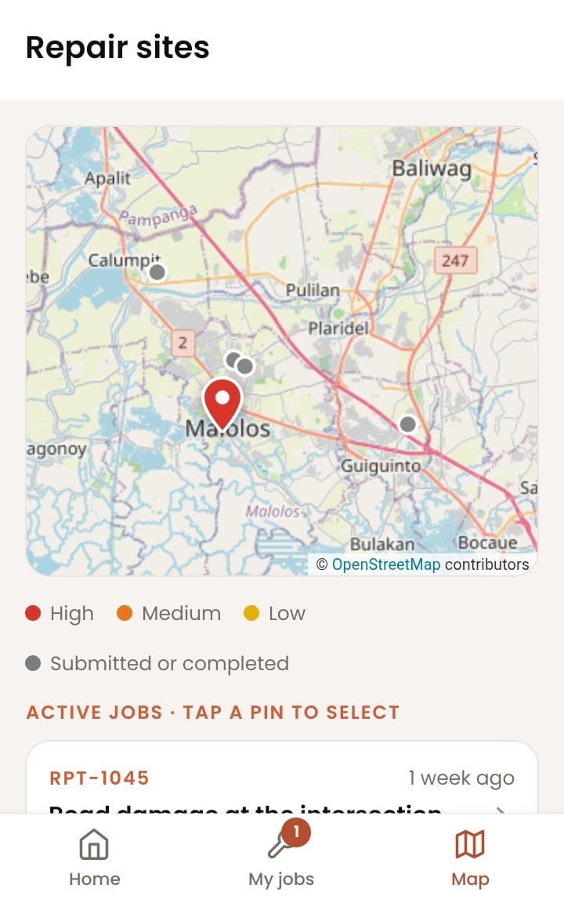
Your jobs in your pocket
MOBILE APP · MAINTENANCE CREWS
Home
Your jobs and what's up next.
My jobs
Active, awaiting review, completed.
Repair form
Notes plus before and after photos.
Map
Every job as a pin.
Notes:
Crews have three tabs: Home, My jobs, and Map. A job's page has directions, Start repair, and the repair form. Status alerts appear as a banner while the app is open, or as a phone notification while it runs in the background.

Slide 26






Tips and troubleshooting
HELP
Page slow to open?
App can't reach the server
Location not working
After a quiet spell the site needs up to a minute to wake up. Wait, then refresh.
Check the phone's internet, then tap Try again. Server settings should show resqroad.onrender.com.
Allow location for the browser or app, or drop the pin on the map instead.
Report stopped as a duplicate
Photo won't upload
Sign-in paused
Damage within about 100 m is already reported. Track that report; its ID is in the message.
Use JPG, PNG, or HEIC under 8 MB each, up to five per set.
After 8 wrong passwords in 15 minutes, sign-in pauses for a while. Wait and try again.
Notes:
Common questions: a slow first page, the app not reaching the server, location, duplicates, photo uploads, and paused sign-ins.

Slide 27

SAFER ROADS START WITH ONE REPORT.
Open ResQRoad at resqroad.onrender.com or in the Android app.
ResQRoad · Road Maintenance Office
Notes:
That's ResQRoad: residents report, the Road Maintenance Office verifies and assigns, and crews repair, with everyone following the same live status.

