Slide 1




3D ENDLESS
CITY RUNNER
UNITY • C# • 3D GAME
RUN • JUMP • COLLECT • DODGE • SURVIVE
A Unity game development project: build an endless runner through a neon city with traffic, coins and gems.
Coins
Gems
Distance

Slide 2






Reason for Choosing This Game
Easy to Understand
Interactive Gameplay
Running, collecting and avoiding obstacles is simple for any player.
Steering, jumping and traffic make every second engaging.
3D Learning
Creative City Theme
Learn 3D environments, character movement, cameras and animation in Unity.
Streets, buildings, cars and barriers give a fresh urban look.
Multiple Features
Skill Development
Coins, gems, scoring, distance, collisions and game-over systems.
Builds practical Unity and C# skills you can reuse in any game.

Slide 3
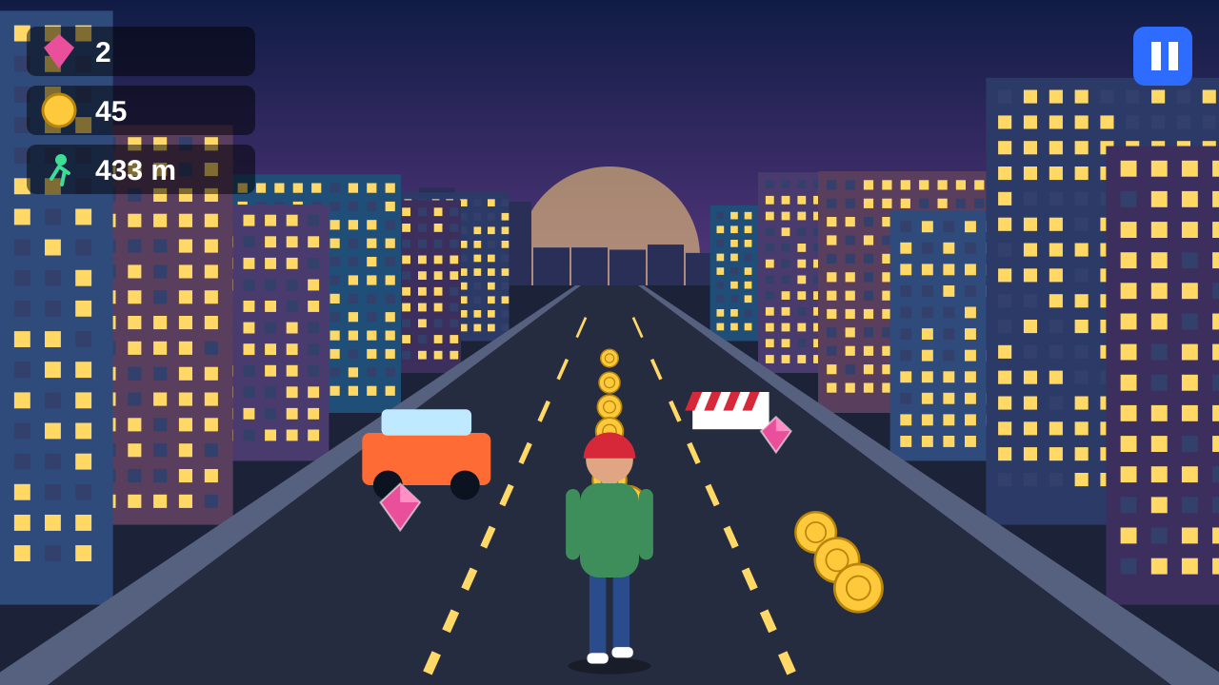


1. Plan the Game
1
Objective
2
Core Decisions
Run as far as possible
Collect coins and gems
Dodge traffic and survive
Automatic forward running
Steer with A / D or arrows
Jump with the Space bar
3
Difficulty
4
Player Journey
Easy: slow, few cars
Medium: faster, more hazards
Hard: fast, dense traffic
Run through the city
Collect coins and gems
Beat your best distance
PLAYER JOURNEY FLOW
Run
Collect
Dodge
433 m

Slide 4
Build Roadmap: 10 Steps
1
2
3
4
5
Plan
Create Project
Import Assets
Build Scenes
City Segments
Define goal, controls and features
Unity 3D (URP), folders and tags
Mixamo hero, city pack, TextMeshPro
Menu, Stage, Info and Gameplay
Road prefabs plus endless spawner
6
7
8
9
10
Player and Camera
Items and Obstacles
HUD and Save
Sound and Fades
Test and Build
Run, steer, jump, follow camera
Coins, gems, cars and barriers
Score UI and PlayerPrefs
SFX, music and transitions
Play, fix, export Android APK

Slide 5

2. Set Up the Unity Project
1
Start a new project
2
Scene and environment
3
Folders and tags
Open Unity Hub, then New Project
Choose the 3D (URP) template
Name it CityRunner3D
Create Empty objects: GameManager, MasterControl
Add road, sidewalks, buildings, skybox and lights
Drop in the Mixamo player character
Place cars, barriers, coins and gems
Add the Main Camera with CameraFollow
Animations
Audio
Materials
Models
Prefabs
Scenes
Scripts
UI
3D (URP) Universal Render Pipeline
TAGS TO CREATE
Project name
CityRunner3D
Player
Obstacle
Ground
Tips: keep folder names clean and consistent • use meaningful names for every object • an organized project is easy to scale

Slide 6








Game Logic and Systems
RUN and COLLECT
Coins and gems
Game Rules
Auto-run forward, no speed button
Collect coins and gems
Avoid cars, barriers and crates
RESTART
Back to menu
AVOID
Cars and barriers
Collision = game over, back to menu
Run endlessly until you crash
Systems Checklist
COLLISION
Hit = game over
Score
Pickups
Collision
Spawner
Save/Load
Restart

Slide 7






Add Sound and Animations
Sound design
Coin pickup
Short bright ding when a coin is collected.
Fade In
Fade Out
Smooth start of a scene
Smooth scene change
Gem pickup
Special reward chime for gems.
Collision
Heavy impact when you hit traffic.
Shrink
Collision FX
Pickups shrink and rise
Stumble plus impact
Button select
Click sound on menu buttons.
Master
Music
SFX
City ambience
Traffic hum plus background music.
100%
70%
80%

Slide 8


Folder Structure
Scripts
StageControls
SegmentGenerator
PlayerMovement
CameraFollow
SaveLoad
LoadToStage
MasterLevelInfo
MainMenuControl
CollisionDetect
CollectableRotate
CollectCoin
CollectGem
Assets
Prefabs
Player
CitySegment
Coin
Gem
Obstacle
Scenes
MainMenu
StageSelect
Information
GamePlay

Slide 9
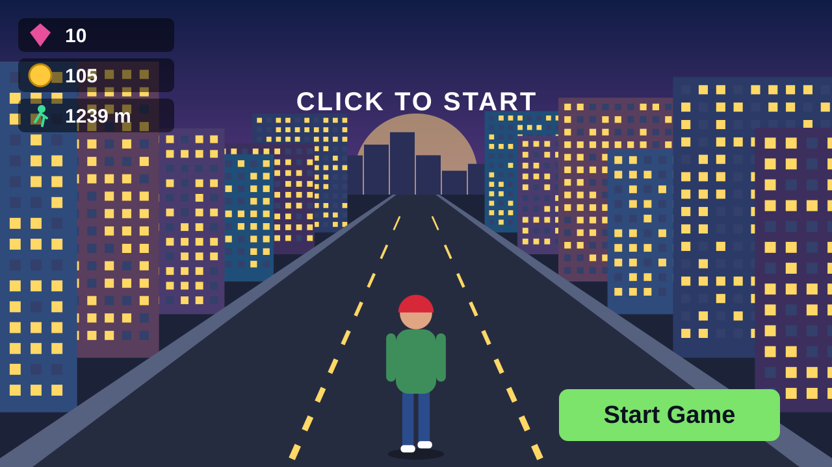
Scene 1: Main Menu
About this scene
The first scene of the game. It shows saved totals and the Start Game button.
What you see
Left: saved gems, coins and best distance
Center: CLICK TO START prompt
Bottom-right: Start Game button
Click Start Game
Sound and fade-out
Stage Select loads
Start Game does not begin the run. It loads Stage Select (index 1).
1
2
3

Slide 10
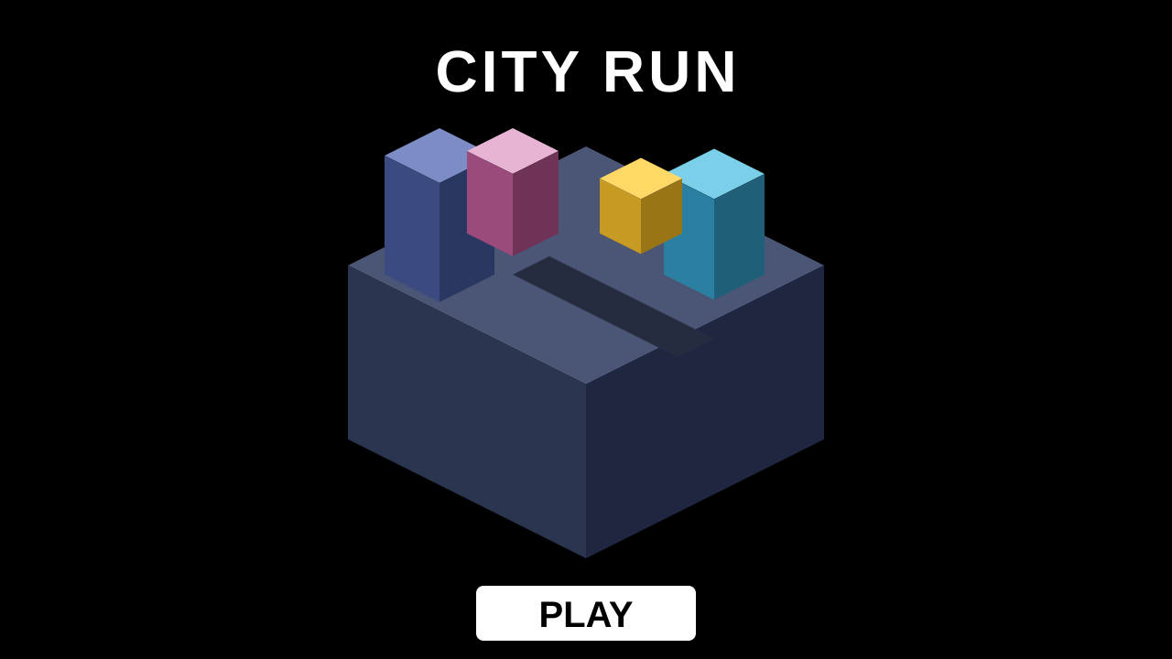
Scene 2: Stage Select
About this scene
Presents the City stage before the run begins and lets the player continue.
What you see
Top: CITY RUN title
Center: low-poly city block preview
Bottom: PLAY button on black
Click PLAY
Button sound plays
Information loads
PLAY plays the button sound, then loads Information (index 2).
1
2
3

Slide 11
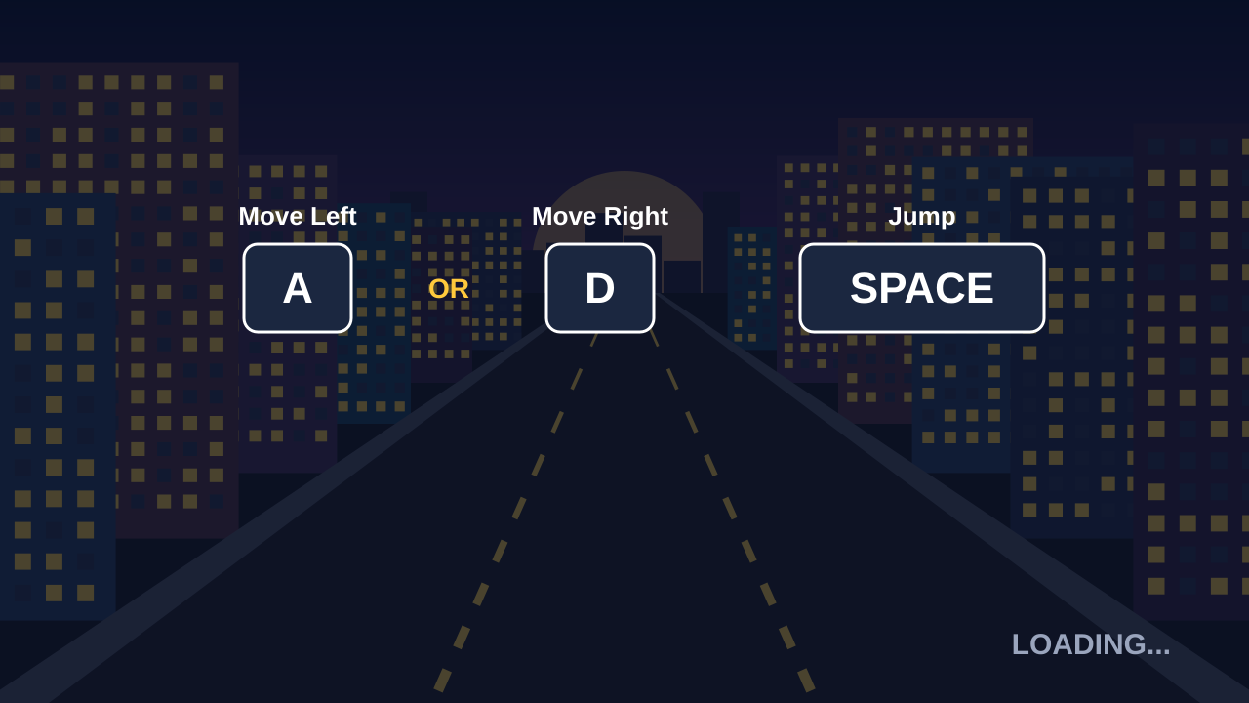
Scene 3: Information
About this scene
Shows the controls for a few seconds while the Gameplay scene prepares to load.
What you see
Left: Move Left (A or left arrow)
Right: Move Right (D or right arrow)
Center: Jump (Space bar)
Read controls
Wait 3 seconds
Gameplay loads
After a short wait the Gameplay scene (index 3) loads by itself.
1
2
3

Slide 12
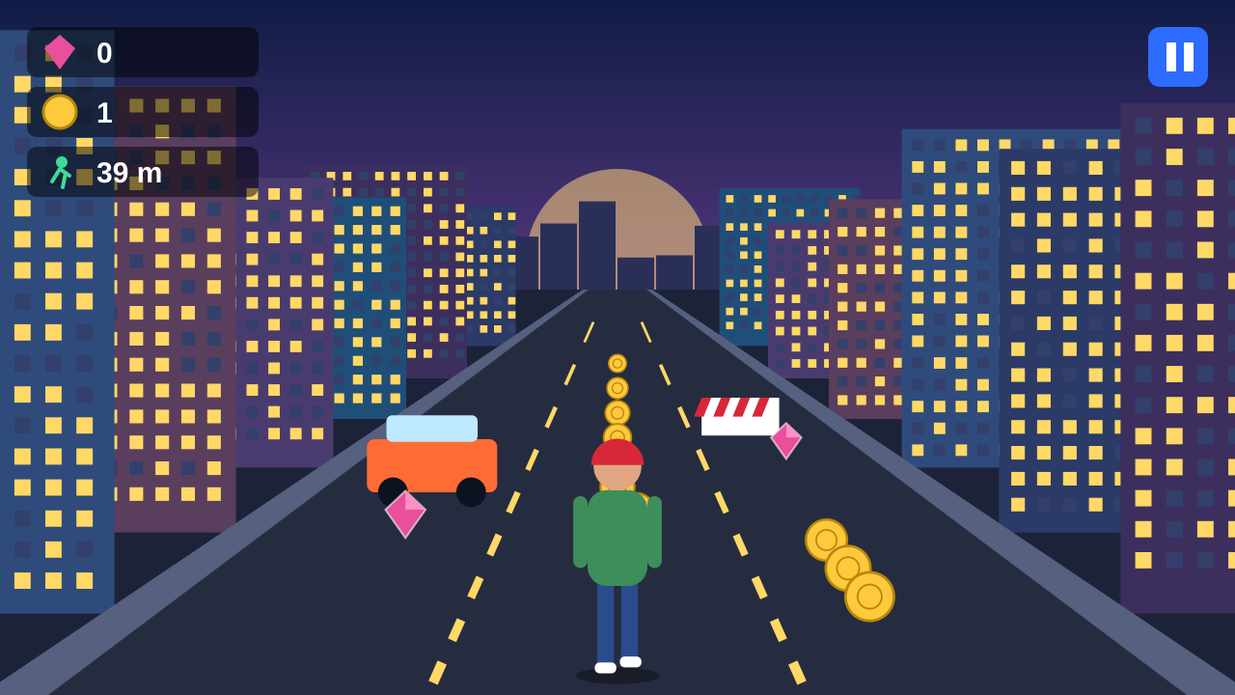
Scene 4: Gameplay
About this scene
The Mixamo 3D character runs forward on its own. Steer and jump to dodge traffic.
What you see
Top-left: gems, coins and distance
Center: runner on a city road
Ahead: cars, barriers and pickups
Steer: A / D, arrows
Jump: Space bar
Crash: save, then menu
Use the arrow keys to steer and the Space bar to jump over obstacles.
1
2
3

Slide 13
StageControls.cs: Stage Select button
using UnityEngine;
using System.Collections;
using UnityEngine.SceneManagement;
public class StageControls : MonoBehaviour {
[SerializeField] AudioSource buttonSelect;
// Hook this to the PLAY button (OnClick)
public void PressPlay() {
StartCoroutine(LoadInfoScene());
}
IEnumerator LoadInfoScene() {
buttonSelect.Play();
yield return new WaitForSeconds(0.5f);
SceneManager.LoadScene(2); // Information scene
}
}
PURPOSE
Handles the PLAY button on the Stage Select scene: plays the click sound, then loads the Information scene.
HOW IT WORKS
1
The player clicks the PLAY button.
2
PressPlay() starts a small coroutine.
3
The button sound plays for half a second.
4
SceneManager loads build index 2 (Information).
Tip Scene numbers come from Build Profiles. Keep the order MainMenu 0, StageSelect 1, Information 2, GamePlay 3.
Attach to: An empty "StageControls" GameObject in the StageSelect scene.
Inspector: Drag the AudioSource into Button Select, then hook PressPlay() to the Button OnClick.

Slide 14
SegmentGenerator.cs: Endless city road
using UnityEngine;
using System.Collections.Generic;
public class SegmentGenerator : MonoBehaviour {
public GameObject[] segments; // city road prefabs
public Transform player;
public float segmentLength = 50f;
public int segmentsAhead = 3;
float zPos = 50f;
readonly Queue<GameObject> active = new Queue<GameObject>();
void Update() {
while (player.position.z + segmentLength * segmentsAhead > zPos)
Spawn();
}
void Spawn() {
GameObject prefab = segments[Random.Range(0, segments.Length)];
Vector3 pos = new Vector3(0, 0, zPos);
active.Enqueue(Instantiate(prefab, pos, Quaternion.identity));
zPos += segmentLength;
if (active.Count > segmentsAhead + 2)
Destroy(active.Dequeue()); // remove old road behind us
}
}
PURPOSE
Creates the endless city. It keeps spawning random road segments ahead of the player and deletes old ones behind.
HOW IT WORKS
1
Update() checks how far ahead the road is built.
2
If less than 3 segments exist ahead, Spawn() runs.
3
A random segment prefab is placed at zPos.
4
zPos grows by 50 and the oldest segment is destroyed.
Attach to: An empty "SegmentGenerator" GameObject in the GamePlay scene.
Inspector: Drag 3 or more CitySegment prefabs into Segments and the Player into Player.

Slide 15
PlayerMovement.cs: Run, steer and jump
using UnityEngine;
[RequireComponent(typeof(Rigidbody))]
public class PlayerMovement : MonoBehaviour {
public float playerSpeed = 8f, horizontalSpeed = 6f, jumpForce = 7f;
public float leftLimit = -5.5f, rightLimit = 5.5f;
[SerializeField] Animator anim;
Rigidbody rb;
bool isGrounded = true;
void Start() => rb = GetComponent<Rigidbody>();
void Update() {
// auto-run forward, steer with A / D or arrow keys
transform.Translate(0, 0, playerSpeed * Time.deltaTime, Space.World);
float h = Input.GetAxisRaw("Horizontal");
Vector3 p = transform.position;
p.x = Mathf.Clamp(p.x + h * horizontalSpeed * Time.deltaTime,
leftLimit, rightLimit);
transform.position = p;
// jump with the Space bar
if (Input.GetKeyDown(KeyCode.Space) && isGrounded) {
rb.AddForce(Vector3.up * jumpForce, ForceMode.Impulse);
isGrounded = false;
anim.SetTrigger("Jump");
}
}
void OnCollisionEnter(Collision c) {
if (c.gameObject.CompareTag("Ground")) isGrounded = true;
}
}
PURPOSE
Runs the hero forward automatically, steers left and right inside the road limits, and jumps with the Space bar.
HOW IT WORKS
1
Translate() moves the player forward on the Z axis.
2
A / D or the arrow keys change X, clamped to the road.
3
Space adds an upward force when the player is grounded.
4
Touching the Ground tag makes isGrounded true again.
Attach to: The Player object (Rigidbody + Capsule Collider, tag Player).
Inspector: Assign the Animator. Freeze rotation on the Rigidbody. Set Active Input Handling to Both.

Slide 16
CameraFollow.cs: Third-person camera
using UnityEngine;
public class CameraFollow : MonoBehaviour {
public Transform target; // the player
public Vector3 offset = new Vector3(0f, 4f, -7f);
public float sideFollow = 0.5f; // 0 = fixed, 1 = full
public float smooth = 8f;
void LateUpdate() {
Vector3 goal = new Vector3(
target.position.x * sideFollow,
target.position.y + offset.y,
target.position.z + offset.z);
transform.position = Vector3.Lerp(
transform.position, goal, smooth * Time.deltaTime);
transform.LookAt(target.position + Vector3.up * 1.5f);
}
}
PURPOSE
Keeps the Main Camera behind and above the runner, following smoothly while the player steers.
HOW IT WORKS
1
LateUpdate() runs after the player has moved.
2
The goal position sits behind the player by offset.
3
Lerp() glides the camera to the goal each frame.
4
LookAt() keeps the runner in the middle of the view.
Tip Lower sideFollow (0 to 1) if the camera feels too shaky when you steer.
Attach to: The Main Camera in the GamePlay scene.
Inspector: Drag the Player into Target. Start with offset (0, 4, -7).

Slide 17
SaveLoad.cs: Progress with PlayerPrefs
using UnityEngine;
public class SaveLoad : MonoBehaviour {
public static bool saveData; // set true when the run ends
int loadedCoins, loadedGems, bestDistance;
void Start() {
loadedCoins = PlayerPrefs.GetInt("COINSAVE", 0);
loadedGems = PlayerPrefs.GetInt("GEMSAVE", 0);
bestDistance = PlayerPrefs.GetInt("BESTDISTANCE", 0);
}
void Update() {
if (!saveData) return;
saveData = false;
int coins = loadedCoins + MasterLevelInfo.coinCount;
int gems = loadedGems + MasterLevelInfo.gemCount;
int best = Mathf.Max(bestDistance, MasterLevelInfo.distanceRun);
PlayerPrefs.SetInt("COINSAVE", coins);
PlayerPrefs.SetInt("GEMSAVE", gems);
PlayerPrefs.SetInt("BESTDISTANCE", best);
PlayerPrefs.Save();
}
}
PURPOSE
Saves total coins, total gems and best distance so the Main Menu can show progress the next time the game opens.
HOW IT WORKS
1
Start() loads the old totals from PlayerPrefs.
2
During the run nothing is written to disk.
3
When saveData becomes true, new totals are calculated.
4
The values are written and the flag is reset.
Attach to: An empty "SaveLoad" GameObject in the GamePlay scene.
Inspector: No Inspector fields. CollisionDetect sets SaveLoad.saveData = true on a crash.

Slide 18
LoadToStage.cs: Information scene timer
using UnityEngine;
using System.Collections;
using UnityEngine.SceneManagement;
public class LoadToStage : MonoBehaviour {
[SerializeField] GameObject fadeOut; // black UI panel + fade animation
void Start() {
StartCoroutine(LoadLevel());
}
IEnumerator LoadLevel() {
yield return new WaitForSeconds(3f); // let the player read controls
fadeOut.SetActive(true); // play the fade-out
yield return new WaitForSeconds(1.5f);
SceneManager.LoadScene(3); // Gameplay scene
}
}
PURPOSE
Runs on the Information scene. It shows the controls for a few seconds, fades out and loads the Gameplay scene.
HOW IT WORKS
1
Start() begins the LoadLevel coroutine.
2
It waits 3 seconds so the player can read.
3
The fade-out panel is switched on.
Tip Keep the fade panel disabled at the start. SetActive(true) is what starts its animation.
4
After 1.5 more seconds the Gameplay scene loads.
Attach to: An empty "LoadControl" GameObject in the Information scene.
Inspector: Create a full-screen black UI Image with a fade animation, then drag it into Fade Out.

Slide 19
MasterLevelInfo.cs: Score and HUD
using UnityEngine;
using TMPro;
public class MasterLevelInfo : MonoBehaviour {
public static int coinCount;
public static int gemCount;
public static int distanceRun;
[SerializeField] Transform player;
[SerializeField] TMP_Text coinText;
[SerializeField] TMP_Text gemText;
[SerializeField] TMP_Text distanceText;
void Start() {
coinCount = 0;
gemCount = 0;
distanceRun = 0;
}
void Update() {
distanceRun = Mathf.FloorToInt(player.position.z);
coinText.text = coinCount.ToString();
gemText.text = gemCount.ToString();
distanceText.text = distanceRun + " m";
}
}
PURPOSE
Stores coins, gems and distance for the current run and updates the three HUD texts every frame.
HOW IT WORKS
1
Static counters are reset to zero in Start().
2
Coins and gems increase from the collect scripts.
3
Distance equals the player Z position in metres.
4
Update() writes all three values into TextMeshPro.
Attach to: An empty "MasterControl" GameObject in the GamePlay scene.
Inspector: Drag the Player and the three TMP texts from the HUD Canvas into the fields.

Slide 20
MainMenuControl.cs: Main Menu logic
using UnityEngine;
using TMPro;
using System.Collections;
using UnityEngine.SceneManagement;
public class MainMenuControl : MonoBehaviour {
[SerializeField] GameObject fadeIn, fadeOut;
[SerializeField] AudioSource buttonSelect;
[SerializeField] TMP_Text coinText, gemText, distanceText;
void Start() {
coinText.text = PlayerPrefs.GetInt("COINSAVE", 0).ToString();
gemText.text = PlayerPrefs.GetInt("GEMSAVE", 0).ToString();
distanceText.text = PlayerPrefs.GetInt("BESTDISTANCE", 0) + " m";
StartCoroutine(HideFadeIn());
}
IEnumerator HideFadeIn() {
yield return new WaitForSeconds(1f);
fadeIn.SetActive(false);
}
public void StartGame() => StartCoroutine(StartButton());
IEnumerator StartButton() {
buttonSelect.Play();
fadeOut.SetActive(true);
yield return new WaitForSeconds(1f);
SceneManager.LoadScene(1); // Stage Select
}
}
PURPOSE
Controls the Main Menu: shows saved totals, fades in, and loads the Stage Select scene when Start Game is pressed.
HOW IT WORKS
1
Start() reads COINSAVE, GEMSAVE and BESTDISTANCE.
2
The saved values fill the three menu texts.
3
The fade-in panel is hidden after one second.
4
StartGame() plays a sound, fades out, loads scene 1.
Attach to: An empty "MenuControl" GameObject in the MainMenu scene.
Inspector: Assign fade panels, AudioSource and 3 TMP texts. Hook StartGame() to the Start Game button.

Slide 21
CollisionDetect.cs: Crash and game over
using UnityEngine;
using System.Collections;
using UnityEngine.SceneManagement;
public class CollisionDetect : MonoBehaviour {
[SerializeField] Animator playerAnim;
[SerializeField] AudioSource collisionFX;
[SerializeField] GameObject fadeOut;
bool hit;
void OnCollisionEnter(Collision other) {
if (hit || !other.gameObject.CompareTag("Obstacle")) return;
hit = true;
SaveLoad.saveData = true; // store coins, gems, distance
StartCoroutine(CollisionEnd());
}
IEnumerator CollisionEnd() {
collisionFX.Play();
GetComponent<PlayerMovement>().enabled = false;
GetComponent<Rigidbody>().isKinematic = true;
playerAnim.SetTrigger("Stumble");
yield return new WaitForSeconds(2f);
fadeOut.SetActive(true);
yield return new WaitForSeconds(2f);
SceneManager.LoadScene(0); // back to Main Menu
}
}
PURPOSE
Detects when the player hits an obstacle, plays the crash sound and stumble animation, saves progress and returns to the menu.
HOW IT WORKS
1
OnCollisionEnter() fires when the player hits a car or barrier.
2
Only objects with the Obstacle tag count as a crash.
3
Sound plays, movement stops and Stumble animation runs.
4
Progress is saved, the screen fades out, Menu reloads.
Attach to: The Player object (same object as PlayerMovement).
Inspector: Tag every obstacle prefab as Obstacle. Assign Animator, crash AudioSource and fade panel.

Slide 22
CollectableRotate.cs: Spinning pickups
using UnityEngine;
public class CollectableRotate : MonoBehaviour {
[SerializeField] float rotateSpeed = 120f; // degrees per second
void Update() {
transform.Rotate(0f, rotateSpeed * Time.deltaTime, 0f, Space.World);
}
}
PURPOSE
Makes any coin or gem spin around the Y axis so the player can notice it from far away.
HOW IT WORKS
1
Update() runs every frame.
2
Rotate() turns the object around Y only.
Tip Use this one script on every collectable. Coins, gems and future power-ups can all share it.
3
Time.deltaTime keeps the speed the same on all phones.
4
Change Rotate Speed in the Inspector to tune it.
Attach to: Coin and Gem prefabs.
Inspector: Set Rotate Speed to about 120 degrees per second.

Slide 23
CollectCoin.cs: Coin pickup
using UnityEngine;
using System.Collections;
public class CollectCoin : MonoBehaviour {
[SerializeField] AudioSource coinDing;
bool collected;
void OnTriggerEnter(Collider other) {
if (collected || !other.CompareTag("Player")) return;
collected = true;
MasterLevelInfo.coinCount += 1;
coinDing.Play();
StartCoroutine(ShrinkAndHide());
}
IEnumerator ShrinkAndHide() {
Vector3 start = transform.localScale;
for (float t = 0f; t < 0.5f; t += Time.deltaTime) {
transform.localScale = Vector3.Lerp(start, Vector3.zero, t / 0.5f);
transform.Translate(Vector3.up * 6f * Time.deltaTime, Space.World);
yield return null;
}
gameObject.SetActive(false);
}
}
PURPOSE
When the player touches a coin it plays a ding, adds 1 to the coin count, rises, shrinks and disappears.
HOW IT WORKS
1
OnTriggerEnter() checks for the Player tag.
2
collected stops the coin counting twice.
3
coinCount goes up by 1 and the ding plays.
4
The coin rises and shrinks for 0.5 s, then hides.
Attach to: The Coin prefab (Collider with Is Trigger ticked).
Inspector: Add an AudioSource with the coin sound (Play On Awake off) and assign it.

Slide 24
CollectGem.cs: Gem pickup
using UnityEngine;
using System.Collections;
public class CollectGem : MonoBehaviour {
[SerializeField] AudioSource gemFx;
bool collected;
void OnTriggerEnter(Collider other) {
if (collected || !other.CompareTag("Player")) return;
collected = true;
MasterLevelInfo.gemCount += 1;
gemFx.Play();
StartCoroutine(ShrinkAndHide());
}
IEnumerator ShrinkAndHide() {
Vector3 start = transform.localScale;
for (float t = 0f; t < 0.5f; t += Time.deltaTime) {
transform.localScale = Vector3.Lerp(start, Vector3.zero, t / 0.5f);
transform.Translate(Vector3.up * 6f * Time.deltaTime, Space.World);
yield return null;
}
gameObject.SetActive(false);
}
}
PURPOSE
Same idea as the coin, but for the rare gem: adds 1 to the gem count with its own reward sound.
HOW IT WORKS
1
OnTriggerEnter() checks for the Player tag.
2
collected stops the gem counting twice.
3
gemCount goes up by 1 and gemFx plays.
4
The gem rises and shrinks for 0.5 s, then hides.
Attach to: The Gem prefab (Collider with Is Trigger ticked).
Inspector: Add an AudioSource with a brighter "reward" sound and assign it to Gem Fx.

Slide 25

Build the App for Android
1
Install Android support
Unity Hub, Installs, Add modules: Android Build Support.
2
Switch platform
File, Build Profiles, Android, then Switch Platform.
3
Player Settings
Package com.yourname.cityrunner, Min API 24, IL2CPP, ARM64.
Add scenes in order
Mobile controls
4
MainMenu 0, StageSelect 1, Information 2, GamePlay 3.
Drag left or right to steer
Swipe up to jump
Touch code is in the step-by-step guide
5
Build and Run
Enable USB debugging on the phone, then Build And Run.

Slide 26


CONCLUSION
Endless Runner: City Adventure
What you achieved
Gameplay journey
Key takeaways
Built an endless runner in Unity with C#
Smooth steering, jumping and collisions
Coins, gems, HUD and a saved score
A full menu-to-gameplay scene flow
Hands-on Unity workflow experience
Start: hero stands on a city street
Run: steer past cars and barriers
Jump: clear obstacles with Space
Score: the longer you run, the more you earn
Unity makes 3D games approachable
C# gives full control of mechanics
Simple ideas become fun with good logic
Start small, keep learning, keep building
THANK YOU! Small steps in code, big jumps in creativity.

