Slide 1
SECURE DATA hiding in images using steganography.
CAPSTONE PROJECT
Presented By:
Student Name : Vaipur Anakha Sethumadhavan
College Name & Department : Government Engineering College Idukki- Electrical and Electronic Engineering.

Slide 2
OUTLINE
Problem Statement
Technology used
Wow factor
End users
Result
Conclusion
Git-hub Link
Future scope

Slide 3
Problem Statement
"Develop a robust method for securely hiding data within digital images using steganography. Focus on optimizing the embedding and extraction processes to maintain the visual quality of the images while ensuring high security and minimizing detection risk."

Slide 4
Technology used
Visual code studio
Pip install cv2

Slide 5
Wow factors
This project aims to develop a robust and secure method for hiding data within digital images using steganography, ensuring that the hidden information remains undetectable to unauthorized entities. The focus will be on optimizing the embedding and extraction processes to maintain the visual quality of the cover images while achieving a high level of data security and minimizing the risk of detection.

Slide 6
End users
Steganography serves a wide range of end users, including:
Government and Military: Protecting sensitive information during communication and covert operations.
Corporates: Safeguarding intellectual property and confidential business communications.
Journalists and Activists: Ensuring secure communication in regions with heavy censorship.
Software Developers: Embedding licensing information or digital watermarks in software applications.
Cybersecurity Professionals: Enhancing data security protocols and preventing unauthorized access.
These groups utilize steganography to keep their data secure and undetectable from prying eyes.

Slide 7
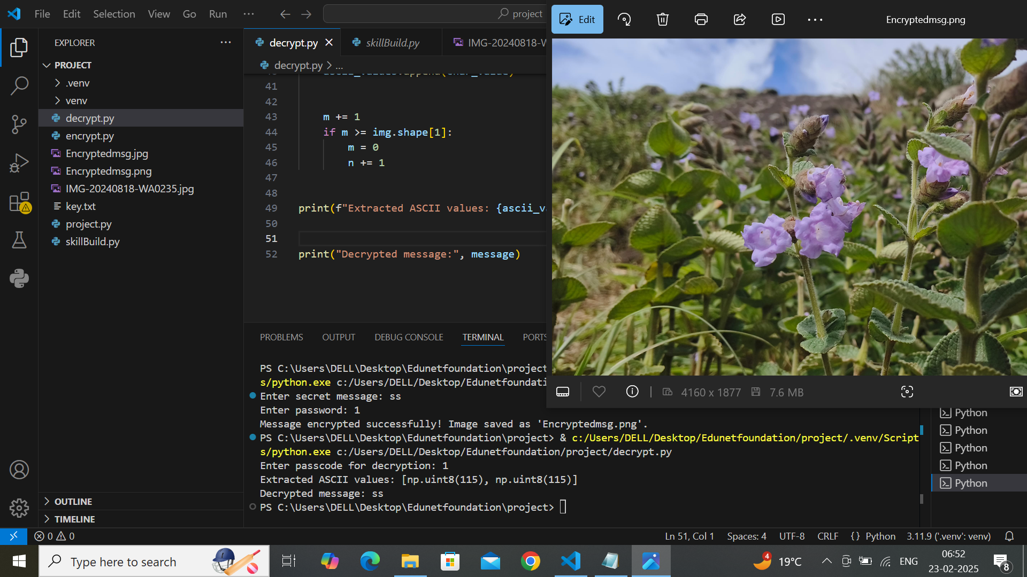
Results

Slide 8
Conclusion
Steganography plays a crucial role in enhancing data security for various end users, including government agencies, corporates, journalists, activists, software developers, and cybersecurity professionals. By embedding sensitive information within digital images, it ensures secure and undetectable communication, safeguarding critical data from unauthorized access and censorship. The ongoing development of robust steganographic methods continues to fortify information security across diverse sectors.

Slide 9
GitHub Link
https://github.com/vaipur/git_anakha

Slide 10
Future scope(optional)
Advanced Techniques: Development of more sophisticated algorithms that can embed and extract data with higher precision and security.
Integration with AI: Leveraging artificial intelligence and machine learning to enhance steganographic methods and detect steganalysis attempts.
Quantum Computing: Exploring the application of quantum cryptography to further secure steganographic communications.
Expanded Applications: Wider adoption in various fields such as digital forensics, watermarking, and secure communications for IoT devices.
Improved Steganalysis: Development of advanced detection mechanisms to identify hidden data and prevent malicious use.
As technology evolves, the capabilities and applications of steganography will continue to grow, providing robust solutions for data security and privacy.

Slide 11
THANK YOU

