Slide 1
Function Based Hand Gesture Detection Using Image
Group 12
Vairag Parikh (1153939)
Udhaya Kumar Rajendran (1134990)

Slide 2
Recap!!
Hand Gestures
Provides a way for humans to communicate with computers
Gesture sensing techniques include device based / vision based
Recognize gesture - analyse - interpret signal

Slide 3
Literature Survey

Slide 4
Hand gesture recognition system for real time mobile device monitoring
skin colour algorithm and face subtraction to detect hand area
contour extraction, convex hull detection, convexity defects extraction
SVM classifier
Elleuch, Hanene; Wali, Ali; Samet, Anis; Alimi, Adel M. (2015). [IEEE 2015 15th International Conference on Intelligent Systems Design and Applications (ISDA) - Marrakech, Morocco (2015.12.14-2015.12.16)] 2015 15th International Conference on Intelligent Systems Design and Applications (ISDA) - A static hand gesture recognition system for real time mobile device monitoring.

Slide 5
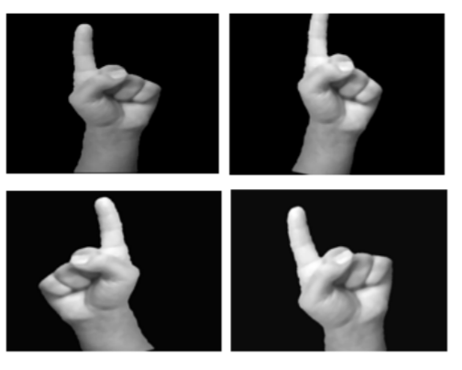
Static Hand Gesture Recognition with Data Augmentation
Data Augmentation
Resizing
Zooming
Shearing
Rotation
Islam, Md. Zahirul; Hossain, Mohammad Shahadat; ul Islam, Raihan; Andersson, Karl (2019). [IEEE 2019 Joint 8th International Conference on Informatics, Electronics & Vision (ICIEV) and 2019 3rd International Conference on Imaging, Vision & Pattern Recognition (icIVPR) - Spokane, WA, USA (2019.5.30-2019.6.2)] 2019 Joint 8th International Conference on Informatics, Electronics & Vision (ICIEV) and 2019 3rd International Conference on Imaging, Vision & Pattern Recognition (icIVPR) - Static Hand Gesture Recognition using Convolutional Neural Network with Data Augmentation..

Slide 6
Methodology
Gather Data
(Input Device)
Pre-processing
Gesture Detection
(Testing Phase)
Classification

Slide 7
Tools
Programming Language - Python
IDE & Graphical Processing Unit - Google Colab

Slide 8
Some Applications
Communication: Hand gesture recognition enables better communication with sign languages
Automobile: Drivers using hand gestures to control the infotainment system
Mobile Devices: Useful to have shortcuts with hand gestures to operate mobile devices

Slide 9
THANK YOU

