Slide 1
Function Based Hand Gesture Detection Using Image
Vairag Parikh–1153939
Udhaya Kumar Rajendran–1134990

Slide 2
What is Gesture Recognition
It is sensor-based technique that detects and understands hand movements as commands.
However, Gesture recognition isn't just for human hand motions; it can also be used to distinguish everything from head nods to various walking patterns.

Slide 3
Category of Gesture Detection
The following application domain classifications can be used to classify gestures:-
Pre-emptive Gestures
Function Associated Gestures
Context Sensitive Gestures
Global Shortcut Gestures
Natural Dialogue Gestures

Slide 4
Gesture Sensing Technologies
Contact-Type
Touch Pads
Contact Less
Device Based
Vision Based
Model Based
Image Based

Slide 5
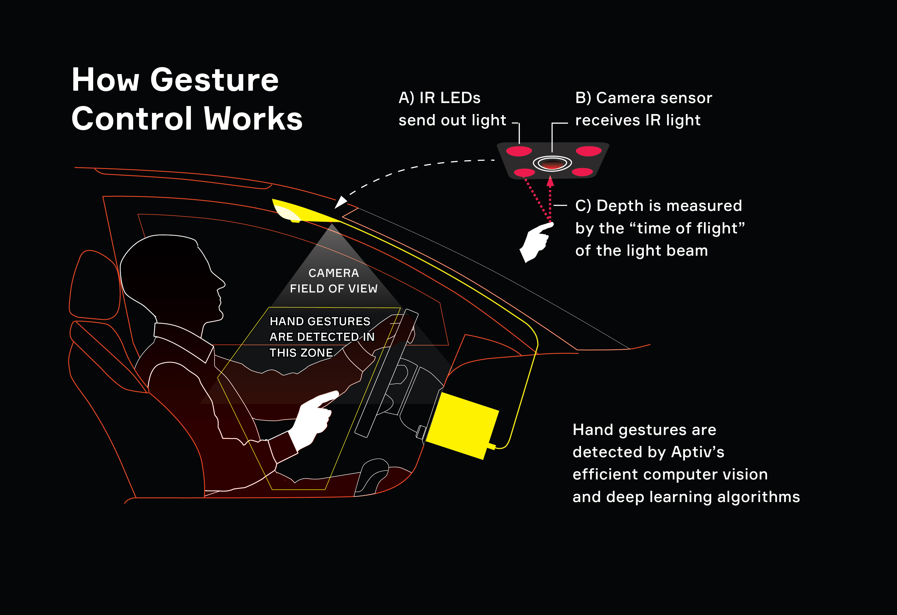
How it Works
Recognize the Gesture
Analyze and process the motion
Interpret signal

Slide 6
Bigger Picture !
Automobile : Drivers don't have to take their eyes off the road as much as they would if they were using touch controls.
Security : Recognize the appearance of hands carrying guns and issue an alert in response.
Public Health : Reducing the amount of germs that are transmitted.

Slide 7
Thank You

