Slide 1


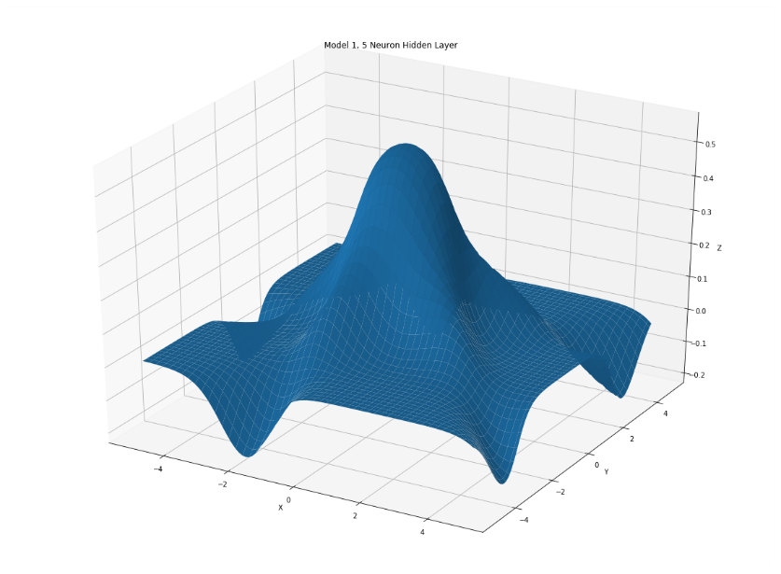
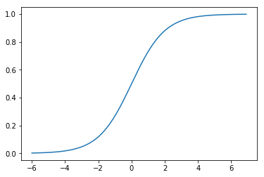
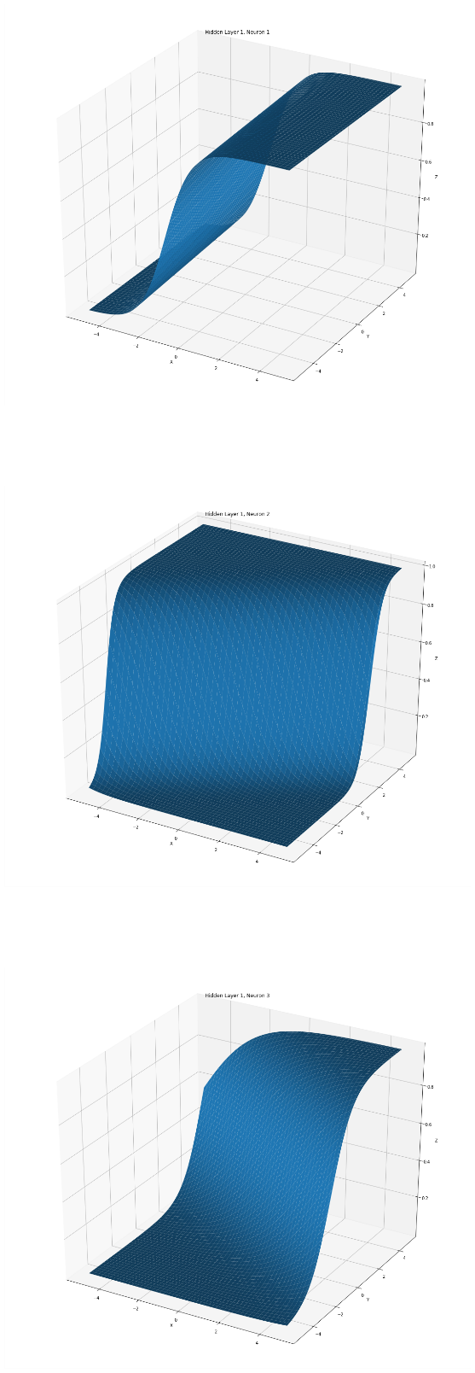
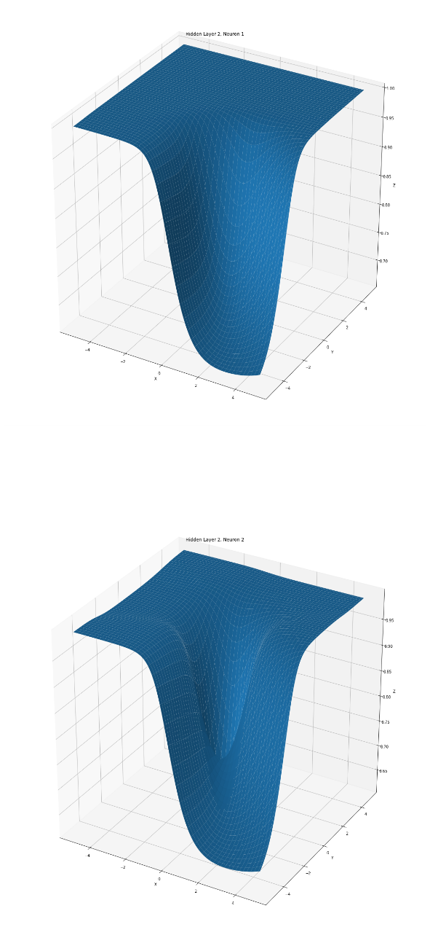
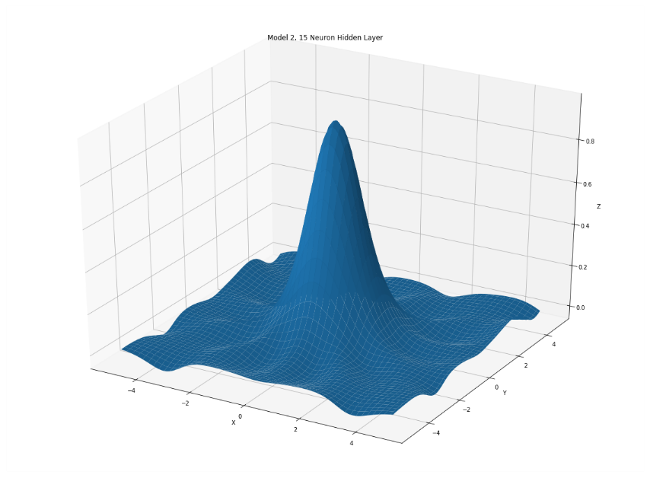
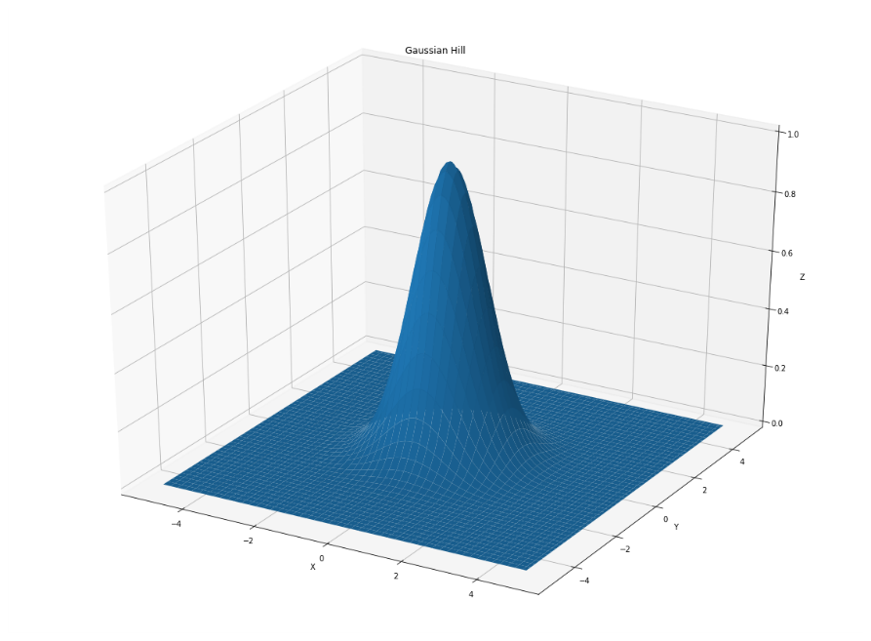
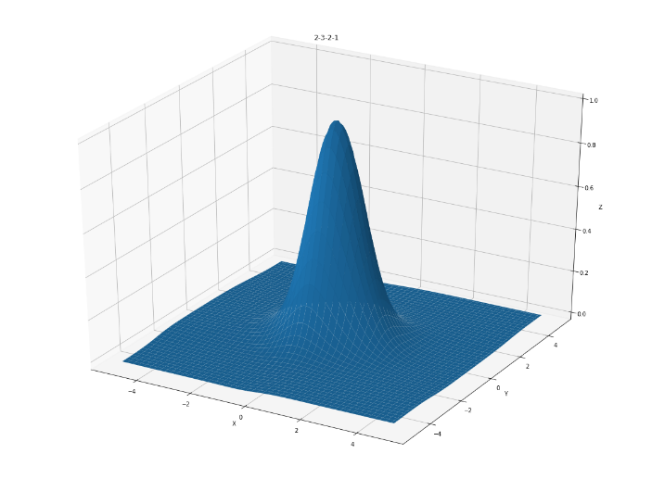
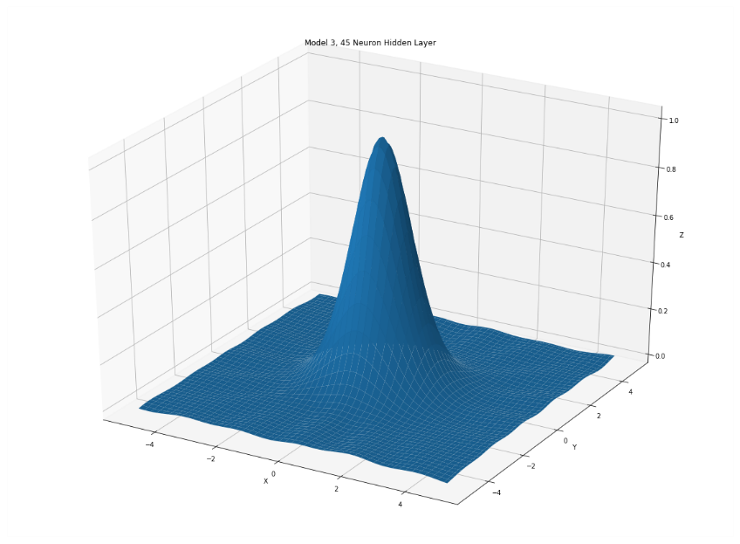
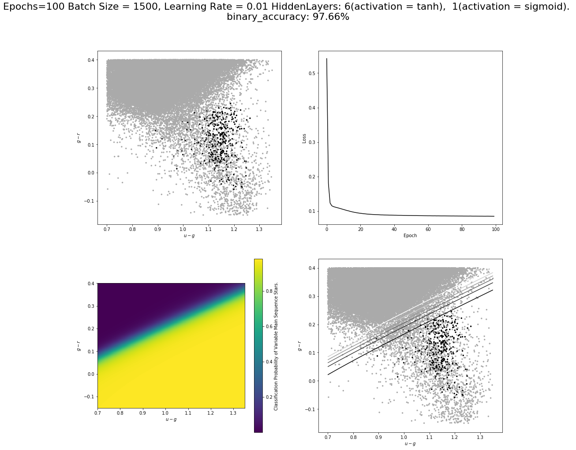
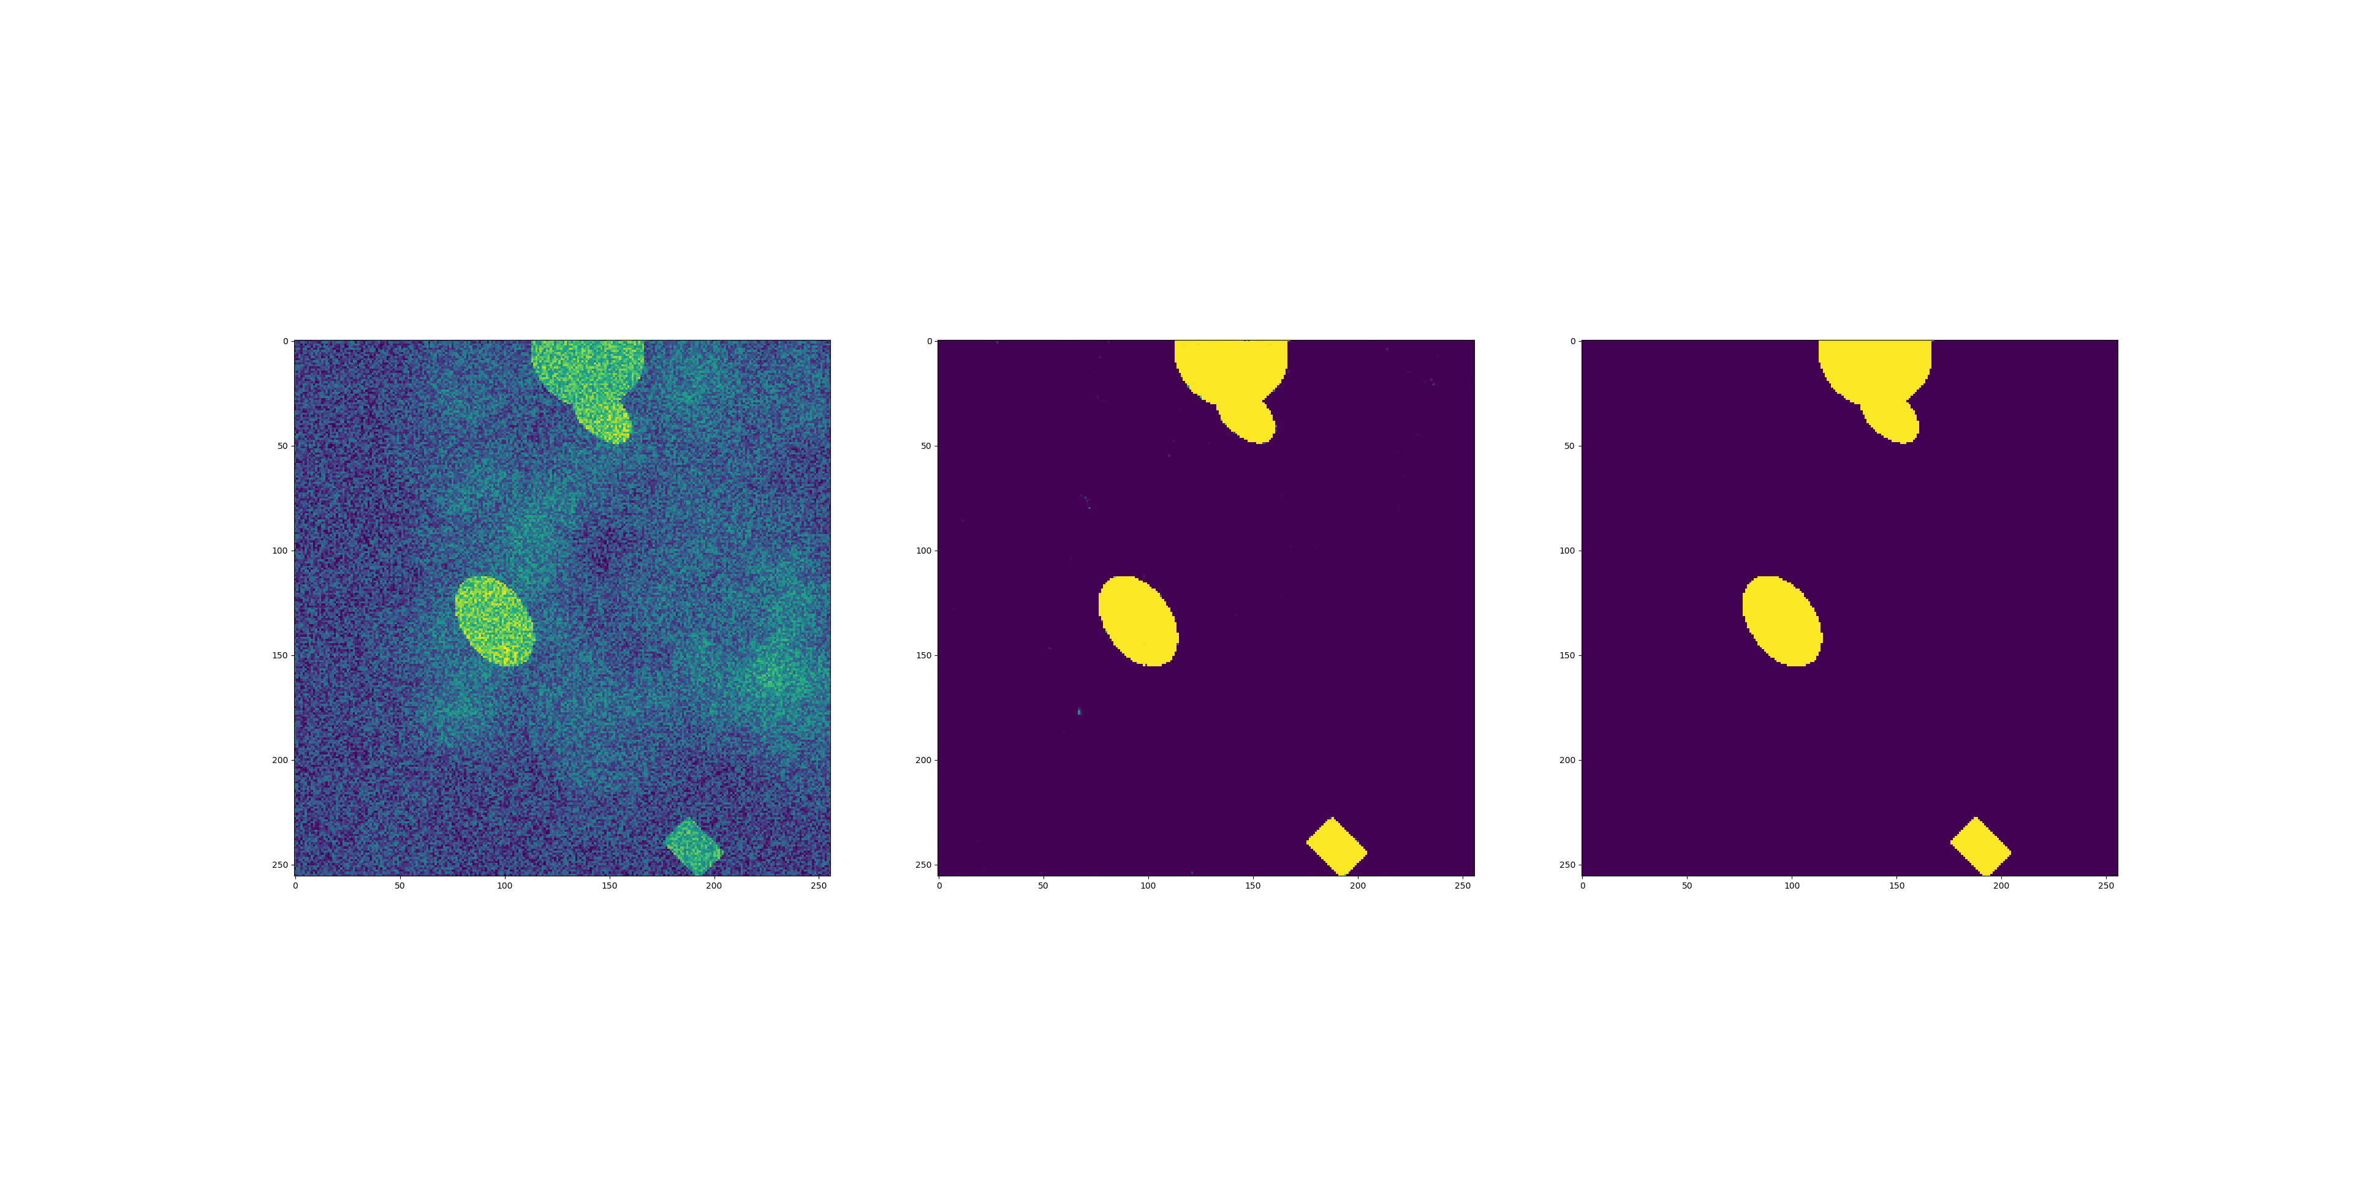
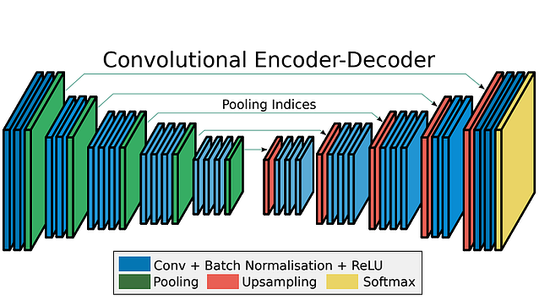
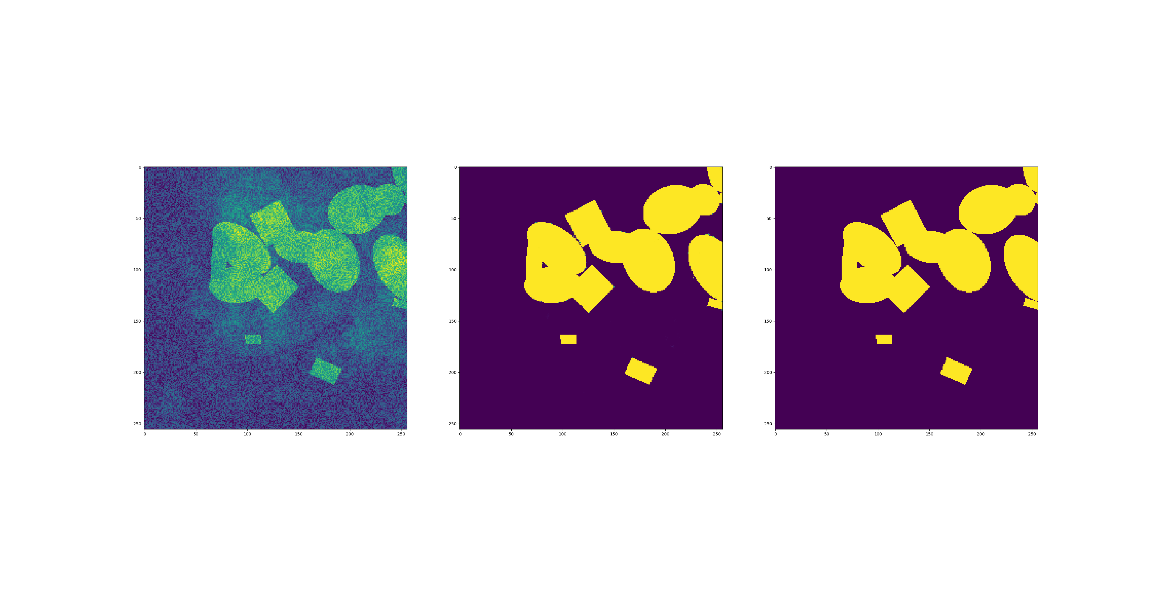













Exploration of Neural Networks for Scientific Data Analysis
Machine Learning Applications for not X-Ray and Neutron Computed Tomography
Image segmentation using machine learning and our module sliceopy Image segmentation using machine learning and our module sliceopy Image segmentation using machine learning and our module sliceopy Image segmentation using machine learning and our module sliceopy Image segmentation using machine
Finding rules of thumb
Figures depicting the learning progress of each neuron
Inputs
$$w_{1}$$
Activation Function
Hidden layer 1
Hidden layer 2
x
$$x_{1}$$
$$\sum_{j=1}^{n}{x_{j}w_{ij}}$$
Sum
Output
y
$$x_{2}$$
$$Z_{i}$$
Output layer
$$w_{2}$$
Inputs
Schematic of a single neuron, where a weighted sum of inputs are fed into an activation function. This performs a non-linear transformation, the output of which signifies the relevance of the weighted inputs.
x
$$x_{1}$$
Input
Hidden layer
y
$$x_{2}$$
$$x_{1}$$
Output
$$y$$
$$x$$
$$x_{2}$$
$$z$$
SliceOPy
AstroML
Building a neural network to classify variable and non-variable stars.
Above, colour magnitudes of main sequence stars collected from the Sloane Digital Sky Survey (SDSS) has been plotted using the AstroML module. We aimed to use a neural network to separate variable RR Lyrae stars from non-variable main sequence stars. We trained the model on a large subset of the labelled stars in the dataset
Image segmentation
Input
output
Target output
Here’s my number, So call me maybe. https://www.cyberailab.com/home/segnet-an-image-segmentation-neural-network

