Slide 1
We’ve seen how a single neuron can act as a linear classifer. And how we can build up a network of neurons. But what How do

Slide 2
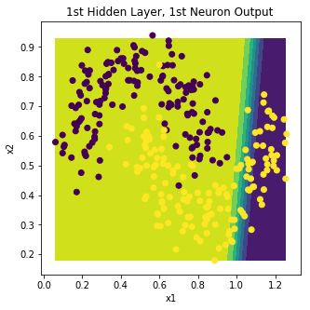
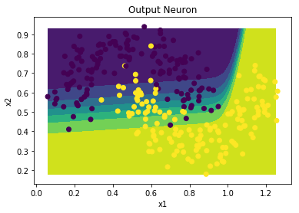
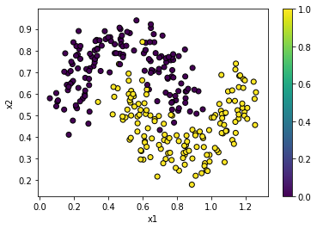
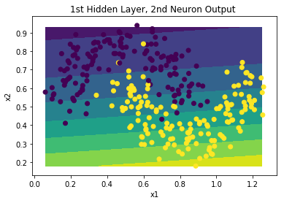
x
y

Slide 3
