Slide 1
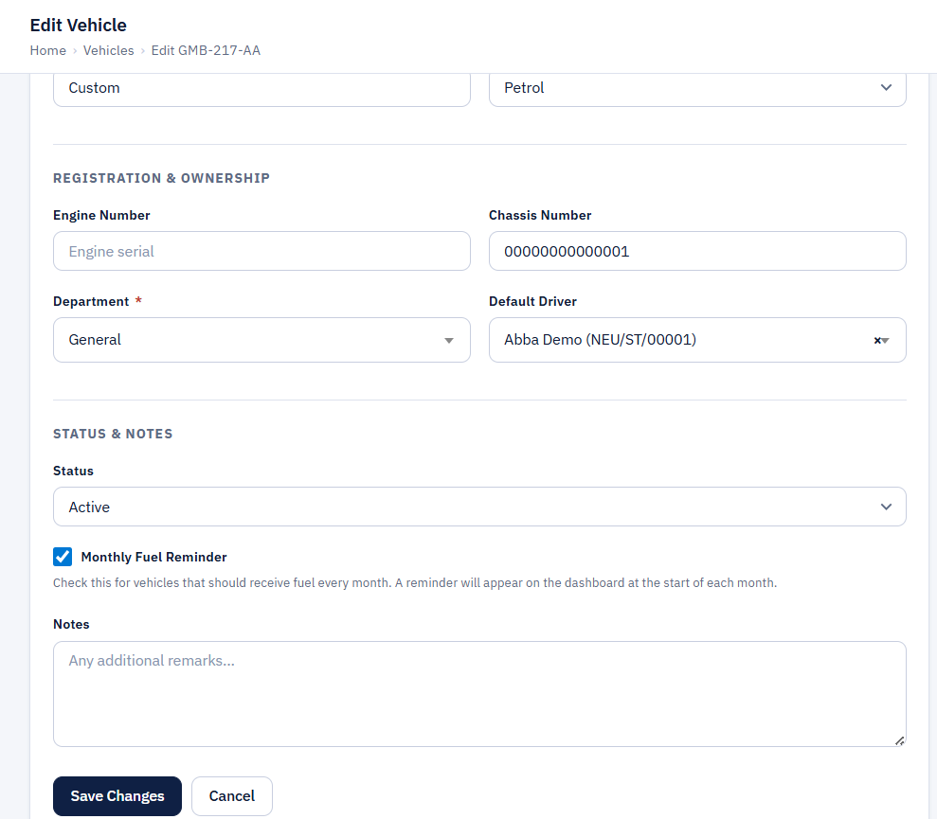
Monthly Fuel Reminders 1/3
When adding vehicles, set "Monthly Fuel Reminder" to flag it.
Dashboard shows a reminder strip at the top of each month listing all flagged vehicles not yet fuelled

Slide 2
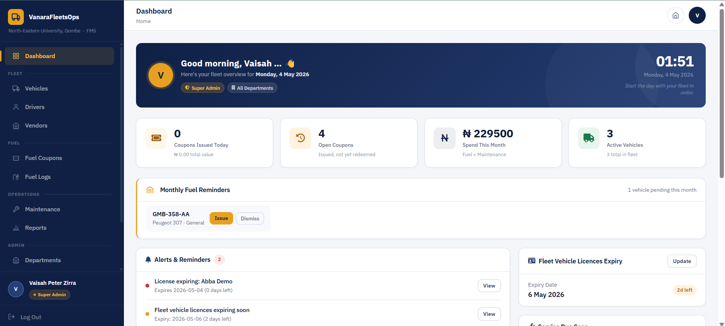
Monthly Fuel Reminders 2/3
Each vehicle in the strip has two buttons: Issue (goes straight to issue coupon form pre-filled with that vehicle) and Dismiss (confirmation popup, then hides that vehicle's reminder for the rest of the month)

Slide 3
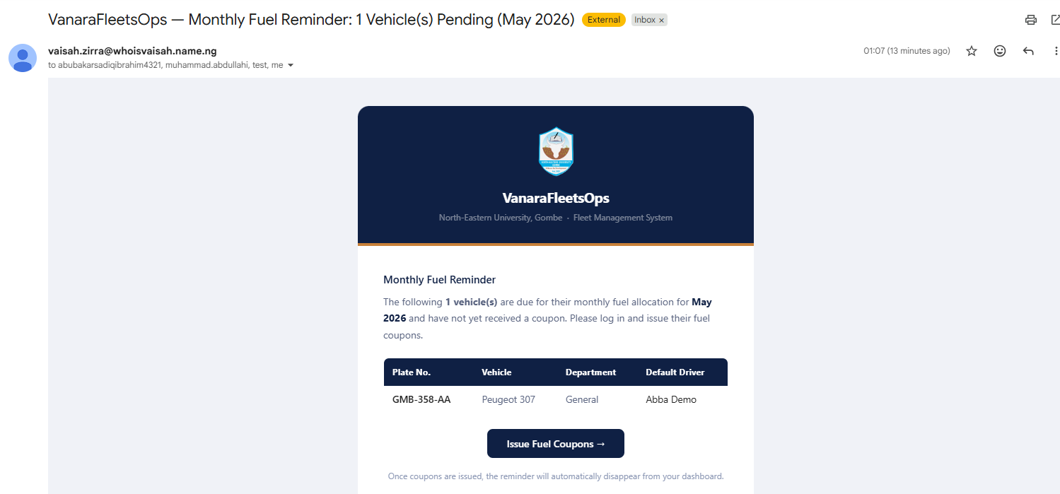
Monthly Fuel Reminders 3/3
Email reminder for monthly fuel.

Slide 4
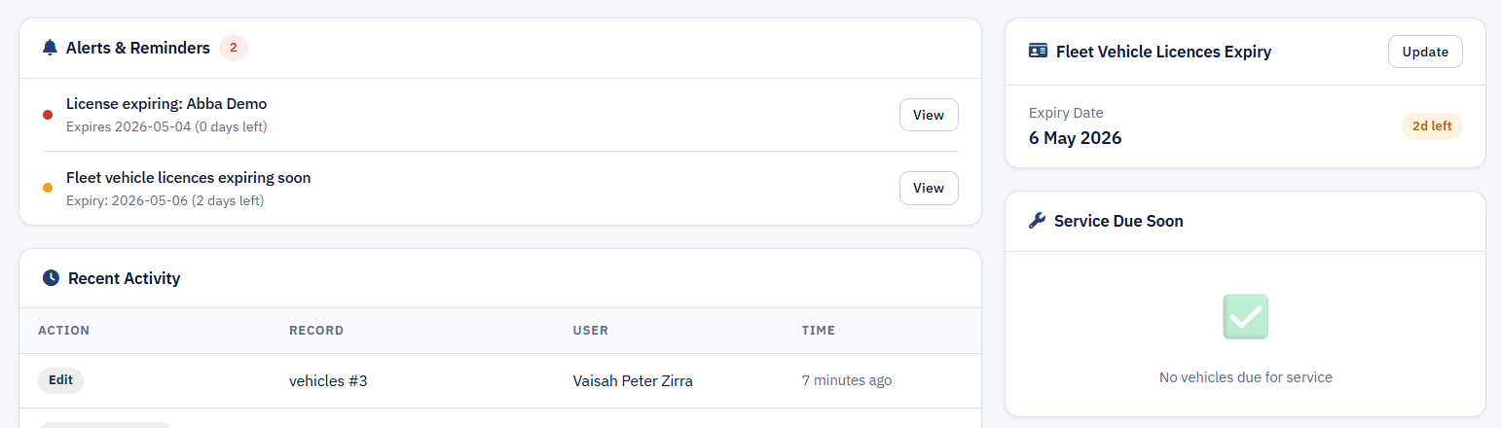
Vehicle Licenses Expiry Reminder 1/2
Since almost all vehicles are renewed at the same time, one Vehicle Licence Expiry record covers the whole fleet.
Dashboard right column has a "Fleet Vehicle Licences" card showing expiry date and status badge
Alert triggers at 60 days before expiry (warning) and on expiry (danger)

Slide 5
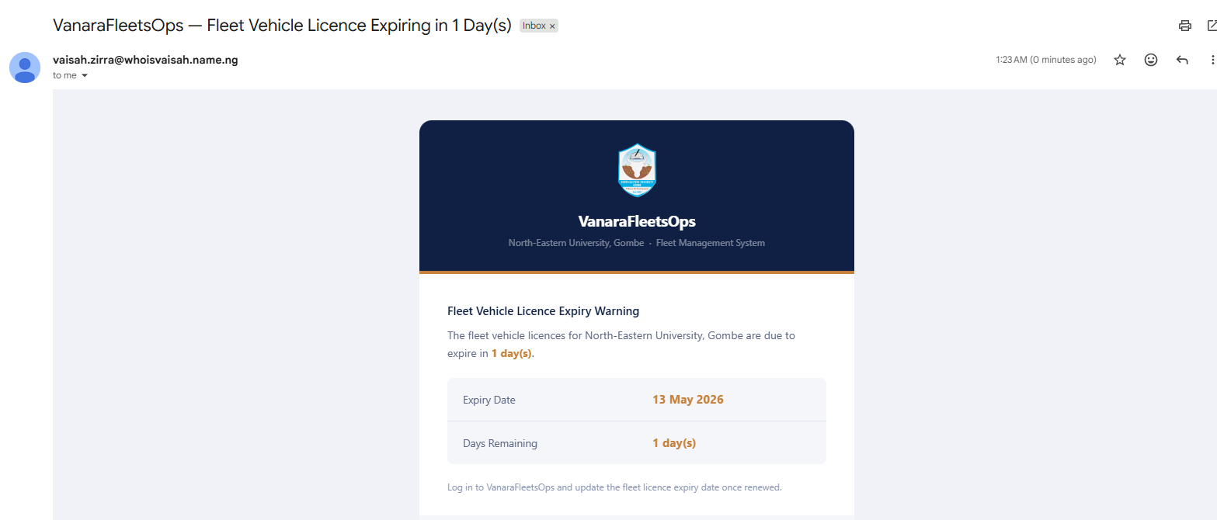
Vehicle Licenses Expiry Reminder 2/2
Email reminder for expiring Fleet Licence

