Slide 1

VanaraFleetsOps
NEU Fleet Management System (FMS)
Fuel Coupon Issuance & Tracking
Vehicle & Driver Registry
Maintenance Records
Management Reports — PDF & Excel
Role-Based Access Control
© 2026 North-Eastern University, Gombe · Fleet Management System

Slide 2
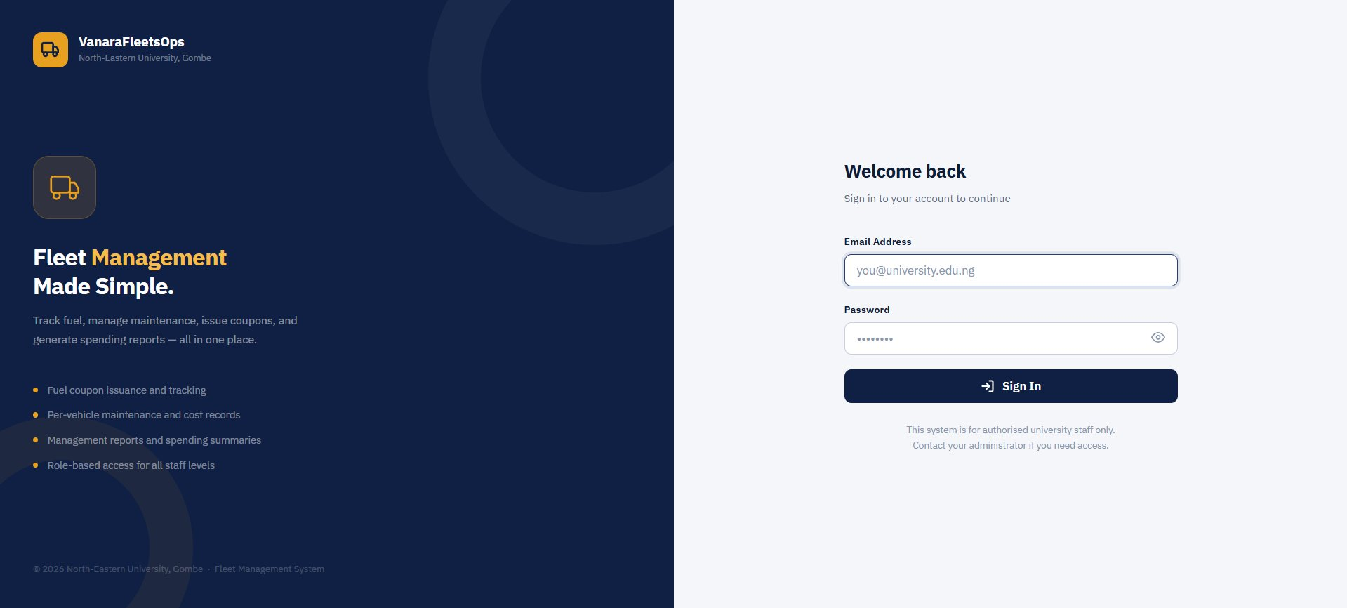
Login Page
• University email authentication
• Role assigned by admin
• Password protected
• Authorised staff only
Secure, email-based access for university staff only

Slide 3
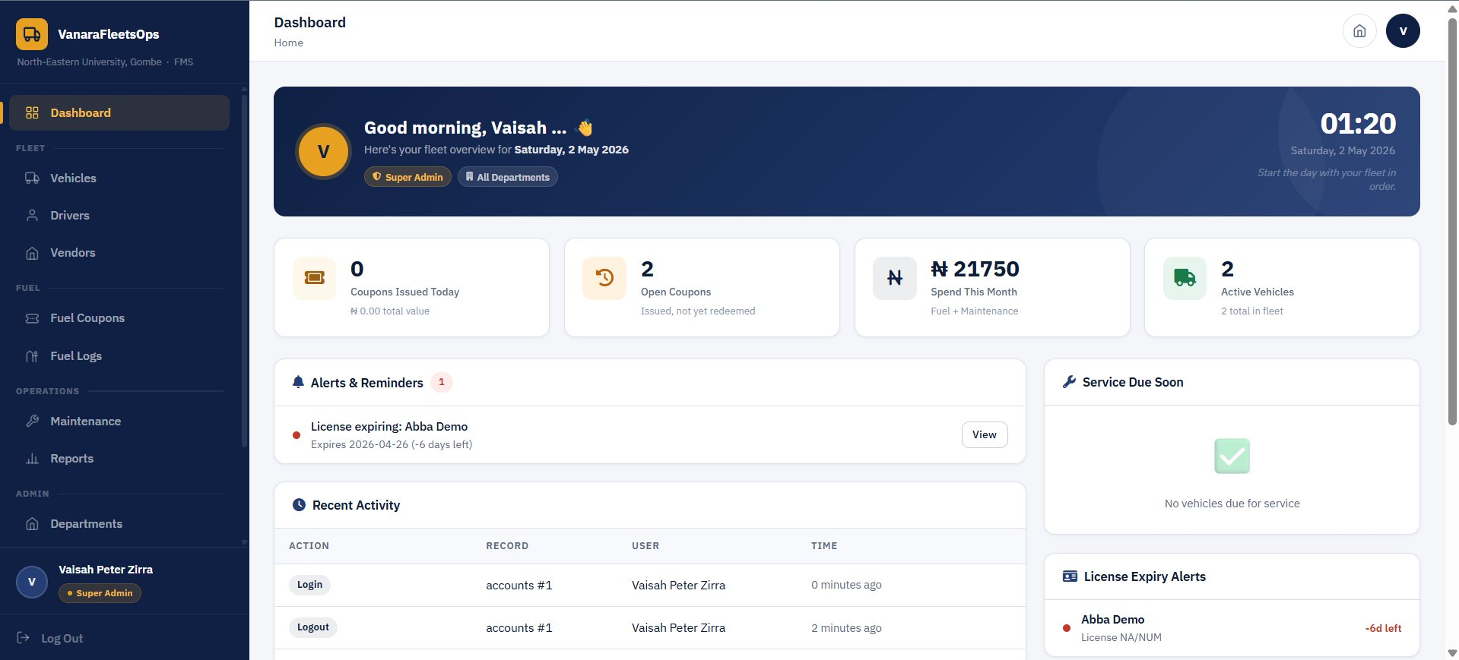
Dashboard
Fleet overview — stats, alerts, and recent activity at a glance

Slide 4
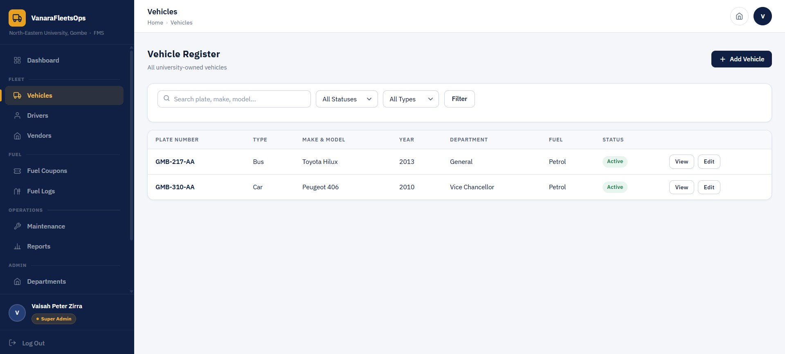
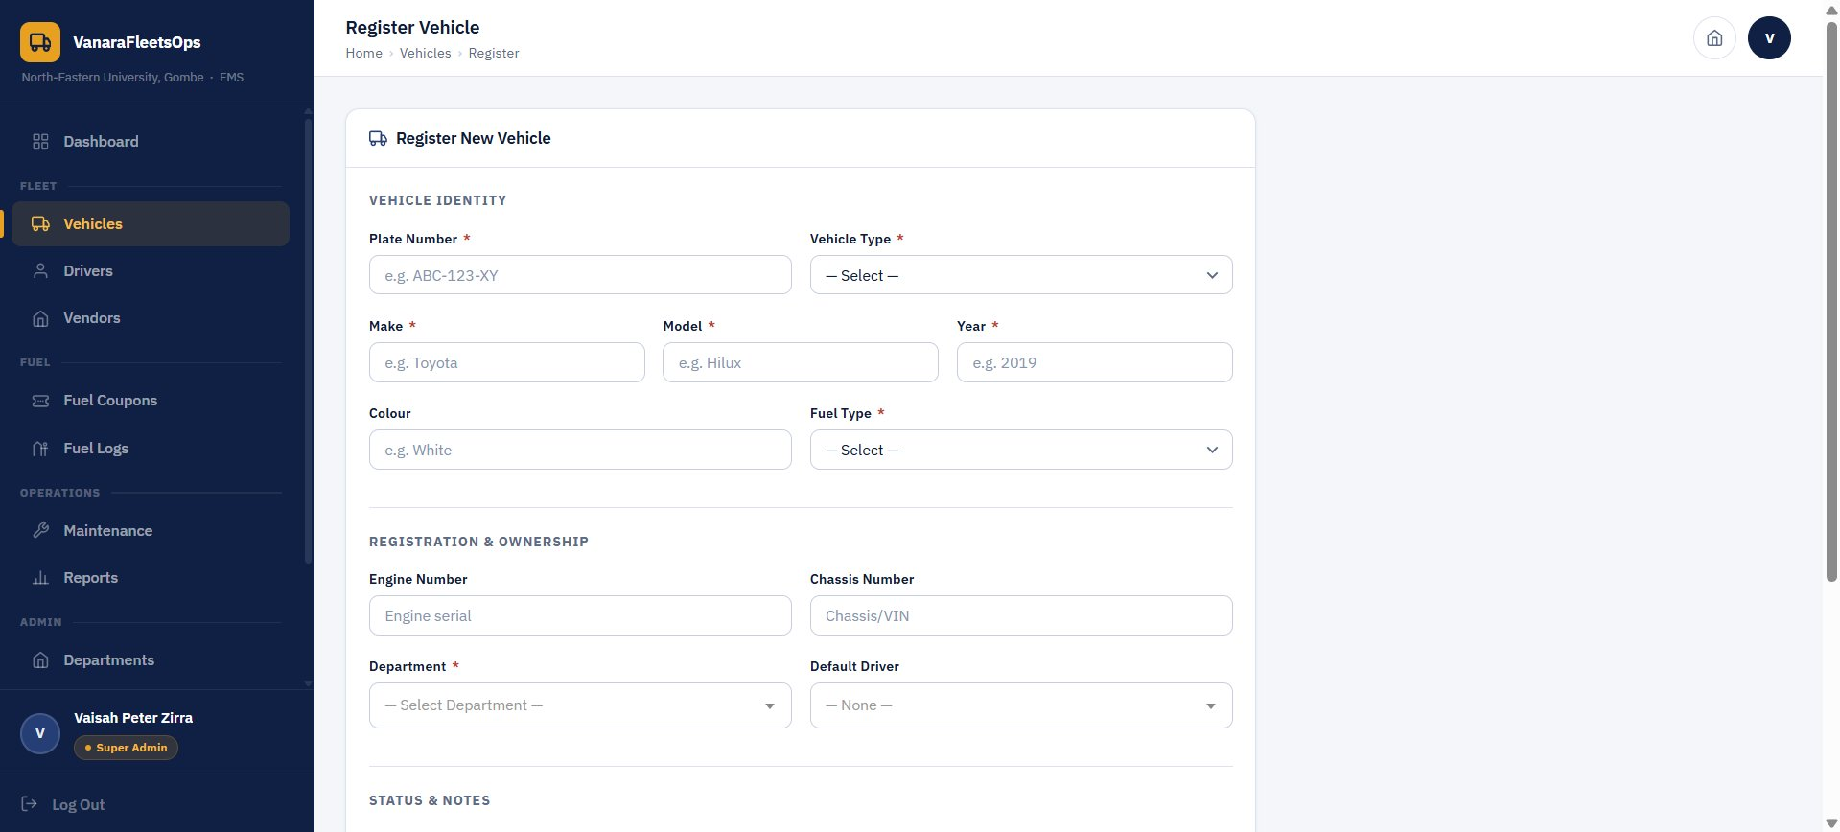
Vehicle Management
Register and track all university-owned vehicles
Vehicle Register
Register New Vehicle Form
Captured per Vehicle:
• Plate Number · Vehicle Type (Bus, Car, Truck…)
• Make & Model · Year · Colour
• Engine & Chassis Number
• Department · Default Driver
• Fuel Type (Petrol/Diesel) · Status (Active/Inactive)

Slide 5

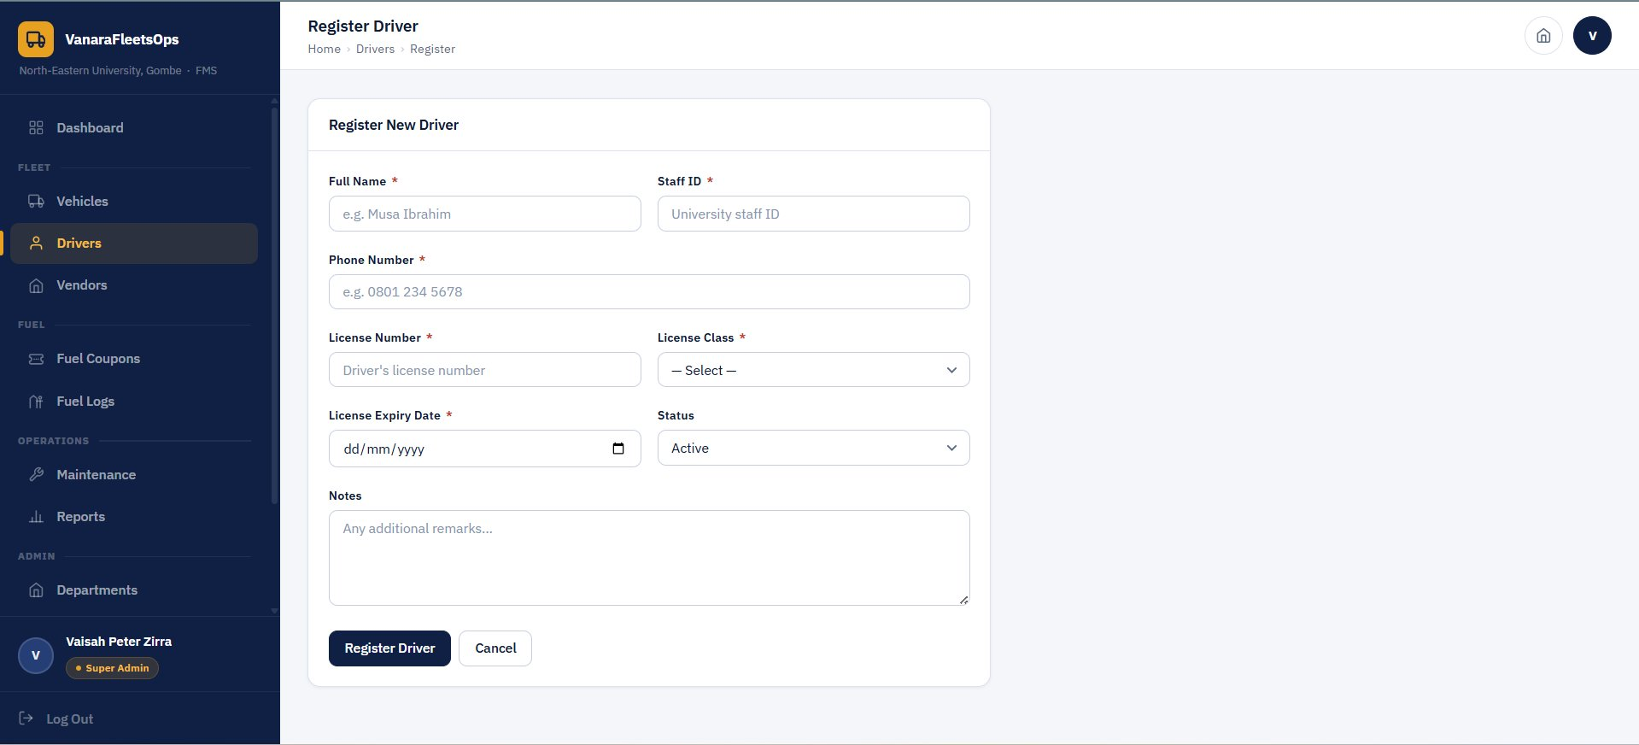
Driver Management
Track all registered vehicle operators and their license status
Driver Register
Register New Driver Form
Captured per Driver:
• Full Name · Staff ID · Phone Number
• License Number · License Class (A, B, C…)
• License Expiry Date — expired licenses flagged in red on the dashboard
• Status (Active / Inactive) · Notes

Slide 6
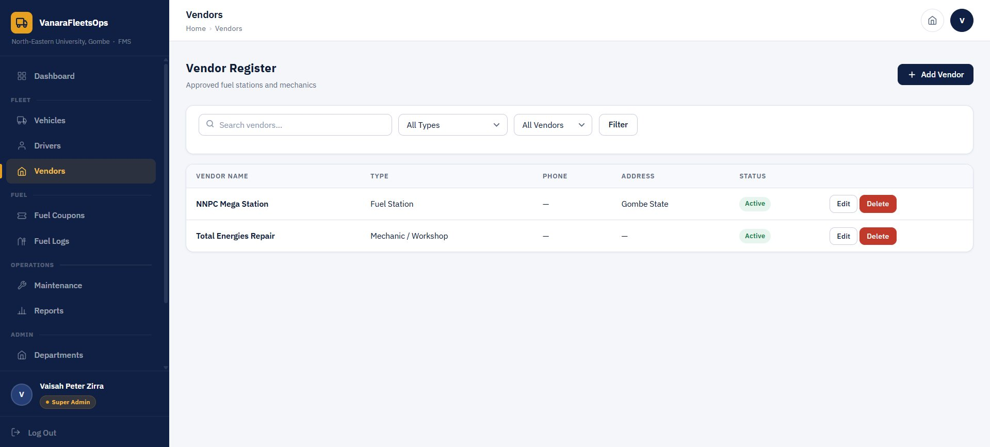
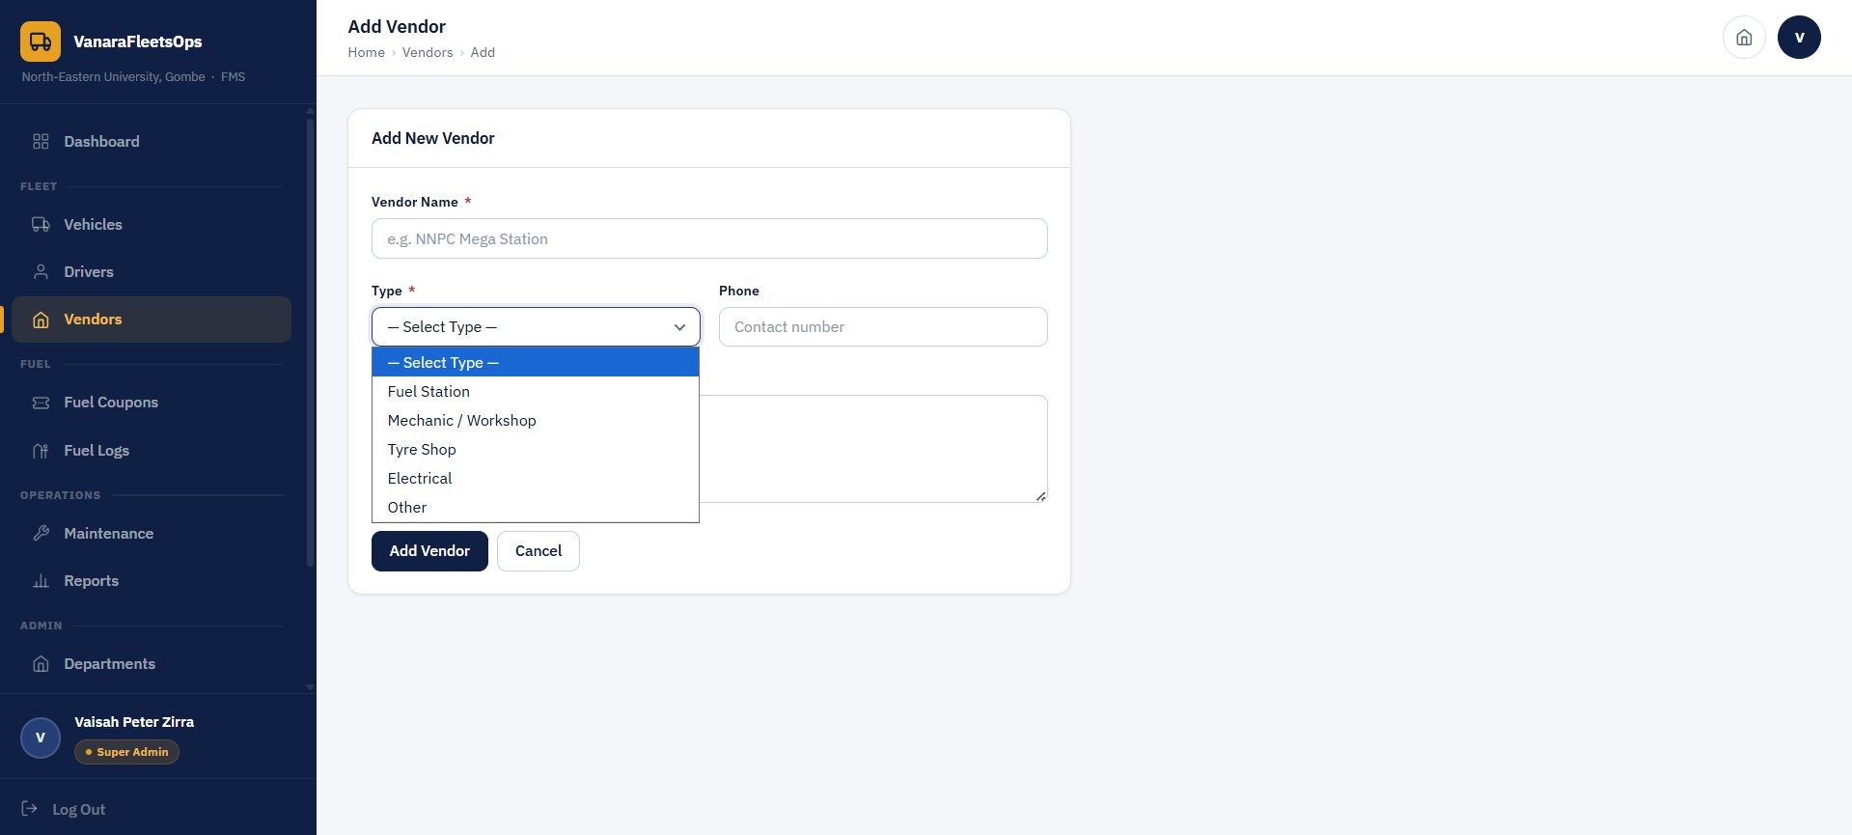
Vendor Management
Approved fuel stations and service providers
Vendor Register
Add New Vendor Form
Vendor Types:
• Fuel Station — used for fuel coupon redemption (e.g. NNPC Mega Station)
• Mechanic / Workshop — for maintenance work (e.g. Total Energies Repair)
• Tyre Shop · Electrical · Other

Slide 7
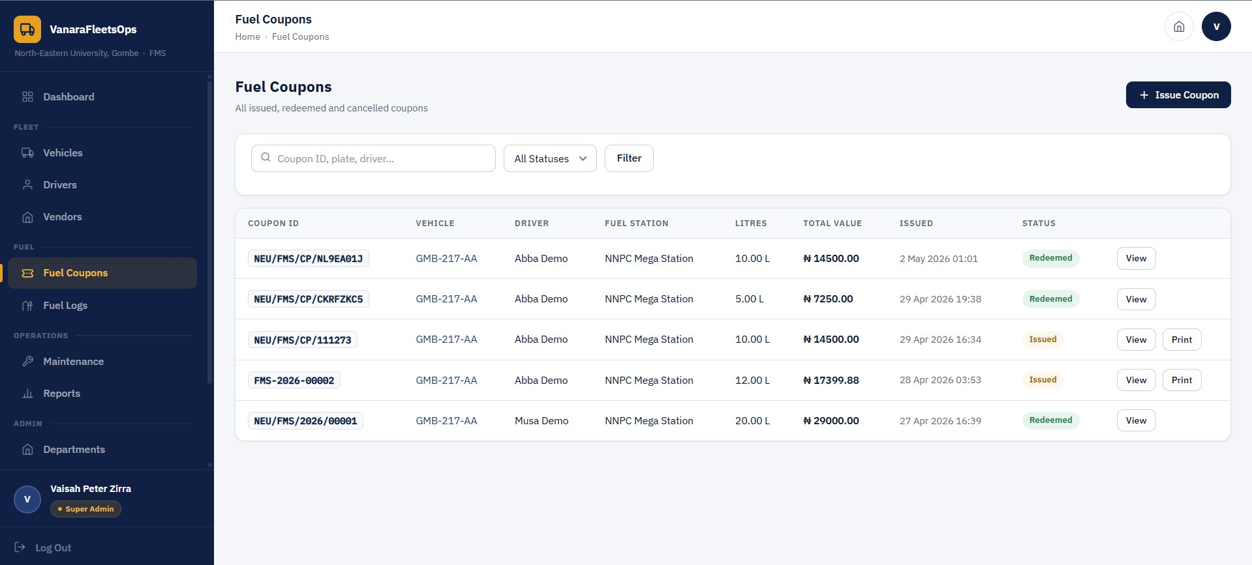
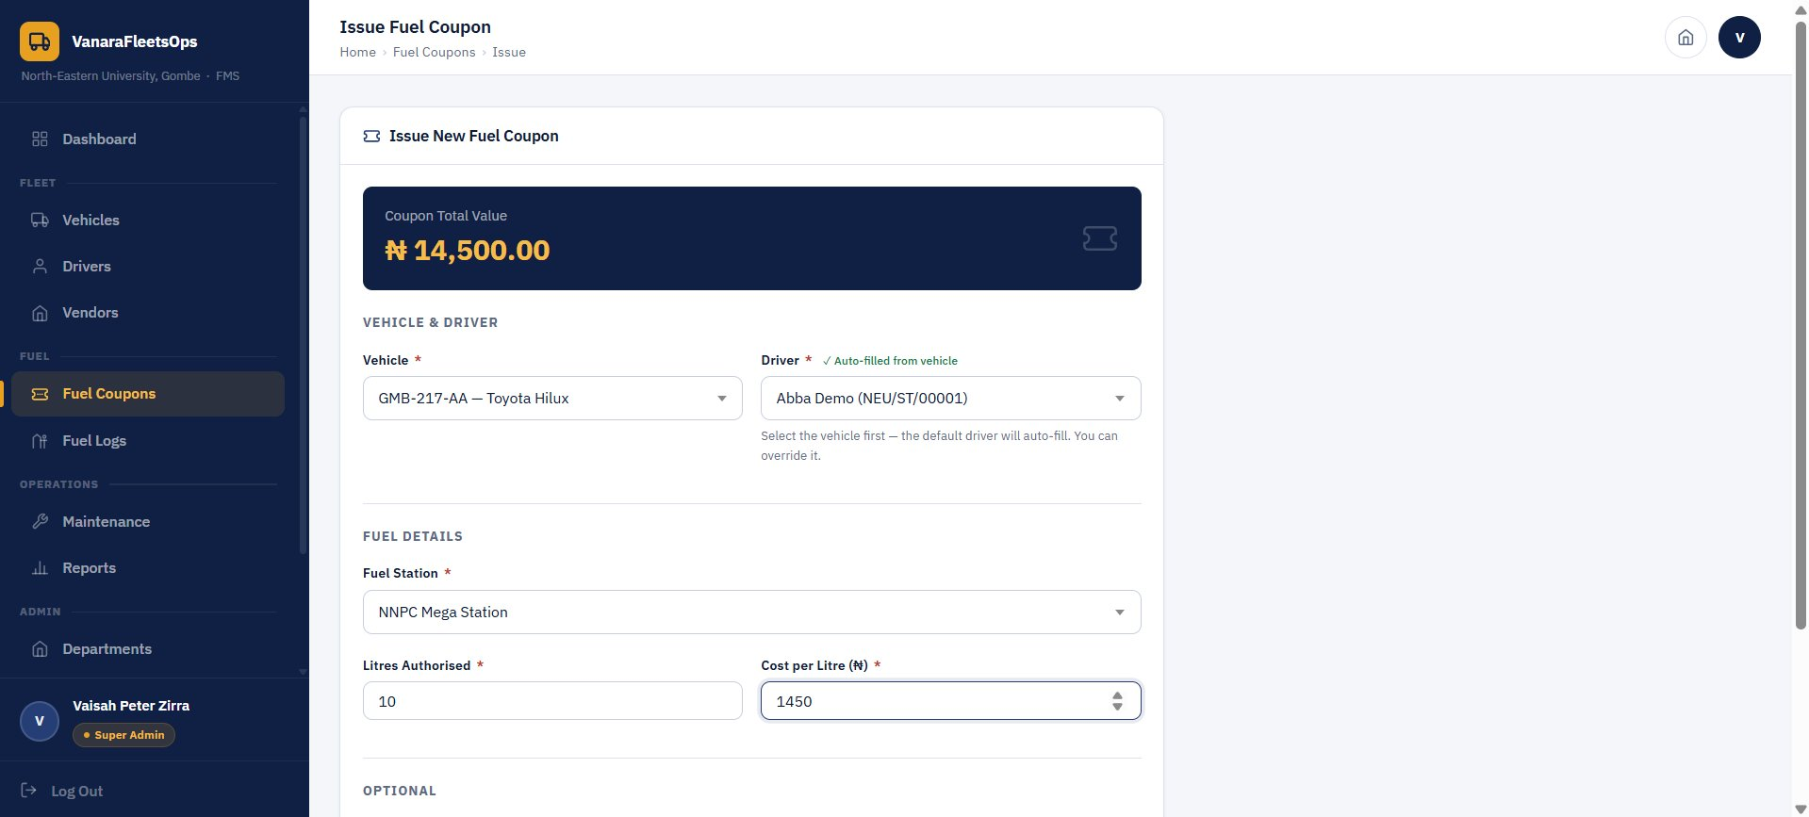
Fuel Coupons
Issue and manage fuel coupons for all vehicles
Fuel Coupons List
Issue New Fuel Coupon Form
How it works:
• Select vehicle (driver auto-fills from vehicle's default driver), fuel station, litres, and price per litre
• Total coupon value is auto-calculated — e.g. 10 L × ₦1,450 = ₦14,500
• Coupon gets a unique ID (e.g. NEU/FMS/CP/NL9EA01J) and a verification code
• Status cycles: Issued → Redeemed (or Cancelled)

Slide 8
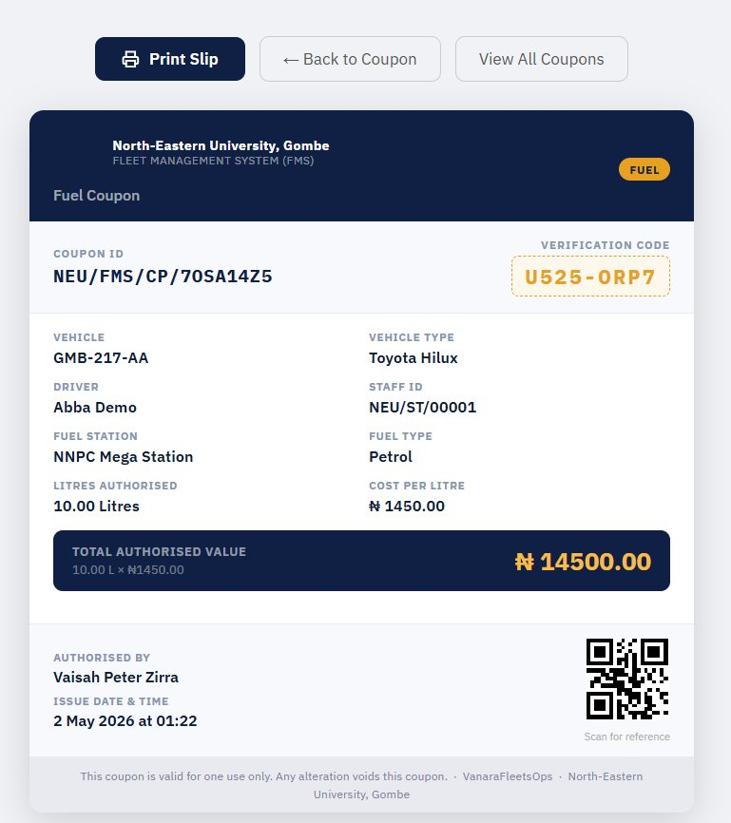
Fuel Coupon Slip
Printable coupon with verification code and QR code
Unique Coupon ID
Verification Code
Vehicle & Driver details
Fuel Station & Fuel Type
Litres & Cost per Litre
Total Authorised Value
Authorised by & Date
QR Code for reference
"This coupon is valid for one use only. Any alteration voids this coupon."

Slide 9
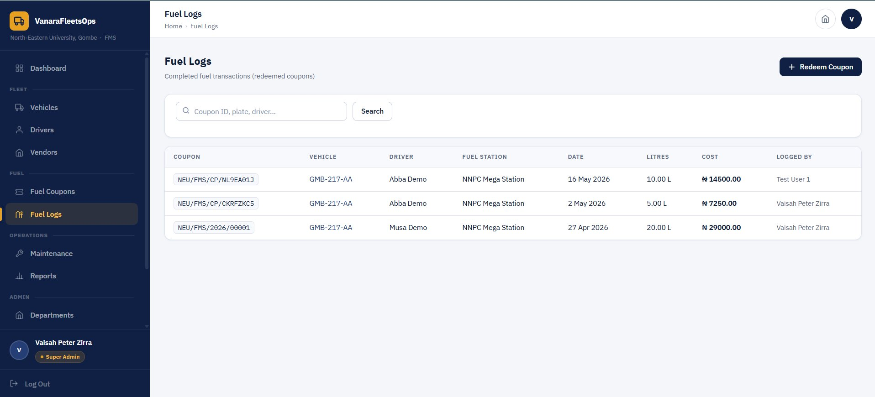
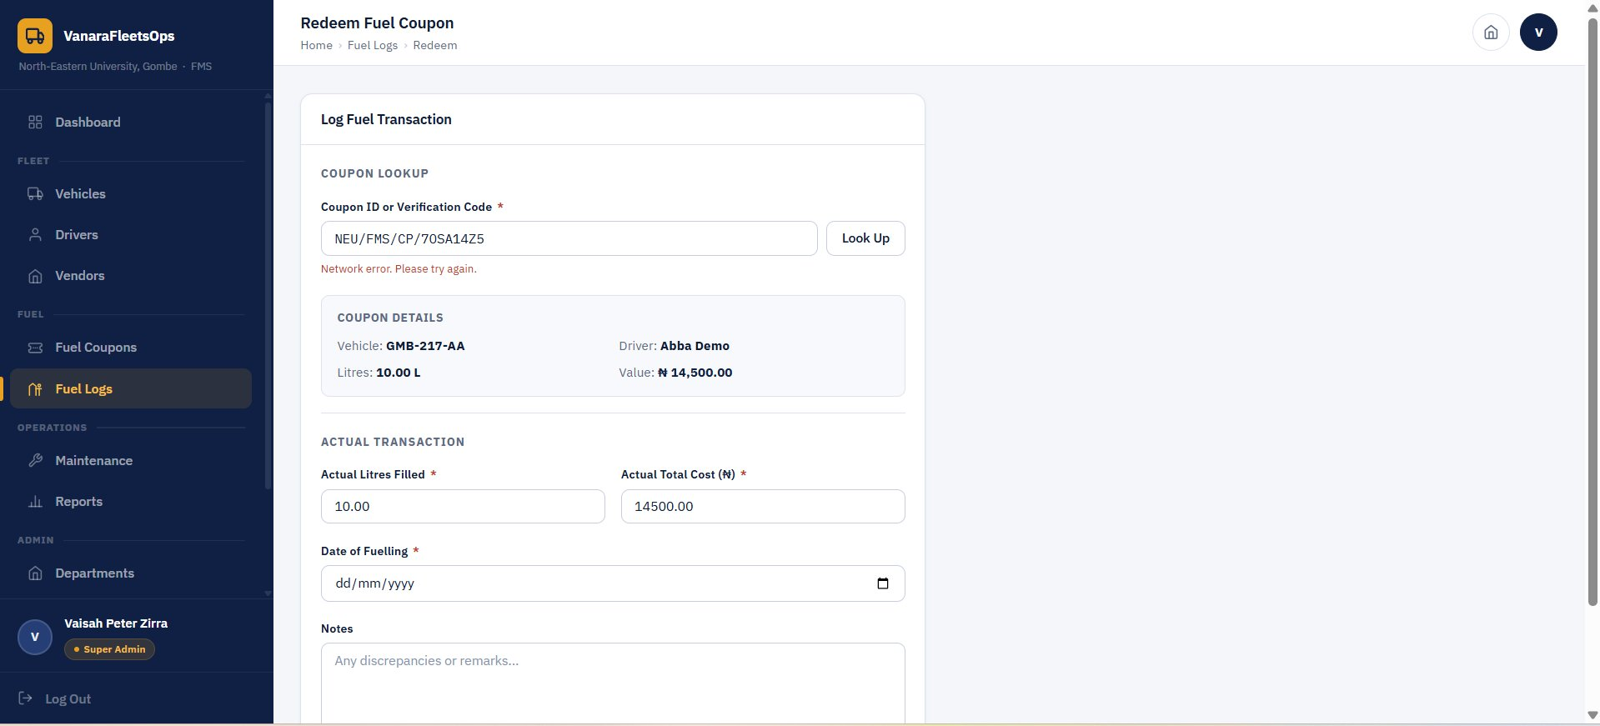
Fuel Logs & Coupon Redemption
Completed fuel transactions — redeemed coupons create a permanent log
Fuel Logs — All Redeemed Transactions
Redeem Coupon — Log Fuel Transaction
Redemption Process:
1. Accountant enters coupon ID or verification code — system fetches coupon details automatically
2. Confirms actual litres filled and actual total cost (may differ from authorised amount)
3. Enters date of fuelling and any notes or discrepancies
4. On submit: coupon status changes to Redeemed and a fuel log entry is created permanently

Slide 10
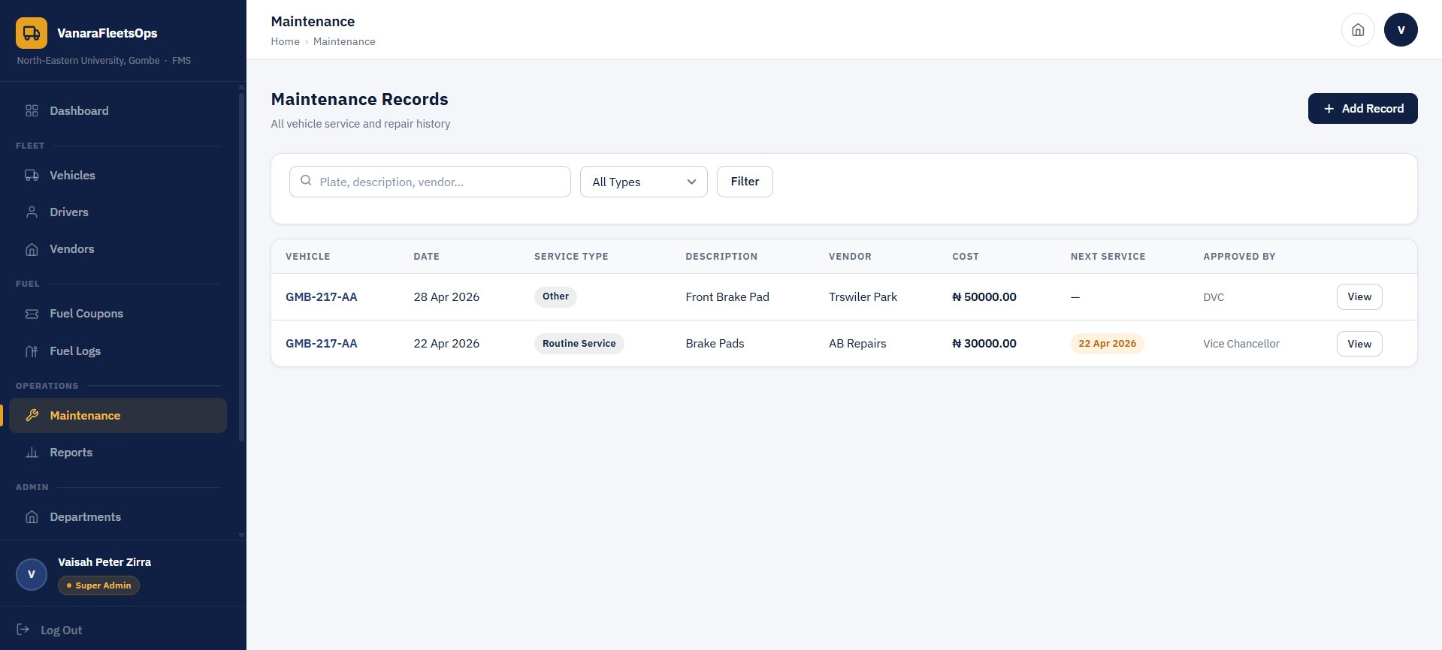
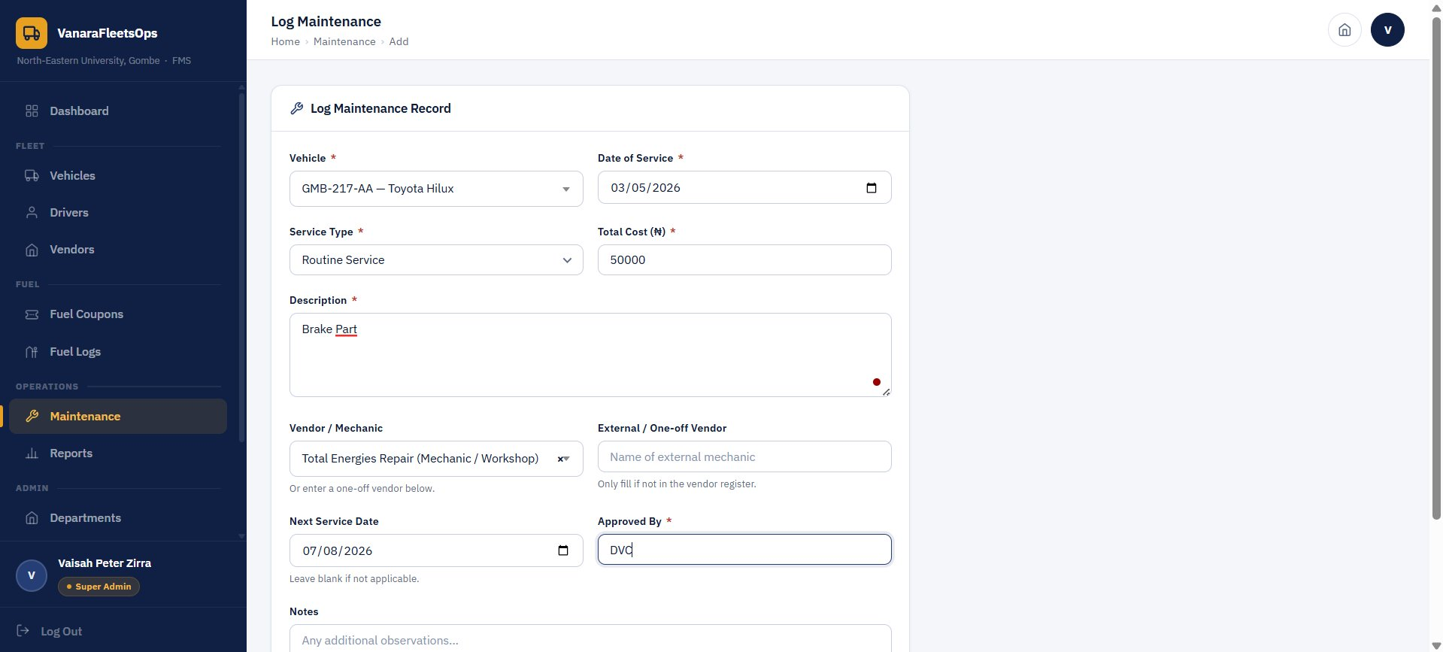
Maintenance Records
Full service and repair history per vehicle
Maintenance Records List
Log Maintenance Record Form
Captured per Maintenance Record:
• Vehicle · Date of Service · Service Type (Routine, Repair, Emergency, Other)
• Description of work done · Total Cost (₦)
• Vendor / Mechanic (from register) or one-off external vendor name
• Next Service Date (highlighted in amber when overdue) · Approved By · Notes

Slide 11
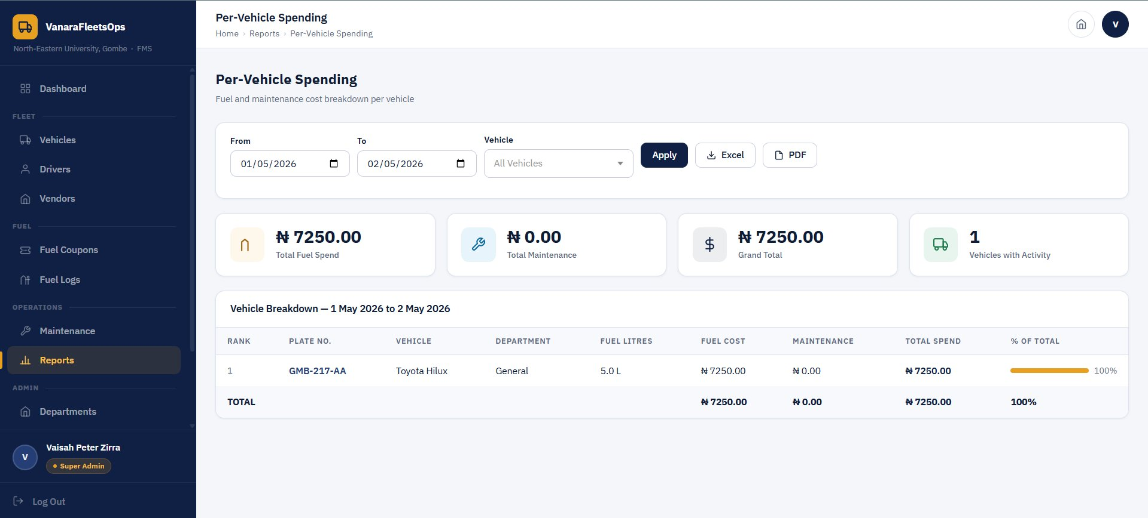
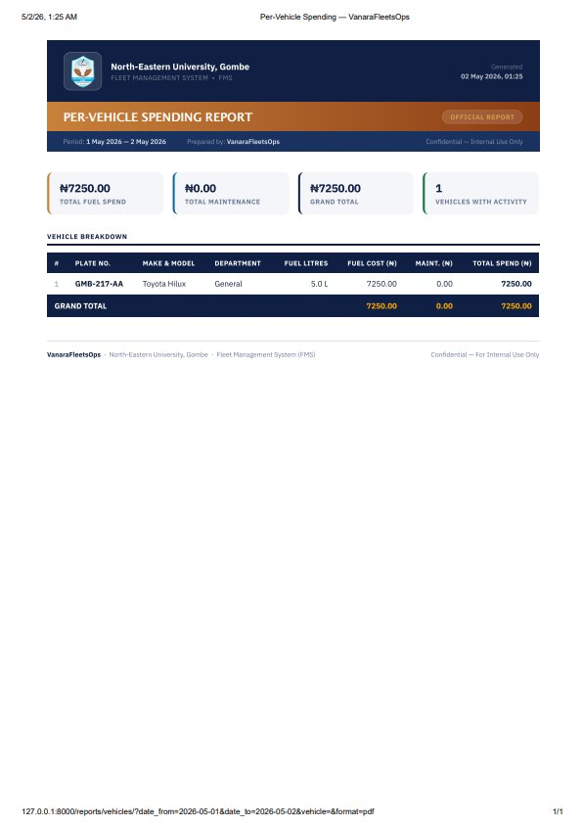
Reports & Analytics
Per-vehicle spending reports exportable to PDF and Excel
Per-Vehicle Spending Report (Web View)
Official PDF Export
Report Features:
• Filter by date range and specific vehicle (or all vehicles)
• Summary stats: Total Fuel Spend · Total Maintenance · Grand Total · Vehicles with Activity
• Vehicle breakdown table: Rank · Plate · Make & Model · Department · Fuel Litres · Fuel Cost · Maintenance · Total · % of Total
• Export to Excel (.xlsx) or PDF — PDF is branded, official-format, marked Confidential

Slide 12
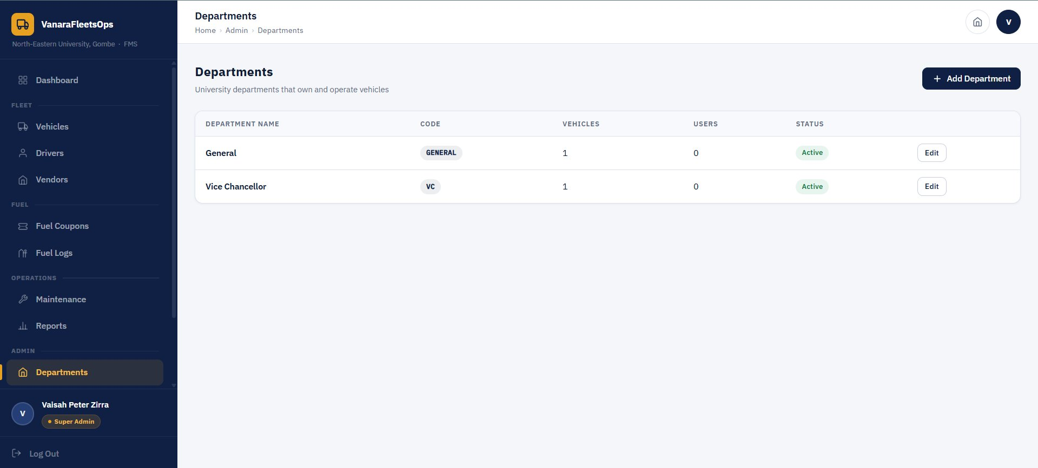
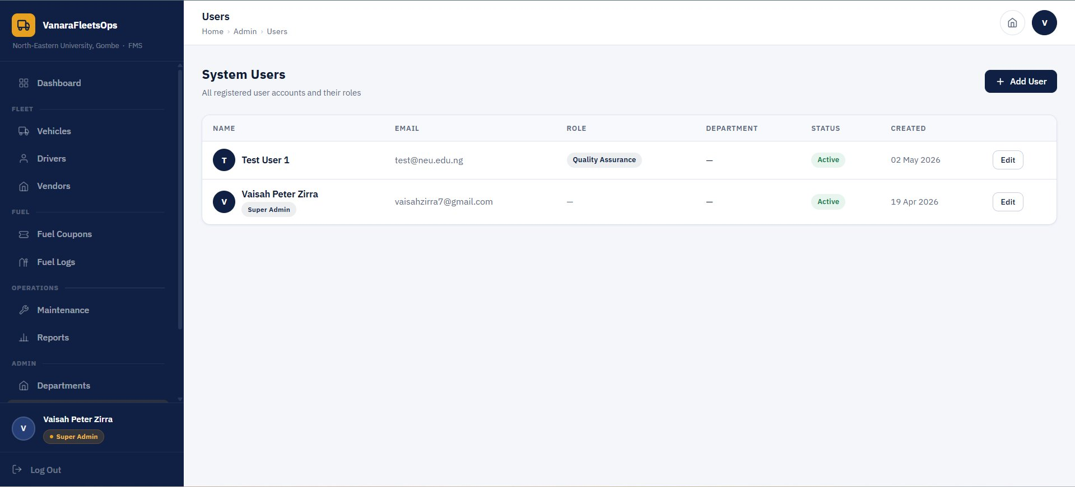
Administration
Departments, system users, and role-based access control
Departments
System Users
Departments:
• University departments that own vehicles
• Each has a short code (e.g. GENERAL, VC)
• Shows vehicle count & user count

Slide 13
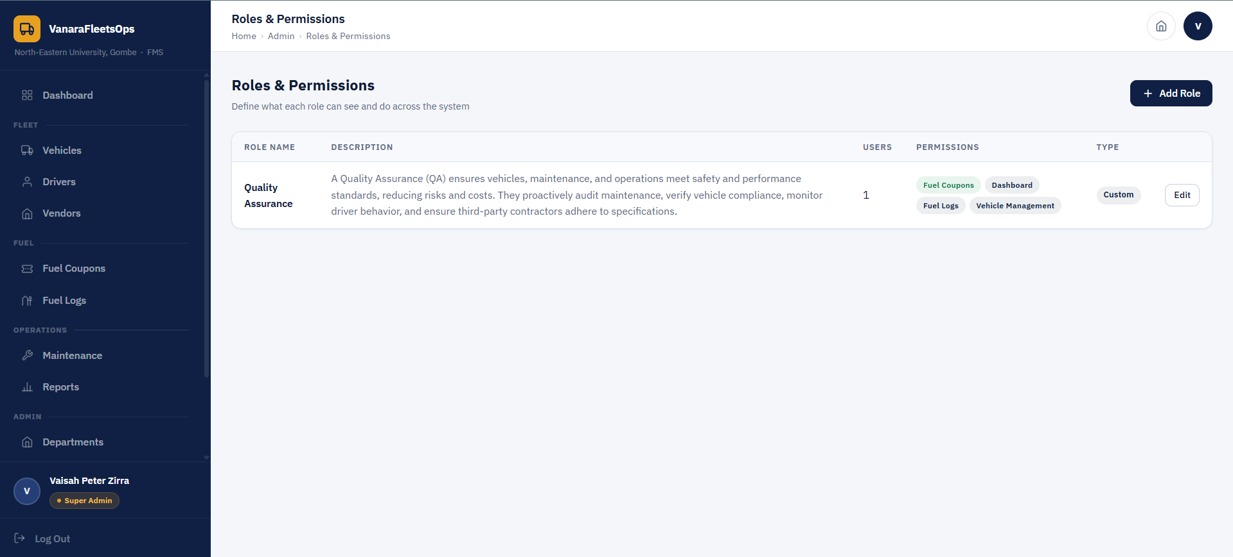
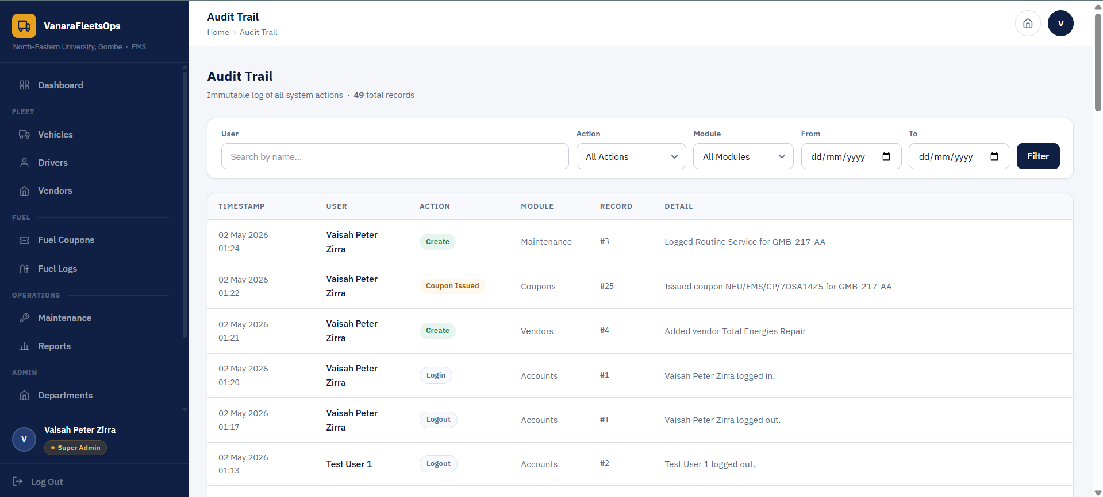
Administration
Departments, system users, and role-based access control
System Roles
Audit Trail
Roles:
• Super Admin — full access to all modules
• Quality Assurance — audit/view access
• Department User — limited to own dept

Slide 14
Thank You
vaisah.zirra@student.neu.eu.ng

