Slide 1
IBM University Engagement Project Submission
“Exploring the Power of Agentic AI with IBM Granite and Lang Flow”

Slide 2

Project Tile – AI Interview Trainer Agent using
Domain of Project – Education
Student Name | Recent Passport Photo | Email ID | Mobile number [WhatsApp]
VAISHNAVI V KUMAR |  | vk178466@gmail.com | 6384733886

Slide 3
Problem Statement -
Problem Statement : Interview Trainer Agent
The Challenge
Many students and job seekers struggle to prepare effectively for technical and HR interviews due to lack of personalized guidance, realistic practice, and constructive feedback.
The Objective
Develop an AI-powered Interview Trainer Agent that:
Generates technical interview questions
Generates HR interview questions
Evaluates answers
Provides feedback
Identifies skill gaps
Improves interview readiness

Slide 4
Technology Used
Technology Used
Lang Flow
IBM watsonx.ai
IBM Granite Models
Python
IBM cloud
I used this approach
Lang Flow + IBM Granite + IBM watsonx.ai

Slide 5
Proposed Solution -
Proposed Solution: AI Interview Trainer Agent
The system helps candidates prepare for interviews by generating role-specific interview questions, evaluating responses, and providing personalized feedback.
Features
Technical Question Generation
HR Question Generation
Answer Evaluation
Interview Tips
Readiness Assessment

Slide 6
Lang flow component Used -
1. Chat Input
Receives user queries and interview requests.
2. Agent
Acts as the central AI component that processes user inputs and generates responses.
3. IBM Granite Model
Provides natural language understanding, reasoning, and interview question generation.
4. Chat Output
Displays generated interview questions, feedback, and recommendations.
5. Prompt Template
Structures prompts to guide the AI in producing accurate and consistent responses.
6. Read File (Future Enhancement)
Enables resume file reading and content extraction for personalized interview preparation

Slide 7
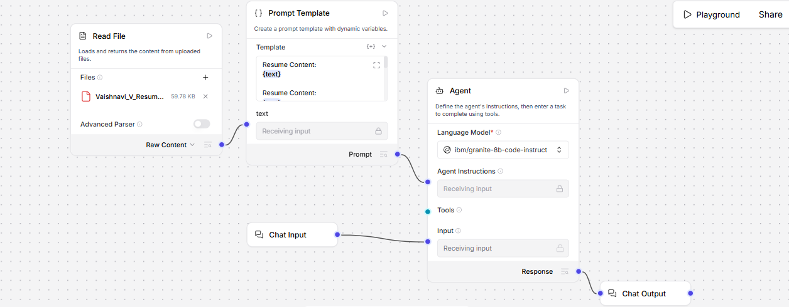
Lang flow workflow -

Slide 8
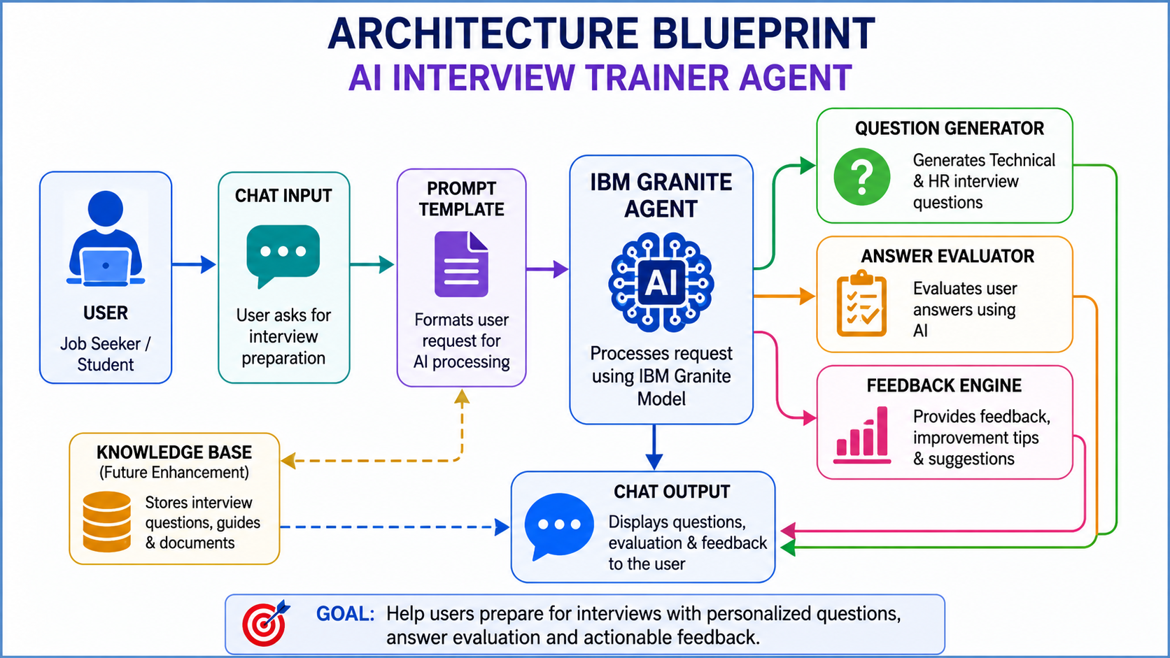
Architecture blueprint

Slide 9

Role of Agentic AI in the solution
Role of : Agentic AI for interview trainer
The AI agent:
Understands interview requirements
Generates personalized questions
Evaluates answers
Provides suggestions
Supports continuous learning
.

Slide 10
Technology Used
Lang Flow
Visual workflow orchestration.
IBM Granite
Large Language Model used for reasoning and question generation.
Watsonx.ai
Model hosting and inference.
Python
Backend integration.

Slide 11
Novelty and Uniqueness
Novelty and Uniqueness of the Proposed Solution
1. Personalized Interview Preparation
The system generates customized technical and HR interview questions based on the user's selected job role, helping candidates focus on relevant topics instead of generic question banks.
2. AI-Powered Question Generation
Using IBM Granite Models, the agent automatically creates interview questions that simulate real-world interview scenarios and improve candidate preparedness.
3. Intelligent Answer Evaluation
The agent analyzes candidate responses and provides constructive feedback, helping users understand their strengths and areas for improvement.
4. Real-Time Feedback and Suggestions
Unlike traditional interview preparation methods, the system instantly provides recommendations, improvement tips, and interview strategies after evaluating answers.
5. Agentic AI Workflow
The solution follows an Agentic AI approach where the AI agent autonomously handles question generation, answer evaluation, and feedback generation without manual intervention.
6. Career Readiness Assessment
The system helps users measure their interview readiness by identifying skill gaps and suggesting topics that require additional preparation.

Slide 12
Git Hub Link
Repository Name: AI-Interview-Trainer-Agent
Repository Contents
README.md
app.json
requirements.txt
Project PPT
Problem Statement PDF
Screenshots
Add your GitHub repository link : https://github.com/vaish-a11/AI-Interview-Trainer-Agent.git
Github id : https://github.com/vaish-a11
·
·
·

Slide 13
Future Scope
Resume PDF Analysis
Generate personalized questions from resumes.
RAG-Based Knowledge Base
Retrieve interview-related content.
Voice-Based Mock Interviews
Real-time interview simulation.
Performance Analytics
Track improvement over time.
Multi-Language Support
Support interviews in multiple languages.
·
·
·

Slide 14


