Slide 1
Spam Classifier Project
by
Vaishnavi Balaji
Internship-31
SME- Gulshana Chaudhary
Flip Robo Technologies
#39, NGEF Lane, 2nd Floor, Suite No.1759, Indiranagar, Bangalore, Karnataka, India 560 038

Slide 2


Table of Contents
Problem Statement
Aim and Objectives
Introduction
Exploratory Data Analysis
Data Pre-Processing
Model Training and Testing
Conclusion

Slide 3
Problem Statement
Spam, or unsolicited commercial email, is a serious issue on the internet. It reduces the email system's usability and takes up space, slowing down system response.
Aim :
The aim is to build a prototype of online hate and abuse comment classifier which can used to classify hate and offensive comments so that it can be controlled and restricted from spreading hatred and cyberbullying.
Objective:
Perform Exploratory Analysis on the data set.
Apply Pre-processing methods on the messages.
Converting message text to vectors.
Training multiple models and testing the model and evaluating using the metrics.
.

Slide 4
Introduction
The majority of us view spam emails as irritating and frequently utilised for product promotion and advertising.
We continue to block these email addresses, however it is pointless because spam emails are still widely used.
There are several significant types of spam emails that pose a serious threat to security, including fake emails, identity theft through hacking, viruses, and malware.
Building a strong real-time email spam classifier that can effectively and correctly mark incoming mail as spam if it is a spam message or appears to be one is necessary to deal with spam emails.

Slide 5
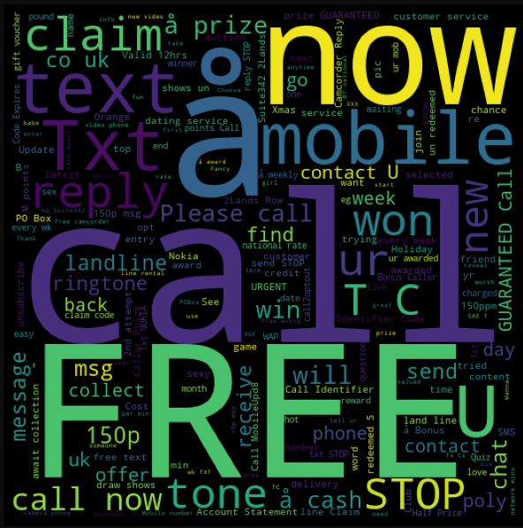
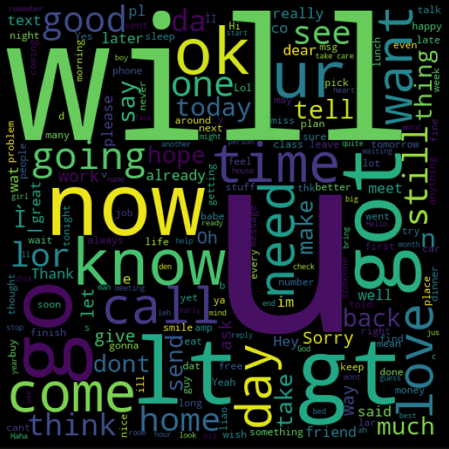
Exploratory Data Analysis
After visualizing the most repeated words in the spam messages, the below words are obtained
The most repeated words for ham messages are shown below.

Slide 6
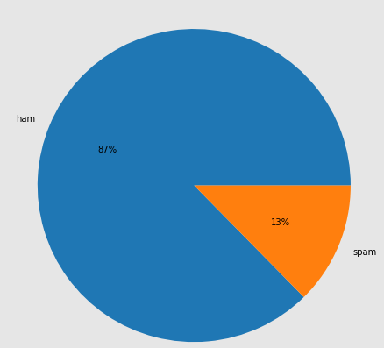
Contd.
On plotting a pie chart of the messaged, 13% of the messages are spam messaged and 87% are genuine messages

Slide 7
Data Pre-Processing
From the given data, the unnecessary columns are removed and after removing the duplicates the percentage loss in data was found to be 7%.
A function was defined to clean the text and return the tokens. The cleaning of the text was done by first removing punctuation and then removing the useless words also known as stop words.
The target column which denotes whether the message is spam or not is converted to numerical feature. Further, the message text is converted into vectors using TFid Vectorizer.

Slide 8
Model Training and Testing
The features and target are split into train and test sections using the train_test_split function for random state-0 and test-size-0.25. The algorithms used for model training and testing are-
Logistic Regression
Random Forest Classifier
Decision Tree Classifier
Gaussian NB Classifier
K Neighbors Classifier
Support Vector Machine
Gaussian Bayes Classifier

Slide 9
Contd.
When the train and test data were used for developing models for the above algorithms the following observations were made:
Linear Regression models has very less difference in accuracy score of training and testing data which is beneficial but the F1 score is only 75%.
Random Forest Classifier had difference of 0.02 between accuracy score of training and test data and F1 score of 90%.
Decision Tree Classifier had difference of 0.03 between accuracy score of training and test data.
Gaussian NB Classifier had difference of 0.06 between accuracy score of training and test data.
KNeighbors Classifier had a difference of 0.04 between accuracy score of training and test data.
Support Vector Classifier had a difference of 0.03 between accuracy score of training and test data.

Slide 10
Conclusion
Random Forest Model is the effective model for the case study since it has a good training score and the difference between training and testing score is less compared to other models.
The model was further analyzed using the hyperparameter tuning and from the results the False Negative reduced from 39 to 38.

Slide 11
Thank you

