Slide 1
Fake News Project
by
Vaishnavi Balaji
Internship-31
SME- Gulshana Chaudhary
Flip Robo Technologies
#39, NGEF Lane, 2nd Floor, Suite No.1759, Indiranagar, Bangalore, Karnataka, India 560 038

Slide 2

Table of Contents
Problem Statement
Aim and Objectives
Introduction
Data Source and Format & Visualisation
Data Pre-processing
Model Training and Testing
Results
Conclusion

Slide 3

Problem Statement
Everyone is extremely concerned about the proliferation of fake news in light of the recent social media growth.
It has been used to sway public opinion, influence elections, including the US Presidential Election of 2016, instigate hatred and rioting, and carry out atrocities like the genocide of the Rohingya people.
According to a 2018 MIT study, fake news spreads on Twitter six times more quickly than legitimate news.
The level of confidence and trustworthiness in the news media has never been lower. It is getting harder and harder to tell what news is true and what is fake.

Slide 4
Aim :
The goal is to create a model using Machine Learning algorithms, that can be used to detect whether a given text message is fake or not. Label "1" in this instance denotes a fake news, while Label "0" denotes a genuine news.
Objectives :
Perform Exploratory Data Analysis on the data set.
Handle text data by performing the necessary processes.
Analyse the relationship between the features and target and convert text into vectors.
Train multiple models and select the efficient model.
Perform hyperparameter tuning on the selected model and analyse the performance metrics.

Slide 5
Introduction
Due to its accessibility and widespread adoption around the world, people now prefer online social media to traditional news and digital channels including television, radio, landlines, and newspapers.
Online social media give business owners important advantages by aiding online marketing, enabling them to sell their goods and forge fast connections with customers from anywhere in the world.
Social media does have drawbacks, though, including the spread of harmful rumors via fake news, information falsification, and fabricated reviews and ratings. Furthermore, social media can expose users to malware programs, which pose serious security risks to the availability, confidentiality, and integrity of mobile systems.
Because there are so many false news articles being spread over the world and because languages and accents vary widely, it is difficult to examine a single item of news. This complicates fake news detection. The best course of action is to apply machine learning techniques to identify bogus news on social media sites by learning from user behavior.

Slide 6
Data Source and Format
There are 2 datasets in csv format, one which is consisting True news and other has Fake news, after concatenating both the datasets the dimensions are 44919 rows and 5 columns.
Out of the 5 columns- Title, Text, Subject, date and label, the columns utilized for the model development are text and label.
Visualisation
When the news text is cleaned, the words which majorly make up the true news and the fake news are analysed using the Word Cloud

Slide 7
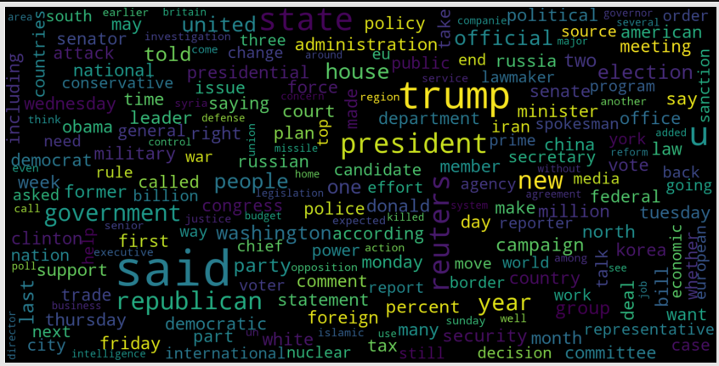
Visualising the words in Genuine News

Slide 8
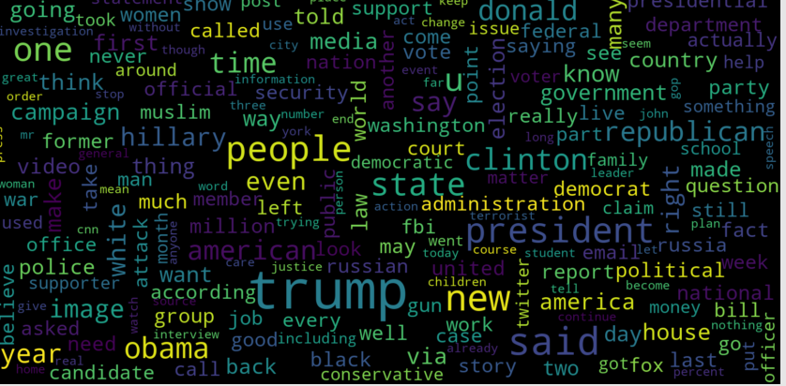
Visualising the words in Fake News

Slide 9
Data Pre-processing
After loading the data and performing the necessary analysis, it is observed that except label column, all the other columns are of object type.
There are null values in subject and date columns which are removed.
The columns- title, subject and date are removed since they won’t be helpful in identification of the news.
Further, the news message is cleaned by removing numbers, punctuation and stop words.

Slide 10
Model Training and Testing
TFid vectorizer is implemented on the text column to convert the text into vectors. The feature which is the text column and target i.e. label column are split and a loop is defined to analyze the results of models for different values of random state and test size of train_test_split function. The algorithms used for model training and testing are
Logistic Regression
Random Forest Classifier
K Neighbors Classifier
Decision Tree Classifier
Passive Aggressive Classifier
It was observed that except K Neighbours Classifier every model had a good accuracy score of 0.9 for both training and test data, but K Neighbours Classifier had an accuracy score of 0.79 for training data and 0.71 for test data.

Slide 11
Results
The number of fake news and genuine news in the given dataset is almost equal.
The two words which are frequently used in the dataset are “said” and “trump”.
While employing the machine learning algorithms, the Logistic Regression Model, Random Forest Model, Decision Tree Model and Passive Aggressive Model have very good accuracy score for both training and test data.
The Random Forest Model is an efficient model with False Negative 11 and True Negative 4259 which is efficient compared to the other models, hence random forest model is considered for Hyperparameter tuning.

Slide 12
Conclusions
Model for detecting Fake news has been successfully trained and tested using Machine Learning Algorithms.
Random Forest Model is an efficient model for this project based on the result of False Negative and True Negative.
After performing hyperparameter tuning on the developed model the False Negative has reduced from 11 to 9 and False Positive has reduced from 14 to 12 and both True Positive and True Negative have improved.

Slide 13
Thank You

