Slide 1
Housing Project
by
Vaishnavi Balaji
Internship-31
SME- Gulshana Chaudhary
Flip Robo Technologies
#39, NGEF Lane, 2nd Floor, Suite No.1759, Indiranagar, Bangalore, Karnataka, India 560 038

Slide 2

Organization of Presentation
Problem Statement
Aim and Objectives
Introduction
Exploratory Data Analysis
Data Pre-processing
Model Training and Testing
Conclusion

Slide 3
Problem Statement
Housing has been basic security for humans for generations to come. But every requirement being fulfilled comes with its own challenges.
Real Estate market forms a major section of the world’s economy. Like how every market utilises the analysis and results of Data Science, real estate market too uses Data Science tool to solve problems in the domain and help increase the revenue of the companies.
It is also used to model marketing strategies and focus on changing trends in house sales and purchases.
There are several algorithms in Machine Learning such as predictive modelling, market mix modelling, recommendation systems which can be implemented in for achieving business goals for housing.

Slide 4
Aim :
Modeling the cost of homes using the relevant independent variables is required. The management will then utilize this model to determine exactly how the prices fluctuate depending on the variables. As a result, they can influence the company's strategy and concentrate on areas that will provide large returns. Additionally, using the model will help management better understand how prices change in a new market.
Objectives :
Perform Exploratory Data Analysis on the data set.
Handle numerical and categorical variables.
Analyse the relationship between the features and target.
Encoding the categorical features and training a model .
Testing the model and evaluating using the metrics.

Slide 5
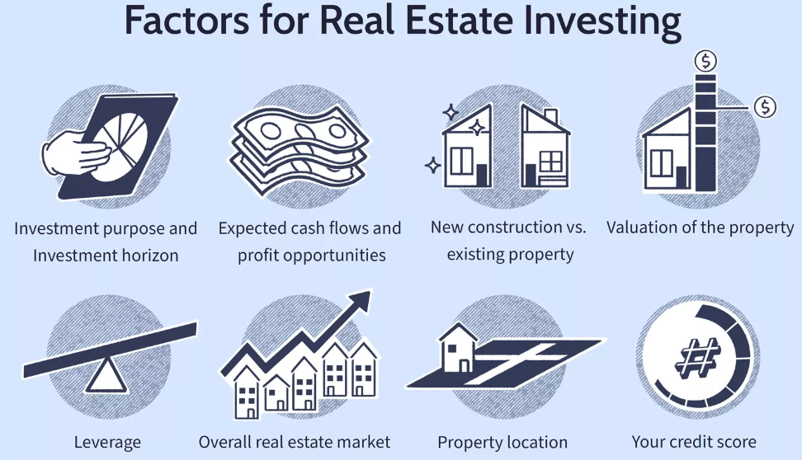
Introduction
Real property is nothing but a piece of land, any improvements on the land and the legal rights to use and operate the land granted to the property owner. Ownership of real estate includes the ability to sell, lease or enjoy the property.
Real Estate is the transactional sale of real property, including everything attached to the land example-natural resources, houses.
Real Estate refers to the physical property rather than the rights belonging to the owner. It is an immovable property attached to a piece of land. There are five main categories of real estate which include residential, commercial, industrial, raw land, and special use.
Investing in real estate includes purchasing a home, rental property, or land. Indirect investment in real estate can be made via REITs or through pooled real estate investment.

Slide 6
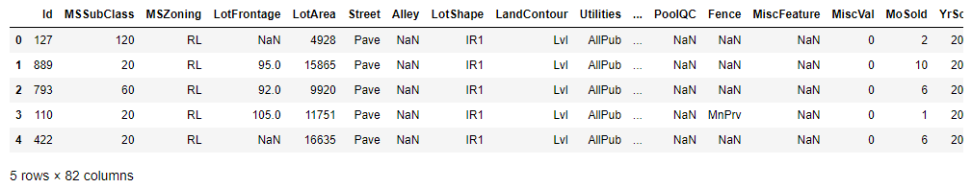
Exploratory Data Analysis
Univariate Analysis
US based housing company Surprise Housing has retrieved a dataset from the sale of houses in Australia. Data is in Comma Separated Format (CSV). Data contains 1460 entries each having 81 variables. There are two datasets which are provided- train.csv and test.csv. Model training is performed on training data and model testing is done on testing data.
The training data has 1168 rows and 82 columns, whereas the test data has 292 rows and 80 columns.
There are 5558 total null values in training data and 1407 null values in test data.
Number of categorical columns in train data are 44 and number of numerical columns are 38.

Slide 7
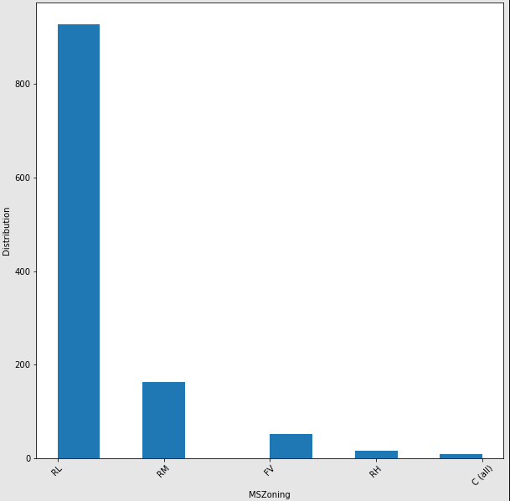
Contd.
MSzoning denotes the general classification of the sale. Majority of the data belong to the Residential Low-Density category followed by Residential Medium Density

Slide 8
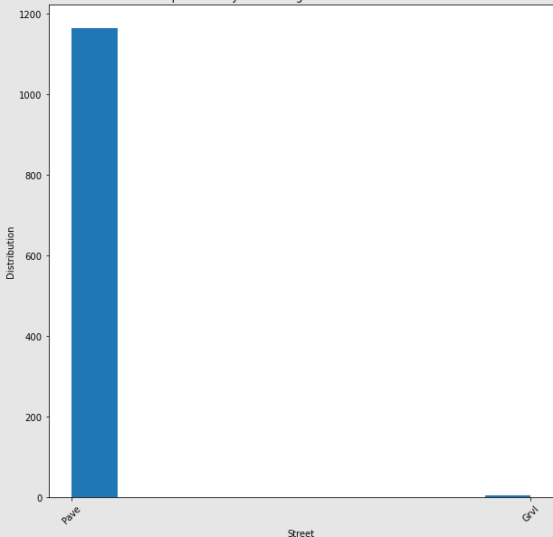
Contd.
Types of road access to the property has 2 values- Pave and Gravel, most of the data points have Pave type of road access.

Slide 9
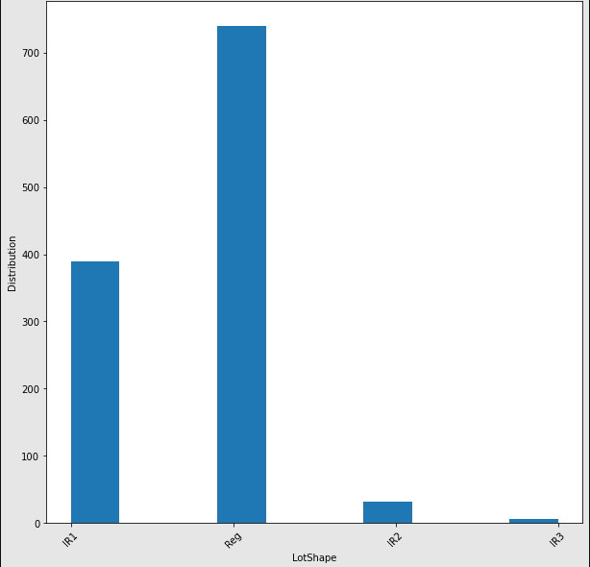
Contd.
LotShape is the general shape of the property. 740 houses have regular shape followed by 390 houses have slightly irregular shape.
1020 houses are almost levelled, followed by 30 houses are Banked - Quick and significant rise from street grade to building.

Slide 10
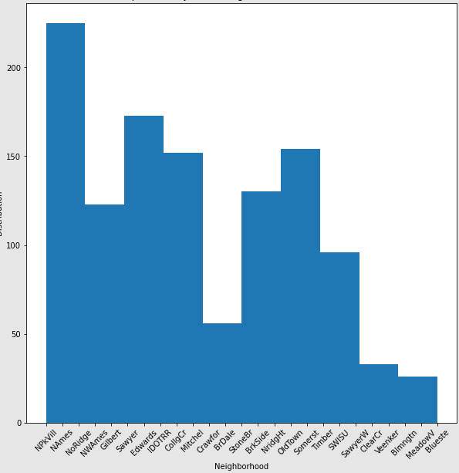
Contd.
All public utilities are available in the houses.
850 houses have Inside LotConfig followed by 210 houses having Corner LotConfig, 60 houses with CullDSac and 30 houses having FR2 LotConfig.
1100 houses have Gentle Sloping followed by 40 houses having Moderate Sloping and 20 houses having severe sloping.
230 houses have their neighbourhood in NorthPark Villa, followed by Sawyer, Edwards.

Slide 11
Contd.
When it comes to type of dwelling, 980 houses are of single-family detached category followed by 100 Townhouse end unit.
580 houses are single storey, followed by 350 houses second storey, 130 houses are One and one-half story: 2nd level finished.
Most of the houses have Gable type of roof followed by hip.
Majority of the houses have roof type of Composite Shingle.
Almost 570 houses have Exterior covering on house as Vinyl Siding followed by Plywood, Wood Siding, Brick Face and Cement Board.
If there is more than one exterior covering, majority of the houses use Cement board followed by Plywood.
690 houses do not have Masonry Veneer type, 340 houses have brick face type followed by 85 houses with stone type.
730 houses have average exterior quality followed by 370 houses having good exterior quality.
1030 houses have average condition of the exterior material followed by 100 houses having a good condition.
530 houses have Foundation type of Cinder block followed by 520 houses have poured concrete.
Around 530 houses have a basement height of 80-89 inches, followed by 400 houses with basement height of 90-99 inches.
Majority of the houses have an average basement condition.

Slide 12
Contd.
1140 houses have Gas forced warm air furnace type of heating.
570 houses have excellent heating condition followed by 340 houses having average heating condition.
Most of the houses have central air conditioning.
Majority of the houses have Standard Circuit Breakers & Romex type of Electrical Systems followed by Fuse Box over 60 AMP and all Romex wiring (Average)
570 houses have Average Kitchen Quality followed by 460 houses having Good Kitchen Quality.
Most of the houses have typical functionality followed by Minor 1,2 deductions.
550 houses do not have a fireplace followed by 300 houses having good quality fireplace.
680 houses have attached garage followed by 310 houses have detached and 60 houses have built-in garage.
450 houses have unfinished garage followed by 340 houses have rough finished garage.
Most of the garages are of average quality.
Several houses have a paved driveway.
Majority of the houses do not have a pool.
930 houses do not have a fence.
1000 houses are of conventional sale type followed by homes which were just constructed and sold.

Slide 13
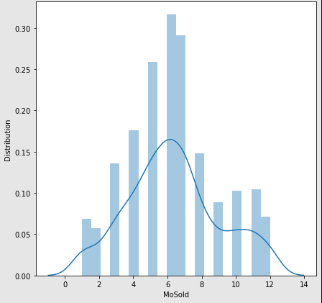
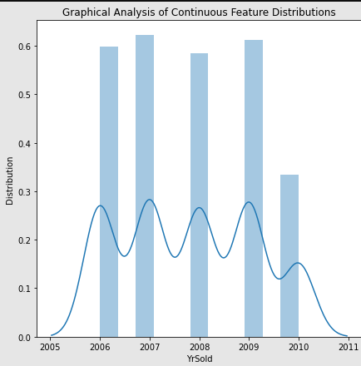
Contd.
Most of the houses were sold between the months of June to July followed by May.
Maximum number of houses were sold in 2007 followed by 2009, 2006 and 2008. 2010 has seen the least number of houses being sold.
Most of the data points for Sale Price is from 100000 to 250000.

Slide 14
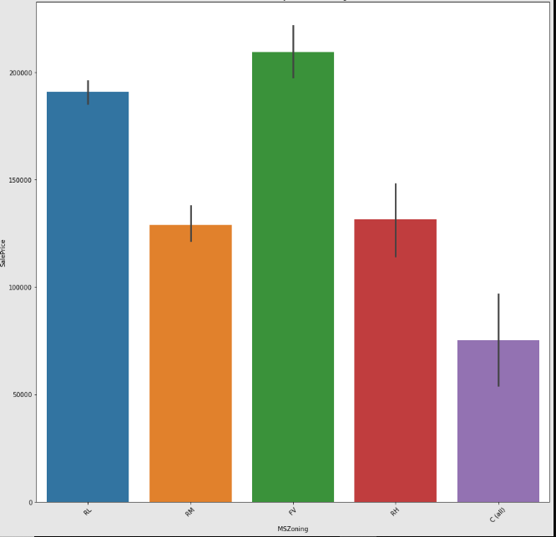
Bivariate Analysis
Floating Village Residential has more sale price followed by Residential Low Density, Residential High Density, Residential Medium Density and Commercial.
Paved Access to property has higher sale price compared to gravel.
No alley access gives higher sale price followed by Paved and gravel.
Moderately irregular properties give higher returns followed by irregular, slightly irregular and regular
Hill Side land contour has higher sale price followed by depressed contour, levelled and banked.
With respect to LotConfiguration CullDSac yields a higher sale price followed by Frontage on 3 sides of property, Corner, Inside and Frontage on 2 sides.

Slide 15
When a property has severe slope, it gives higher returns compared with Moderate Sloping and Gentle Sloping
North Ridge neighbourhood has highest sale price followed by Northridge Heights, Stone Brook and Veenker. Meadow Village neighbourhood has the lowest sale price of houses.
With respect to condition 1, houses which are adjacent to positive off-site feature have higher sale price followed by houses which are within 200' of North-South Railroad and houses which are near positive off-site feature--park, greenbelt, etc.
Townhouse end unit buildings have higher sale price followed by houses which are single-family detached, townhouse inside unit, townhouse inside unit and two-family Conversion; originally built as one-family dwelling.
Two and one-half story: 2nd level finished buildings have higher sale price followed by 2 story and 1 story. One and one-half story: 2nd level unfinished buildings have the least sale price.
Houses with shed type of roof have high sale price followed by hip, flat, mansard, gabel and gambrel.
Wood Shingle roof material houses have high sale price followed by Wood Shakes, membrane, tar and gravel, metal and composite shingle.
Houses which are made of imitation stucoo, stone and cement board have high sale price.

Slide 16
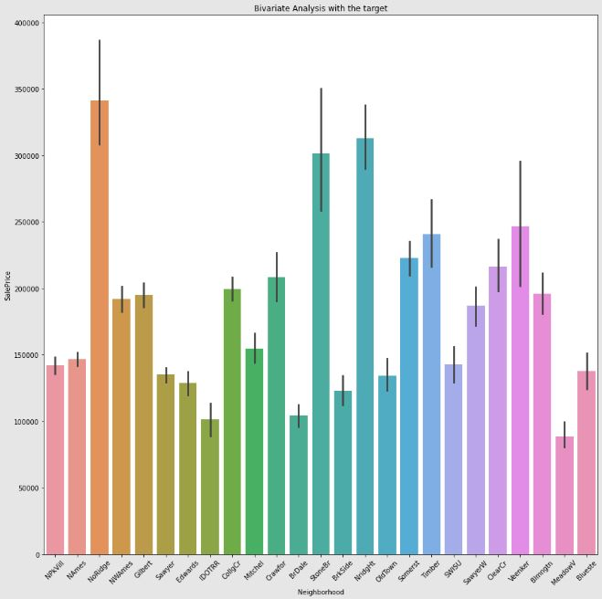

Slide 17
When the material of the exterior is excellent, the sale price is high followed by good, average and fair.
Poured concrete foundation has high sale price followed by stone, wood, cinder block, brick and tile and slab.
For heating type in houses, gas forced warm air furnace ranks high sale price followed by steam heat, hot water, wall furnace.
Houses with heating quality Excellent have high selling price.
Houses which have air conditioning have high selling price compared with houses which don’t.
Houses with electrical systems-Standard Circuit Breakers & Romex have high selling price followed by Fuse Box over 60 AMP and all Romex wiring (Average), 60 AMP Fuse Box and mostly Romex wiring (Fair).
Excellent kitchen quality has proportionally high sale price followed by good, average and fair.
With respect to fire place quality, houses which have poor quality fire place have lesser selling price compared to houses which do not have fire place.
Built-in garage houses have high selling price followed by attached category, basement, 2types, detached and car port.
Houses with paved driveway have higher selling price.
Houses which do not have fence have the highest selling price.
Houses which are just constructed and sold, have high selling price followed by house sales which have a contract 15% Down payment regular terms.
For sale conditions, when new buildings were not completed when last assessed have high sale price followed by normal sales.

Slide 18
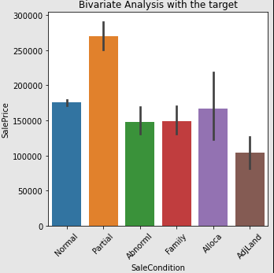
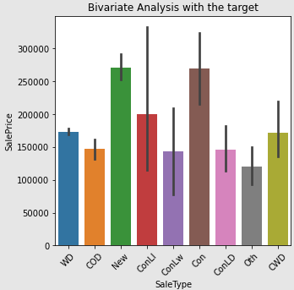
Excellent kitchen quality has proportionally high sale price followed by good, average and fair.
With respect to fire place quality, houses which have poor quality fire place have lesser selling price compared to houses which do not have fire place.
Built-in garage houses have high selling price followed by attached category, basement, 2types, detached and car port.
Houses with paved driveway have higher selling price.
Houses which do not have fence have the highest selling price.
Houses which are just constructed and sold, have high selling price followed by house sales which have a contract 15% Down payment regular terms.
For sale conditions, when new buildings were not completed when last assessed have high sale price followed by normal sales.

Slide 19
Data Pre-processing
The columns- "MiscFeature","Fence","PoolQC","FireplaceQu" had high number of missing values hence were eliminated from the column.
In the given dataset, the columns with high number of missing values are MiscFeature, Fence, PoolQC and FireplaceQu, hence they are eliminated from the dataset.
The rest 14 columns which have null values are imputed with mean of the column for numerical type and mode of the column for categorical type.
When box plot was plotted for the data, as per the observation there were many datapoints beyond the range. Using the z-score the values above value 3 were eliminated.
40 categorical columns were encoded using the get_dummies function in pandas.
Since there are several columns after encoding, the feature selection is done using Chi2 test and Principal Component Analysis.
From the analysis it is observed that information can be retained with 12 features.

Slide 20
Model Training and Testing
The features and target are split using the train_test_split function in sklearn, and a loop is defined to obtain the random state value for the function which yields best results. The following algorithms were used in training models.
Linear Regression
Decision Tree Regressor
K Neighbours Regressor
Random Forest Regressor
Support Vector Regressor
Gradient Boost Regressor
XGBoost Regressor
Adaboost Regressor
From results of r2 score of all the models, we can conclude that the Linear Regression Model for random state-2 and test size-0.20 has r2 score of 0.8 for training data and 0.81 for test data and mean absolute percentage error-0.15 is the efficient model compared to others

Slide 21
Conclusions
In the given dataset the main features which affect the Sale price of the house are -OverallQual, GrLivArea, GarageCars, GarageArea, FullBath, TotalBsmtSF, TotRmsAbvGrd, YearBuilt, 1stFlrSF, ExterQual_Gd, Foundation_PConc, YearRemodAdd.
During the model development, the algorithms which have high r2 score for train data are Decision Tree Regressor, Random Forest Regressor, Gradient boosting Regressor followed by Linear Regression and Adaboost Regressor.
But Decision Tree, Random Forest, KNeighbours, Adaboost,Gradient boosting regressor have overfitting problem which is reduced to a large extent in Linear Regression.
The linear regression model for predicting sale price of houses was hyper tuned which gave an increase in 0.02 in r2 score of the test data.

Slide 22
Thank You

