Slide 1
Case Study on
E-Retail Factors for Customer Activation
And Retention
by
Vaishnavi Balaji
Internship-31
SME- Gulshana Chaudhary
Flip Robo Technologies
#39, NGEF Lane, 2nd Floor, Suite No.1759, Indiranagar, Bangalore, Karnataka, India 560 038
Customer Retention Project
by Vaishnavi Balaji Roll No: 1601-16-744-005
M. E Communication Engineering
4th Semester
Internship-31
Flip Robo Technologies
13th October 2022
Hyderabad

Slide 2
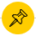

Organization of Seminar
Problem Statement
Aim and Objectives
Introduction
Exploratory Data Analysis
Conclusion

Slide 3

Problem Statement
In the age of E-commerce, Customer Satisfaction is the most critical yardstick which
is monitored to measure the profits of the organisation.
Customer Satisfaction stands as a key factor in determining the tendency of the
customer to repurchase and refer the portal to their friends and family.
Hence because of positive experience of the customer leads to cyclical profits and
conversely negative experience may be hazardous to the profit and reputation of the
organisation.

Slide 4

Aim :
Analyse the e-retail success factors which play a major role in customer satisfaction.
Objectives :
Perform Exploratory Analysis on the data set.
Segregate the dataset based on customer’s personal information.
Analyse the relationship between the features based on the factors of Intention of Repeat Purchase, Online Retailing, Brand Image and Loyalty.
Encoding the categorical features and training a model .
Testing the model and evaluating using the metrics.

Slide 5
Introduction
The concept of electronic commerce has evolved in India with the evolution of Internet. As
and when people got access to seamless network connectivity, the exposure to purchase
commodities online increased.
The spectrum of e-retailing is huge, right from planning travel tickets to purchasing big appliances as well as getting groceries delivered at the doorstep.
With the rise in access to internet gave rise to an exponential increase in Indian E-commerce portals wherein customer can browse a variety of items related to a particular product.
The interval from customer browsing the application/portal to getting the product delivered is a game changer for the Organisation, due to which majority of the e-retailers focus of customer satisfaction to enhance their turnovers and understand which field has to be improved in their organisation.

Slide 6
Exploratory Data Analysis
The data is collected from Indian Online shoppers.
Dataset consists of 269 rows and 71 columns.
Except the column “What is the Pin Code of where you shop online from?” , all the
other columns are of object data type.
There are no null values in the data set.
After analysing the personal information, we can conclude that there were double the
number of women than men who have taken this survey.
Most of the people are in the age group- 20-50 years followed by
teenagers and senior citizens being minority.
Most of the people belong from Delhi, Noida and Bangalore.
There are two categories in cities section- Noida and Greater Noida
which has to be processed.
Most of the people have been shopping for a long time.
Majority of the people purchase online for around 10 times a year.

Slide 7
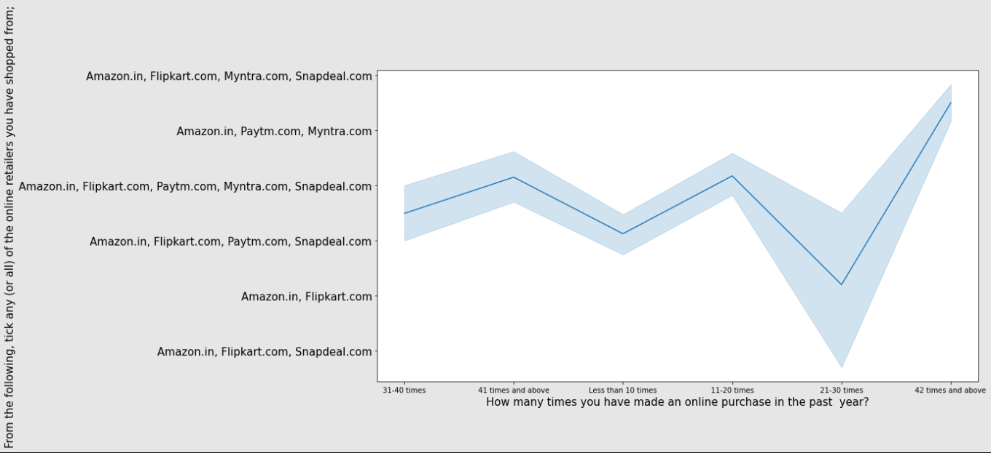
Contd.
Analysis based on following factors:
Intention of Repeat Purchase:
Shopaholics who shop more than 41 times a year shop from multiple brands, people who shop for 32-40 and less than 10 times a year do not shop from Myntra. No matter what the scenario is , people often shop from Amazon and Flipkart.

Slide 8
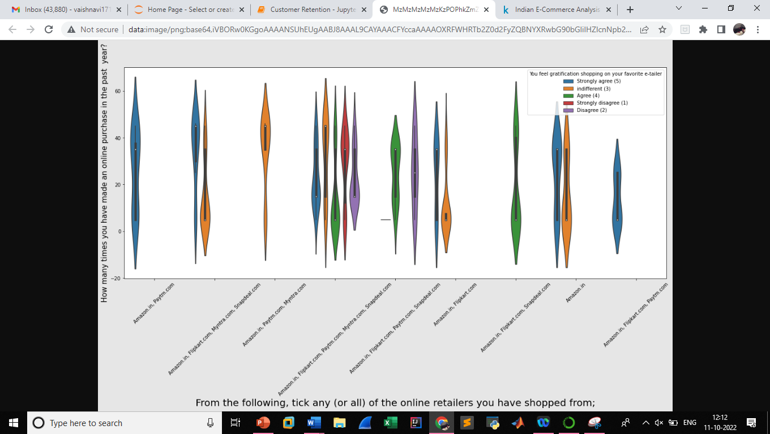
Contd.
Customers who shop from brands like Amazon and Flipkart are satisfied.
Customers who shop from multiple brand don’t seem to be satisfied.
Customer who shop from Amazon and Flipkart gain access to a lot of loyalty programs, whereas people who shop from multiple brands do not receive the same.

Slide 9
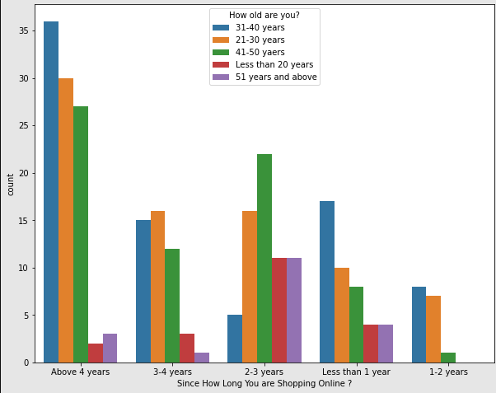
Contd.
2. Online Retailing:
Large number of people have been shopping beyond 4 years except the age group below 20 years and above 51 years.
Customers who have been shopping from 1-2 years do not include teenagers and old people.

Slide 10
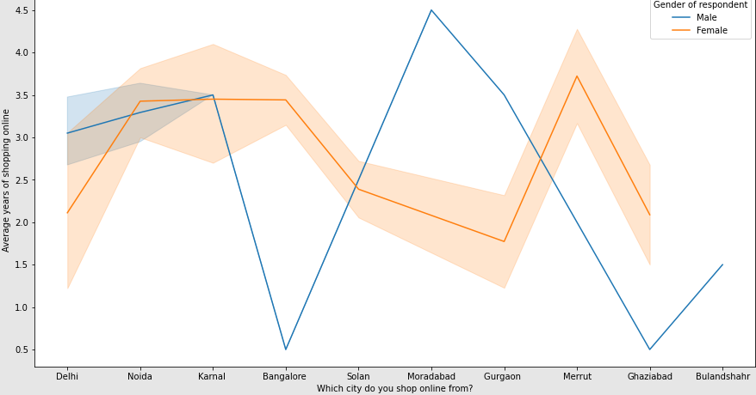
Contd.
The density of women customers are higher than men.
Customers who are men from Bangalore and Ghaziabad have shopped for less than a year.
Highest number of men shopping online belong from Delhi and Noida.
Men from Moradabad have been shopping for the longest time.
Women from Meerut and Noida have shopped the longest time.

Slide 11
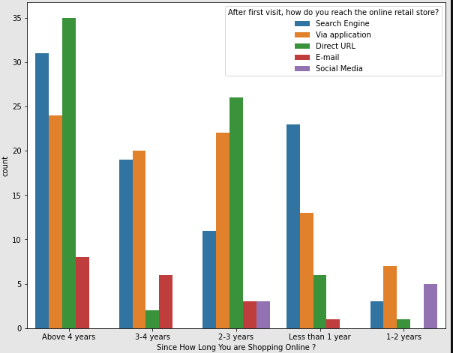
Contd.
Many customers who have been shopping online for more than 4 years still use the website, which indicates online brands need to focus on regularly updating their website.

Slide 12
Contd.
3. Brand Image:
With respect to the below mentioned features-
Easy to use website/application Visual appeal
Wide variety of products on offer Complete, relevant description of product information
Fast loading speed of website and application Reliability of the website or application
Quickness to complete purchase Availability to several payment options
Speedy order delivery Privacy of customer’s information
Security of customer’s Financial Information Perceived trustworthiness
Presence of online assistance through multi-channel
Amazon and Flipkart have the highest percentage for brand image followed by Paytm and Myntra.

Slide 13
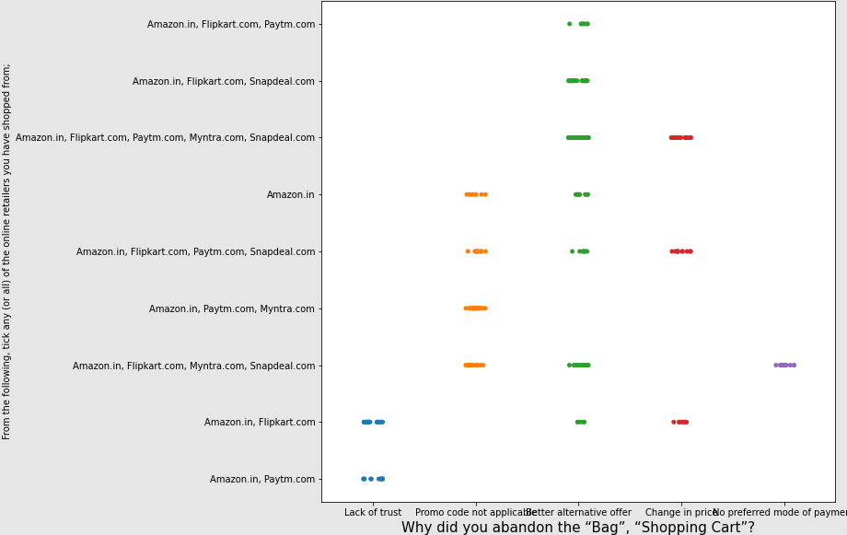
Contd.
There are many people who leave their cart because they find better alternative offers, which
is occurring often in Amazon, Flipkart and Paytm.

Slide 14
Contd.
Loyalty:
In the given dataset the negative features about the brand are given as follows:
Longer Time to get logged in Longer time to display graphics and photos
Late declaration of price Longer Page loading time
Limited mode of payment in most products Longer delivery period
Change in website design Frequent disruption when moving from one page to another
Customers are loyal to Amazon, Flipkart and Paytm even though they have negative remarks about them, they would still recommend these brands to their family and friends.

Slide 15
Conclusion
From the given dataset, models are developed using many algorithms- Logistic Regression, Decision Tree Classifier, Random Forest Classifier, K-Neighbors Classifier, Support Vector Classifier, Gaussian NB. After comparing the results, the models which are efficient are-Logistic Regression model, Random Forest Classifier model, K-Neighbors Classifier model, Support Vector Classifier model.
In the above models the parameter which is the target is “Which of the Indian online retailer would you recommend to a friend?”, which is considered as a major factor in analyzing Customer Satisfaction.
The cross-validation score of 0.99 is achieved.

Slide 16
Thank you

