Slide 1
Micro-Credit Project
by
Vaishnavi Balaji
Internship-31
SME- Gulshana Chaudhary
Flip Robo Technologies
#39, NGEF Lane, 2nd Floor, Suite No.1759, Indiranagar, Bangalore, Karnataka, India 560 038

Slide 2

Table of Contents
Problem Statement
Aim and Objectives
Introduction
Exploratory Data Analysis
Data Pre-processing
Model Training and Testing
Conclusion

Slide 3

Problem Statement
A Microfinance Institution (MFI) is an organization that offers financial services to low income populations.
Mobile financial system becomes very useful when targeting especially the unbanked poor families living in remote areas with not much sources of income.
A telecom service provider has introduced a number of products and built its company and organisation around the budget operator model, giving superior products to all price-conscious clients at lower prices.
They focus on offering their services and goods to low-income families and underprivileged consumers in order to aid them when they are in need because they recognize the value of communication and how it influences a person's life.
They are working with an MFI to offer microcredit on cell phone balances with a 5-day repayment period. If the Consumer does not repay the lent money within the allotted five days, he is considered to be in default.

Slide 4
Aim :
The goal is to create a model that can be used to estimate, in terms of a likelihood, whether the customer will repay the lent amount within 5 days of loan insurance for each loan transaction. Label "1" in this instance denotes a paid debt, or a non-defaulter, while Label "0" denotes a loan that has not been paid, or a defaulter.
Objectives :
Perform Exploratory Data Analysis on the data set.
Handle numerical and categorical variables.
Analyse the relationship between the features and target.
Train multiple models and select the efficient model.
Perform hyperparameter tuning on the selected model and analyse the performance metrics.

Slide 5
Introduction
For financial organizations, credit risk management is crucial since it has a direct impact on financial performance.
Microcredit organizations still use traditional credit scoring methods based on linear calculation of a limited number of indicators, even though artificial intelligence (AI) and machine learning are not new.
Instead, these organizations are reluctant to accept these techniques in their credit risk assessment process. On the other hand, machine learning nonetheless, provides a far larger perspective of a client and can be used to handle all business risks, not just credit risk.
Despite the fact that banks have a diversified portfolio, credit risk is still the most crucial to control. Credit risk is a financial loss that results from a counterparty's inability to meet their contractual commitments (such as the timely payment of interest or principal) or from a higher chance of default over the course of the transaction.

Slide 6
Exploratory Data Analysis
The offered sample data is taken from the client database. The client needs some predictions that might aid them in future investments and better customer selection in order to increase the selection of clients for credit.
There are 209593 entries and 36 columns.
There are no null values in the dataset.
There are 3 categorical columns, 12 numerical columns and 21 float columns.
msisdn column has mobile numbers of customers which are unique and entries are not available for every customer since there are 209593 entries and for msisdn there are only 186243 values, hence eliminating the column.
All the entries are for the year 2016 hence removing the year column.
Mean is greater than median in all the columns so aur data is right skewed.
The features- pdate_year, pcircle has only one value for the complete dataset hence eliminating the same.

Slide 7
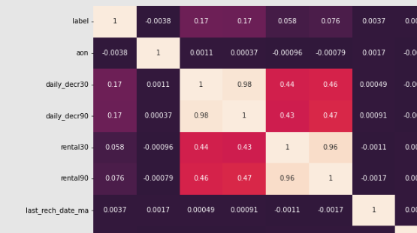
Contd.
The difference between 75% and maximum is higher that's why outliers are high which needs to be removed.
The pdate column tells the date when the data is collected. It contains only three-month data.
The features which are highly correlated with each other are daily_decr30, daily_decr90, rental30, rental90, cnt_loans30, amount_loans30, amount_loans30, amount_loans90 column medianamnt_loans30, medianamnt_loans90. We have to drop one of the features which are highly correlated with other features.

Slide 8
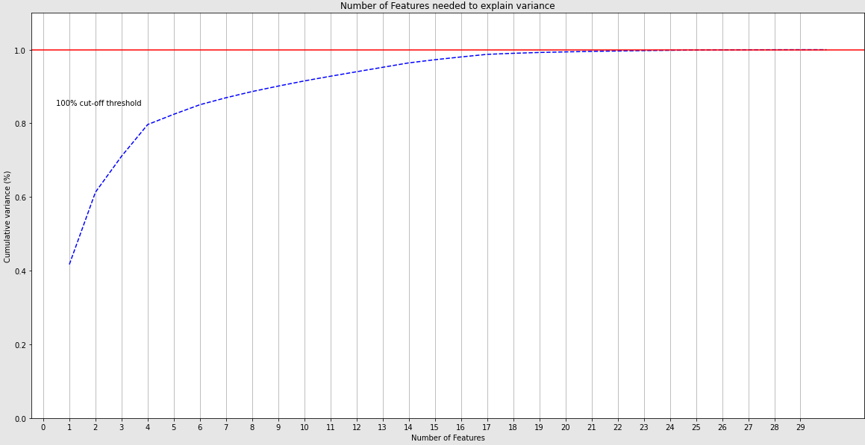
Data Pre-processing
There are many outliers in the data which were removed using the z-score.
The target variable is imbalanced and resampling algorithm is applied on the target column.
The features and target were split from the database and Chi square test was utilised in determining the feature importance and 21 features are required to retain all the information for model development.

Slide 9
Model Training and Testing
The features and target are split into train and test sections using the train_test_split function for random state-4 and test-size-0.30. The algorithms used for model training and testing are Logistic Regression, Random Forest Classifier, Decision Tree Classifier and Gaussian NB Classifier.
Linear Regression models had no difference in accuracy score of training and testing data which is beneficial but the training score is only 74%.
Random Forest Classifier had difference of 3 units between accuracy score of training and test data.
Decision Tree Classifier had difference of 5 units between accuracy score of training and test data.
Gaussian NB Classifier had no difference of accuracy score between training and test data.
The four algorithms were employed in model development and the model was selected based on the accuracy score and f1 score on training and testing data and the results are as below,
Model | Accuracy Score (%) |  | F1-Score (%)
 | Train | Test | Train | Test
Logistic Regression | 74 | 74 | 74 | 74
Random Forest Classifier | 100 | 97 | 100 | 97
Decision Tree Classifier | 100 | 95 | 100 | 95
Gaussian NB Classifier | 66 | 66 | 64 | 64

Slide 10
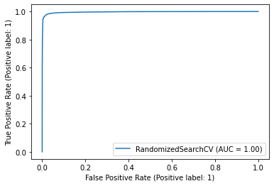
Conclusions
Random Forest Model is the effective model for the case study since it has a good training score and the difference between training and testing score is less compared to Decision Tree Classifier.
The Random Forest model was further analysed using the Randomised Search CV hyperparameter tuning algorithm and from the results the False Negative reduced from 163 to 158.
The roc curve of the developed classification model is shown below.

Slide 11
Thank You

