Slide 1
Logistic Regression

Slide 2
Outline
Introduction & Motivation
Linear Regression Limitation for Classification
Logistic Function & Probability Interpretation
Mathematical Model for Logistic Function
Decision Boundary & Geometry
Loss Function for Logistic Regression

Slide 3
Outline
7. Maximum Likelihood Estimation (MLE)
8. Gradient Descent Optimization
9. Regularization (L1 & L2)
10. Performance Metrics

Slide 4
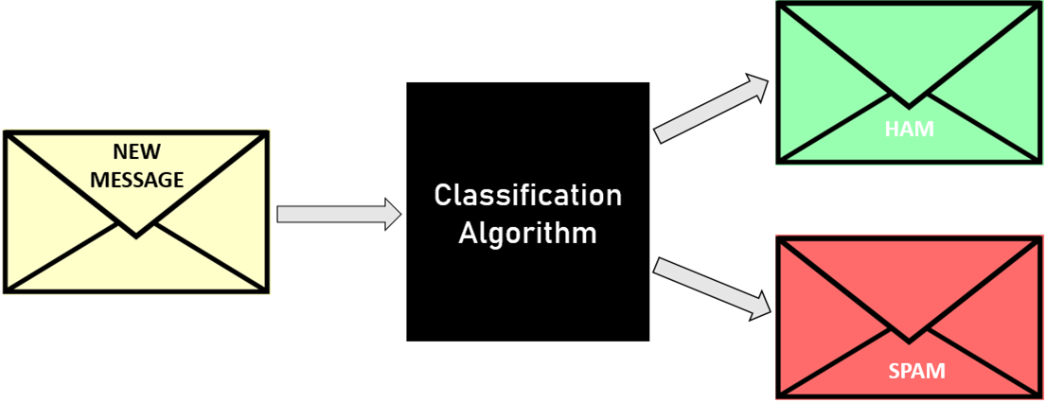
Introduction & Motivation
1.Why Do We Need Logistic Regression?
In many real-world machine learning problems, the goal is not to predict a continuous value, but to make a decision between classes.
Is this email Spam or Not Spam?
Does a patient have a disease or no disease?
Is a network packet malicious or normal?
Will a customer buy or not buy a product?
These problems are fundamentally classification problems, especially binary classification.

Slide 5
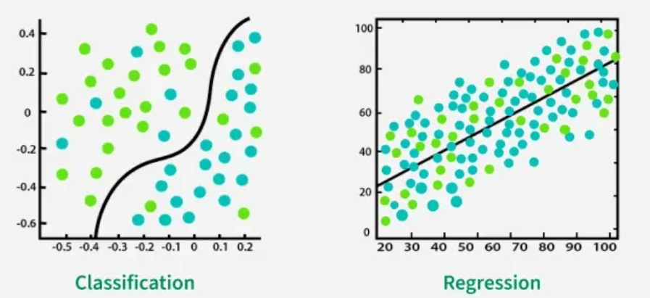
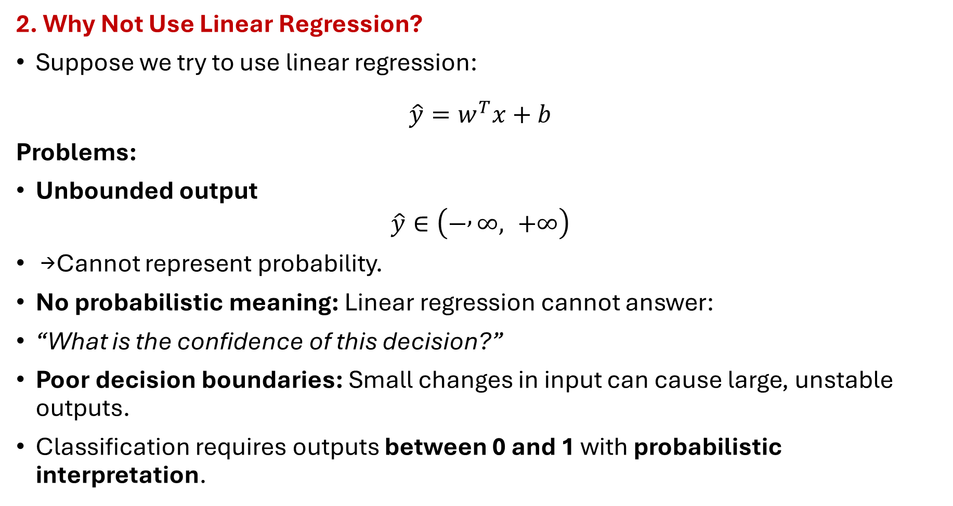
Introduction & Motivation
2. Why Not Use Linear Regression?
Suppose we try to use linear regression:
$$\hat{y}=w^{T}x+b$$
Problems:
Unbounded output
$$\hat{y}∈\left(− , ∞, +∞\right)$$
→ Cannot represent probability.
No probabilistic meaning: Linear regression cannot answer:
“What is the confidence of this decision?”
Poor decision boundaries: Small changes in input can cause large, unstable outputs.
Classification requires outputs between 0 and 1 with probabilistic interpretation.

Slide 6
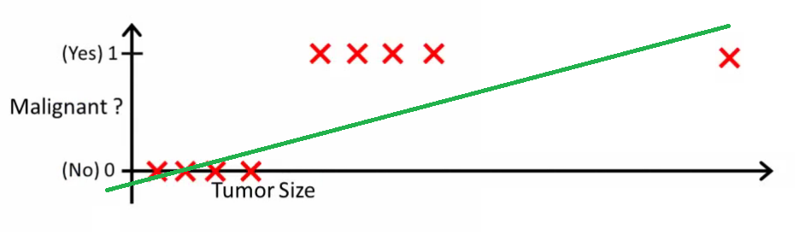
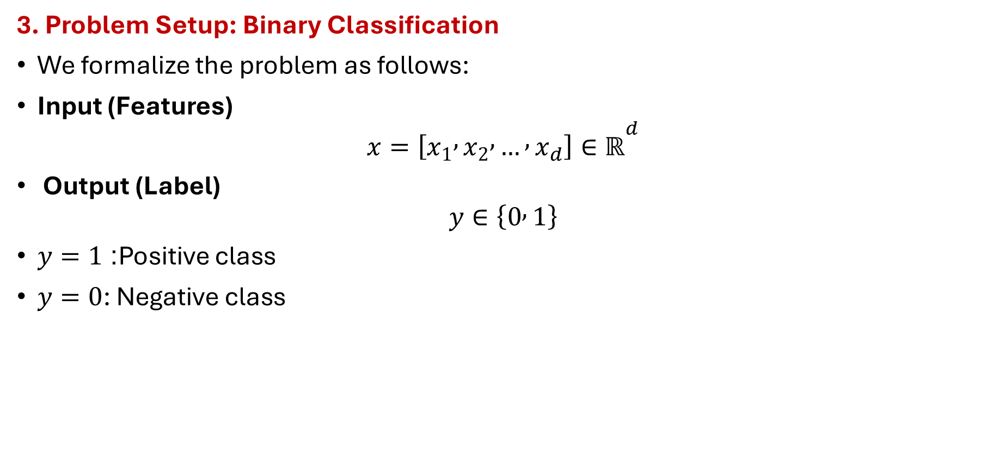
Introduction & Motivation
3. Problem Setup: Binary Classification
We formalize the problem as follows:
Input (Features)
$$x=\left[x_{1} , x_{2} , … , x_{d}\right]∈ℝ^{d}$$
Output (Label)
$$y∈\left\{0 , 1\right\}$$
$y=1$: Positive class
$y=0$: Negative class

Slide 7
Introduction & Motivation
4. Desired Model Properties
We want a model that:
Requirement | Reason
Outputs in ([0,1]) | Probability interpretation
Smooth & differentiable | Gradient-based optimization
Linear decision boundary | Interpretability
Probabilistic | Risk-aware decisions

Slide 8
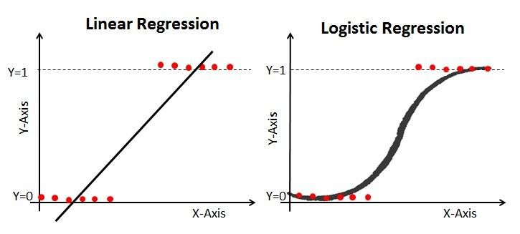
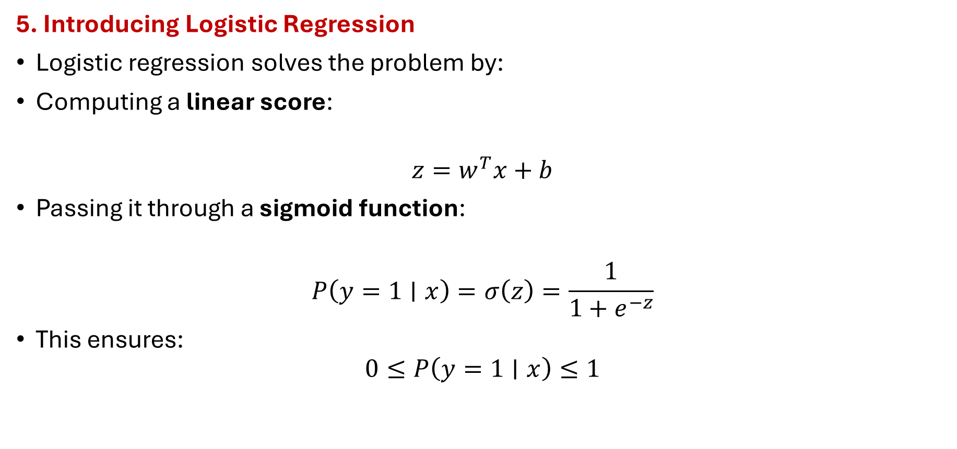
Introduction & Motivation
5. Introducing Logistic Regression
Logistic regression solves the problem by:
Computing a linear score:
$$z=w^{T}x+b$$
Passing it through a sigmoid function:
$$P\left(y=1∣x\right)=σ\left(z\right)=\frac{1}{1+e^{−z}}$$
This ensures:
$$0≤P\left(y=1∣x\right)≤1$$

Slide 9
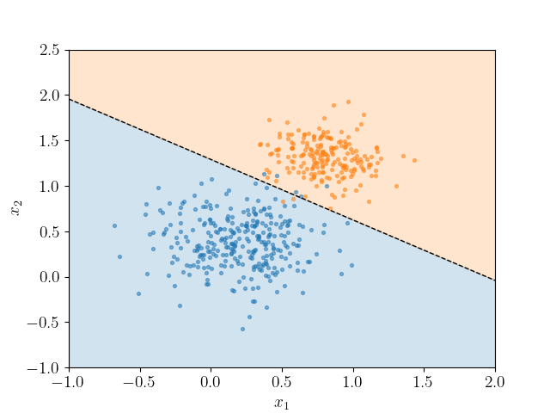

Introduction & Motivation
6. Decision Rule
To convert probability into a class label:
$$\hat{y}=\left\{\begin{matrix}1, & P\left(y=1∣x\right)≥0.5 \\ 0, & \text{otherwise}\end{matrix}\right.$$
The value 0.5 is a threshold (can be tuned).

Slide 10
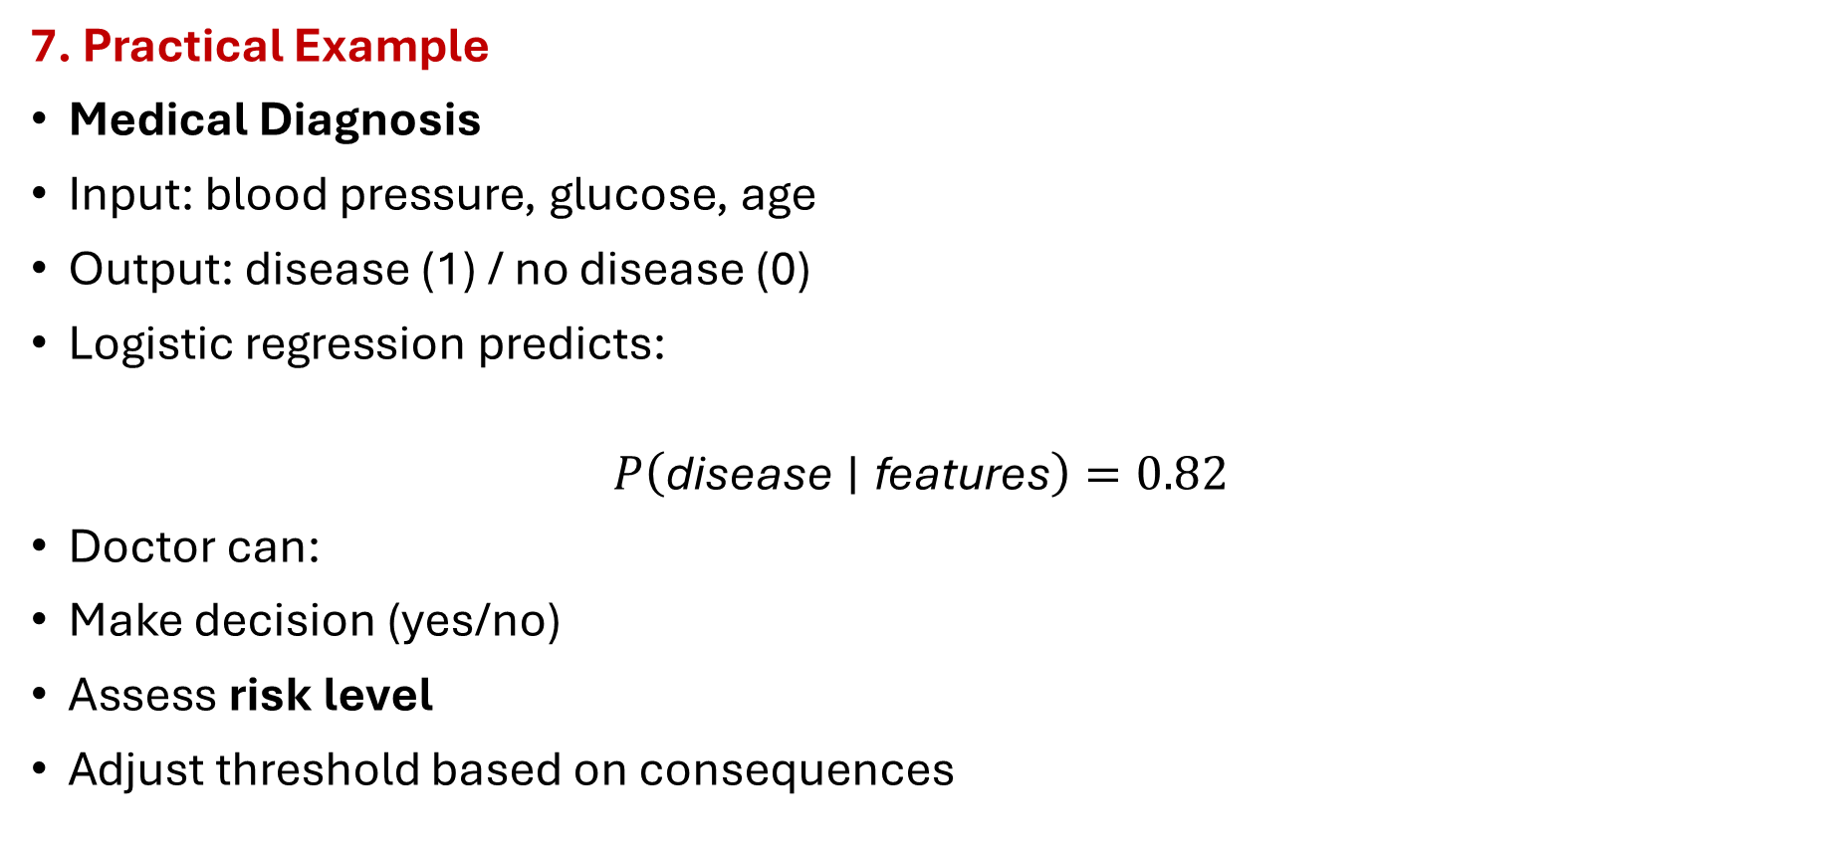
Introduction & Motivation
7. Practical Example
Medical Diagnosis
Input: blood pressure, glucose, age
Output: disease (1) / no disease (0)
Logistic regression predicts:
$$P\left(\text{disease}∣\text{features}\right)=0.82$$
Doctor can:
Make decision (yes/no)
Assess risk level
Adjust threshold based on consequences

Slide 11
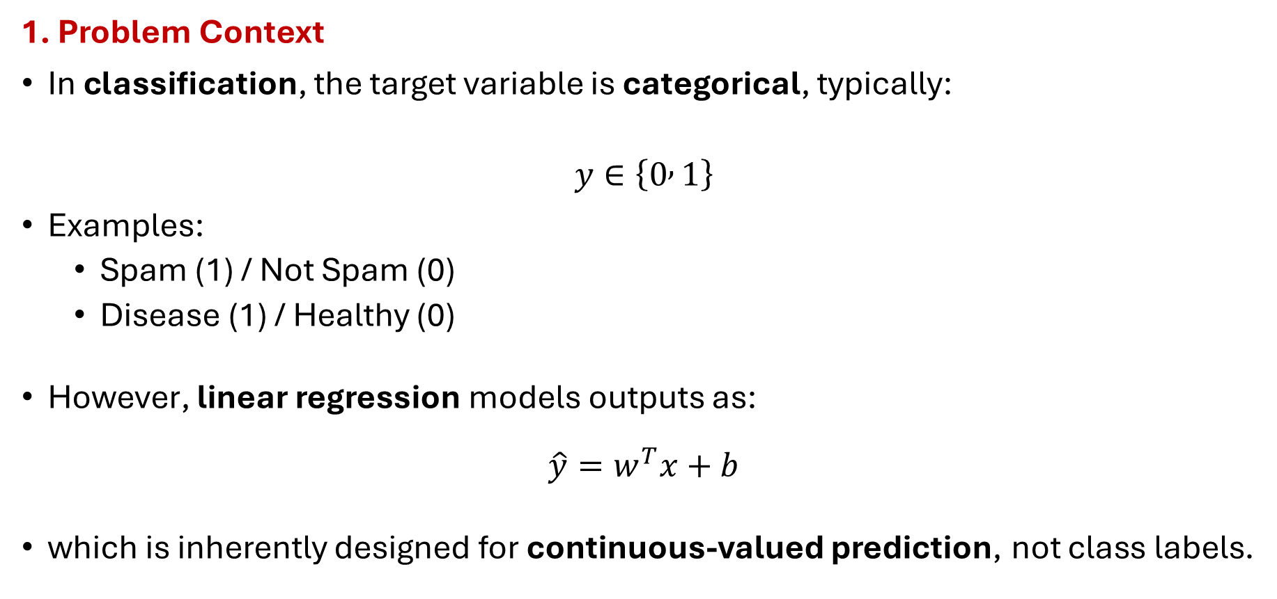
Linear Regression Limitation for Classification
1. Problem Context
In classification, the target variable is categorical, typically:
$$y∈\left\{0 , 1\right\}$$
Examples:
Spam (1) / Not Spam (0)
Disease (1) / Healthy (0)
However, linear regression models outputs as:
$$\hat{y}=w^{T}x+b$$
which is inherently designed for continuous-valued prediction, not class labels.

Slide 12
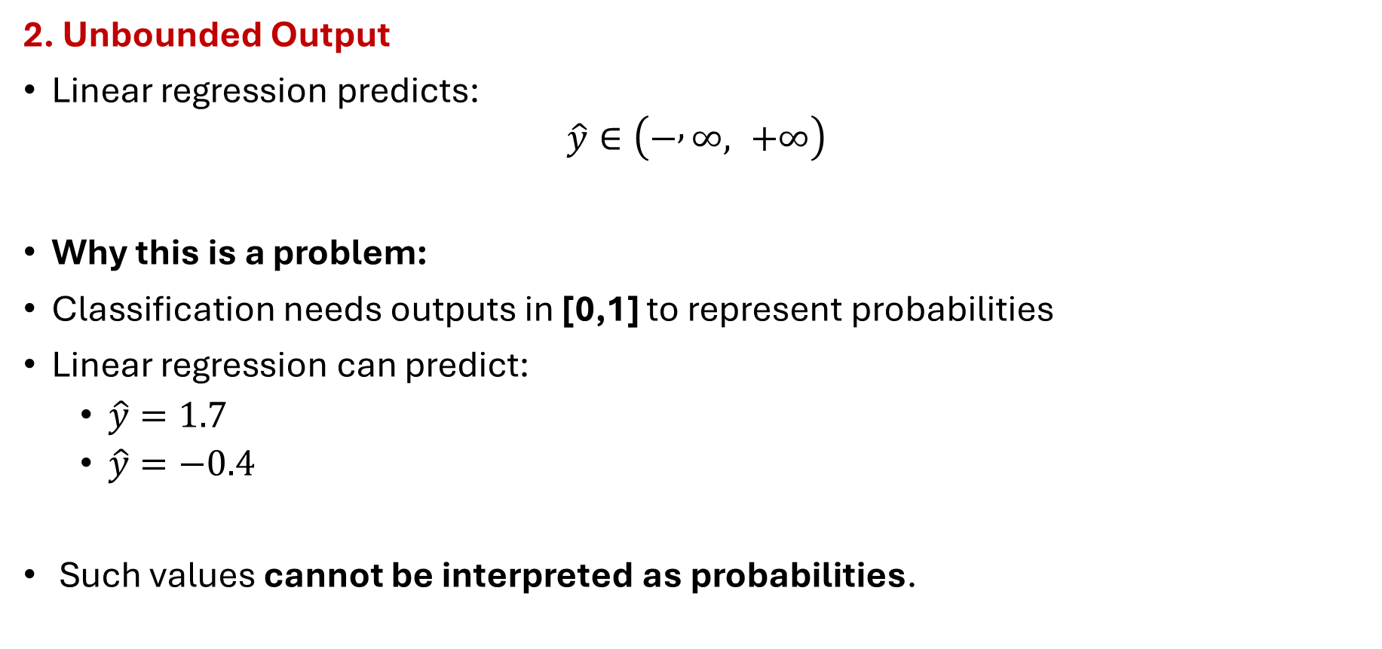
Linear Regression Limitation for Classification
2. Unbounded Output
Linear regression predicts:
$$\hat{y}∈\left(− , ∞, +∞\right)$$
Why this is a problem:
Classification needs outputs in [0,1] to represent probabilities
Linear regression can predict:
$\hat{y}=1.7$
$\hat{y}=−0.4$
Such values cannot be interpreted as probabilities.

Slide 13
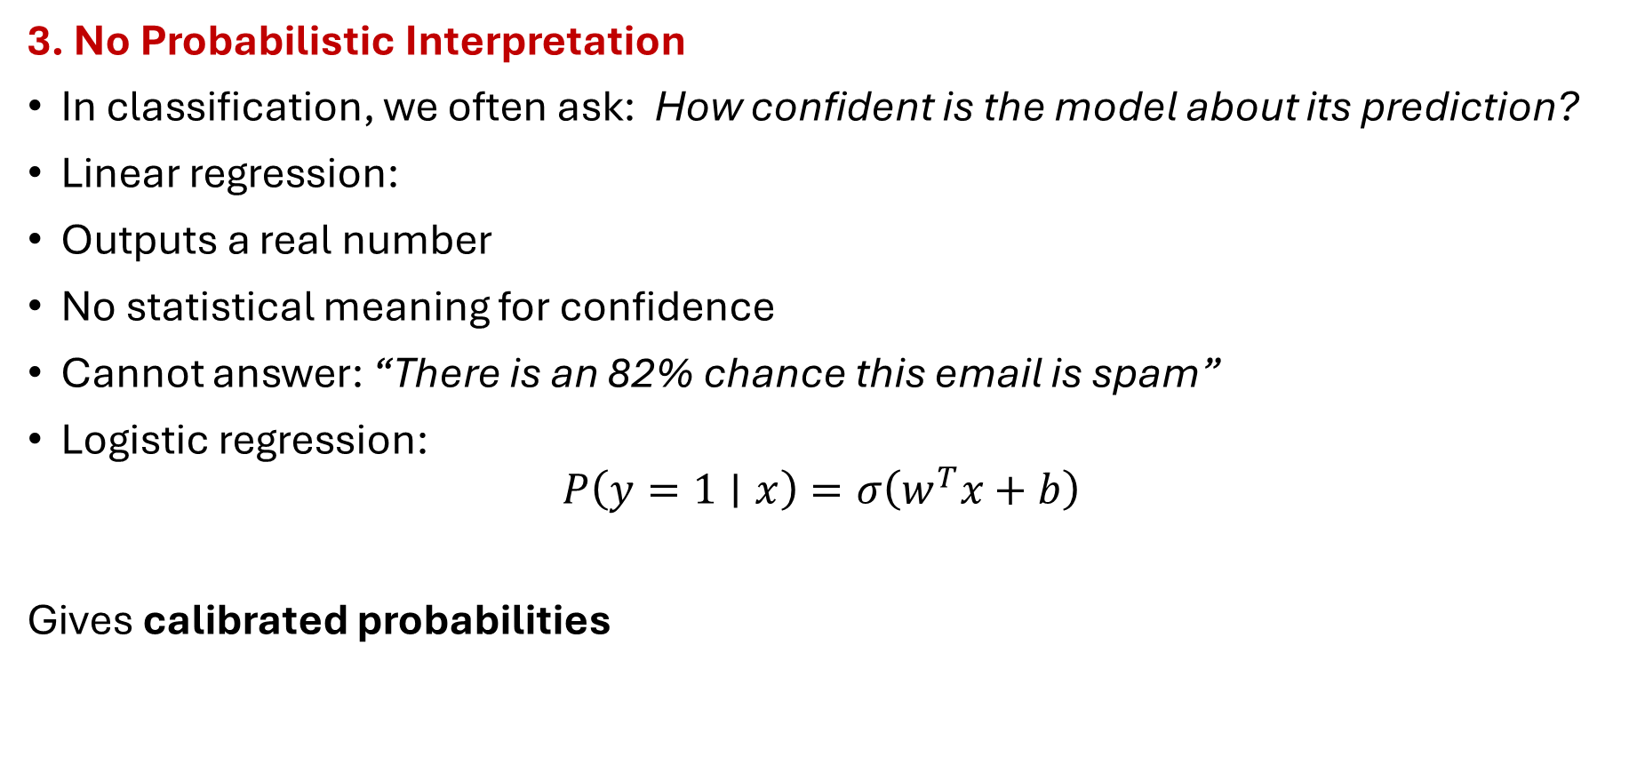
Linear Regression Limitation for Classification
3. No Probabilistic Interpretation
In classification, we often ask: How confident is the model about its prediction?
Linear regression:
Outputs a real number
No statistical meaning for confidence
Cannot answer: “There is an 82% chance this email is spam”
Logistic regression:
$$P\left(y=1∣x\right)=σ\left(w^{T}x+b\right)$$
Gives calibrated probabilities

Slide 14
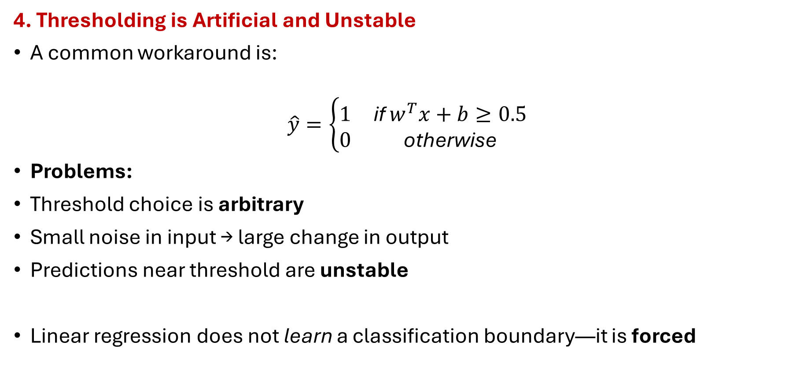
Linear Regression Limitation for Classification
4. Thresholding is Artificial and Unstable
A common workaround is:
$$\hat{y}=\left\{\begin{matrix}1 & \text{if} w^{T}x+b≥0.5 \\ 0 & \text{otherwise}\end{matrix}\right.$$
Problems:
Threshold choice is arbitrary
Small noise in input → large change in output
Predictions near threshold are unstable
Linear regression does not learn a classification boundary—it is forced

Slide 15
Linear Regression Limitation for Classification
5. Mean Squared Error is Inappropriate for Classification
Linear regression minimizes MSE:
Issues with MSE for classification:
Penalizes distance, not misclassification
Treats errors symmetrically (wrong confidence not punished)
Leads to non-optimal decision boundaries
Classification requires a likelihood-based loss, not squared error.

Slide 16
Linear Regression Limitation for Classification
6. Sensitivity to Outliers
Linear regression fits by minimizing squared error
A few mislabeled or extreme points can:
Pull the regression line
Shift the decision threshold drastically
This is dangerous in classification tasks like:
Medical diagnosis
Fraud detection
Intrusion detection

Slide 17
Linear Regression Limitation for Classification
7. Poor Decision Boundary Geometry
Even if labels are binary:
Linear regression does not optimize separation
The fitted line minimizes error, not class overlap
Logistic regression:
Explicitly models class probabilities
Optimizes a boundary that maximizes likelihood of correct classification

Slide 18
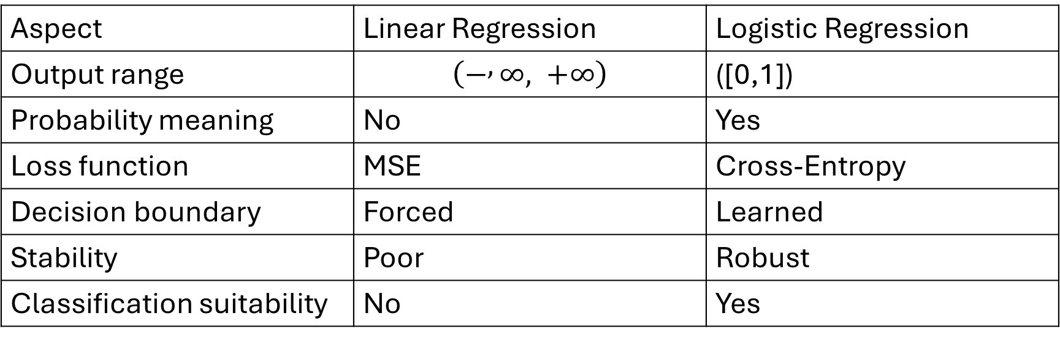
Linear Regression Limitation for Classification
8.Summary of Limitations
Aspect | Linear Regression | Logistic Regression
Output range | $$\left(− , ∞, +∞\right)$$ | ([0,1])
Probability meaning | No | Yes
Loss function | MSE | Cross-Entropy
Decision boundary | Forced | Learned
Stability | Poor | Robust
Classification suitability | No | Yes

Slide 19
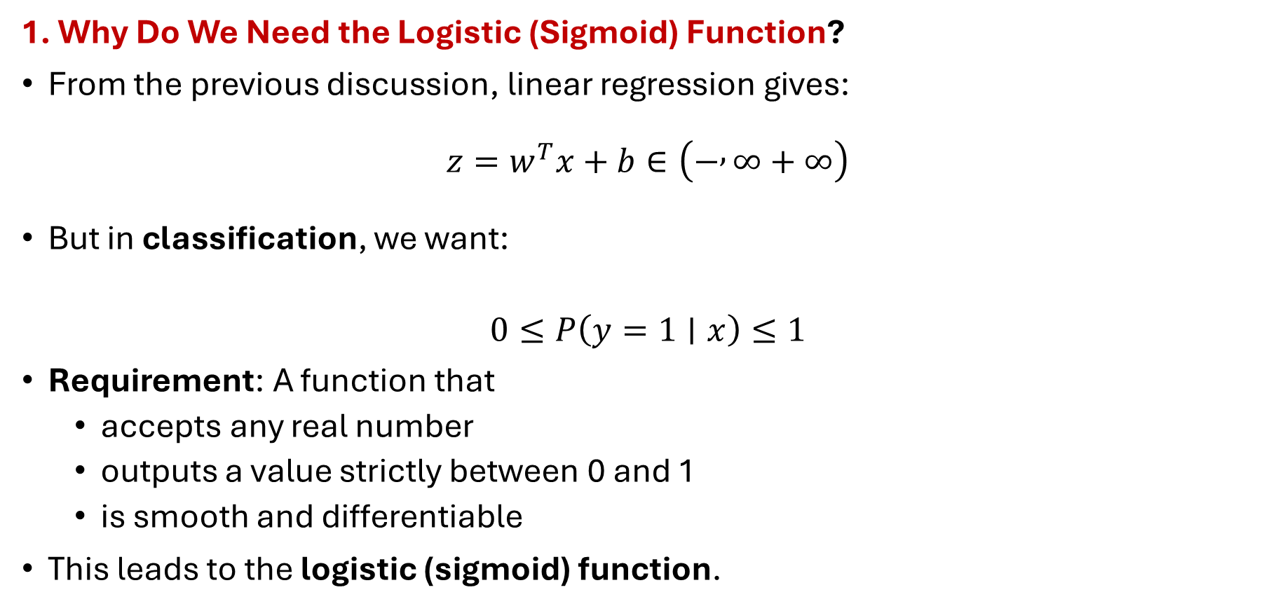
Logistic Function & Probability Interpretation
1. Why Do We Need the Logistic (Sigmoid) Function?
From the previous discussion, linear regression gives:
$$z=w^{T}x+b∈\left(− , ∞+∞\right)$$
But in classification, we want:
$$0≤P\left(y=1∣x\right)≤1$$
Requirement: A function that
accepts any real number
outputs a value strictly between 0 and 1
is smooth and differentiable
This leads to the logistic (sigmoid) function.

Slide 20

Logistic Function & Probability Interpretation
2. Definition of the Logistic (Sigmoid) Function)
$$\boxed{σ\left(z\right)=\frac{1}{1+e^{−z}}}$$
where:
$$z=w^{T}x+b$$

Slide 21
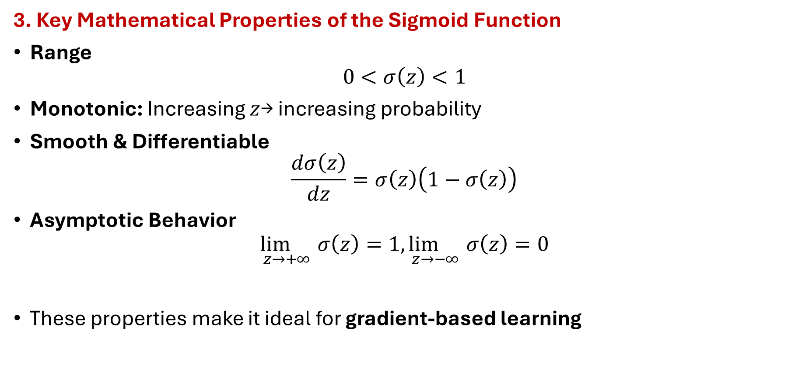
Logistic Function & Probability Interpretation
3. Key Mathematical Properties of the Sigmoid Function
Range
$$0<σ\left(z\right)<1$$
Monotonic: Increasing $z$→ increasing probability
Smooth & Differentiable
$$\frac{dσ\left(z\right)}{dz}=σ\left(z\right)\left(1−σ\left(z\right)\right)$$
Asymptotic Behavior
$$\underset{z→+∞}{\lim{}}σ\left(z\right)=1, \underset{z→−∞}{\lim{}}σ\left(z\right)=0$$
These properties make it ideal for gradient-based learning

Slide 22
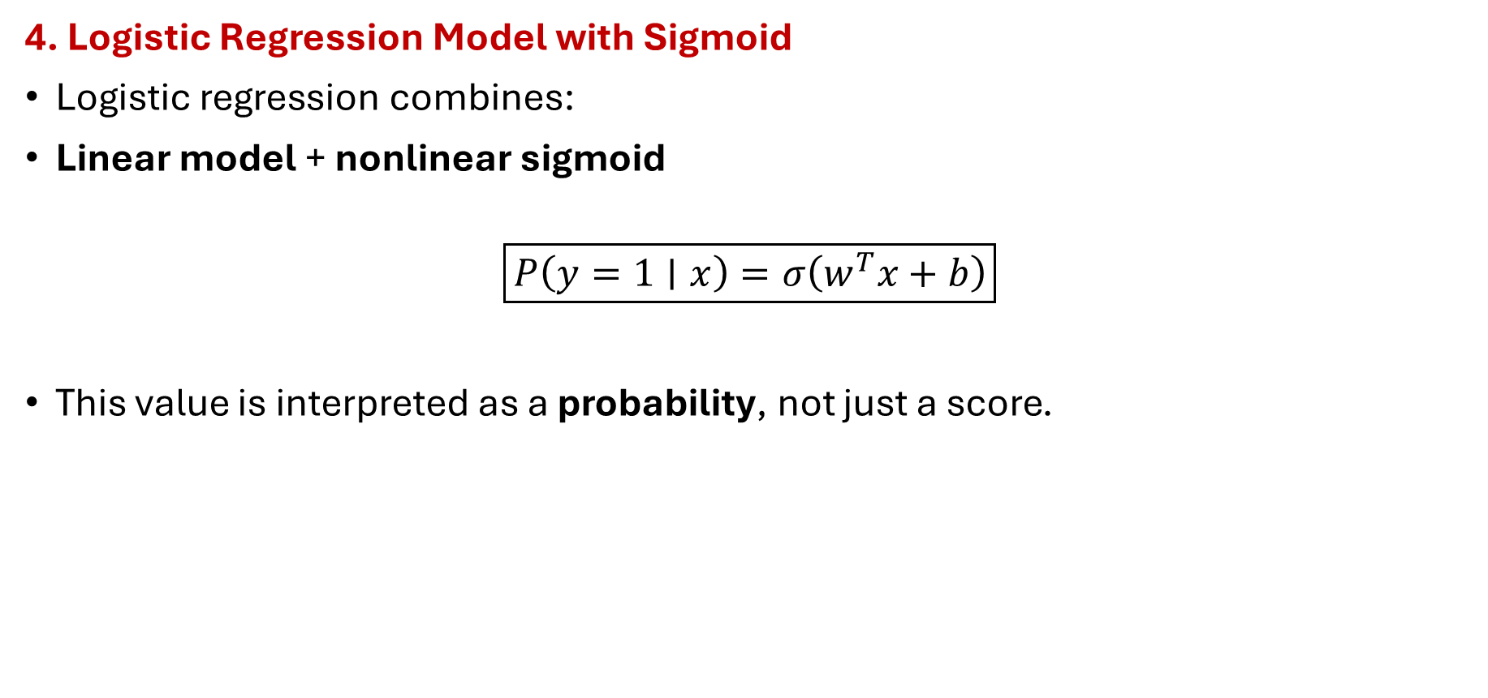
Logistic Function & Probability Interpretation
4. Logistic Regression Model with Sigmoid
Logistic regression combines:
Linear model + nonlinear sigmoid
$$\boxed{P\left(y=1∣x\right)=σ\left(w^{T}x+b\right)}$$
This value is interpreted as a probability, not just a score.

Slide 23
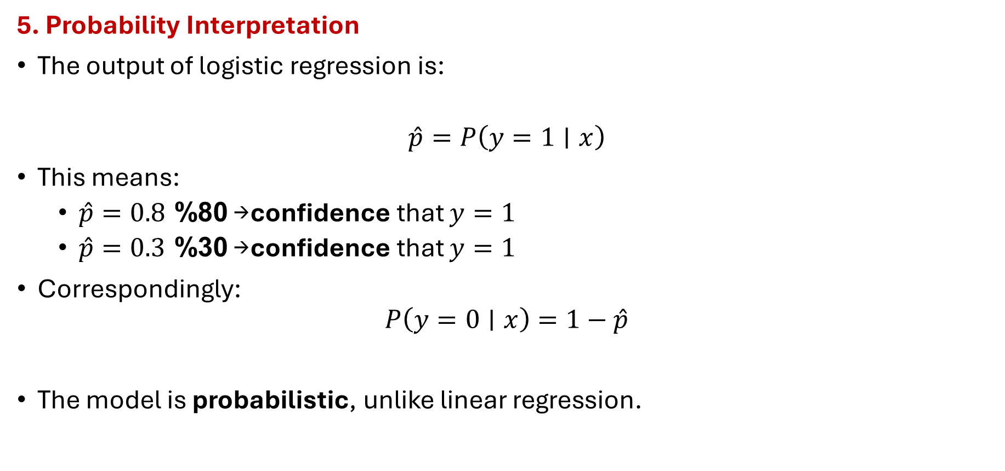
Logistic Function & Probability Interpretation
5. Probability Interpretation
The output of logistic regression is:
$$\hat{p}=P\left(y=1∣x\right)$$
This means:
$\hat{p}=0.8$→ 80% confidence that $y=1$
$\hat{p}=0.3$→ 30% confidence that $y=1$
Correspondingly:
$$P\left(y=0∣x\right)=1−\hat{p}$$
The model is probabilistic, unlike linear regression.

Slide 24
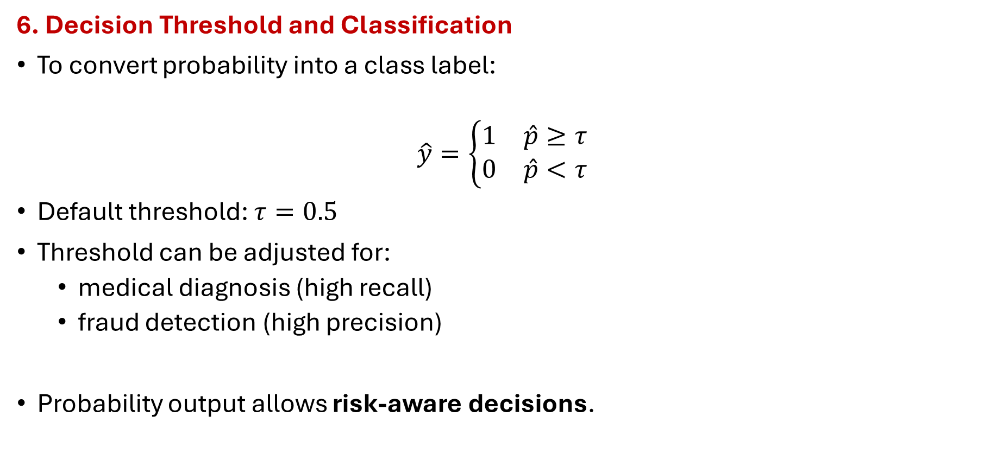
Logistic Function & Probability Interpretation
6. Decision Threshold and Classification
To convert probability into a class label:
$$\hat{y}=\left\{\begin{matrix}1 & \hat{p}≥τ \\ 0 & \hat{p}<τ\end{matrix}\right.$$
Default threshold: $τ=0.5$
Threshold can be adjusted for:
medical diagnosis (high recall)
fraud detection (high precision)
Probability output allows risk-aware decisions.

Slide 25
Logistic Function & Probability Interpretation
8.Intuition Through Values
(z) | (\sigma(z)) | Interpretation
−4 | 0.018 | Almost certainly class 0
−1 | 0.269 | Likely class 0
0 | 0.5 | Uncertain
1 | 0.731 | Likely class 1
4 | 0.982 | Almost certainly class 1

Slide 26
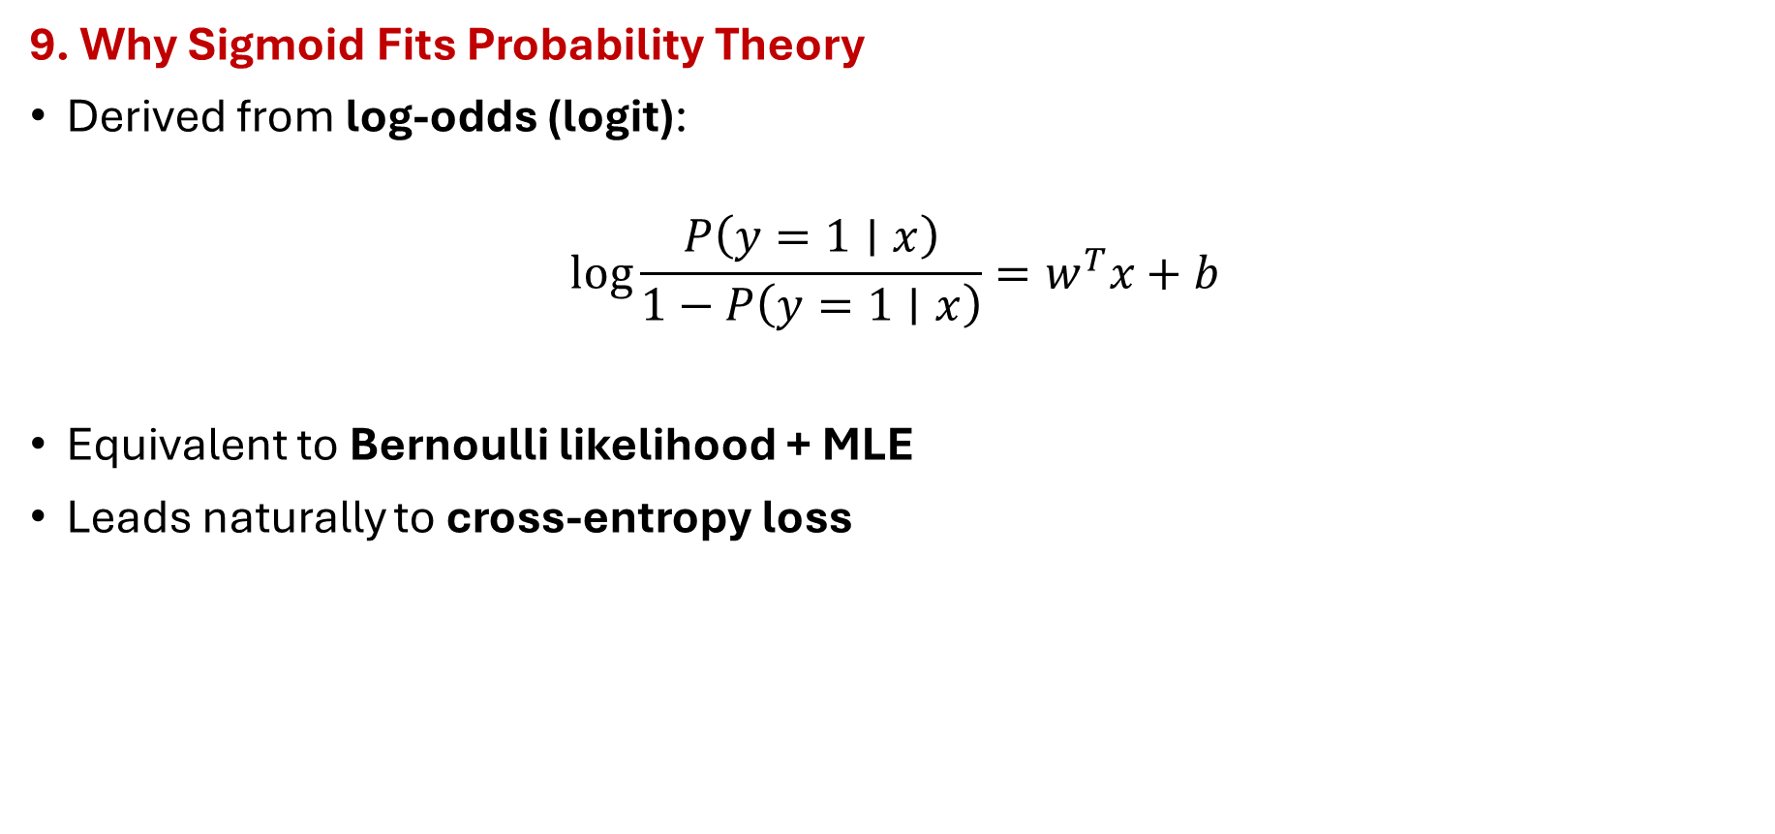
Logistic Function & Probability Interpretation
9. Why Sigmoid Fits Probability Theory
Derived from log-odds (logit):
$$\log{\frac{P\left(y=1∣x\right)}{1−P\left(y=1∣x\right)}}=w^{T}x+b$$
Equivalent to Bernoulli likelihood + MLE
Leads naturally to cross-entropy loss

Slide 27

Mathematical Model for Logistic Function
1. Problem Setting
Given a dataset:
$$𝒟=\left\{\left(x_{i} , y_{i}\right){\left.\}\right.}_{i=1}^{N}\right.$$
Feature vector:
$$x_{i}=[x_{i1} , x_{i2} , …x_{id}{\left.]\right.}^{T}∈ℝ^{d},$$
Label:
$$y_{i}∈\left\{0 , 1\right\}$$
Goal: Model the conditional probability $P\left(y=1∣x\right)$

Slide 28
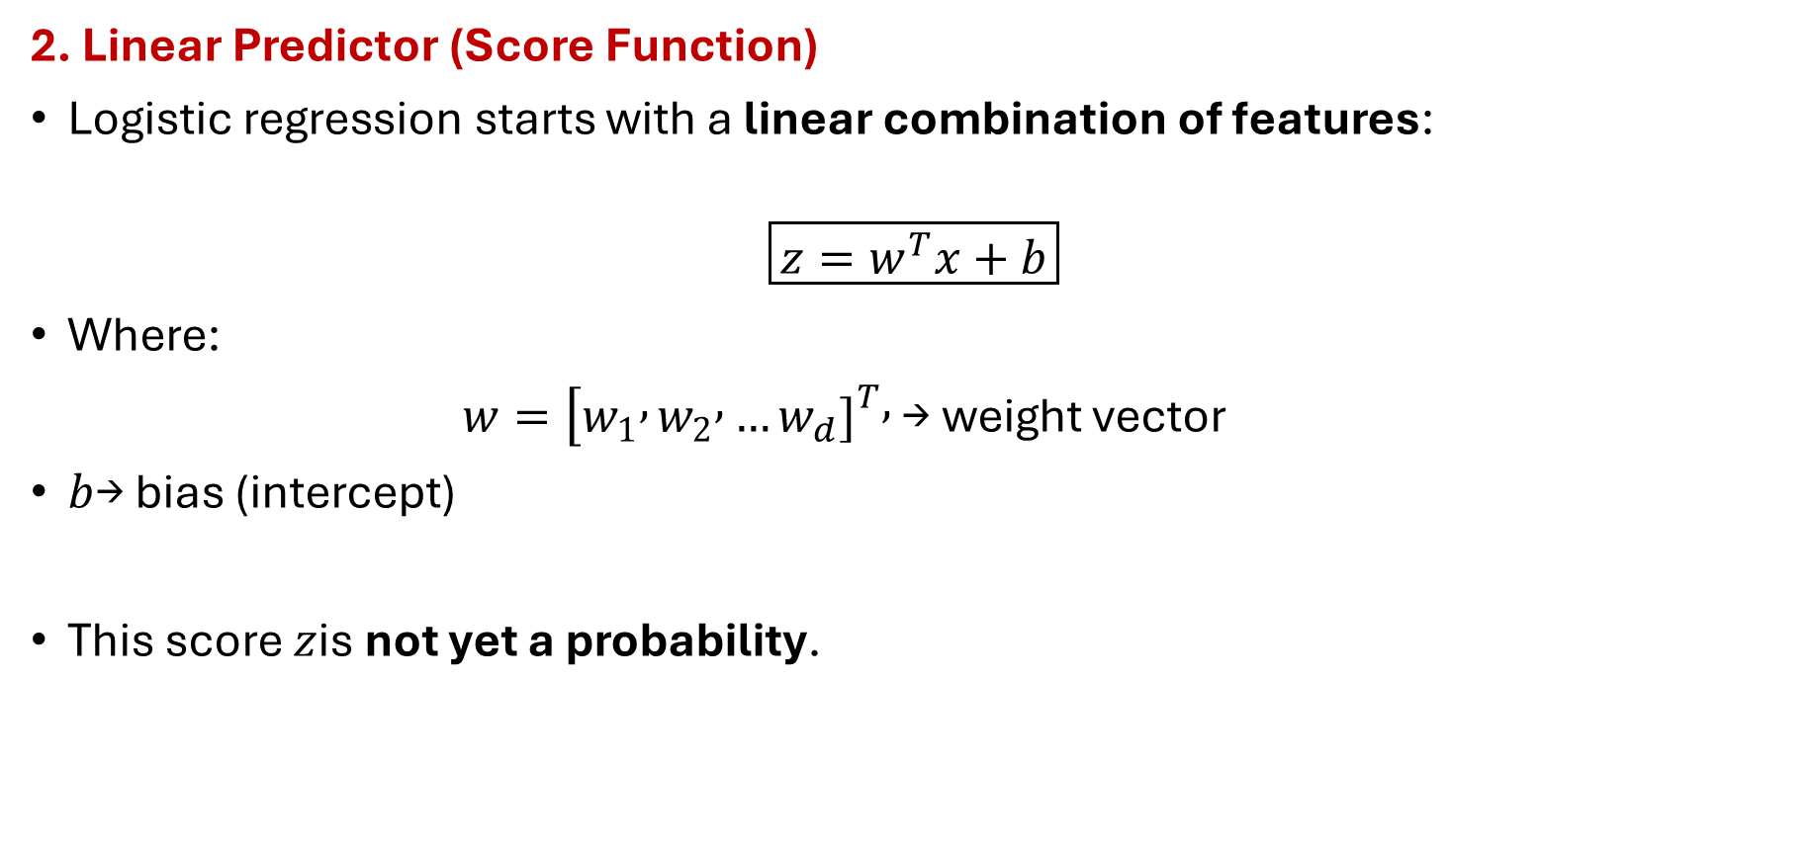
Mathematical Model for Logistic Function
2. Linear Predictor (Score Function)
Logistic regression starts with a linear combination of features:
$$\boxed{z=w^{T}x+b}$$
Where:
$w=[w_{1} , w_{2} , …w_{d}{\left.]\right.}^{T},$→ weight vector
$b$→ bias (intercept)
This score $z$is not yet a probability.

Slide 29

Mathematical Model for Logistic Function
3. Logistic (Sigmoid) Mapping
To convert $z$ into a probability:
$$\boxed{σ\left(z\right)=\frac{1}{1+e^{−z}}}$$
Thus,
$$\boxed{P\left(y=1∣x\right)=σ\left(w^{T}x+b\right)}$$
And,
$$P\left(y=0∣x\right)=1−σ\left(w^{T}x+b\right)$$

Slide 30
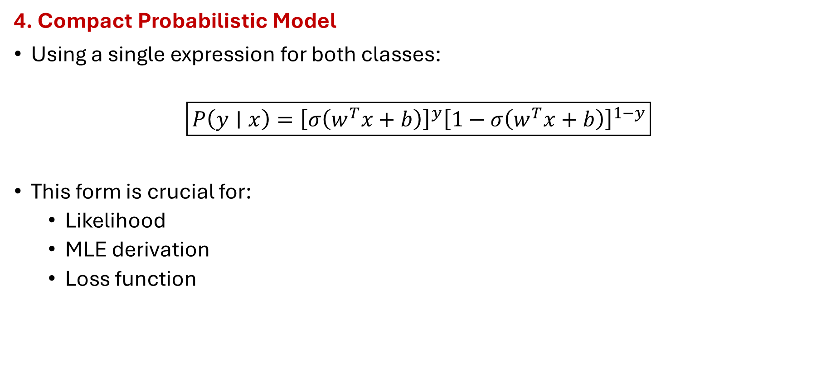
Mathematical Model for Logistic Function
4. Compact Probabilistic Model
Using a single expression for both classes:
$$\boxed{P\left(y∣x\right)={\left[σ\left(w^{T}x+b\right)\right]}^{y}{\left[1−σ\left(w^{T}x+b\right)\right]}^{1−y}}$$
This form is crucial for:
Likelihood
MLE derivation
Loss function

Slide 31
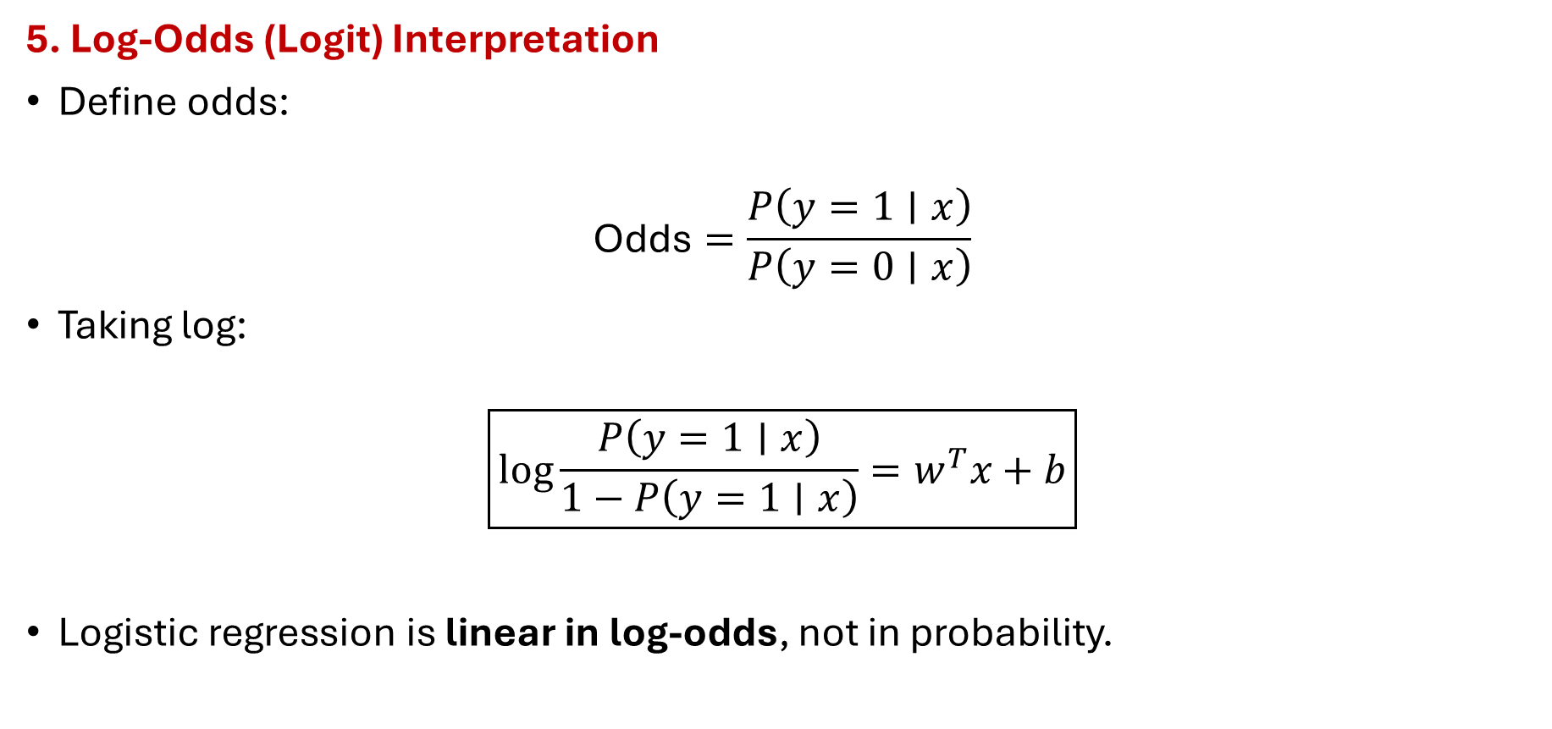
Mathematical Model for Logistic Function
5. Log-Odds (Logit) Interpretation
Define odds:
$$\text{Odds}=\frac{P\left(y=1∣x\right)}{P\left(y=0∣x\right)}$$
Taking log:
$$\boxed{\log{\frac{P\left(y=1∣x\right)}{1−P\left(y=1∣x\right)}}=w^{T}x+b}$$
Logistic regression is linear in log-odds, not in probability.

Slide 32

Mathematical Model for Logistic Function
6. Decision Rule (Classifier)
Convert probability to class label:
$$\hat{y}=\left\{\begin{matrix}1, & σ\left(w^{T}x+b\right)≥τ \\ 0, & σ\left(w^{T}x+b\right)<τ\end{matrix}\right.$$
Default threshold: $τ=0.5$
Can be tuned based on application

Slide 33
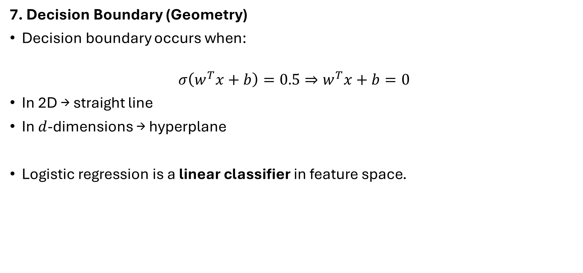
Mathematical Model for Logistic Function
7. Decision Boundary (Geometry)
Decision boundary occurs when:
$$σ\left(w^{T}x+b\right)=0.5⇒w^{T}x+b=0$$
In 2D → straight line
In $d$-dimensions → hyperplane
Logistic regression is a linear classifier in feature space.

Slide 34

Mathematical Model for Logistic Function
8. Vectorized Form (Dataset Level)
For dataset $X∈ℝ^{N×d}$:
$$\boxed{\hat{p}=σ\left(Xw+b\right)}$$
Where:
$\hat{p}∈ℝ^{N}$→ predicted probabilities
$σ\left(⋅\right)$applied element-wise

Slide 35

Mathematical Model for Logistic Function
9. What Is Learned?
During training, logistic regression learns:
Weight vector $w$
Bias $b$
By minimizing:
$$\text{Negative} \text{Log}\text{−}\text{Likelihood}\text{ (}\text{Cross}\text{−}\text{Entropy}\text{)}$$
(not MSE)

Slide 36
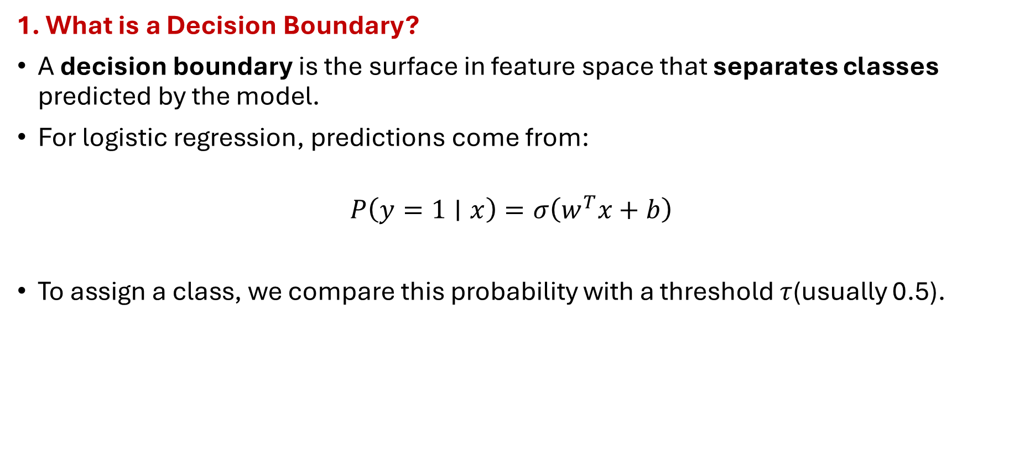
Decision Boundary & Geometry
1. What is a Decision Boundary?
A decision boundary is the surface in feature space that separates classes predicted by the model.
For logistic regression, predictions come from:
$$P\left(y=1∣x\right)=σ\left(w^{T}x+b\right)$$
To assign a class, we compare this probability with a threshold $τ$(usually 0.5).

Slide 37
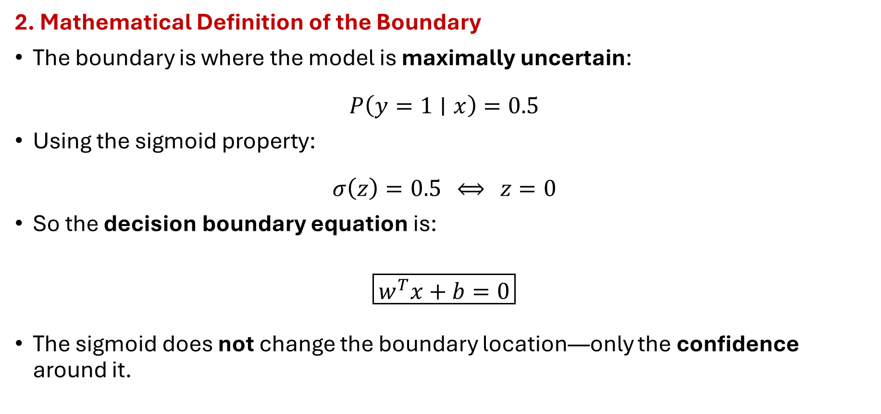
Decision Boundary & Geometry
2. Mathematical Definition of the Boundary
The boundary is where the model is maximally uncertain:
$$P\left(y=1∣x\right)=0.5$$
Using the sigmoid property:
$$σ\left(z\right)=0.5 ⟺ z=0$$
So the decision boundary equation is:
$$\boxed{w^{T}x+b=0}$$
The sigmoid does not change the boundary location—only the confidence around it.

Slide 38
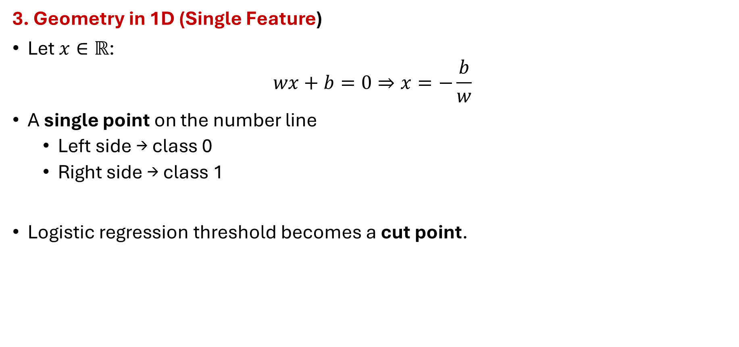
Decision Boundary & Geometry
3. Geometry in 1D (Single Feature)
Let $x∈ℝ$:
$$wx+b=0⇒x=−\frac{b}{w}$$
A single point on the number line
Left side → class 0
Right side → class 1
Logistic regression threshold becomes a cut point.

Slide 39
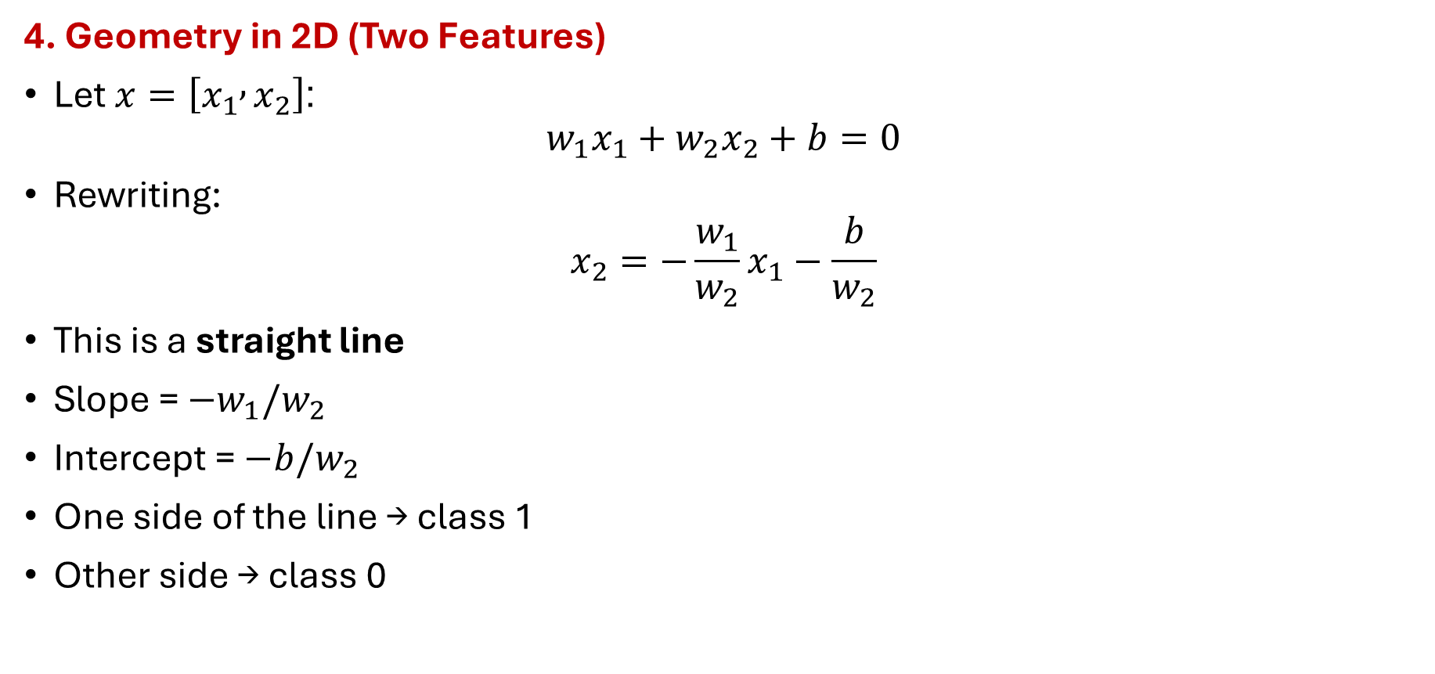
Decision Boundary & Geometry
4. Geometry in 2D (Two Features)
Let $x=\left[x_{1} , x_{2}\right]$:
$$w_{1}x_{1}+w_{2}x_{2}+b=0$$
Rewriting:
$$x_{2}=−\frac{w_{1}}{w_{2}}x_{1}−\frac{b}{w_{2}}$$
This is a straight line
Slope = $−w_{1}/w_{2}$
Intercept = $−b/w_{2}$
One side of the line → class 1
Other side → class 0

Slide 40
Decision Boundary & Geometry
5. Geometry in Higher Dimensions
Logistic regression always produces a linear separator in the original feature space.
Feature Dimension | Decision Boundary
1D | Point
2D | Line
3D | Plane
(d)D | Hyperplane

Slide 41
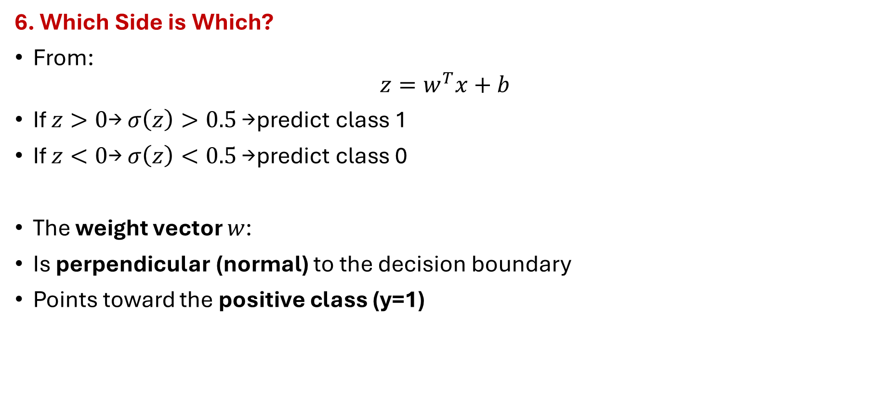
Decision Boundary & Geometry
6. Which Side is Which?
From:
$$z=w^{T}x+b$$
If $z>0$→ $σ\left(z\right)>0.5$→ predict class 1
If $z<0$→ $σ\left(z\right)<0.5$→ predict class 0
The weight vector $w$:
Is perpendicular (normal) to the decision boundary
Points toward the positive class (y=1)

Slide 42
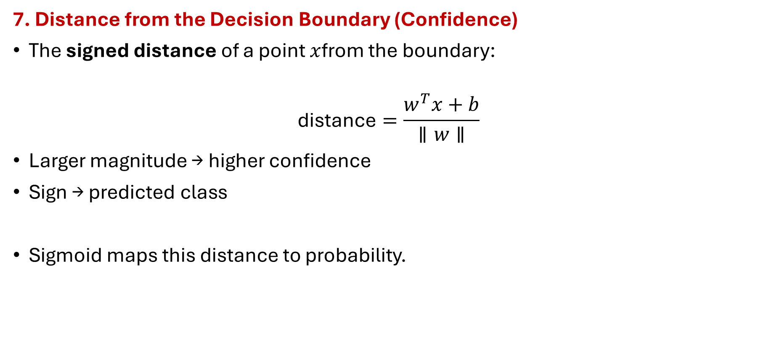
Decision Boundary & Geometry
7. Distance from the Decision Boundary (Confidence)
The signed distance of a point $x$from the boundary:
$$\text{distance}=\frac{w^{T}x+b}{∥w∥}$$
Larger magnitude → higher confidence
Sign → predicted class
Sigmoid maps this distance to probability.

Slide 43

Decision Boundary & Geometry
8. Probability Contours (Iso-Probability Lines)
Lines of constant probability satisfy:
$$w^{T}x+b=c$$
Parallel to the decision boundary
$c>0$→ higher probability of class 1
$c<0$→ higher probability of class 0
This creates smooth probability gradients across space

Slide 44

Decision Boundary & Geometry
9. Effect of Threshold Change
If threshold $τ≠0.5$:
$$σ\left(w^{T}x+b\right)=τ⇒w^{T}x+b=\log{\frac{τ}{1−τ}}$$
Boundary shifts parallel
Orientation unchanged

Slide 45
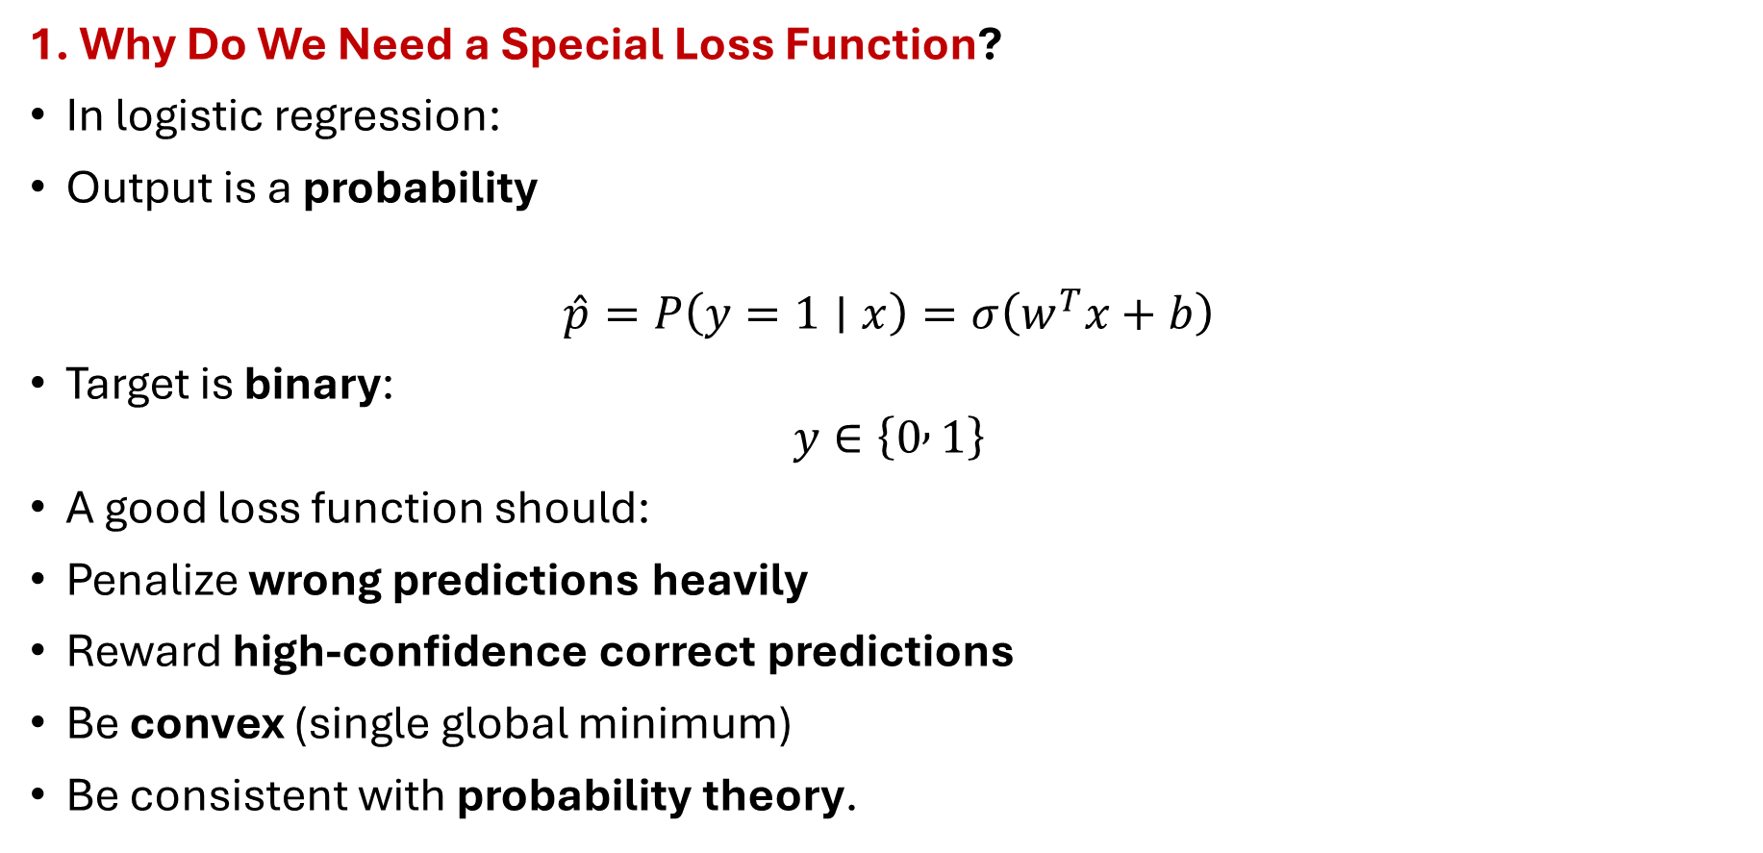
Loss Function for Logistic Regression
1. Why Do We Need a Special Loss Function?
In logistic regression:
Output is a probability
$$\hat{p}=P\left(y=1∣x\right)=σ\left(w^{T}x+b\right)$$
Target is binary:
$$y∈\left\{0 , 1\right\}$$
A good loss function should:
Penalize wrong predictions heavily
Reward high-confidence correct predictions
Be convex (single global minimum)
Be consistent with probability theory.

Slide 46

Loss Function for Logistic Regression
2. Probabilistic Foundation (Bernoulli Model)
Each label $y$is modeled as a Bernoulli random variable with parameter $\hat{p}$:
$$P\left(y∣\hat{p}\right)={\hat{p}}^{y}\left(1−\hat{p}{\left.)\right.}^{1−y}\right.$$
If $y=1$: probability = $\hat{p}$
If $y=0$: probability = $1−\hat{p}$
This naturally leads to a likelihood-based loss.

Slide 47

Loss Function for Logistic Regression
3. Negative Log-Likelihood → Loss Function
Log-likelihood for one sample:
To train the model, we maximize this likelihood.
Equivalently, we minimize the negative log-likelihood.

Slide 48

Loss Function for Logistic Regression
4. Binary Cross-Entropy (Log Loss)
Loss for a single data point
This is called:
Binary Cross-Entropy
Log Loss
Negative Log-Likelihood (Bernoulli)
All are mathematically equivalent.

Slide 49
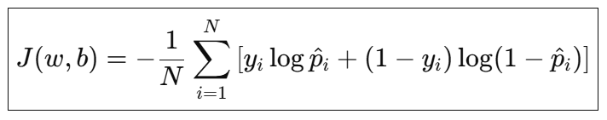

Loss Function for Logistic Regression
5. Dataset-Level Loss
For $N$training samples:
where:
$${\hat{p}}_{i}=σ\left(w^{T}x_{i}+b\right)$$

Slide 50

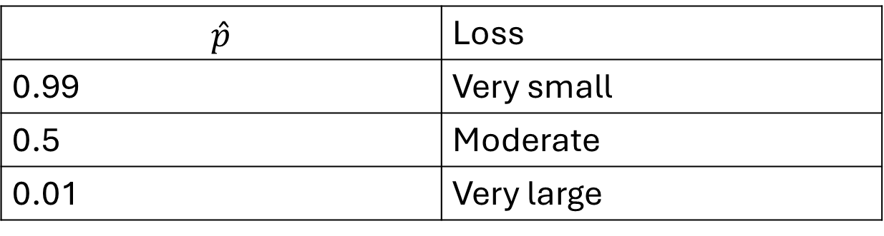

Loss Function for Logistic Regression
6. Why This Loss Makes Sense (Intuition)
Case 1: True label $y=1$
$$\hat{p}$$ | Loss
0.99 | Very small
0.5 | Moderate
0.01 | Very large

Slide 51


Loss Function for Logistic Regression
6. Why This Loss Makes Sense (Intuition)
Case 2: True label $y=0$
Confident but wrong predictions are punished exponentially.
(\hat{p}) | Loss
0.01 | Very small
0.5 | Moderate
0.99 | Very large

Slide 52

Loss Function for Logistic Regression
7. Loss in Terms of the Linear Score $z$
Since:
$$\hat{p}=σ\left(z\right)=\frac{1}{1+e^{−z}}$$
The loss can be rewritten as:
Numerically stable
Used internally in most ML libraries

Slide 53
Loss Function for Logistic Regression
8.Why Not Mean Squared Error (MSE)?
Aspect | MSE | Cross-Entropy
Designed for | Regression | Classification
Penalizes confidence | No | Yes
Convex for logistic model | No | Yes
Probabilistic meaning | No | Yes
Gradient quality | Poor | Strong

Slide 54
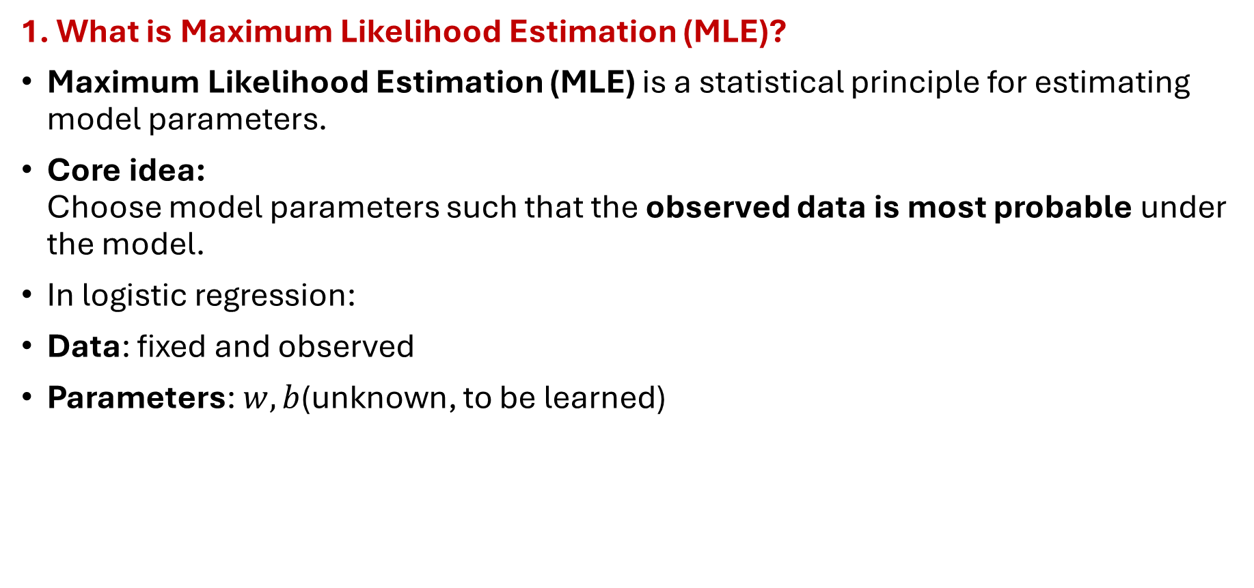
Maximum Likelihood Estimation (MLE)
1. What is Maximum Likelihood Estimation (MLE)?
Maximum Likelihood Estimation (MLE) is a statistical principle for estimating model parameters.
Core idea: Choose model parameters such that the observed data is most probable under the model.
In logistic regression:
Data: fixed and observed
Parameters: $w,b$(unknown, to be learned)

Slide 55

Maximum Likelihood Estimation (MLE)
2. Likelihood vs Probability (Crucial Distinction)
In training:
$ℒ\left(w , , b\right)=P\left(\text{data} , ∣w, b\right)$
We do not ask: “What is the probability of data?”
We ask: “For which $w,b$is this data most likely?”
Concept | What varies | What is fixed
Probability | Data | Parameters
Likelihood | Parameters | Data

Slide 56

Maximum Likelihood Estimation (MLE)
3. Probabilistic Model in Logistic Regression
Logistic regression models:
$$P\left(y=1∣x\right)=σ\left(w^{T}x+b\right)$$
Since $y∈\left\{0 , 1\right\}$, we assume:
$y∼\text{Bernoulli}\left(p\right) \text{where} p=σ\left(w^{T}x+b\right)$

Slide 57

Maximum Likelihood Estimation (MLE)
4. Likelihood for a Single Training Example
Using the Bernoulli distribution:
$$\boxed{P\left(y ; ∣ ; x; wb\right)=p^{y}\left(1−p{\left.)\right.}^{1−y}\right.}$$
This compact form covers:
$$y=1⇒P=p$$
$$y=0⇒P=1−p$$

Slide 58

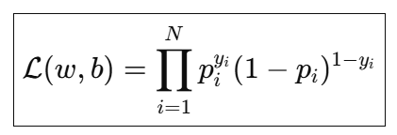
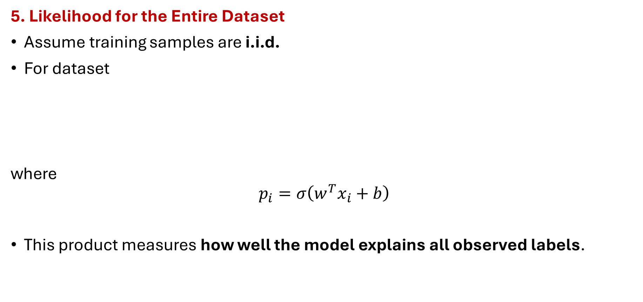
Maximum Likelihood Estimation (MLE)
5. Likelihood for the Entire Dataset
Assume training samples are i.i.d.
For dataset
where
$$p_{i}=σ\left(w^{T}x_{i}+b\right)$$
This product measures how well the model explains all observed labels.

Slide 59
Maximum Likelihood Estimation (MLE)
6. Log-Likelihood (Why We Take Logs)
Multiplying many probabilities causes:
Numerical underflow
Difficult differentiation
So we take logarithm (monotonic):
Product → Sum
Same maximizer
Easier gradients

Slide 60

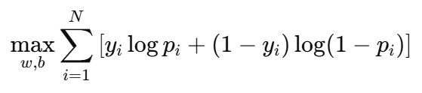
Maximum Likelihood Estimation (MLE)
7. Maximum Likelihood Objective
MLE seeks:
That is:

Slide 61


Maximum Likelihood Estimation (MLE)
8. From MLE to Loss Function
Optimization algorithms typically minimize rather than maximize.
So define loss = negative log-likelihood:
Dividing by $N$gives average loss.
This is exactly the Binary Cross-Entropy Loss.

Slide 62

Maximum Likelihood Estimation (MLE)
9. Intuitive Interpretation of MLE
MLE pushes the model to:
Assign high probability to true class labels
Assign low probability to incorrect classes
Because:
If $y=1$and $p→0$→ loss $→∞$
If $y=0$and $p→1$→ loss $→∞$
Confident mistakes are punished the most.

Slide 63
Maximum Likelihood Estimation (MLE)
10. Why MLE is Ideal for Logistic Regression
Property | Reason
Probabilistic | Matches sigmoid output
Convex objective | Global optimum
Strong gradients | Fast convergence
Statistical foundation | Bernoulli distribution
Interpretable | Likelihood of observed data

Slide 64


Gradient Descent Optimization
1. Why Gradient Descent?
In logistic regression, we cannot solve for $w,b$in closed form (unlike linear regression). So, we iteratively minimize the loss using Gradient Descent (GD).
Objective (Binary Cross-Entropy):

Slide 65

Gradient Descent Optimization
2. Core Idea of Gradient Descent
Gradient descent updates parameters in the direction of steepest decrease of the loss.
$$θ:=θ−η∇_{θ}J\left(θ\right)$$
$θ$: parameters ($w,b$)
$η$: learning rate
$∇_{θ}J$: gradient of loss
Think of rolling downhill on the loss surface until the minimum.

Slide 66



Gradient Descent Optimization
3. Gradients for Logistic Regression
Using chain rule with sigmoid + cross-entropy, the gradients simplify neatly.
Gradient w.r.t. weights
Gradient w.r.t. bias
The term $\left(p_{i}−y_{i}\right)$is the prediction error in probability space.

Slide 67


Gradient Descent Optimization
4. Update Rules
With learning rate $η$:
Each iteration:
Compute probabilities $p_{i}$
Compute gradients
Update parameters
Repeat until convergence

Slide 68
Gradient Descent Optimization
5. Types of Gradient Descent
Method | Data used per update | Pros | Cons
Batch GD | Entire dataset | Stable, exact | Slow for large (N)
Stochastic GD (SGD) | One sample | Fast, online | Noisy updates
Mini-batch GD | Small batch (e.g., 32) | Best trade-off | Needs tuning

Slide 69


Gradient Descent Optimization
6. Learning Rate ($η$) Effects
Too small → slow convergence
Too large → divergence / oscillation
Typical values:
$$η∈\left[{10}^{−4} , {10}^{−1}\right]$$
Often tuned using validation loss.

Slide 70
Regularization (L1 & L2)
1. Why Do We Need Regularization?
In logistic regression, we minimize the negative log-likelihood (cross-entropy). Without constraints, the model may:
Fit noise in the training data
Learn very large weights
Generalize poorly to unseen data
Regularization adds a penalty on model complexity to control overfitting.

Slide 71



Regularization (L1 & L2)
2. Regularized Objective Function (General Form)
Unregularized loss:
With regularization:
$Ω\left(w\right)$: regularization term
$λ≥0$: regularization strength (hyperparameter)
Bias $b$is usually not regularized.

Slide 72

Regularization (L1 & L2)
3. L2 Regularization (Ridge / Weight Decay)
Definition
$$\boxed{Ω\left(w\right)=∥w∥_{2}^{2}=\sum_{j=1}^{d}{w_{j}^{2}}}$$
Regularized loss
$$\boxed{J_{\text{L}\text{2}}\left(w , ,b\right)=J\left(w , ,b\right)+λ\sum_{j=1}^{d}{w_{j}^{2}}}$$

Slide 73

Regularization (L1 & L2)
3. L2 Regularization (Ridge / Weight Decay)
Effect on Optimization (Gradient)
Gradient becomes:
$$\frac{∂J_{\text{L}\text{2}}}{∂w_{j}}=\frac{∂J}{∂w_{j}}+2λw_{j}$$
Update rule:
$$\boxed{w:=\left(1−2ηλ\right)w−η∇J}$$
This shrinks weights smoothly toward zero → called weight decay.

Slide 74

Regularization (L1 & L2)
4. L1 Regularization (Lasso)
$$\boxed{Ω\left(w\right)=∥w∥_{1}=\sum_{j=1}^{d}{∣}w_{j}∣}$$
Regularized loss
$$\boxed{J_{\text{L}\text{1}}\left(w , ,b\right)=J\left(w , ,b\right)+λ\sum_{j=1}^{d}{∣}w_{j}∣}$$

Slide 75

Regularization (L1 & L2)
4. L1 Regularization (Lasso)
Effect on Optimization
Gradient (subgradient):
$$\frac{∂∣w_{j}∣}{∂w_{j}}=\left\{\begin{matrix}+1 & w_{j}>0 \\ −1 & w_{j}<0 \\ \text{undefined}\text{ (}\text{use} \text{subgradient}\text{)} & w_{j}=0\end{matrix}\right.$$
Leads to exact zero weight

Slide 76
Performance Metrics
1. Why Performance Metrics Matter
In logistic regression, the model outputs probabilities, but real-world decisions depend on how good those predictions are.
A single metric (like accuracy) is often misleading, especially when:
Classes are imbalanced
Cost of errors is unequal (medical, fraud, intrusion detection)

Slide 77
Performance Metrics
2. Confusion Matrix (Foundation of All Metrics)
For binary classification:
TP: Correctly predicted positives
TN: Correctly predicted negatives
FP: False alarm
FN: Missed detection
All performance metrics are derived from this table
 | Predicted 1 | Predicted 0
Actual 1 | TP (True Positive) | FN (False Negative)
Actual 0 | FP (False Positive) | TN (True Negative)

Slide 78

Performance Metrics
3. Accuracy
$$\boxed{\text{Accuracy}=\frac{TP+TN}{TP+TN+FP+FN}}$$
Interpretation: Fraction of total correct predictions
Limitation: Misleading for imbalanced datasets
Example: If 95% data is class 0, predicting “always 0” gives 95% accuracy but is useless.

Slide 79

Performance Metrics
4. Precision (Positive Predictive Value)
$$\boxed{\text{Precision}=\frac{TP}{TP+FP}}$$
Interpretation: Of all predicted positives, how many are actually positive?
High precision means:
Few false alarms
Important when FP is costly

Slide 80

Performance Metrics
5. Recall (Sensitivity / True Positive Rate)
$$\boxed{\text{Recall}=\frac{TP}{TP+FN}}$$
Interpretation: Of all actual positives, how many did we detect?
High recall means:
Few missed positives
Important when FN is costly

Slide 81

Performance Metrics
6. Precision–Recall Trade-off
Increasing recall → often decreases precision
Increasing precision → often decreases recall
Controlled by decision threshold $τ$:
Lower $τ$→ higher recall, lower precision
Higher $τ$→ higher precision, lower recall

Slide 82

Performance Metrics
7. F1-Score (Harmonic Mean)
$$\boxed{F1=2⋅\frac{\text{Precision}⋅\text{Recall}}{\text{Precision}+\text{Recall}}}$$
Why harmonic mean?
Penalizes extreme imbalance
Requires both precision and recall to be high
Best when:
Data is imbalanced
Both FP and FN matter

Slide 83

Performance Metrics
8. Specificity (True Negative Rate)
$$\boxed{\text{Specificity}=\frac{TN}{TN+FP}}$$
Interpretation: How well the model identifies negatives

Slide 84

Performance Metrics
9. ROC Curve (Receiver Operating Characteristic)
Axes
X-axis: False Positive Rate
$$FPR=\frac{FP}{FP+TN}$$
Y-axis: True Positive Rate (Recall)
Each point corresponds to a different threshold.

Slide 85

Performance Metrics
10. AUC (Area Under the ROC Curve)
Meaning
$\boxed{\text{AUC}=P\left(\text{model} \text{ranks} \text{a} \text{random} \text{positive} \text{higher} \text{than} \text{a} \text{random} \text{negative}\right)}$
AUC | Interpretation
0.5 | Random guessing
0.7–0.8 | Good
0.8–0.9 | Very good
> 0.9 | Excellent

Slide 86

Performance Metrics
11. Log Loss (Cross-Entropy Loss)
Since logistic regression outputs probabilities:
Measures probability calibration
Penalizes confident wrong predictions
Lower log loss = better probability estimates.

Slide 87
Performance Metrics
12. Choosing the Right Metric
Application | Preferred Metric
Medical diagnosis | Recall
Fraud detection | Precision
Imbalanced datasets | F1-score
Threshold tuning | ROC–AUC
Probability quality | Log Loss

Slide 88
THANK YOU

