Slide 1
INFO 6210 Database Management and Database Design
Team 20
Amulya Rao Ravindra
Krishna Ravichandran
Sanjeev Kumar Sugumar
Sneha Ravichandran
Sriram Ravindran
Vaishnavi Gadve
CITIZEN RECORD MANAGEMENT
SYSTEM

Slide 2
Agenda
Design Implementation & Code Explanation
Database Design & Purpose
Data Visualization
Topic
Business Rules
Final ERD
Table Constrains , Computed columns & views
Thank You Q&A

Slide 3
Database Purpose:
The purpose of this database is to create a central repository to capture and maintain information about the country's citizens.
It can only be accessed by the government and its agencies to maintain secrecy and confidentiality of the citizen's information, and no other authority or individual will be allowed to access this database.
Business Rules
Each citizen will have only one Phone Number entered.
For the first travel of a citizen, the country of exit will not be recorded.
A property can be owned by only one citizen.
Joint bank accounts are not allowed for a citizen.
For each citizen, a new utility record will be created.
A citizen can have only one address.

Slide 4
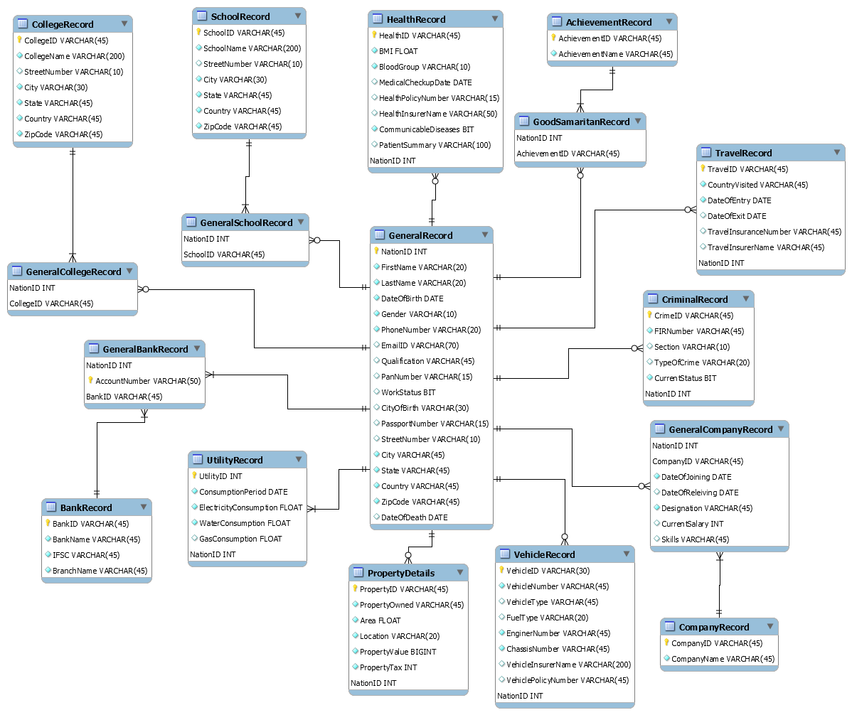
Final ERD

Slide 5
Final ERD

Slide 6
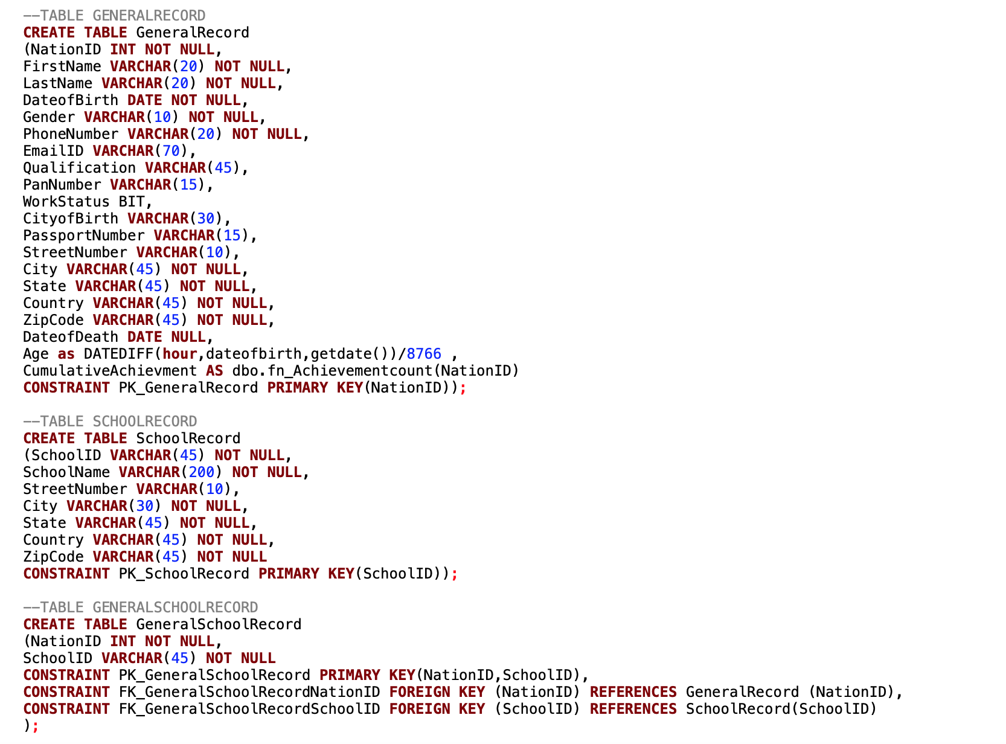
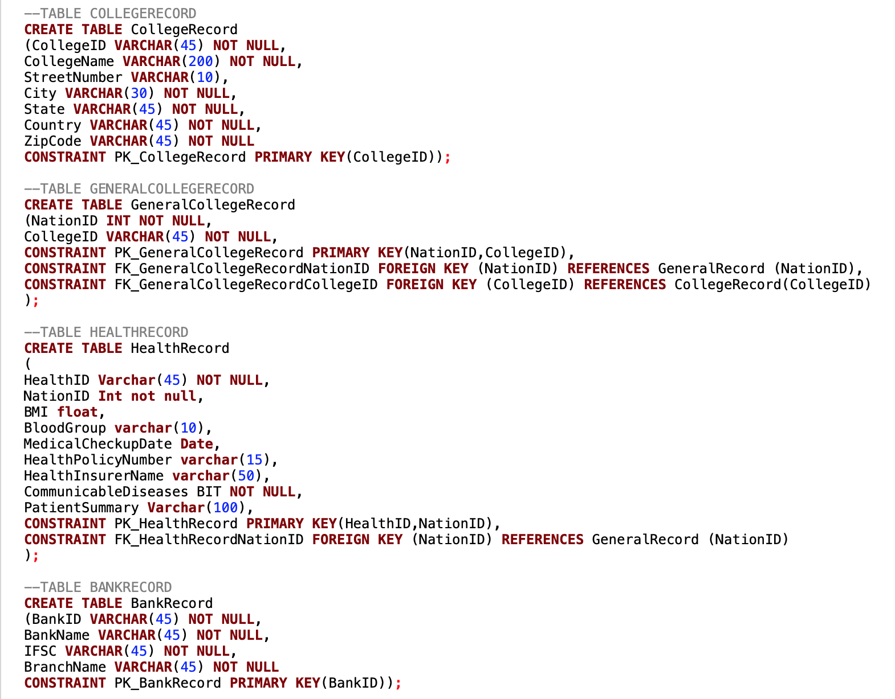
Database Implementation

Slide 7
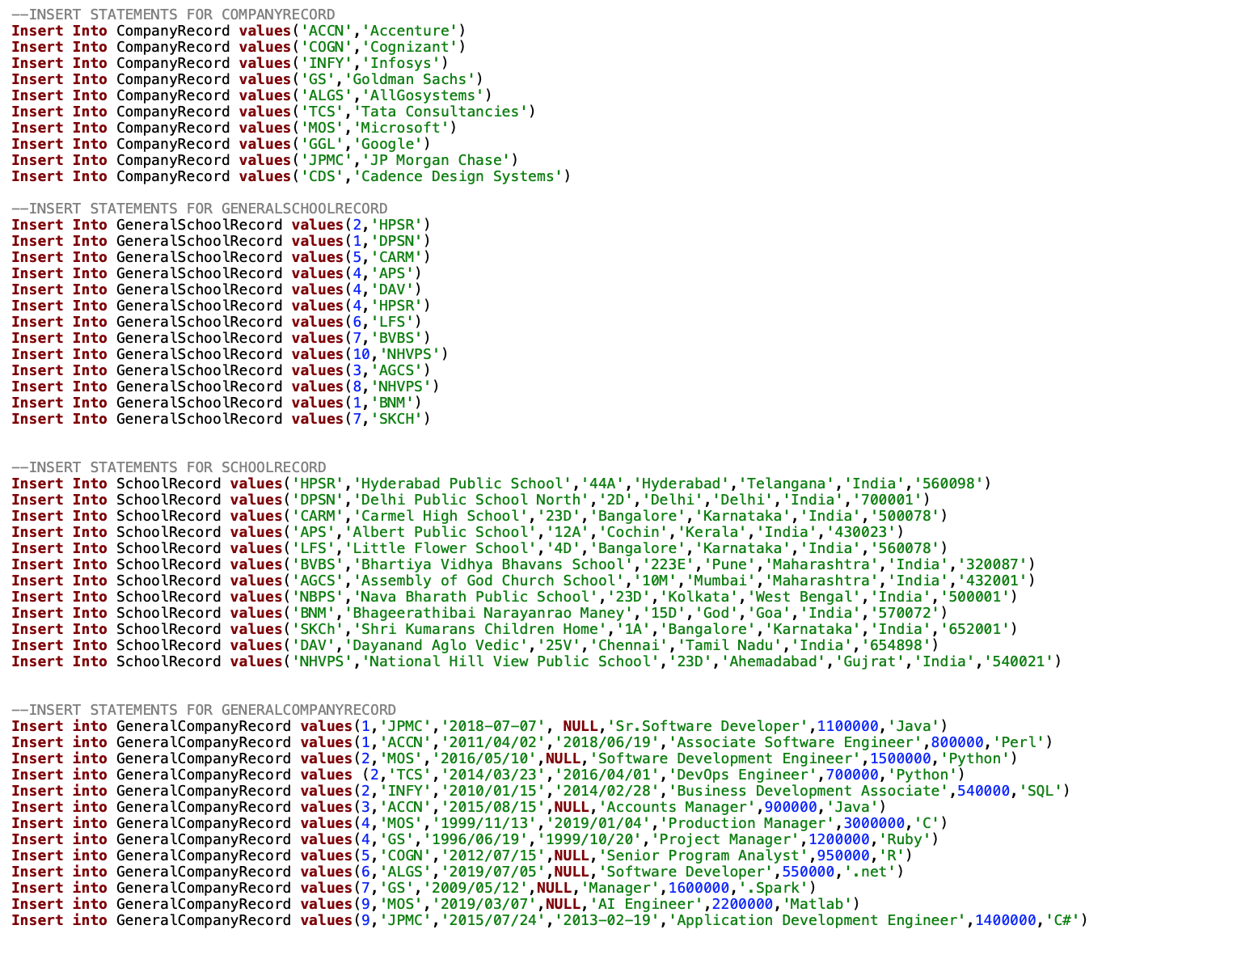
Database Implementation
Sample text

Slide 8
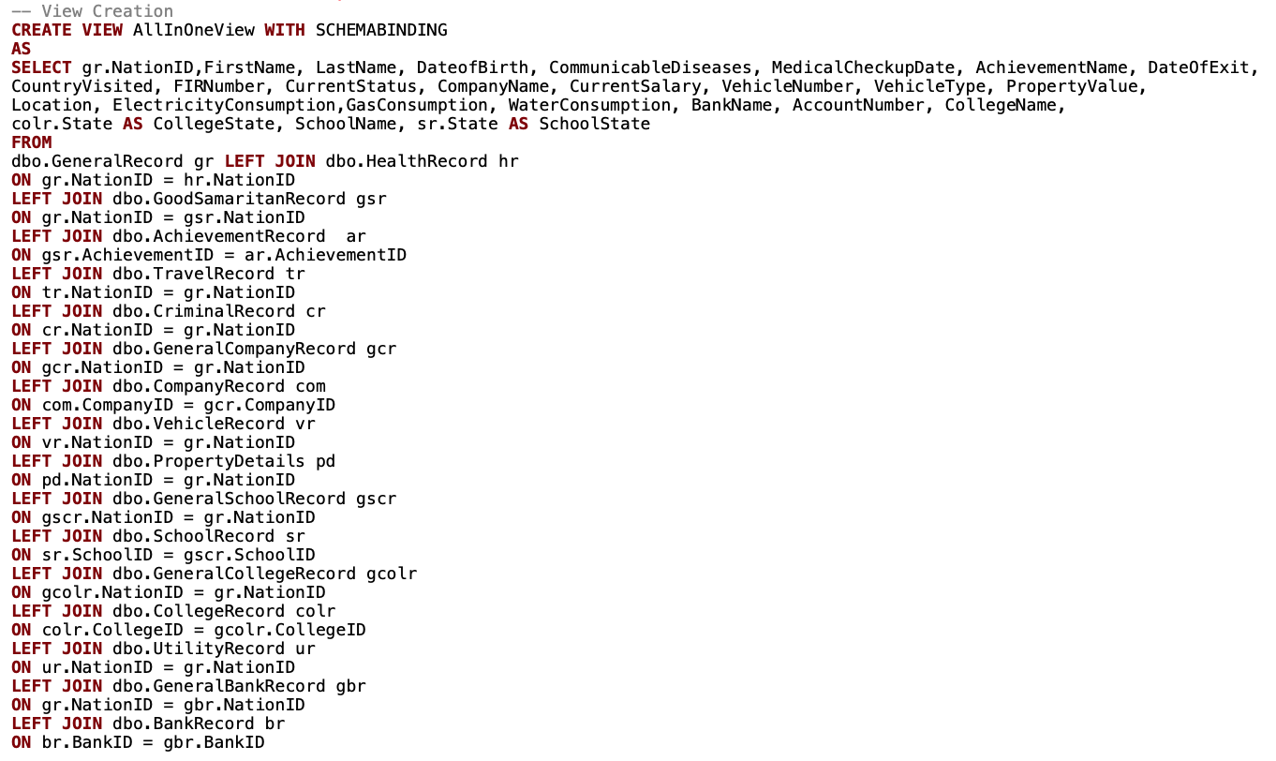
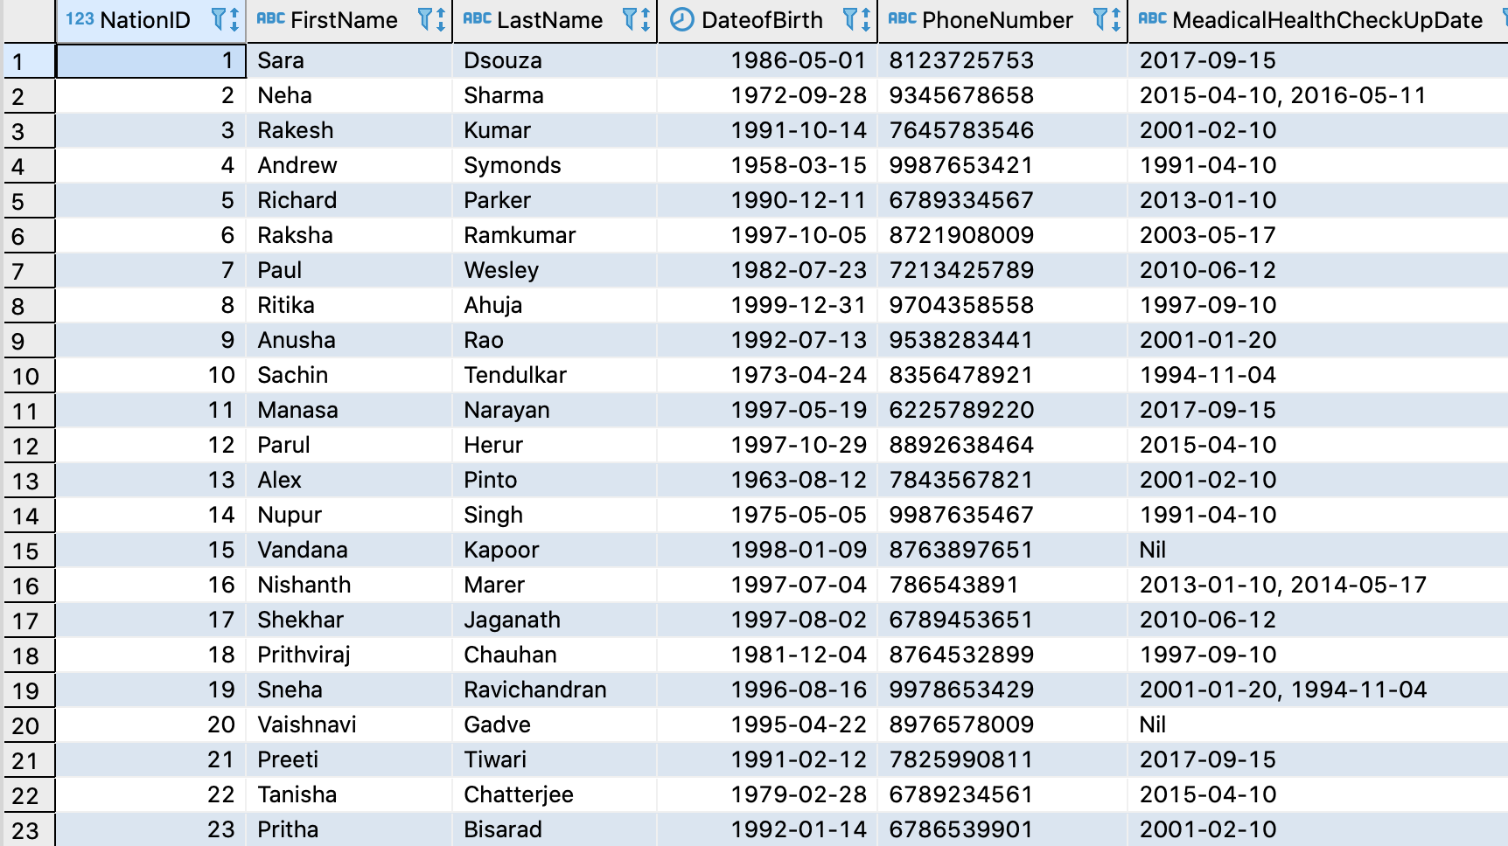
Views - I
Explanation
Sample Explanation

Slide 9
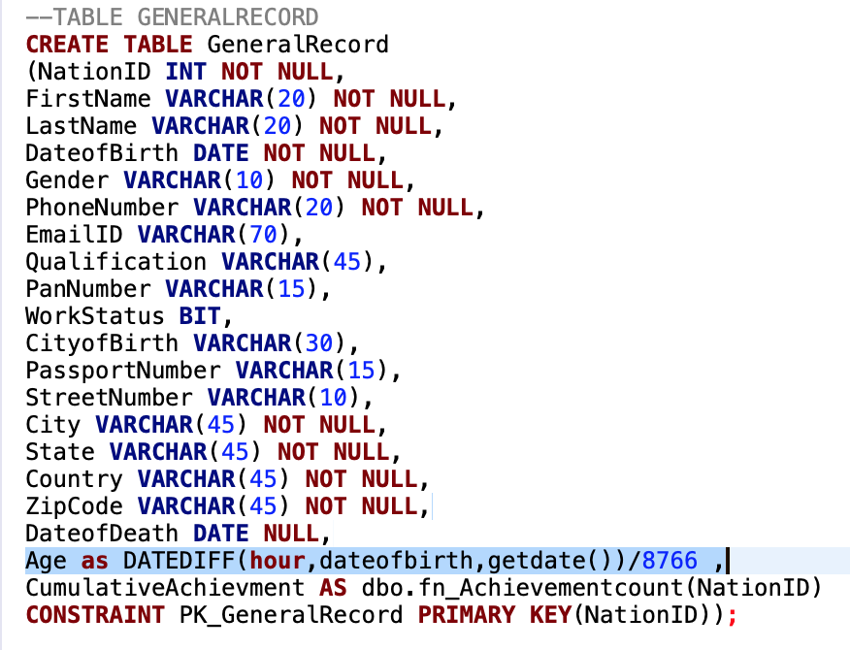
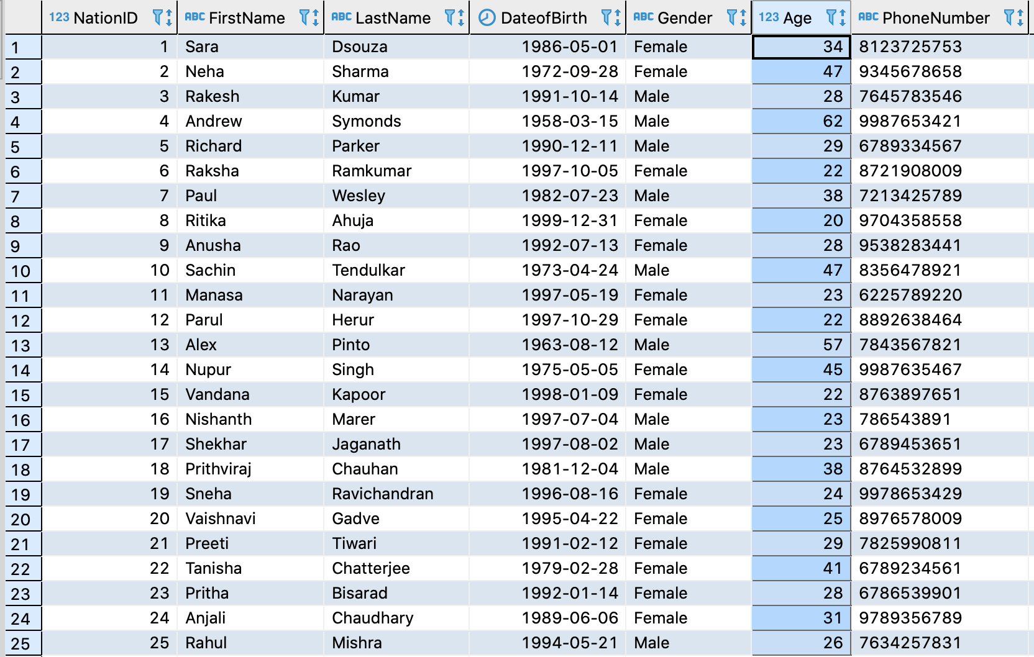
COMPUTED COLUMNS-1
Explanation

Slide 10
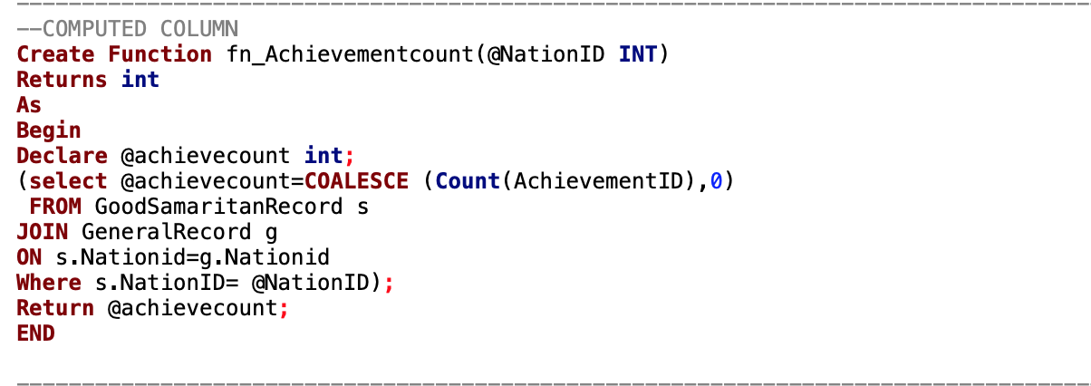
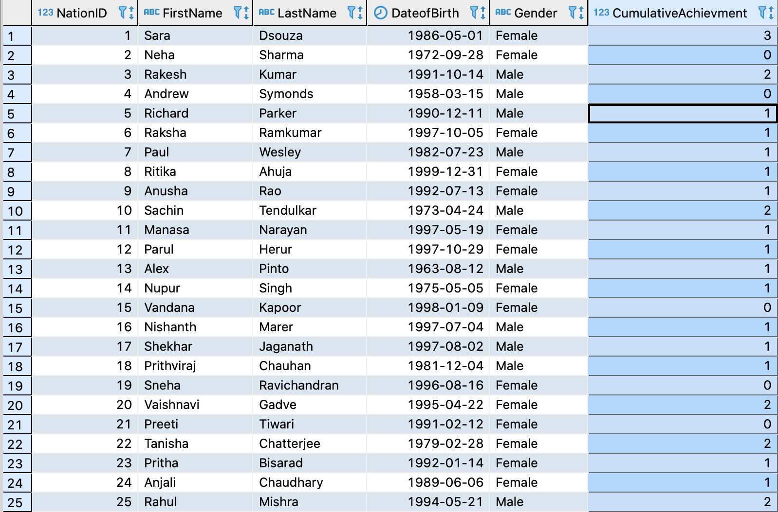
COMPUTED COLUMNS-2
Explanation

