Slide 1
The enemy
Summary-
The story is set in Japan during World War II and revolves around Dr. Sadao Hoki, a Japanese surgeon, and his wife Hana. One day, they find a wounded American soldier washed ashore near their house. Since America is Japan’s enemy, helping him could be considered treason.
Although Dr. Sadao is loyal to his country, he is bound by his duty as a doctor. He decides to treat the soldier, named Tom, despite the risk. Hana initially hesitates due to fear and hatred toward the enemy but eventually helps her husband.
Dr. Sadao successfully performs surgery and saves the soldier’s life. He informs the Japanese General, who secretly promises to have the enemy killed but never takes action. Meanwhile, local servants leave the house, believing it is wrong to shelter an enemy.
Realizing the danger to himself and his wife, Dr. Sadao helps the American soldier escape safely by giving him food, clothes, and a boat. After the soldier leaves, Dr. Sadao feels relieved but also guilty for betraying his nation.

Slide 2
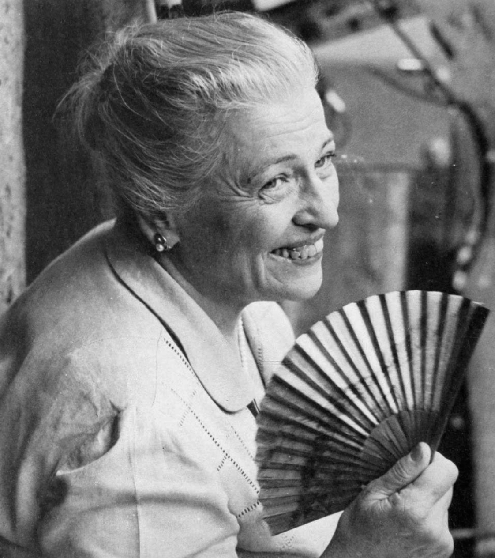
AUTHOR: PEARL.S.BUCK
Pearl S. Buck (1892–1973) was an American novelist and humanitarian, best known for her novel The Good Earth, which won the Pulitzer Prize and later earned her the Nobel Prize in Literature in 1938, making her the first American woman to receive it. Raised in China by missionary parents, she drew deeply from her experiences there to portray Chinese life with authenticity and empathy. Her short story The Enemy reflects her recurring themes of compassion, humanity, and moral conflict during wartime. Beyond literature, Buck was a strong advocate for cross-cultural understanding and child welfare, founding organizations to support adoption and promote East–West harmony, leaving a legacy that combined literary brilliance with humanitarian service.

Slide 3
POETS&PANCAKES
Summary :-
“Poets and Pancakes” is an autobiographical essay describing the working atmosphere of Gemini Studios, a famous film studio in Chennai, where the author Asokamitran worked.
The essay mainly focuses on the make-up department, especially a brand of make-up called “Pancake”, which was used excessively on actors. This make-up often caused discomfort and confusion among actors, making it a subject of irony and humor.
Asokamitran describes the hierarchy and ego within the studio. The make-up artists held great power and often treated others rudely. He also talks about the office boy, who constantly complained about being exploited and blamed a vague entity called “the enemy” for his troubles, though no one really knew who the enemy was.
The essay highlights the presence of poets and writers at Gemini Studios, who were not fully understood or appreciated. A visit by an English poet (later identified as Stephen Spender) and a talk on Communism confused most of the audience, showing the gap between intellectual ideas and the practical film world.

Slide 4
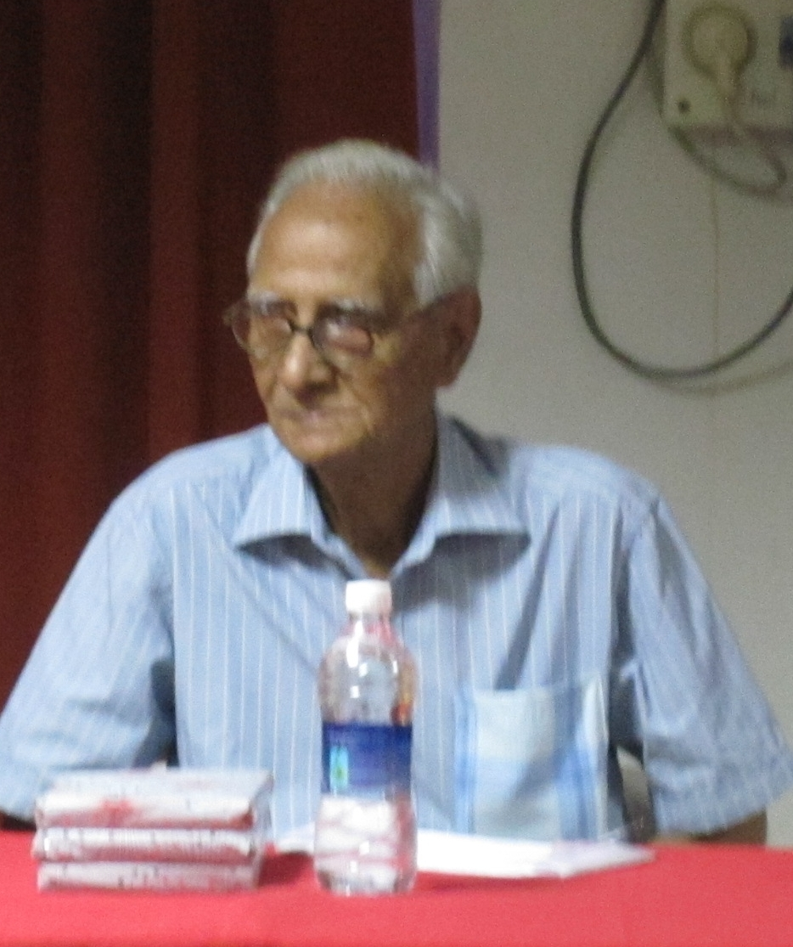
AUTHOR :- ASOKAMITRAN
Asokamitran (1931–2017) was a noted Indian writer from Tamil Nadu, best known for his sharp, simple, and realistic style of storytelling. He worked for over two decades at Gemini Studios in Chennai, and his experiences there inspired his famous essay Poet and Pancakes, which humorously and insightfully portrays the film industry’s inner workings. Writing in both Tamil and English, Asokamitran produced more than 200 short stories, novels, and essays, often focusing on ordinary lives and everyday struggles. His works are admired for their clarity, wit, and ability to capture the essence of middle-class existence, making him one of the most respected modern voices in Indian literature.

Slide 5
THE THIRD LEVEL
Summary:-
“The Third Level” is a short story about Charley, a man who believes he has discovered a mysterious third level at Grand Central Station, New York, which does not officially exist.
Charley accidentally reaches this third level while trying to escape the stress and anxiety of modern life. On this level, everything appears old-fashioned—gas lamps, wooden counters, old currency, and people dressed in 1890s clothing. Charley realizes he has traveled back to the year 1894.
He tries to buy train tickets to Galesburg, Illinois, a peaceful town he associates with happiness, but fails because he does not have the old-style currency. Later, he exchanges his money for old bills and attempts to return, but the third level disappears.
Charley’s psychiatrist believes the third level is only a product of Charley’s imagination, a psychological escape from reality. However, the story takes a twist when Charley receives a letter from his friend Sam, who seems to have actually traveled to the past and settled in Galesburg, suggesting that the third level might be real after all.

Slide 6
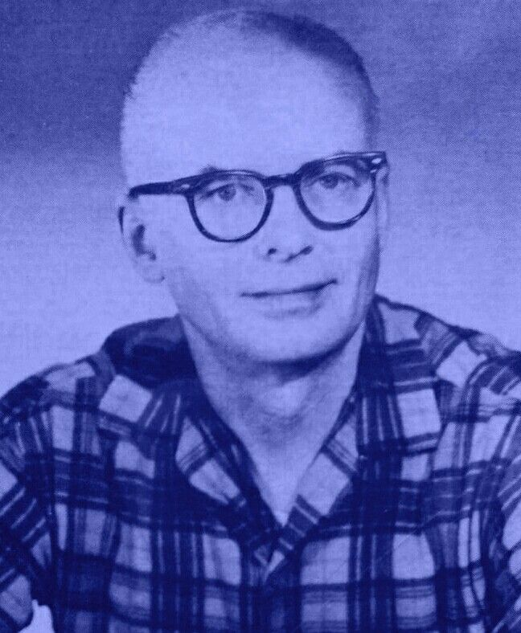
AUTHOR :- JACK FINNEY
Jack Finney, the author of The Third Level, was an American writer best known for his fascination with time travel and ordinary people caught in extraordinary circumstances. Born on October 2, 1911, in Milwaukee, Wisconsin, and educated at Knox College, Finney wrote across genres including science fiction, thrillers, and noir fiction. His career spanned from 1946 to 1995, during which he produced notable works such as The Body Snatchers (later adapted into several films) and Time and Again, a classic of time-travel fiction. Finney’s writing often reflected nostalgia for earlier eras of American life, blending historical detail with imaginative storytelling.

Slide 7
GOING PLACES
Summary :-
The story “Going Places” revolves around Sophie, a teenage girl who lives in a poor family but dreams of a glamorous and successful life. She dislikes her dull reality and often imagines herself becoming a fashion designer, an actress, or owning a boutique.
Sophie is known for her habit of daydreaming and exaggerating stories. One day, she tells her family that she met Danny Casey, a famous Irish footballer. Though her family doubts her story, Sophie continues to believe in her fantasy and even imagines meeting him again.
Her friend Jansie, who is more practical and realistic, warns Sophie not to spread such stories. However, Sophie’s imagination keeps growing stronger. She goes to a lonely place hoping to meet Casey, but he never appears, showing that her dreams are not real.
The story highlights the contrast between dreams and reality, showing how imagination can comfort a person but may also lead to disappointment if not balanced with realism.

Slide 8
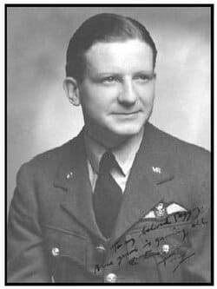
AUTHOR :-A.R. BARTON
A. R. Barton, the writer of Going Places, is a modern English author who lives in Zurich and writes in English. He is known for his evocative storytelling that often explores themes of adolescent dreams, fantasies, and the contrast between imagination and reality. Barton’s career reflects versatility—he has contributed to notable literary magazines such as Stand, London Magazine, and Hollands Maandblad. In Going Places, he captures the restless energy of youth, highlighting how teenagers often indulge in unrealistic ambitions and hero worship while struggling to accept the practical limitations of life. His writing style is simple yet impactful, making readers reflect on the fine line between aspiration and illusion.

Slide 9
ON THE FACE OF IT
Summary :-
The story revolves around Darius, a young boy who has a burn scar on his face from an accident. Because of his scar, he feels isolated and resentful, believing that people judge him solely by his appearance. Darius meets Lennox, an older man who has lost a leg in a war and wears a metal leg brace.
Lennox is cheerful, optimistic, and has a positive outlook on life, despite his disability. He encourages Darius to stop hiding from the world and to look beyond appearances, emphasizing that life should be lived fully, without fear of judgment.
The story ends on a hopeful note, showing the impact of encouragement and friendship in helping someone overcome self-doubt and insecurities.

Slide 10
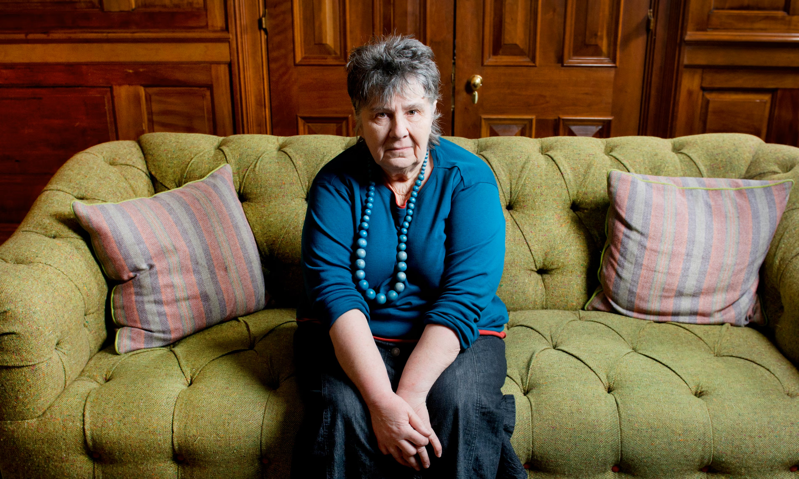
Author :-Susan Hill
Susan Hill, the writer of On the Face of It, is a renowned British author celebrated for her novels, plays, and short stories that often explore human emotions, isolation, and the complexities of life. Born in Scarborough, England, in 1942, she studied English at King’s College, London, and published her first novel The Enclosure while still a student. Hill is best known for her ghost story The Woman in Black, which became a modern classic and was adapted into stage and film productions. Her works span across genres—literary fiction, crime thrillers, children’s books, and plays—reflecting her versatility as a writer. In On the Face of It, she sensitively portrays themes of loneliness, prejudice, and the need for acceptance, which are recurring concerns in her writing.

