Slide 1
RevHire Project
Console-Based Job Portal Application

Slide 2
Introduction
RevHire is a console-based job portal application
It connects job seekers with employers
Built to understand real-world Java & JDBC usage

Slide 3
Project Overview
Job seekers can register and apply for jobs
Employers can post jobs and manage applications
System stores data using MySQL database

Slide 4
Architecture
Model: Represents database entities
DAO: Handles database operations using JDBC
Service: Contains business logic
Util: Input handling and helper methods

Slide 5
Key Features
User registration and login
Job posting and job search
Apply, shortlist, or reject candidates
Resume management

Slide 6
Technologies Used
Java – core programming language
JDBC – database connectivity
MySQL – data storage
JUnit – unit testing

Slide 7
Database Design
Tables: JobSeeker, Employer, Job, Resume, Application
schema.sql used for database creation
Relationships maintained using foreign keys

Slide 8
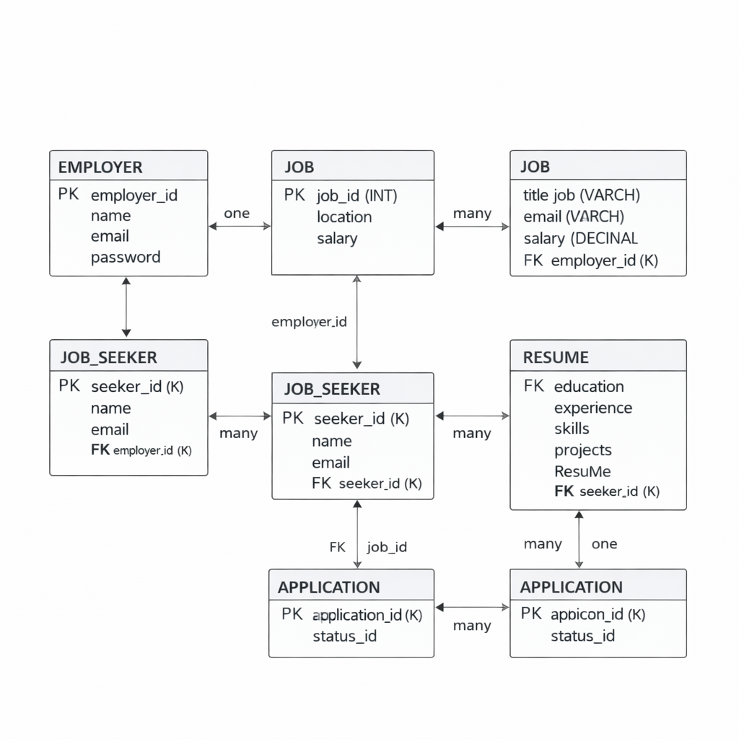

Slide 9
Testing
JUnit used for DAO layer testing
Ensures correct database operations
Improves code reliability

Slide 10
Conclusion
RevHire demonstrates real-world Java concepts
Good understanding of JDBC and MySQL
Strong base for full-stack development

