Slide 1




NEXT GEN EMPLOYABILITY PROGRAM
Creating a future-ready workforce
Team Members
College Name
Student Name :Vaishnavi Student ID :950821104047
GCE,Tiunelveli

Slide 2

CAPSTONE PROJECT SHOWCASE
Project Title
Voting Application using Django Framework
Abstract | Problem Statement | Project Overview | Proposed Solution | Technology Used | Modelling & Results | Conclusion

Slide 3
Abstract
Django for Secure Online Voting :
This presentation explores building secure online voting applications with Django, a powerful Python web framework. We'll showcase:
Rapid Development
Secure Voting
Scalability
Explore user registration, voting security, and administrative controls. See how Django creates secure online voting systems.
Source : Vaishnavi

Slide 4
Problem Statement
Developing a secure question-answer platform with Django poses challenges in:
Ensuring data integrity
Safeguarding user confidentiality
Addressing scalability concerns
The challenge is to:
Create a secure question-answer platform using Django
Facilitate seamless user engagement
Implement robust security measures
Scale effectively to accommodate increasing user interactions
Source : Vaishnavi

Slide 5
Project Overview
Title : Voting Machine with Django
Developer : Vaishnavi S
Objectives : Develop secure online voting with Django, ensuring integrity, scalability, and trust.
Structure : Setup, Authentication, Poll Management, Voting Interface, Results.
Materials : Django, database, HTML/CSS, Python.
Outcome : Secure, scalable system, showcasing Django expertise.
Source : Vaishnavi

Slide 6
Proposed Solution
Solution Overview:
Develop a web-based voting application using Django framework.
Implement secure user authentication and authorization.
Create an intuitive user interface for casting votes securely.
Ensure data integrity and confidentiality throughout the voting process.
Utilize Django's robust features for scalability and administrative control.
Source : Vaishnavi

Slide 7
Speaker Notes:
Our proposed solution is to develop a secure online voting system using Django:
Django offers rapid development capabilities, enabling us to build the system efficiently. Its built-in features for authentication, database management, and templating simplify development.
Implementing robust security measures, such as encryption, authentication, and access controls, ensures data integrity and confidentiality throughout the voting process.
Leveraging Django's scalability capabilities, we can design the system to handle large voter bases and accommodate increasing user interactions seamlessly.
Source : Vaishnavi

Slide 8


Technology Used
Front-end
Back-end
Source : Vaishnavi

Slide 9
Modelling & Results
Modelling :
System Architecture:
Client-server architecture with Django as the backend framework.
Database schema for storing user data, polls, and voting results.
Frontend interface using HTML/CSS for user interaction.
Results :
Response time: Measure system responsiveness to user actions.
Scalability: Assess system's ability to handle increasing user loads.
Security: Evaluate effectiveness of security measures in protecting user data.
Source : Vaishnavi

Slide 10
Homepage
Key Elements:
User login and registration options.
"Add Question" and "Add Choices" buttons for all registered users.
Featured polls for upcoming elections.
Navigation menu for easy access to different sections, including admin panel (Admin only).
Speaker Notes:
Homepage emphasizes interaction.
All registered users can contribute questions and choices.
Admin-exclusive features restricted to administrators.
Source : Vaishnavi

Slide 11
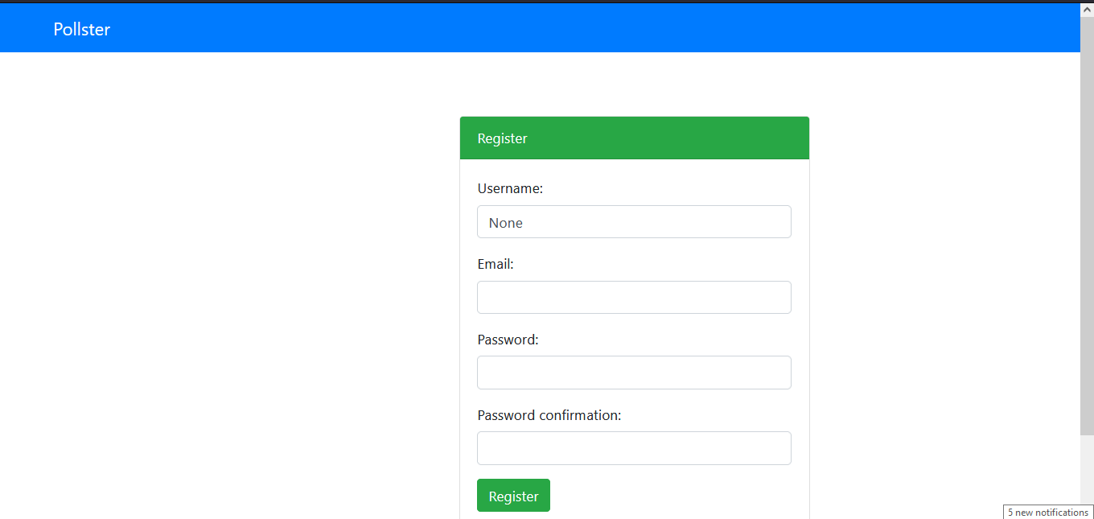
Registration Page :
New users sign up to join the community.
Form : Users enter username, email, and password.
Benefits : Access exclusive content, personalized features.
Encouragement : Emphasize value of joining.

Slide 12
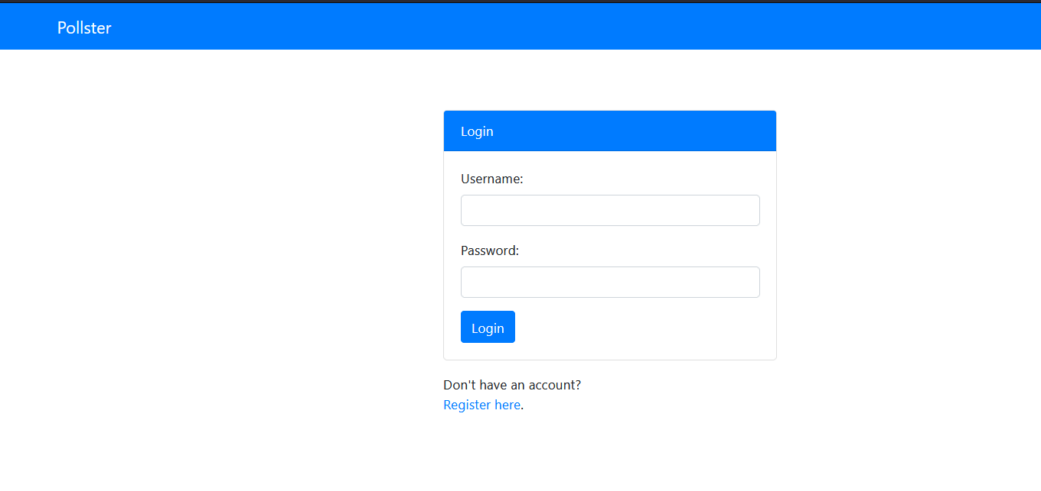
Login Page :
Gateway for secure account access.
Users enter credentials for authentication.
Emphasize security: Encryption, authentication.
Crucial for account integrity and confidentiality.
.
Source : Vaishnavi

Slide 13
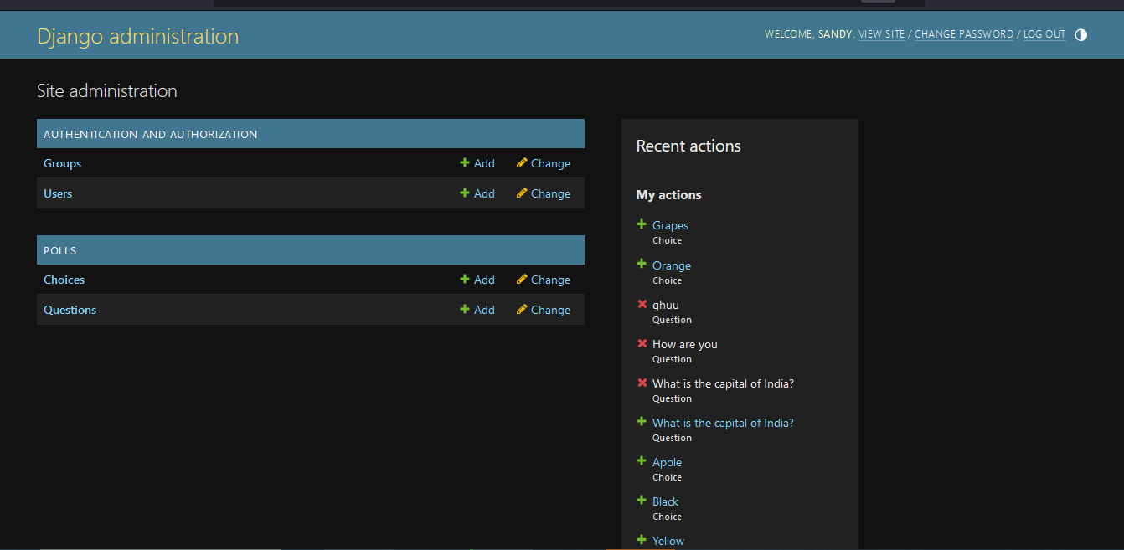
Admin Page
Backend access for website management.
Tasks: Content, user, and site management.
Importance: Maintaining integrity, managing interactions, ensuring compliance.
Empowerment: Customizing site for community needs, ensuring smooth operation.
Source : Vaishnavi

Slide 14
Blog Page
Functionality : Users contribute by adding questions and choices.
Admin Privileges : Only administrators add users and groups.
Special Login : Users access enhanced features.
Speaker Notes:
Blog page enables community interaction.
Users add questions and choices.
Admins manage users and groups.
Special login grants users enhanced features.
Source : Vaishnavi

Slide 15
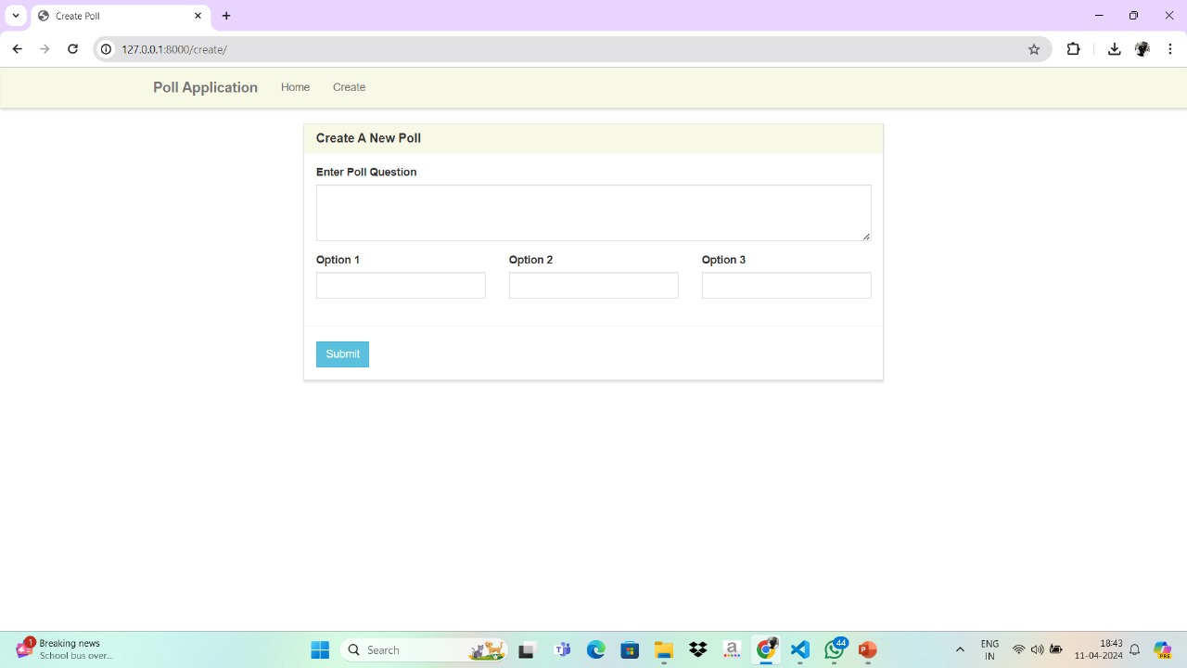
Poll Application
Create new poll
Source : Vaishnavi

Slide 16
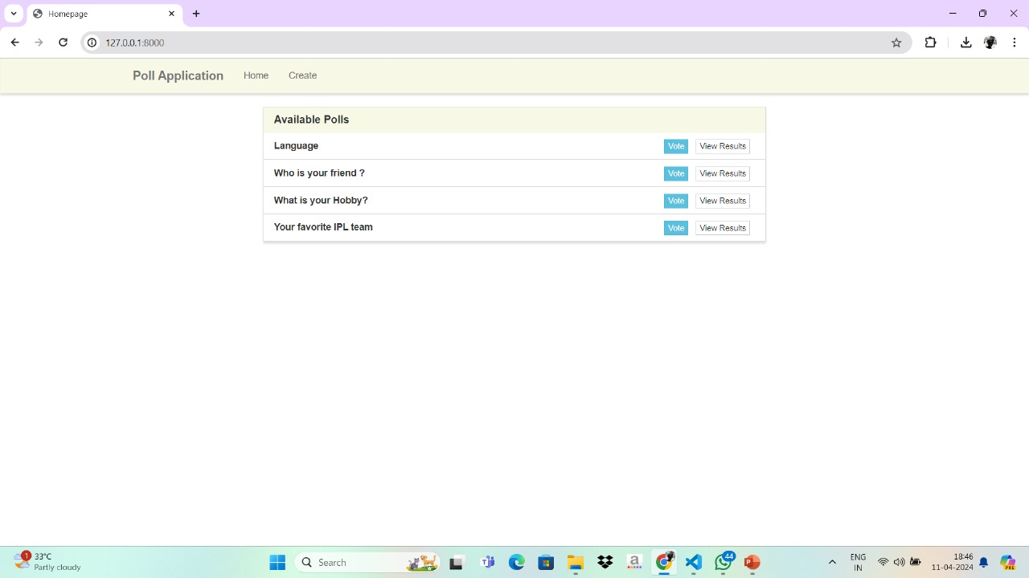
Available Polls
Source : Vaishnavi

Slide 17
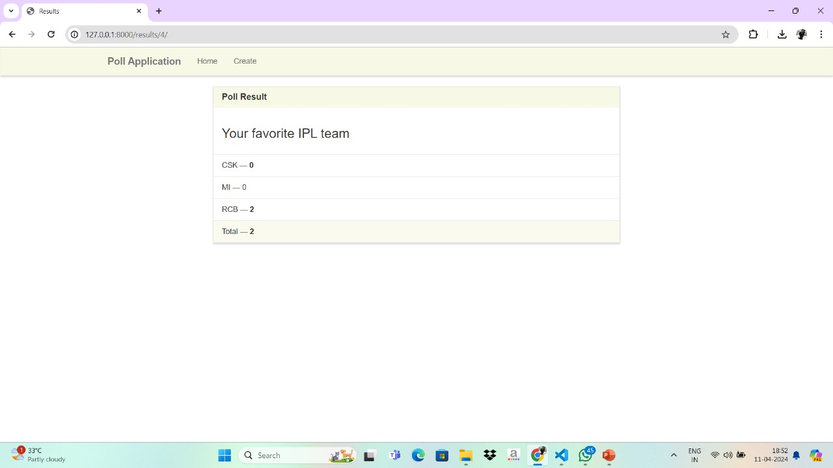
Poll Results

Slide 18
Future Enhancements:
Enhanced Profiles: Personalize with avatars and bios.
Voting Analytics: Insights into user trends.
Community Forums: Facilitate user interaction.
Mobile App: Extend accessibility.
Speaker Notes:
Enhance profiles for personalization.
Provide voting analytics for insights.
Add community forums for interaction.
Develop a mobile app for wider accessibility.
Source : Vaishnavi

Slide 19
Conclusion :
Title: Advancing Online Voting
Recap : Highlight key features and benefits.
Commitment: Promise ongoing improvements.
Engagement: Encourage user participation.
Appreciation: Thank users for their support.
Speaker Notes:
Encourage user engagement and contributions.
Express gratitude for user support in building a stronger platform.
Source : Vaishnavi S

Slide 20
Thank You!
Notes:
Thank You !!

