Slide 1

SMART INDIA HACKATHON 2026
TITLE PAGE
Problem Statement ID – SIH26___
Problem Statement Title- APAAR ID-Based Student Data Management and Verification Platform
Theme- Smart Education
PS Category- Software
Team ID- ______
Team Name- TEAM-RESILIENCE

Slide 2

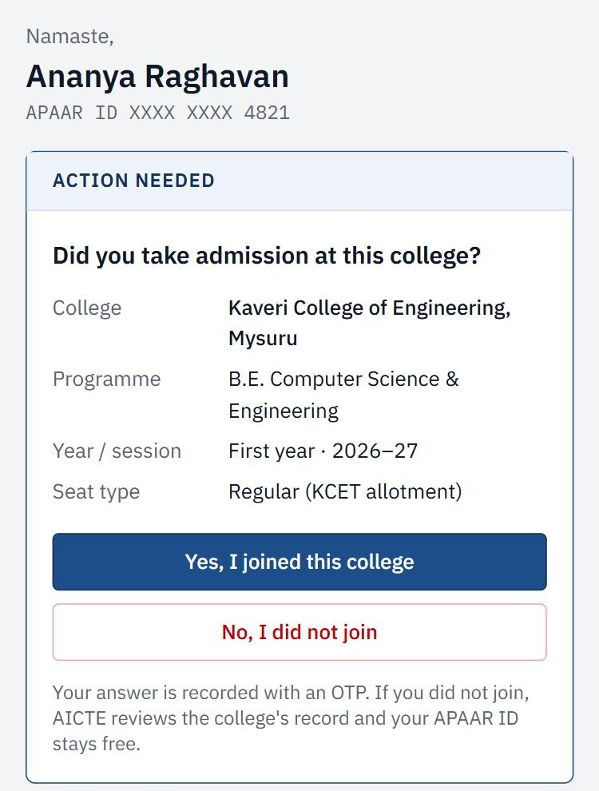
APAAR-SATYA
Student Data Management and Verification using APAAR ID
Core Issue
v Only Totals Reach AICTE: Most institutions report total enrolment, not student-level data.
v Excess Admissions: Seats filled beyond approved intake are hard to detect in time.
v Quota Misuse and Ghost Students: NRI / OCI / FN seats and fake entries are difficult to verify.
v Duplicate Enrolment: The same student may hold seats in two colleges.
Proposed Solution
Novelty
v APAAR Records: Each admitted student is uploaded with APAAR ID.
v Seat Ledger: Seats issued as per approval; extra uploads are blocked.
v Three-Source Check: A record is verified only when three sources agree.
v Fraud Check: Duplicate APAAR IDs, similar names, shared mobiles.
v Student Confirmation: Students confirm via DigiLocker, SMS or IVR.
v Verifiable Certificates: QR code with APAAR ID and Student ID.
v Truth Score: Counselling, DigiLocker, NSP and ABC data are cross-checked.
v Passive Liveness: No semester credits means a possible ghost student.
v Policy Simulator: AICTE can test a new rule first.
v Submit Once: The same data fills AICTE, AISHE and NIRF reports.
v Fair Review: Dual-degree students are not penalised; colleges can appeal.

Slide 3







TECHNICAL APPROACH
Student Data Upload
(Excel or API, signed by Principal)
APAAR Validation
(ID format and duplicate check)
Seat and Rule Check
(approved intake, quota rules)
Multi-Source Verification
(counselling, DigiLocker, NSP, ABC)
Central Repository
(secure storage with audit trail)
Seat Ledger
Duplicate Check
Student Confirmation
Truth Score
Verification
Seats issued from approval
Hashed APAAR matching
DigiLocker, SMS or IVR
Score from 6 sources
QR on certificates
Extra uploads blocked
Similar name matching
“I did not join” option
Verified or under review
Shows only what is needed
Quota-wise tracking
Shared mobile / bank links
Seat surrender request
Reason for every flag
Student sees access log
AICTE Dashboard
Alerts, fill rates, risky institutions and reports.
Officer Review and Decision
Authorised officer checks the evidence and decides.
Technologies Used: Next.js, React (frontend) | FastAPI, PostgreSQL (backend) | Python, NetworkX (fraud checks) | Keycloak, HashiCorp Vault (security) | Simulated APAAR, DigiLocker and NSP APIs

Slide 4
FEASIBILITY AND VIABILITY
FEASIBILITY
VIABILITY
Analysis:
Buildable with standard web technologies such as Next.js, FastAPI and PostgreSQL. Prototype screens and core checks are already built and tested on synthetic student records.
Analysis:
Low-cost platform for AICTE. Colleges save time because one verified upload fills several reports.
Challenges:
No direct access to APAAR, counselling and NSP data yet. Spelling differences in Indian names may create false duplicate matches.
Challenges:
Real data access needs government approval. College adoption and DPDP Act compliance are also challenges.
Strategies:
Use simulated APIs with the real data formats. Normalise common name variants and send doubtful cases for manual review.
Strategies:
Start with one state and its counselling cell. Use role-based access, consent records and audit logs. Free for colleges; paid verification for employers.

Slide 5
IMPACT AND BENEFITS
POTENTIAL
IMPACTS
BENEFITS
ü Accurate Records: AICTE gets student-level data instead of only total numbers.
ü Excess Admission Control: Seats beyond approved intake are blocked at upload.
ü Scholarship Protection: Scholarships reach only verified students.
ü Faster Inspections: Risk-based sampling instead of visiting every college.
ü Student Protection: Students can report fake enrolment and surrender seats.
ü Better Planning: Real fill-rates help AICTE decide next year’s approvals.
ü Less Paperwork: One verified upload fills AICTE, AISHE and NIRF data.
ü Trusted Certificates: Employers verify degrees by scanning a QR code.
ü Privacy: Caste, quota and marks are not shown to verifiers.
ü Transparency: Every change is saved in a tamper-evident audit log.
ü Sustainable Model: Free for students and colleges; employers pay for verification.
ü Rural Reach: Students without smartphones confirm by SMS or voice call.

Slide 6
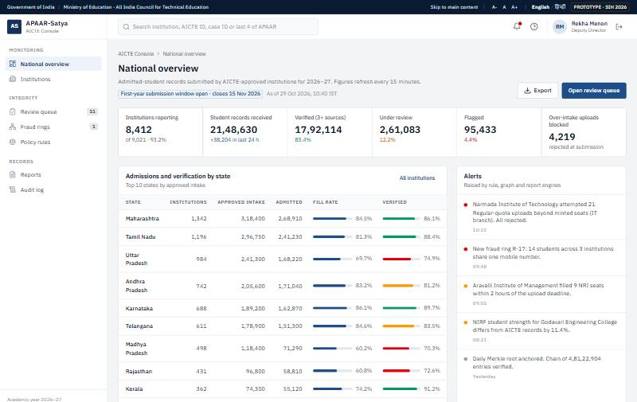
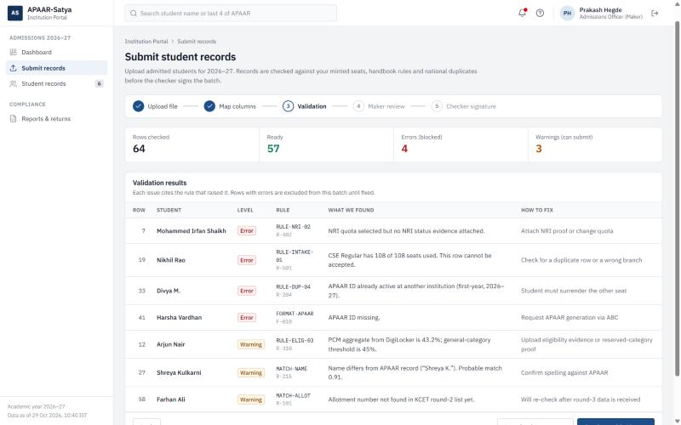
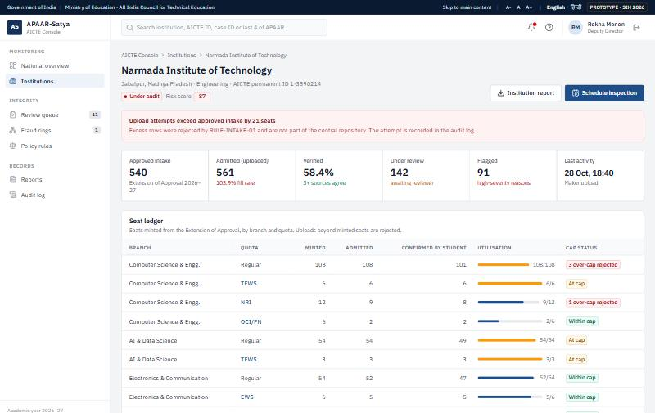
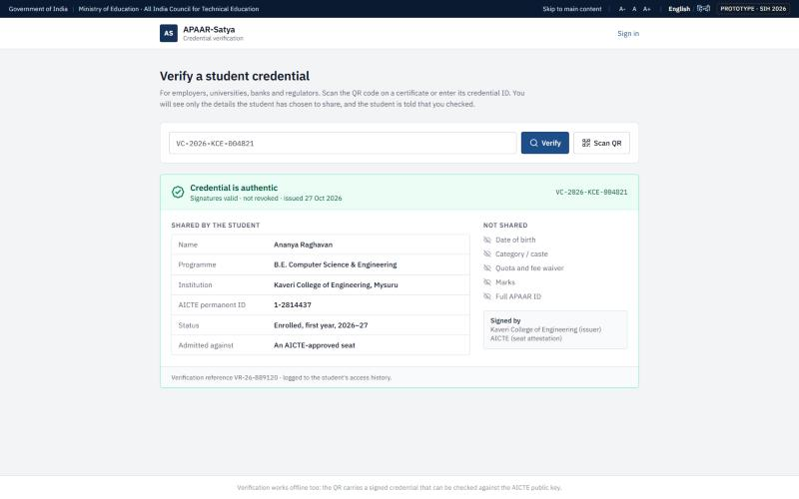
RESEARCH AND REFERENCES
[1] Ministry of Education (PIB), APAAR backgrounder, June 2026: 26.30 crore APAAR IDs generated. Available: static.pib.gov.in
[4] AICTE Approval Process Handbook 2026–27 and UGC guidelines for pursuing two academic programmes simultaneously, 2022.
[2] I. Fellegi and A. Sunter, “A Theory for Record Linkage,” JASA, vol. 64, 1969. doi.org/10.1080/01621459.1969.10501049
[5] B. Laurie et al., RFC 6962: Certificate Transparency (Merkle audit logs), IETF, 2013.
[3] L. Akoglu, H. Tong and D. Koutra, “Graph-based anomaly detection and description: a survey,” DMKD, 2015.
[6] W3C Verifiable Credentials Data Model 2.0; Digital Personal Data Protection Act, 2023.
SOLUTIONS ALREADY EXIST
OUR SOLUTION STANDS OUT
Ø AICTE portal collects only total intake.
Ø AISHE survey collects self-reported statistics.
Ø DigiLocker and NAD store issued certificates.
Ø APAAR and ABC give each student an ID.
Ø ONE VERIFIED RECORD: links APAAR, counselling, DigiLocker, NSP, ABC.
Ø SEAT LEDGER: blocks admissions beyond approved intake at upload.
Ø STUDENT CONFIRMATION: students confirm or report their own admission.
Ø EXPLAINABLE FLAGS: every flag shows its reason for officer review.
Ø PROTOTYPE READY: dashboards and checks shown on synthetic data.
Link:
vaishak2k6.github.io/APAAR-Satya
GitHub link:
github.com/vaishak2k6/APAAR-Satya

