Slide 1
INTRODUCTION
Project title :nrega analysis in powerbi
Name: VAISHAKHI Pawar [Batch no.: MIP-DA-09] submission date: 22th June 2024 software used: powerbi

Slide 2
Project overview
This project delves into the analysis of data related to the National Rural Employment Guarantee Act (NREGA), a transformative government scheme aimed at providing rural households with guaranteed wage employment opportunities. The dataset used for this analysis encompasses a wide range of parameters, including the number of job cards issued, the workforce engaged, budget allocation, work completion statistics, and more. Through the application of data analytics techniques, we aim to gain valuable insights into the implementation and impact of NREGA across different states and districts in India.

Slide 3
Summarize project goals
There are total 5 types of project objective cover in this presentation that are:
Evaluate Employment Opportunities
Identify Regional Disparities
Analyse Budget Utilization
Determine Factors for Work Completion
Provide Data-Driven Insights

Slide 4
PROJECT OBJECTIVE
Evaluate Employment Opportunities
Assess the effectiveness of NREGA in providing employment opportunities to rural households by analyzing the number of job cards issued, the number of workers engaged, and the persondays of employment provided.

Slide 5
Visual 1: Pie Chart - Number of Job Cards Issued by State
Purpose: To display the proportion of job cards issued across different states. Explanation and Usage: This visual provides a clear view of the distribution of job cards among the states, making it easy to see which states have a larger share of job cards. It helps identify the regions where NREGA is being heavily utilized versus those with lesser engagement, informing policymakers about areas that may require additional outreach or support.

Slide 6
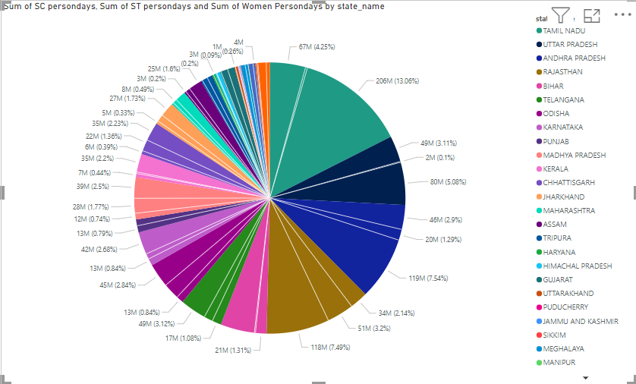

Slide 7
PROJECT OBJECTIVE
2. Identify Regional Disparities
Investigate regional disparities in the implementation and outcomes of NREGA across different states and districts, focusing on factors such as the number of active job cards, active workers, and persondays of employment provided.

Slide 8
Visual 2: Matrix - Average Wage Rate per Day per Person by State and District
Purpose: To show the average daily wage rate for NREGA workers across different states and districts in a tabular format. Explanation and Usage: This visual format allows for a detailed comparison of wage rates, making it easier to spot discrepancies and variations across different regions. Policymakers can use this information to ensure fair wage distribution and make adjustments where necessary to address wage disparities.

Slide 9
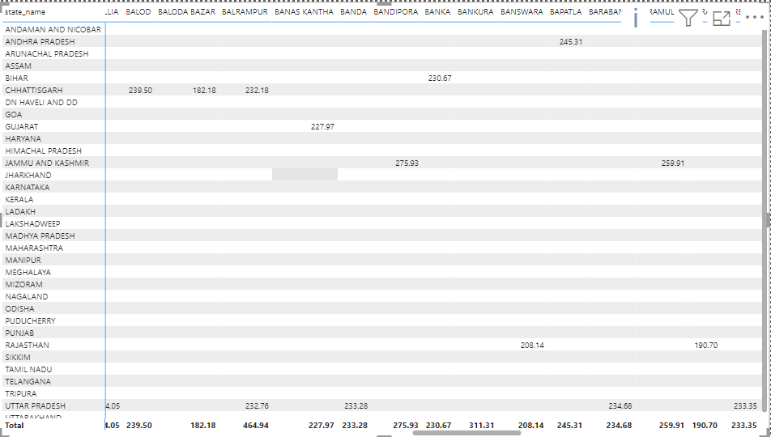

Slide 10
PROJECT OBJECTIVE
3. Analyze Budget Utilization:
Examine the utilization of the allocated budget and its correlation with employment generation by analyzing expenditure data, including total expenditure, wages, material and skilled wages, and administrative expenditure.

Slide 11
Visual 3: Donut Chart - Distribution of Persondays Among SC, ST, and Women Workers
Purpose: To illustrate the distribution of persondays among Scheduled Caste (SC), Scheduled Tribe (ST), and women workers. Explanation and Usage: This visual effectively highlights the participation of these marginalized groups within NREGA. It allows for an assessment of inclusivity and helps ensure that the program benefits SC, ST, and women workers equitably. It is useful for ensuring that the scheme aligns with social equity goals.

Slide 12
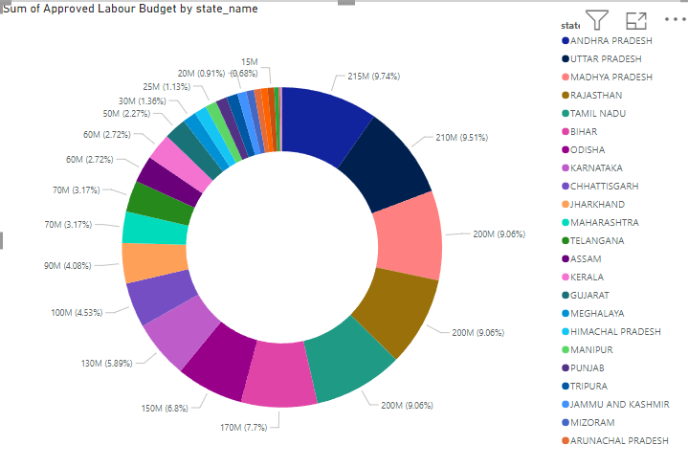

Slide 13
PROJECT OBJECTIVE
4. Determine Factors for Work Completion:
Identify key factors contributing to the completion of NREGA works and any roadblocks to success by analyzing the number of works taken up, ongoing works, completed works, and expenditure on various categories of works.

Slide 14
Visual 4: Bar Chart - Total Number of Active Workers by District
Purpose: To display the number of active workers in each district. Explanation and Usage: This visual helps in understanding the distribution of the active workforce within NREGA at the district level. It can reveal districts with high or low engagement, guiding targeted interventions to increase participation in underrepresented areas. It also allows for comparison across districts within the same state.

Slide 15
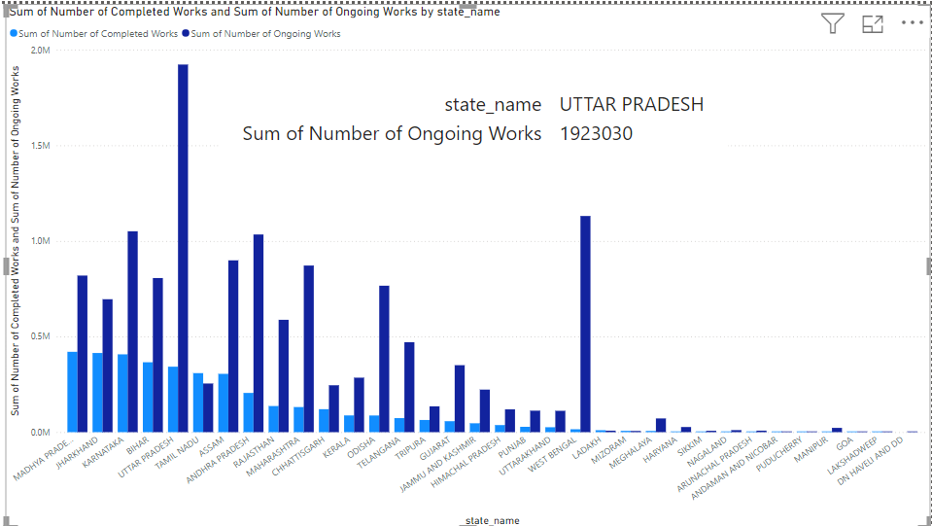

Slide 16
PROJECT OBJECTIVE
5. Provide Data-Driven Insights:
Generate data-driven insights and recommendations to guide policymakers and administrators in optimizing the scheme's impact, focusing on trends, disparities, and the effectiveness of budget allocation and work completion.

Slide 17
Visual 5: Scatter Plot - Correlation Between Approved Labour Budget and Total Expenditure
Purpose: To show the relationship between the approved labour budget and the total expenditure. Explanation and Usage: This visual helps in understanding how the allocation of budget correlates with actual expenditure. It can reveal whether regions are effectively utilizing their budgets or if there are discrepancies that need addressing. Policymakers can use this information to optimize budget allocation and improve financial management within the program.

Slide 18
