Slide 1

SRIB – KLE Tech. Univ. Worklet Projects Review
Emotion recognition in the wild
SRIB Mentor Name : Dr. Sandeep Palakkal
SRIB Mentor Dept. : S/W Products R&D Team @ SRIB
KLE Tech Mentors : Dr. Uma M.,Prof. Satish C.,Prof. Shrishail P.
KLE Team Members :
1) Aakanksha Patil : EC
2) Lakshmi Badiger : EC
3) Samanvitha Karanth : EC
4) Vaishak Kuppast : EC
5) Varad Vinod Prabhu : EC
May 4th, 2019

Slide 2
Project Overview / Summary
Project Domain:
Project Goals / Objectives:
Collect and annotate emotion dataset to assist achieving the prescribed accuracy on EmotiW dataset
Port the solution onto the smartphone and report the speed achieved.
KPI - 60% accuracy on EmotiW.
-Dataset with proper annotation and balanced between classes
Computer vision and AI
Problem Definition:
To develop a deep learning based solution for emotion recognition in the wild using both audio and video input modalities.
Major Achievements:
Challenges:
LMED Network
Accuracy - 45.37%
Successful deployment of inceptionv3 and MTCNN model on smartphone.
Prominent features between the classes aren’t distinguishable.
Run time increases as model complexity increases.

Slide 3
Literature Survey
Audio-Visual Emotion Recognition in Video Clips.
Multimodal emotion recognition system, which is based on the analysis of audio and visual.
Audio channel features extracted are Mel-frequency Cepstral coefficients, filter bank energies and prosodic features.
For visual part first facial landmarks are calculated and then a summarized emotion video is given to visually discriminate between the emotions.
Final confidence is got using the modalities using late fusion/ stacking.
2) Combining multimodal features within a fusion network for emotion recognition in the wild.
For each video clip, LBP-TOP, HOG and acoustic features are extracted to recognize the emotion.
For the static facial expression recognition based on video frame DCNN and RCNN features are extracted.
Linear SVM is used to classify these extracted features.
A fusion network is used to combine the results of each SVM classifier.

Slide 4
Dataset(s) Analysis / Description
Source | Angry | Disgust | Fear | Happy | Neutral | Sad | Surprise | Resolution
MMI subjects | 109 10 | 152 18 | 100 10 | 259 23 | 151 23 | 147 12 | 121 12 | 370*368
MUG subjects | 1744 65 | 2152 60 | 1621 42 | 3143 55 | 1889 54 | 1625 45 | 1893 50 | 896*896
CK subjects | 600 51 | 600 45 | - | 600 52 | 600 116 | 600 56 | 600 88 | 640*490
RAF | 607 | 274 | 98 | 2602 | 1261 | 1151 | 736 | 129*171
FERPLUS | 2467 | 191 | 652 | 7527 | 10,309 | 3515 | 3562
AFEW | 165 | 104 | 111 | 195 | 183 | 155 | 103 | -
STED | 125 | 65 | 54 | 267 | 269 | 94 | 78 | -
 | No of images
Training | 2000
Validation | 500
Testing | 500
 | No of Videos
Training | 1617
Validation | 351

Slide 5
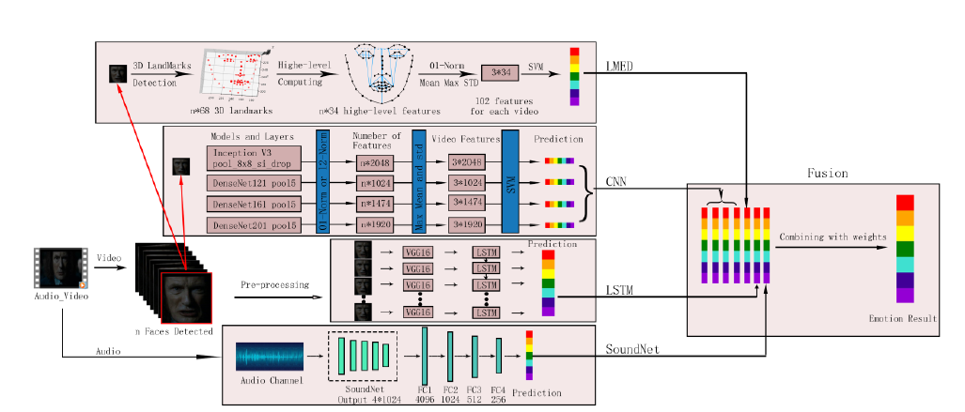
Approach / Solution
Multi feature based emotion recognition for video clips

Slide 6
Different Approaches Devised
DATASET :
Extracting only faces from the image.
Face landmark detection for each image.
MODEL :
Different learning rates for model.
Different datasets.
Using pretrained densenet model trained on FER dataset.
Freezing and unfreezing different number of layers.

Slide 7
Experimental Results / Observations
LMED Network results
 | Angry | Disgust | Fear | Happy | Neutral | Sad | Surprise
Angry | 23 | 0 | 1 | 11 | 7 | 4 | 0
Disgust | 3 | 0 | 1 | 8 | 11 | 3 | 0
Fear | 6 | 1 | 3 | 4 | 8 | 2 | 0
Happy | 7 | 0 | 1 | 57 | 16 | 4 | 0
Neutral | 3 | 1 | 0 | 3 | 59 | 1 | 0
Sad | 11 | 0 | 2 | 10 | 15 | 5 | 0
Surprise | 5 | 1 | 3 | 3 | 24 | 2 | 0
Precision | Recall | F1-score | Support
0.40 | 0.53 | 0.46 | 43
0.00 | 0.00 | 0.00 | 24
0.27 | 0.27 | 0.12 | 24
0.63 | 0.63 | 0.67 | 85
0.42 | 0.42 | 0.88 | 67
0.24 | 0.12 | 0.12 | 43
0.00 | 0.00 | 0.00 | 38
Test Score : 45.37%

Slide 8
Second network results
Dataset | Model | No of Epochs | Layers unfreezed | Training accuracy | Validation accuracy
Combined data | Inceptionv3 | 20 | 30 | 80.37% | 77.22%
FER | Densenet 121 | 100 | 91 | 59.19% | 54.67%
FER | Densenet 161 | 100 | 91 | 66.65% | 54.06%
FER | Densenet 201 | 100 | 92 | 66.16% | 54.52%

Slide 9
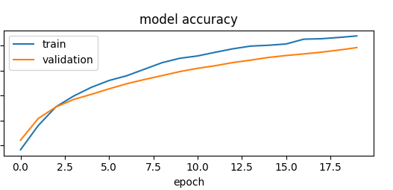
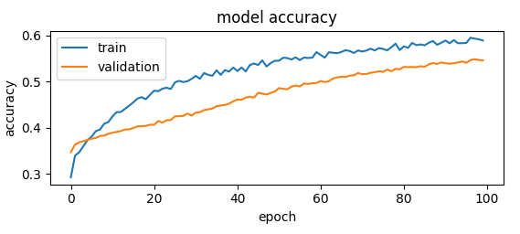
Inceptionv3 model Densenet121 model

Slide 10
Contributions:
Accuracy of LMED network in paper is 39%, our model accuracy is 45.37%.
Observations:
Inceptionv3 model is a dense model hence run time on smart phone is in seconds.
Future Work:
Reduce the run time of the model on smartphone.
To work on fusion algorithm to improve the overall accuracy.

Slide 11
THANK YOU

