Slide 1

Project Title: Text Detection from Images
SRIB – KLE Tech. Univ. Worklet Projects Review
KLE Team Members
a) Medha Bhat -EC
b) Mahima Nayak -EC
c) Vaishakh Kuppast -EC
d) Vaishnavi J -EC
SRIB Mentor Name : Sandeep Palakkal,
SRIB Mentor Dept. : S/W Products R&D Team @ SRIB
KLE Tech. Univ.
Hubballi
JAN 19th , 2019

Slide 2
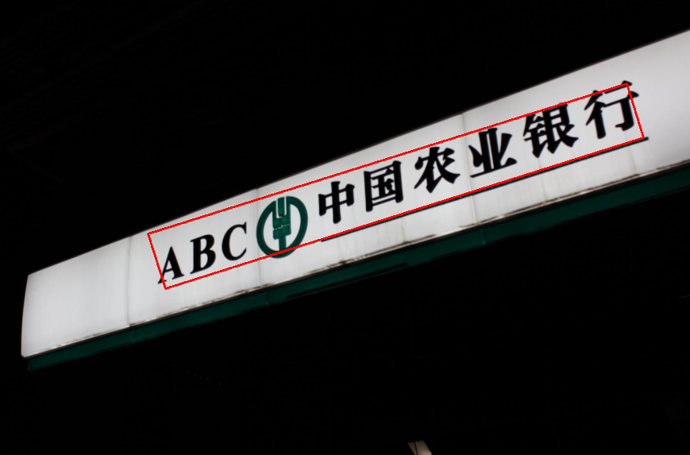
Project Overview
Project Domain :
Project Objectives :
Optical Character Recognition Is project domain.
Text in images provides semantic information present in it.
The automatic understanding of text in image helps in document analysis,robotic system.
Train and test fully-convolutional neural network to detect the multi-oriented text in the images on desktop computer with GPU support.
Achieved 0.67 recall and 0.83 precision.
Many computer driven tasks require
reading text from images.
Existing CNN’s read text that appear in horizontal or near horizontal direction images.
The problem is to recognize text appearing in multi-oriented direction.
Problem Definition :
Technical Challenges :
Detection of text in low contrast images and complex background.
False detection due to closely spaced text lines.
Decreasing the training loss which was NAN.

Slide 3

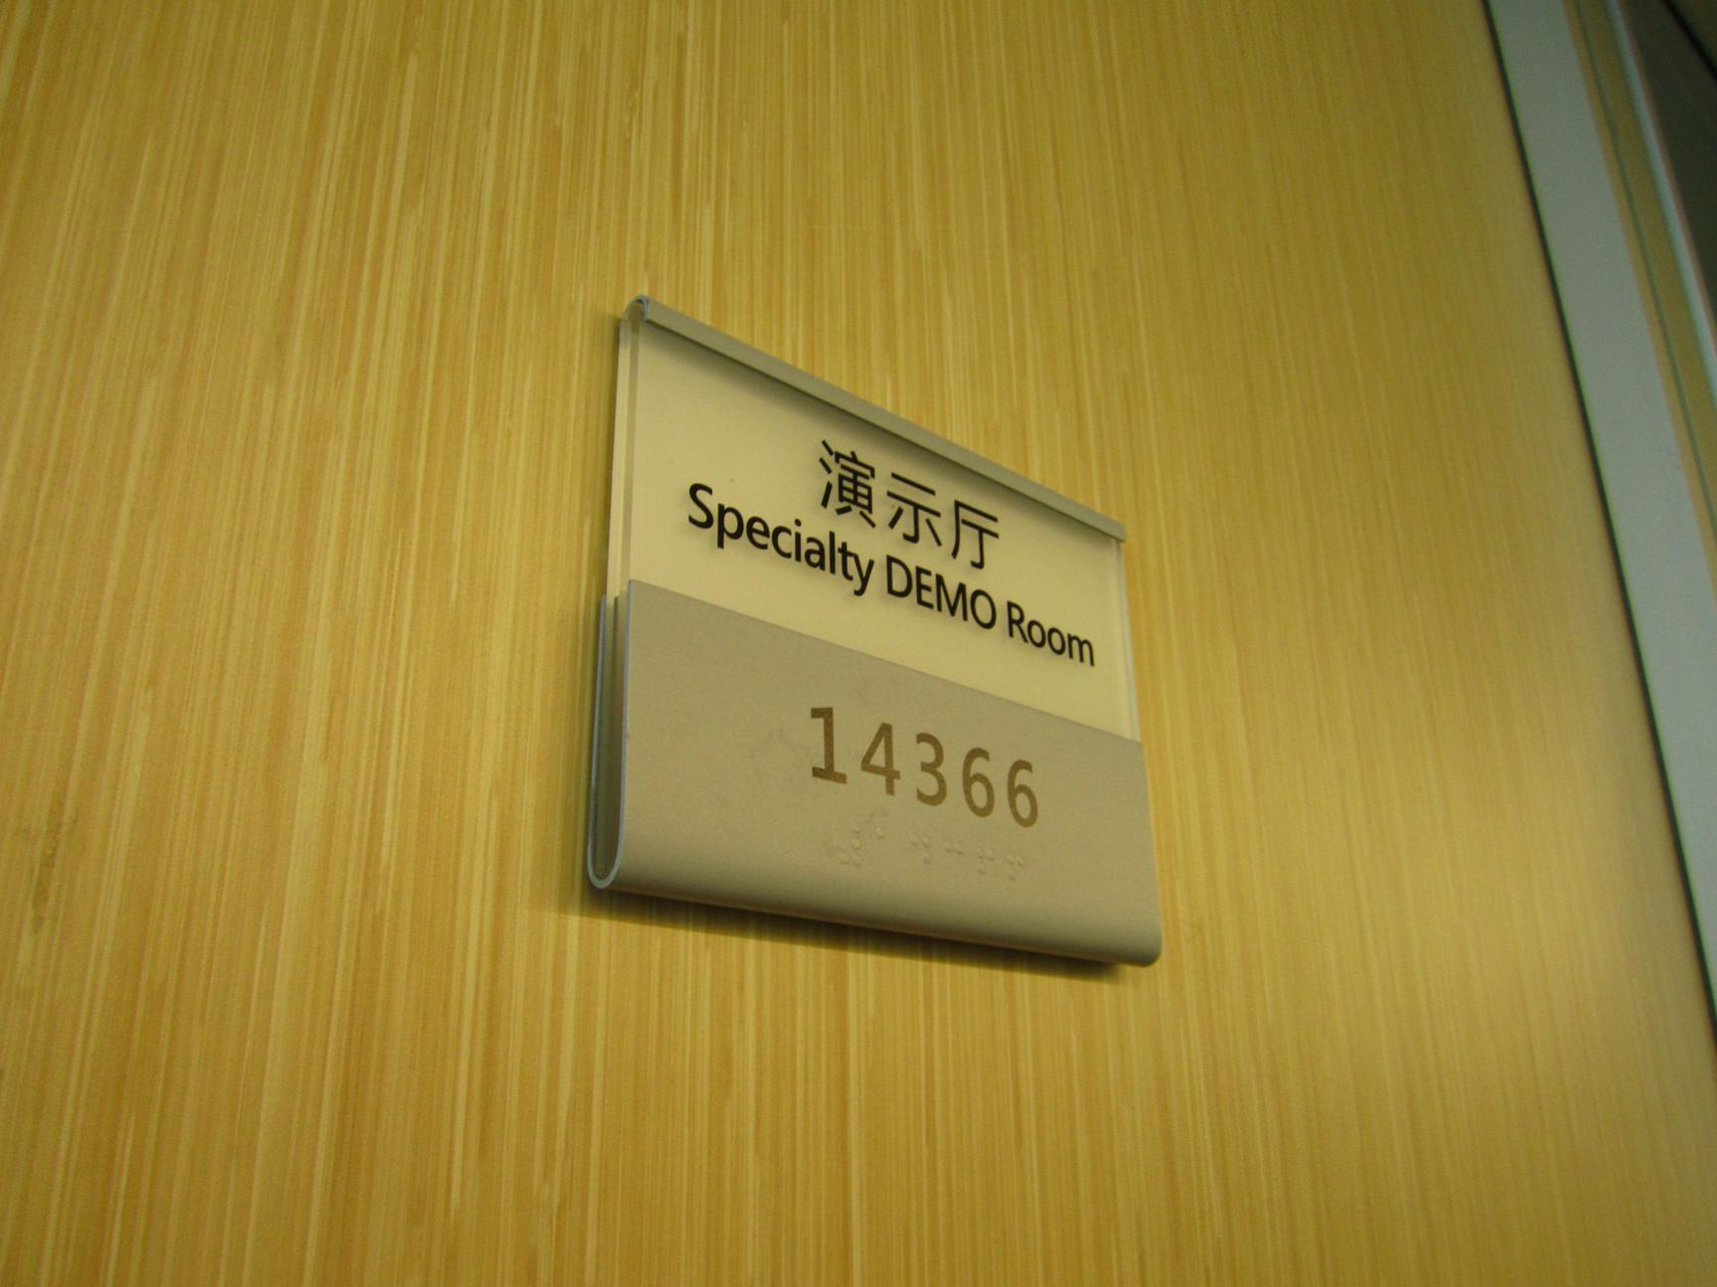
DATASET DESCRIPTION
MSRA-TD500
It consists of 300 training images and 200 testing images.
The resolutions of the images vary from 1296x864 to 1920x1280.
Figure 1 Figure 2

Slide 4
Dataset(s) Analysis
Dataset Capture / Preparation / Generation :
Dataset used is - MSRA –TD500 dataset.
It is obtained from – MSRA_TEXT_DETECTION_500_Database_
URL: http://www.iapr-tc11.org/mediawiki/index.php/
Dataset Understanding / Analysis :
MSRA Text Detection 500 Database (MSRA-TD500) contains 500 natural images, which are
taken from indoor and outdoor scenes using a packet camera.
Each image in the database has a ground truth file, in which each line records the information of one text.
Ground truth file consists of coordinates of identified text region and its orientation.
Dataset Pre-Processing / Related Challenges :
Resizing of images to 225*225 to meet the computational facility.
Generation of ground truth images for training Caffe model of Text FCN and Centroid FCN.
Due to the diversity of the texts and the complexity of the backgrounds in the images
generating ground truth images has been difficult leading to low precision values.

Slide 5
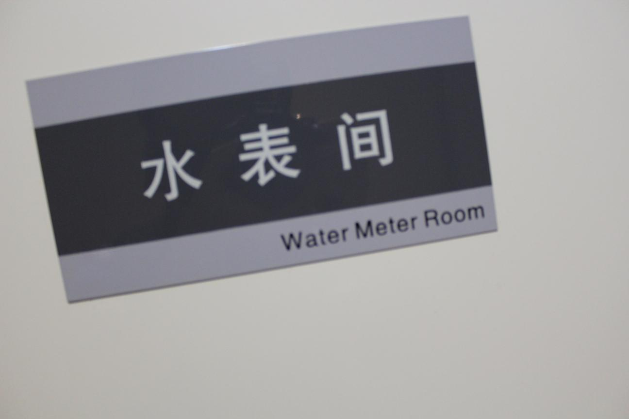

Generation of Ground Truth images
Original Image
Ground Truth Image

Slide 6
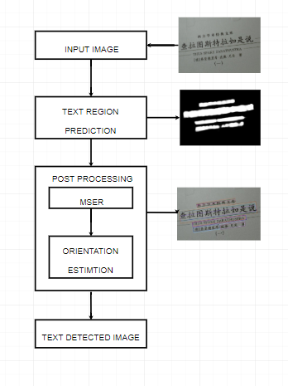
Text FCN Method
Concept Diagram :

Slide 7
Methodology
The salient maps are determined by the Text block FCN model.
The architecture consists of 5 convolutional stages inherited from the vgg-16 model.
The input images are resized to 225*225 so as to meet the computational facility.
After each stage deconvolution is performed that results into feature map.
Feature maps so obtained from all the 5 stages are fused together.
On the fused feature maps 1*1 convolution is performed that results in the final salient map for the given input image.
On the obtained salient maps connected component analysis is performed. MSER technique is used to form the text blocks in the salient map.

Slide 8
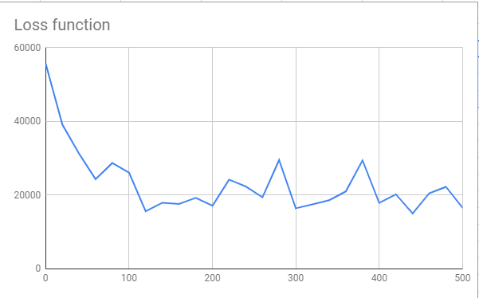
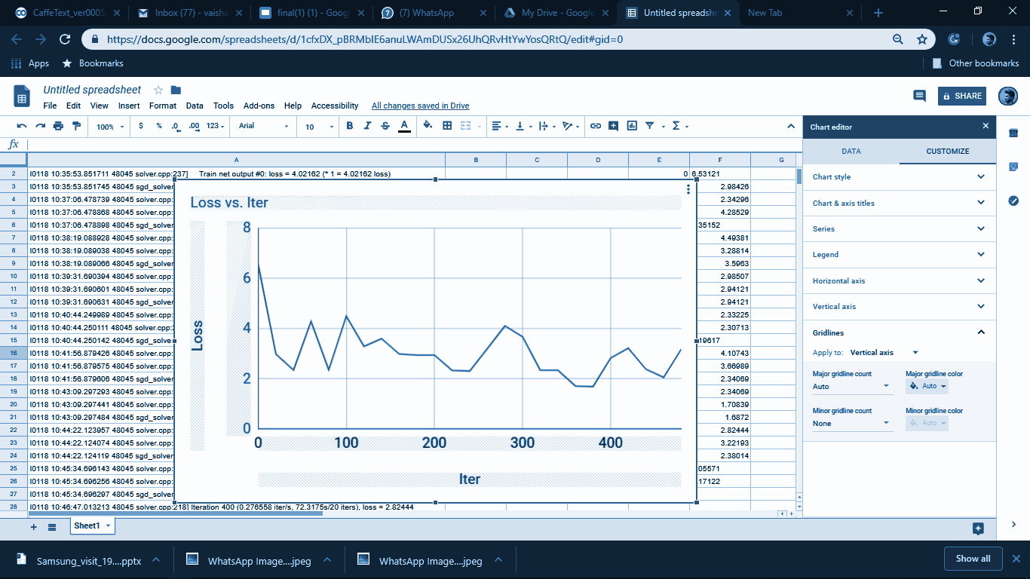
Retraining of Network
Figure 5 Figure 6
Learnings:
The training of network gave loss as NAN.
Tweaking of Lr_mult and Base_Lr.
NAN issues resolved by redefining the loss layer.

Slide 9
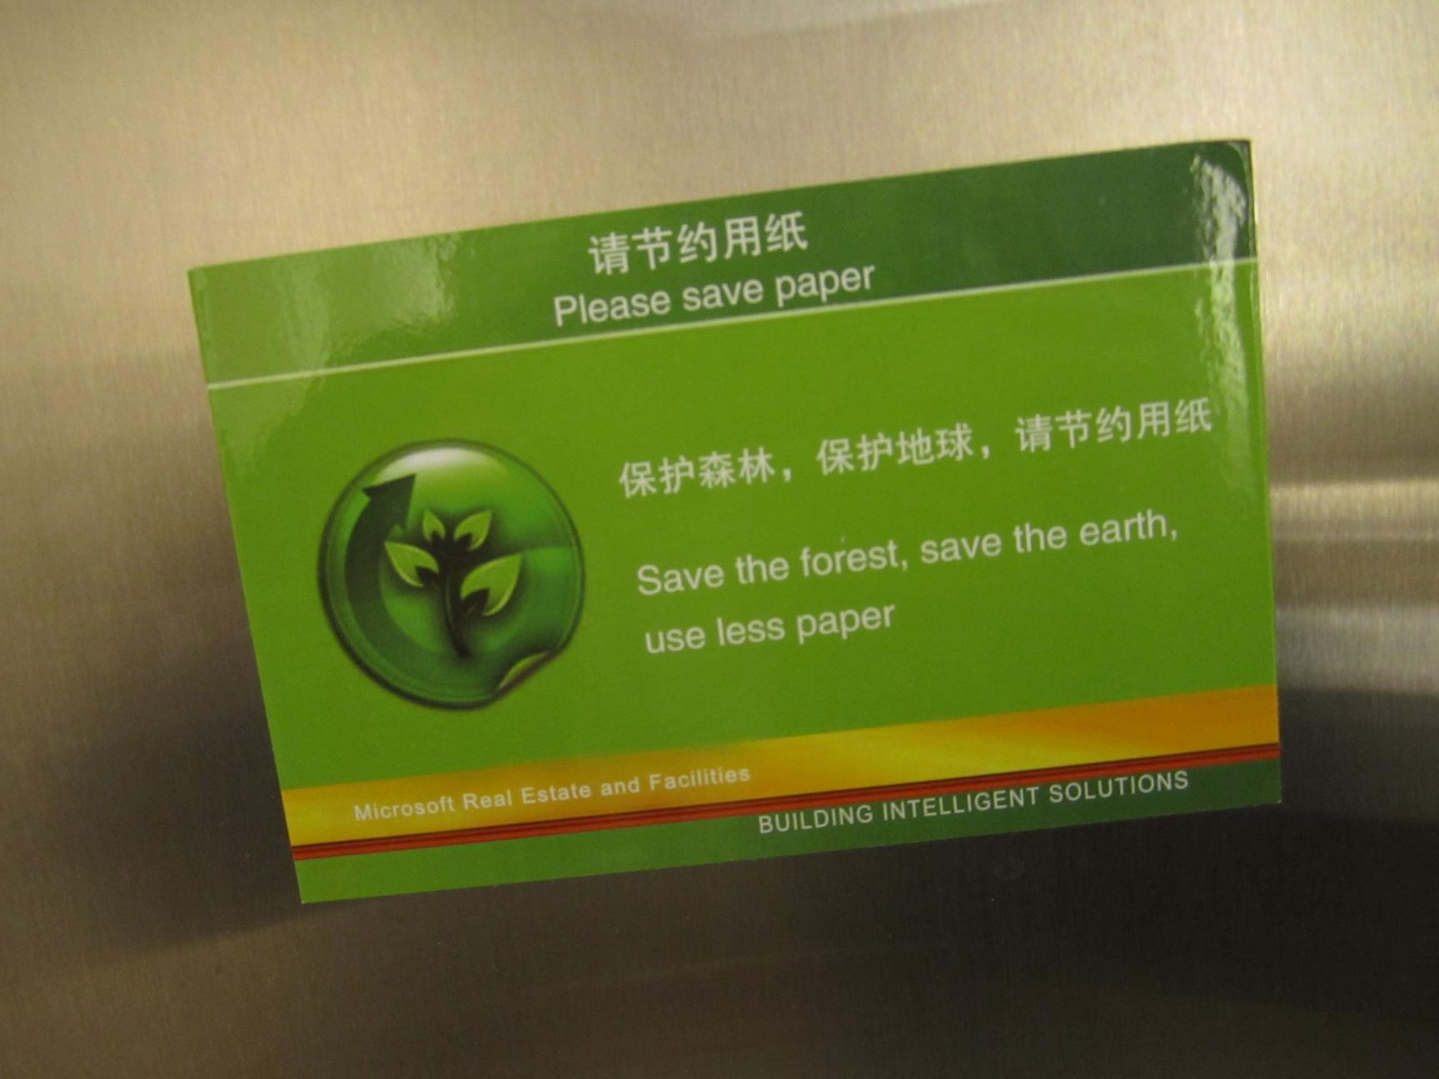
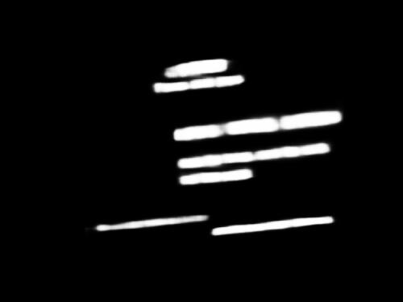
Experimental Results
Results :
Text FCN model trained for 18000 iterations on GPU.
Input Image
Salient Map

Slide 10
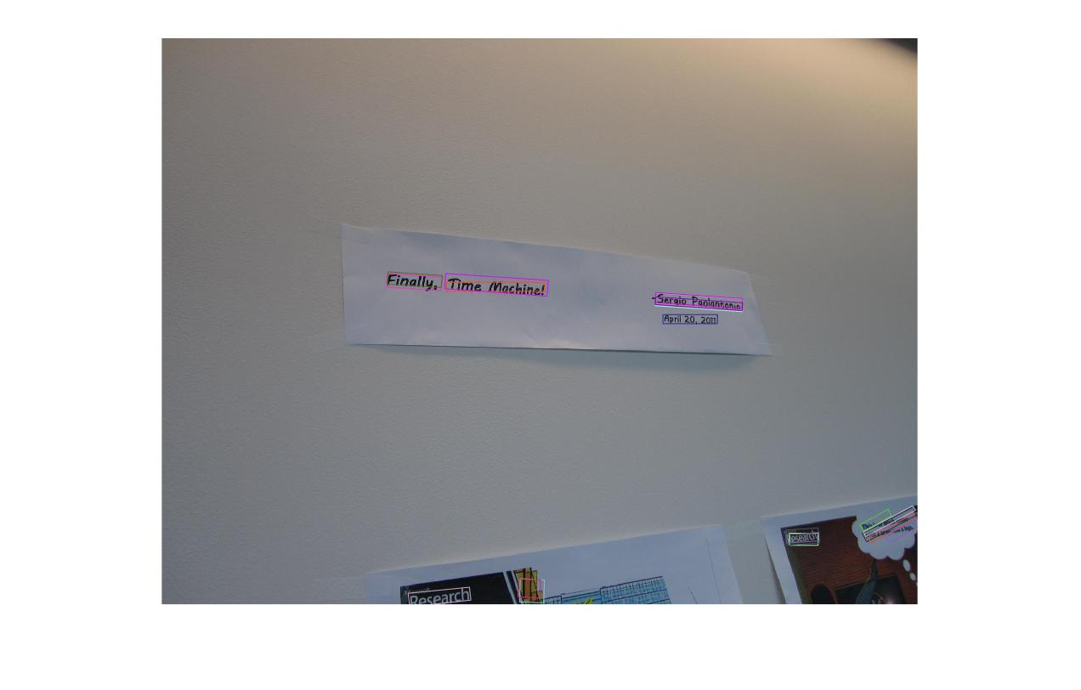

Experimental Results
Results of MSER
Figure 7
Figure 8

Slide 11
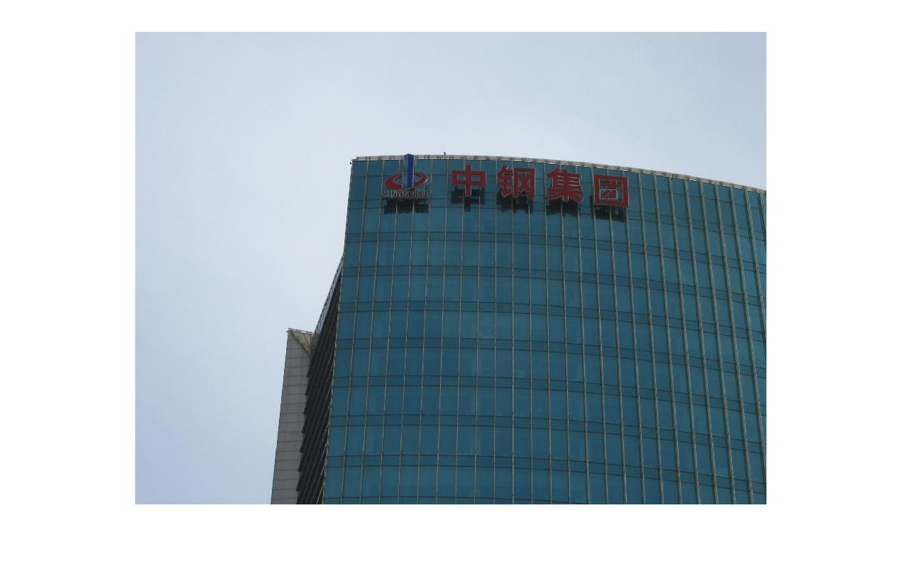
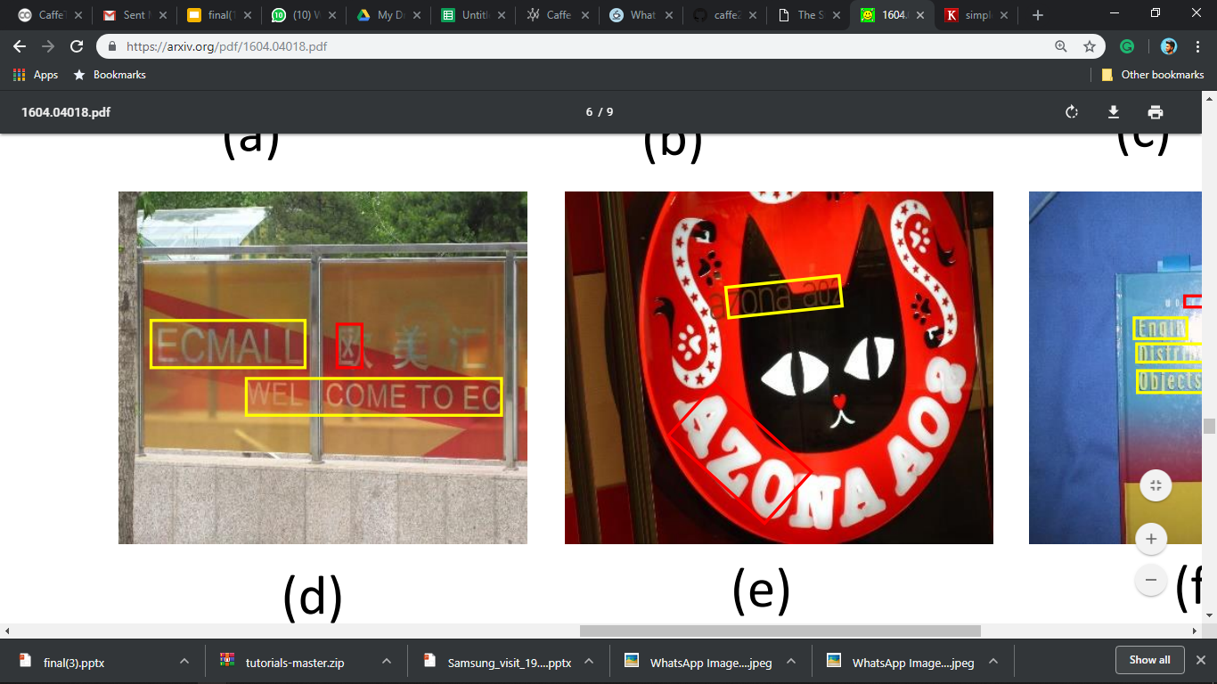
Experimental Results / Observations
Figure 9 Figure 10
Major findings / Observations / Conclusions :
Obtained recall of 0.42 and precision of 0.75.
Failure cases are observed with false detections and missing boxes in certain situations, such
as low contrast , complex background and closed spaced text lines .

Slide 12
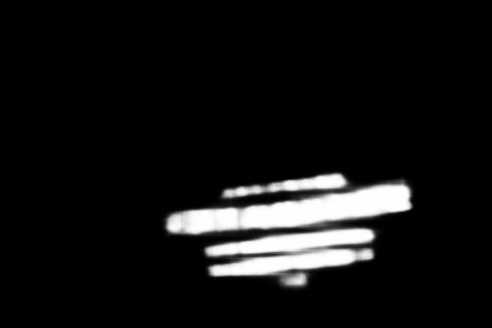

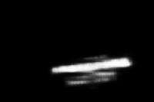
Multi-Scaled images
Salient maps for Multi-Scaled Images
200x133
500x333
1000x666
Learnings:
Scaled images increases accuracy of detecting text regions
Increase in recall to 0.58.

Slide 13
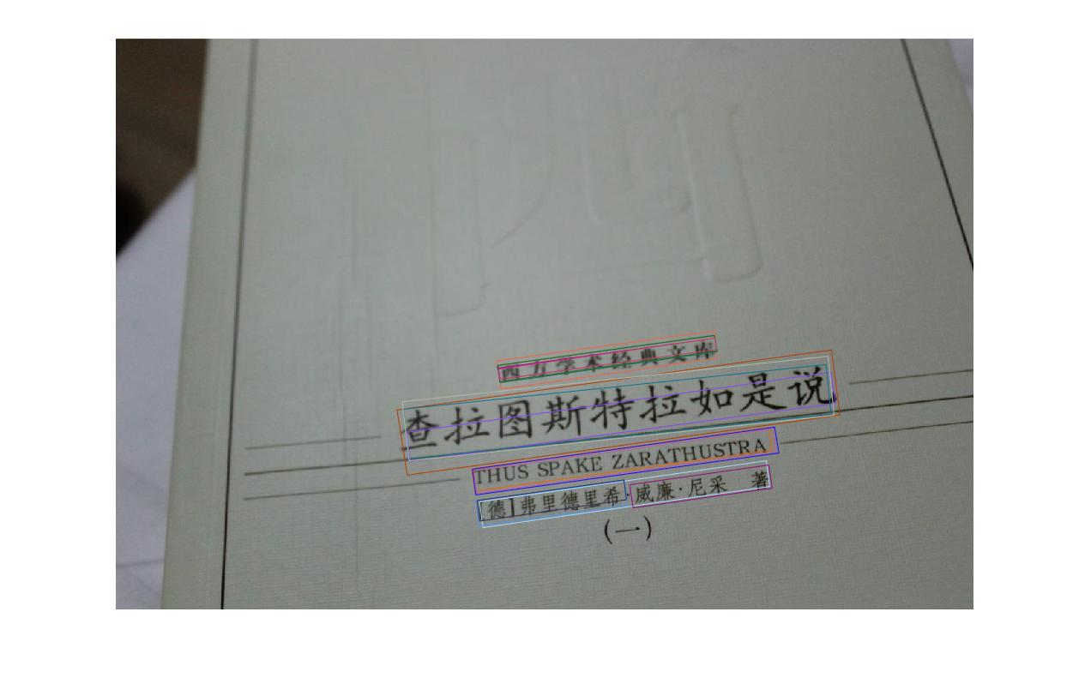
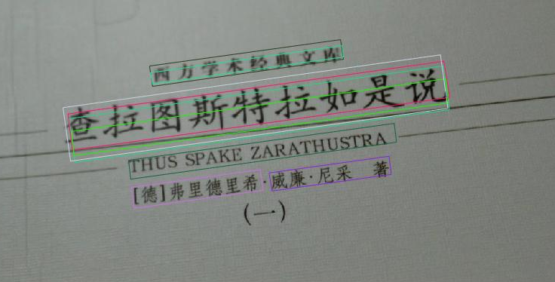
Multiscaling of Salient Maps
Single Salient map result
Multi-Scaled Maps result
Figure 11 Figure 12
Learnings:
Decrease in the number of false detections.
Increase of recall to 0.58.

Slide 14
Concept diagram
Other Approach
The input image is fed to a Text block FCN model .
Salient map is obtained for the given input image from text block FCN model.
Thresholding on obtained salient map is performed in order to obtain binary segmentation of salient map.
The contours determining the coordinates of bounding boxes of text lines are obtained.
The obtained coordinates are plotted in input image depicting the bounding box for text lines.

Slide 15
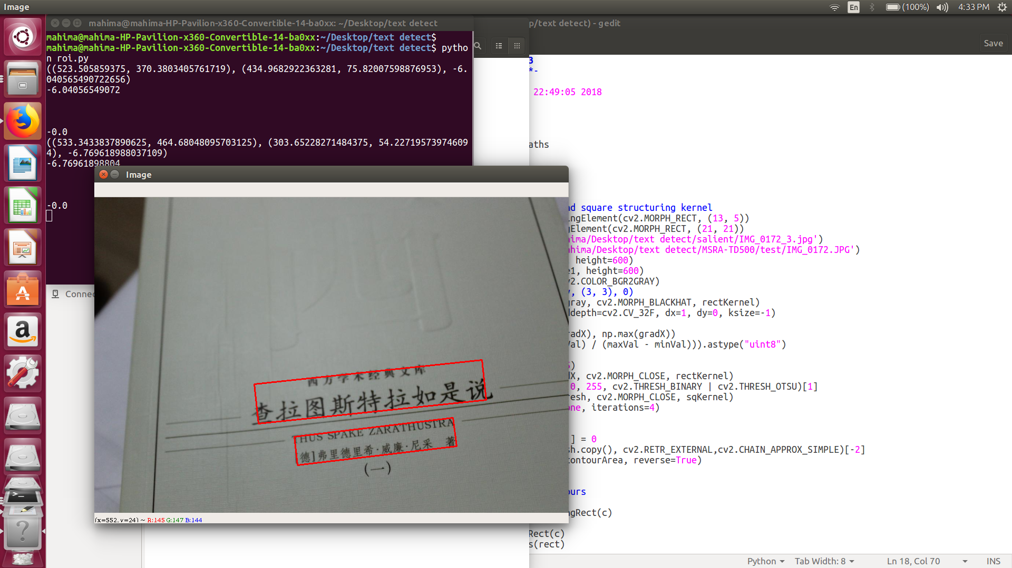
Results and Shortcomings
Figure 13 Figure 14

Slide 16
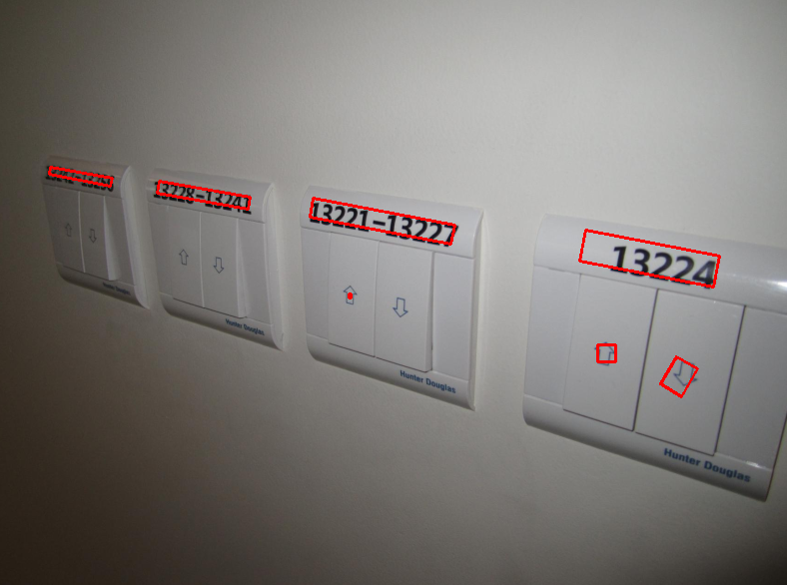
Results and Shortcomings
Figure 15
Learnings:
Single lined text lines are detected.
Closedly spaced lines are combined with single box.
False detections of symbols and shapes.
Precision : 0.36 ,Recall : 0.58

Slide 17
Conclusion :
Obtained recall of 0.42 and precision of 0.75, by validating with ground truth values for text FCN method.
Reduction in false detection of text region which increased precision.
Contribution :
Detection of text using thresholding gave Precision : 0.36 , Recall : 0.58
Reduced the false detection of text regions by generating multiscale salient map followed by applying MSER.
Future scope :
Training on regional language text images.
We can build an end to end text recognition system.

Slide 18
THANK YOU !

