Slide 1
IMAGE FILTERING
CVG SUMMER PROJECT
TEAM MEMBERS
VAISHAK KUPPAST
VIJETH PATIL
MEDHA BHAT

Slide 2
FILTERING
OCCLUSION
TEXT DETECTION
BLUR DETECTION
SHADOW DETECTION

Slide 3
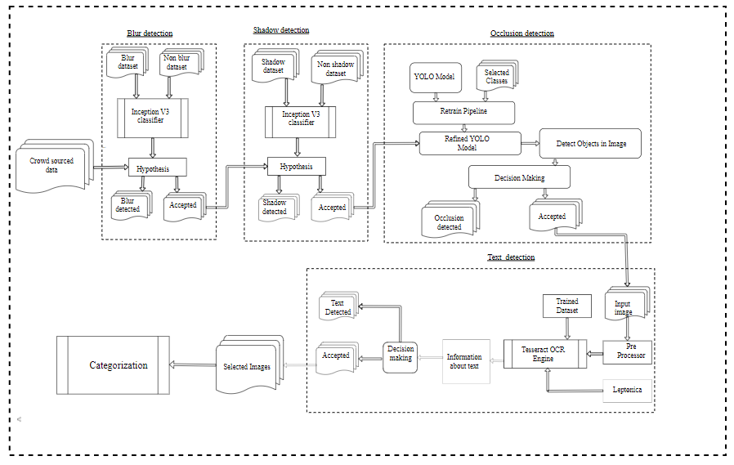
Designed Pipeline.

Slide 4
 | 5 CLASS | 10 CLASS | 10 CLASS |  | 15 CLASS
 | Without filtering | With filtering | Without filtering | With filtering | Without filtering | With filtering
TRAIN ACCURACY | 86 | 100 | 86 | 94 | 91 | 96
TEST ACCURACY | 80.8 | 100 | 74.7 | 91.5 | 83.2 | 95
VALIDATION ACCURACY | 82 | 100 | 78 | 93 | 83 | 99
VALIDATION LOSS | 0.27 | 0.002 | 0.3368 | 0.161 | 0.225 | 0.1303
N(no of epochs) | 386 | 431 | 685 | 515 | 1139 | 925
TRAINING TIME | 43 min 22 sec | 19 min 4 sec | 44 min 32 sec | 19 min 42 sec | 45 min 29 sec | 30 min 10 sec
Data Size | 2714 | 2196 | 6552 | 5920 | 10499 | 8271
Mobile net

Slide 5
 | 5 CLASS | 10 CLASS | 10 CLASS |  | 15 CLASS
 | Without filtering | With filtering | Without filtering | With filtering | Without filtering | With filtering
TRAIN ACCURACY | 100 | 100 | 94 | 100 | 91 | 95
TEST ACCURACY | 99.3 | 100 | 92.3 | 99.1 | 83.2 | 93
VALIDATION ACCURACY | 100 | 100 | 89 | 100 | 83 | 98
VALIDATION LOSS | 0.0082 | 0.01564 | 0.1625 | 0.058 | 0.225 | 0.218
N(no of epochs) | 240 | 416 | 633 | 690 | 1139 | 873
TRAINING TIME | 25 min | 15 min 40 sec | 21 min 46 sec | 37 min | 45 min 29 sec | 26 min 35 sec
Data Size | 2714 | 2196 | 6552 | 5920 | 10499 | 8271
Inception v3

Slide 6
There is increase in the train accuracy by 14%,8%,5% for 5,10,15 classes of dataset for MobileNet v2 model after filtering.
Similarly the train accuracy was increased by 6%,4% for the same classes of dataset for Inception V3 model.

Slide 7
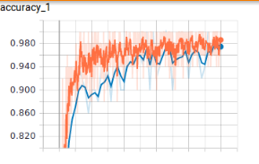
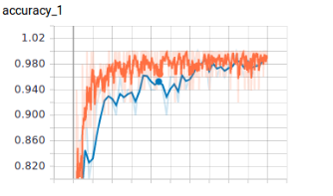
We run our algorithm on 5 classes of crowd sourced data and 5 classes of filtered images. We got following graph for validation and train accuracy.
Without filtering.
With filtering.

Slide 8
Thank you!!!

