Slide 1
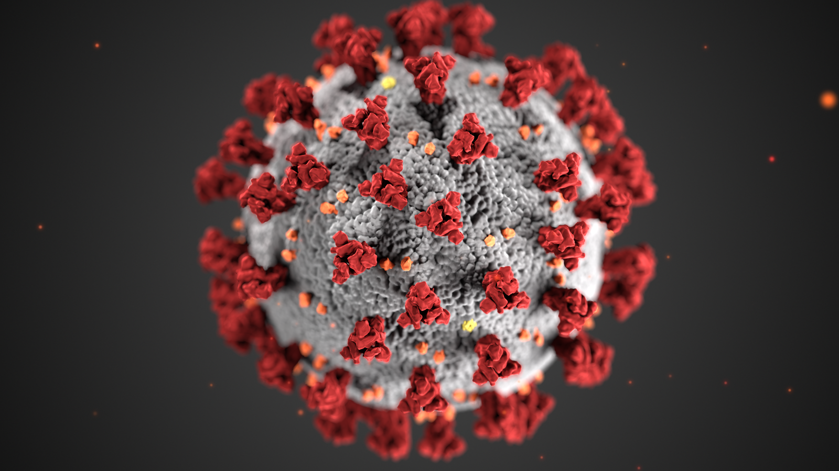
COVID-19 STATUS TRACKER

Slide 2
PROJECT BY: CREATIVE CODERS
Our Team Members
Aparna
Fousiya
Libiya
Sudharsanam
Vaishak

Slide 3
OBJECTIVE
1. To create a web app that displays country and state wise status of:
Total Covid Cases
Active Covid Cases
2. To create graphical representations of above cases
3.To create a login page and sign up page for patiend page and to store the data in database.
4.To Create a Survay Page to collect the patient details and to store the data in database.
5.To create a space where patient and heralth-worker can interact.

Slide 4

TOOLS USED
ReactJs
NodeJs
MongoDB
ReactChartJs
ExpressJs
Axios
Cors
material UI
React Countup

Slide 5
PAGES
Awareness Page
Home Page
Covid Dashboard
Sign Up Page
Login Page
Survey Page
Chat Page

Slide 6
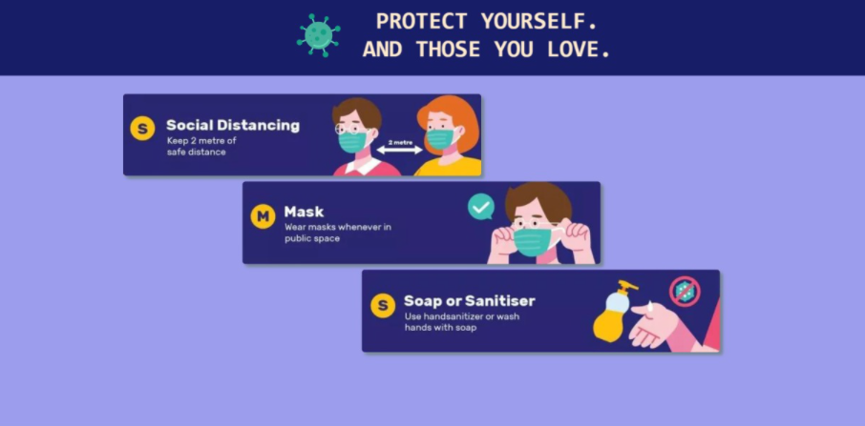
AWARENESS PAGE
Message / Details
Stylesheet – animations

Slide 7

HOME PAGE

Slide 8
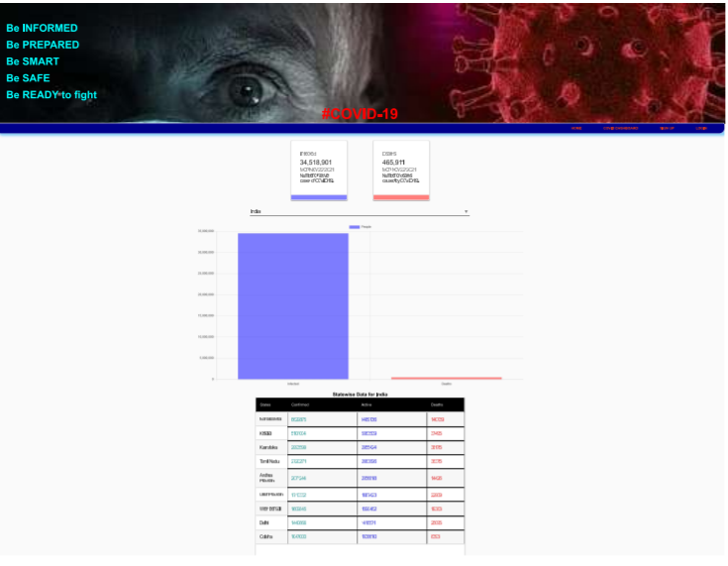
Covid Dashboard
API Source:
https://covid19.mathdro.id/api

Slide 9
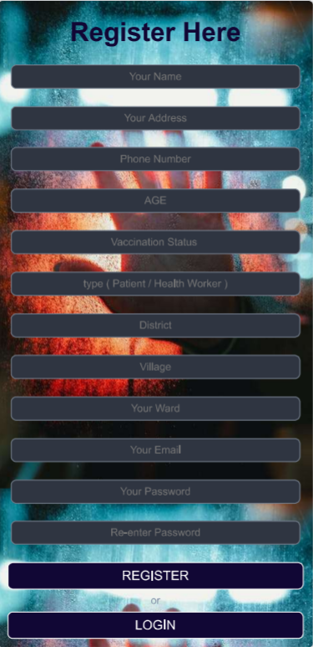
SIGN UP PAGE
A signup page (also known as a registration page) enables users and organizations to independently register and gain access to your system. It is common to have multiple signup pages depending on the types of people and organizations you want to register.

Slide 10
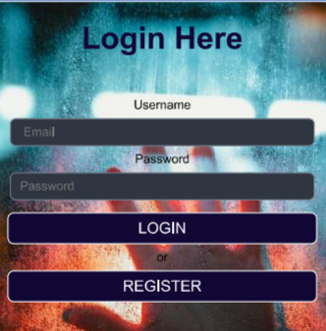
LOGIN FORM
A Login form is used to enter authentication credentials to access a restricted page or form. The login form contains a field for the username and another for the password. When the login form is submitted its underlying code checks that the credentials are authentic, giving the user can access the restricted page.

Slide 11
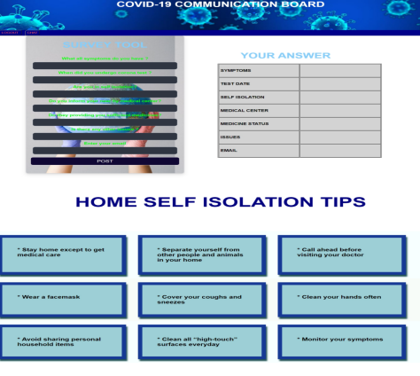
Survey Page

Slide 12
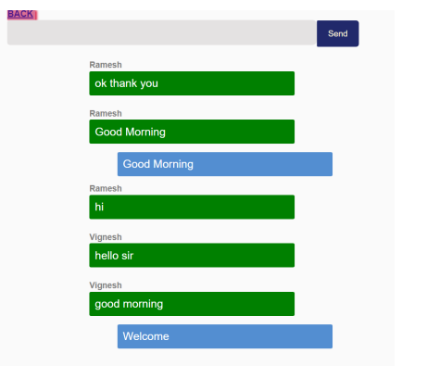
Chat Page

Slide 13
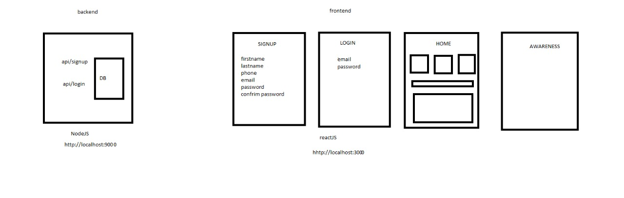
Architecture
React App

Slide 14


