Slide 1
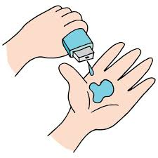
Project Title - SmartCrop: AI-Driven Sustainability Advisor for Farmers
Student Name: VAISHAL DSOUZA
AICTE ID : STU687e298d7c6d71753098637

Slide 2

PROBLEM STATEMENT
Small-holder farmers often experience low agricultural yields and financial instability due to reliance on traditional trial-and-error methods for crop selection. In the absence of scientific insights into soil nutrients such as Nitrogen, Phosphorus, and Potassium, along with environmental factors like rainfall, temperature, and humidity, farmers frequently cultivate crops that are unsuitable for their land conditions. This mismatch results in inefficient use of scarce water resources and excessive application of chemical fertilizers, which gradually degrades soil fertility and harms long-term productivity. The lack of accessible, data-driven decision tools further widens the gap between small-scale farmers and large industrial farms. There is a critical need for an easy-to-use, intelligent solution that can guide farmers toward optimal crop choices, ensuring higher yields, food security, and sustainable agricultural practices.

Slide 3
Project Description
SmartCrop is a predictive and analytical tool that serves as a digital agricultural extension officer. The system utilizes a Random Forest Classifier trained on a comprehensive dataset of 2,200 agricultural records to recommend the optimal crop for a specific plot of land. Beyond simple prediction, the project integrates Explainable AI (XAI) through feature importance visualizations to show farmers which factors most influence their land's productivity. It also features a Sustainability Advisor that provides customized water-management and soil-health tips for each recommended crop, helping users transition toward regenerative farming practices.

Slide 4

WHO ARE THE END USERS?
Small-holder Farmers: Who need low-cost, expert data insights to increase their income and food security.
Agricultural Extension Officers: Who can use the tool to provide data-driven, localized advice to the communities they serve.
NGOs & Agricultural Cooperatives: Organizations focused on promoting sustainable farming and climate resilience in rural areas.

Slide 5
SDG Alignment
SDG 2: Zero Hunger – By maximizing yields per hectare to ensure local food availability.
SDG 12: Responsible Consumption and Production – By optimizing fertilizer and water usage to reduce waste.
SDG 13: Climate Action – By recommending crops that are best suited for current local rainfall and temperature trends.

Slide 6

Technology Used
Python (v3.12+)
Pandas and NumPy
Matplotlib and Seaborn
Scikit-learn
Google Colab / VS Code
IBM watsonx

Slide 7
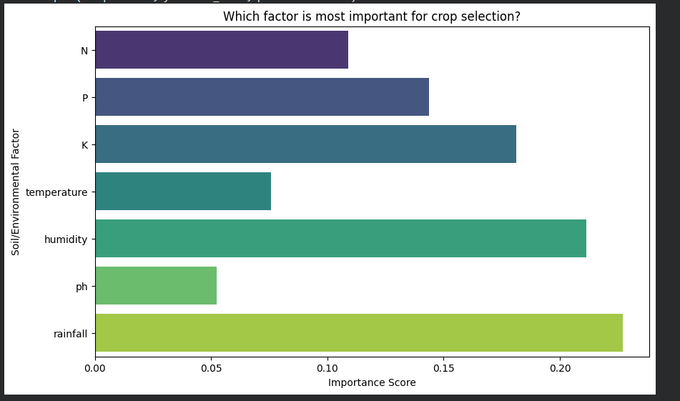
RESULTS
Demo Link

Slide 8
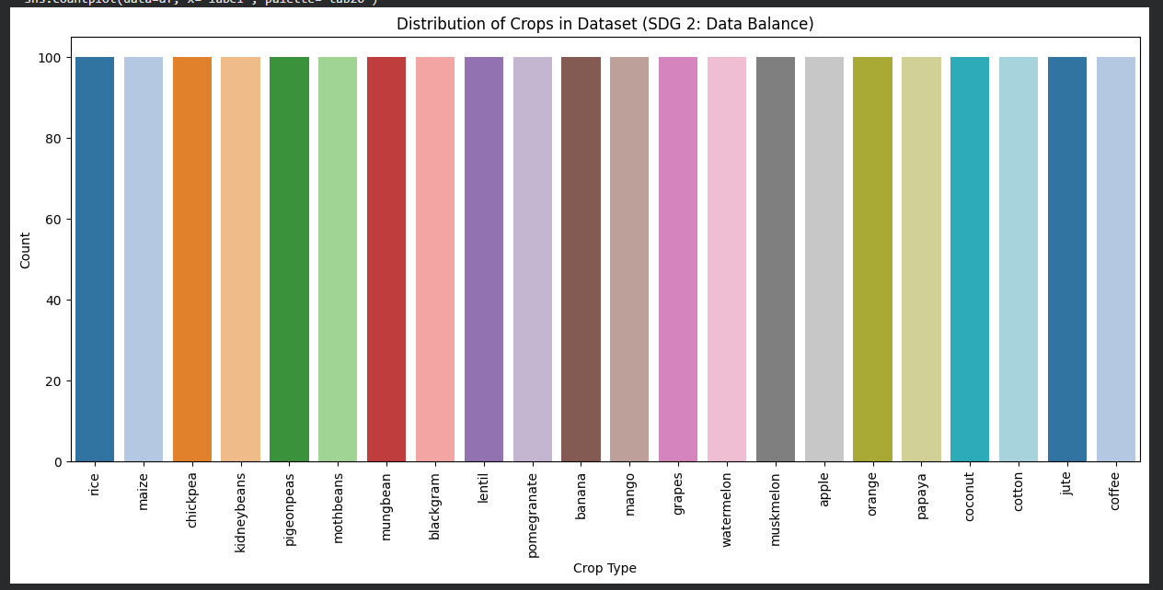
RESULTS

Slide 9
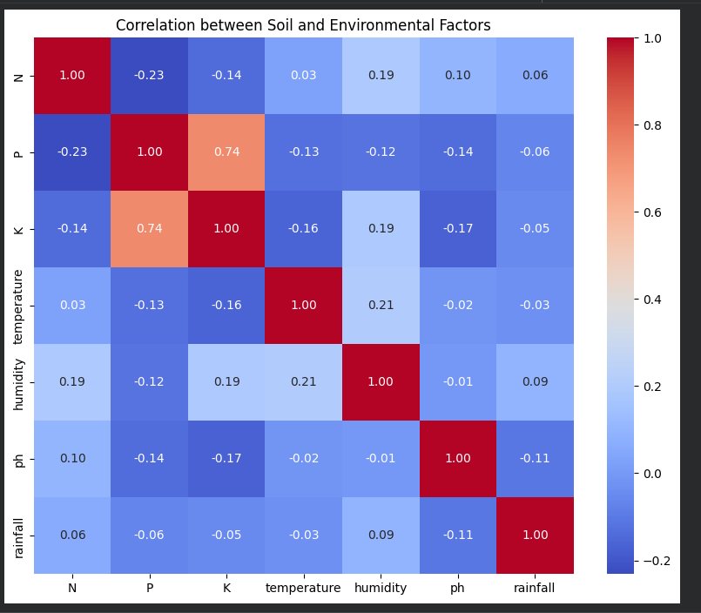
RESULTS

Slide 10
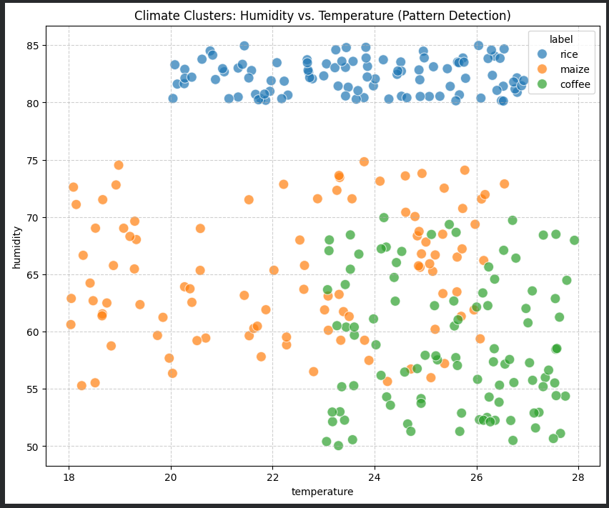
RESULTS

Slide 11
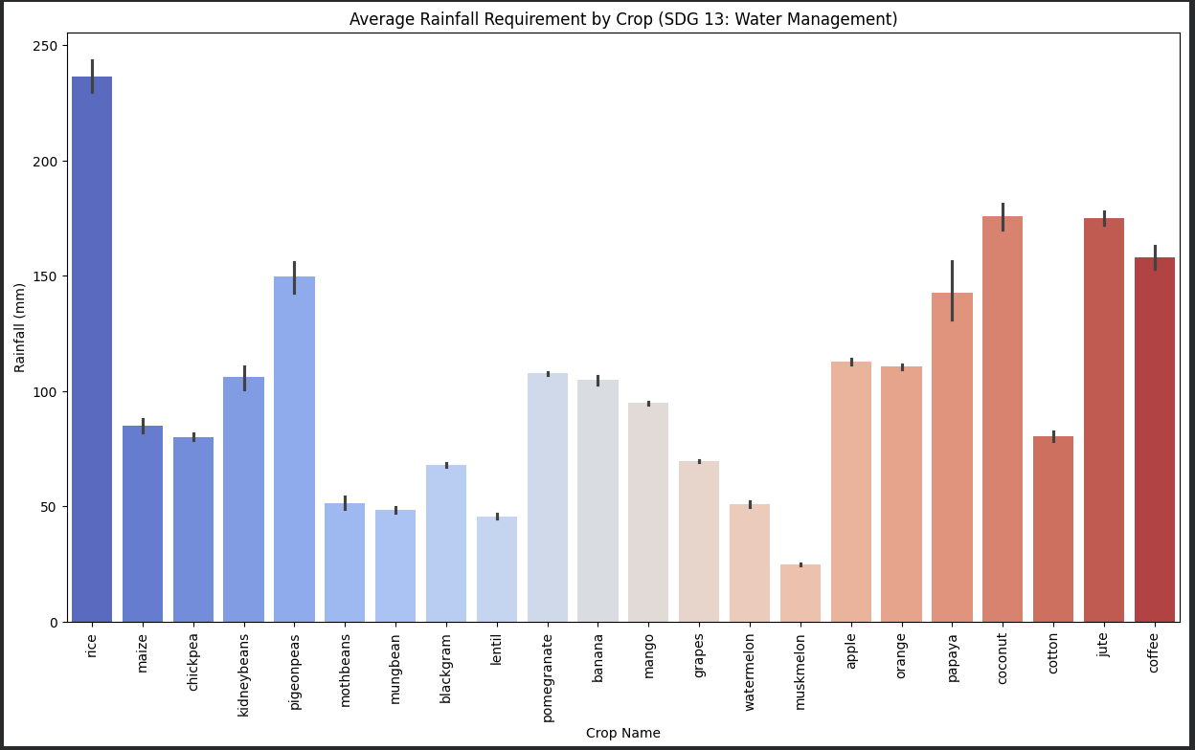
RESULTS

Slide 12
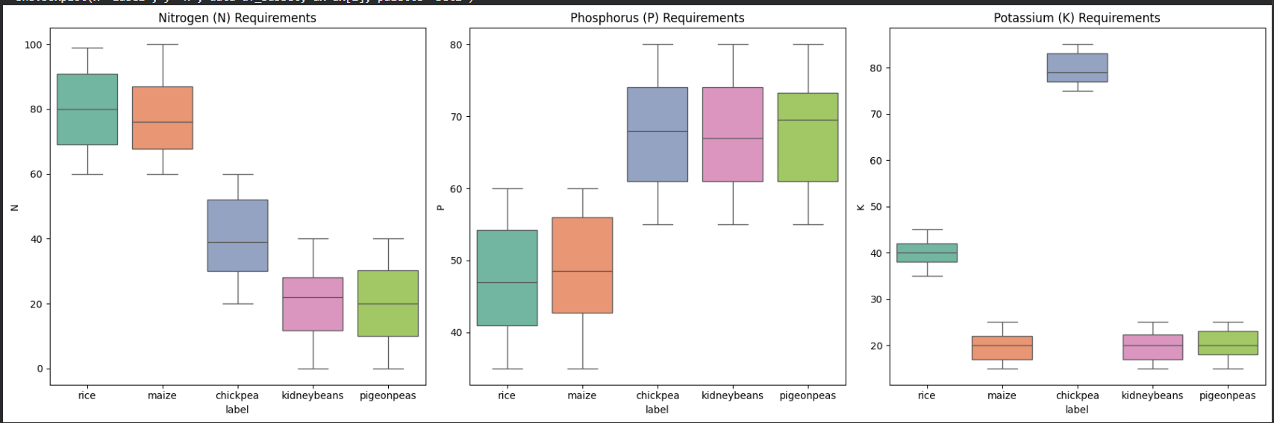
RESULTS

Slide 13
RESULTS
High Accuracy: The model achieved a high accuracy score (typically >99% in testing) across 22 different crop varieties.
Transparency: The Feature Importance plot revealed that environmental factors like Rainfall and Humidity are often as critical as soil nutrients (NPK) in crop selection.
Decision Support: The Sustainability Profile output successfully provides actionable advice, such as recommending "Alternate Wetting and Drying" for rice to save water.

Slide 14
Future Scope & Scalability
Integration with Real-time IoT: Connecting the AI model to live soil sensors for real-time automated recommendations.
Mobile Application: Developing a lightweight Android app for farmers with limited internet access to use the tool offline.
Multimodal Input: Allowing farmers to upload photos of their soil or current crops for health monitoring and pest detection.
Economic Forecasting: Adding a module to predict the market price of recommended crops to help farmers maximize their economic gains.

Slide 15
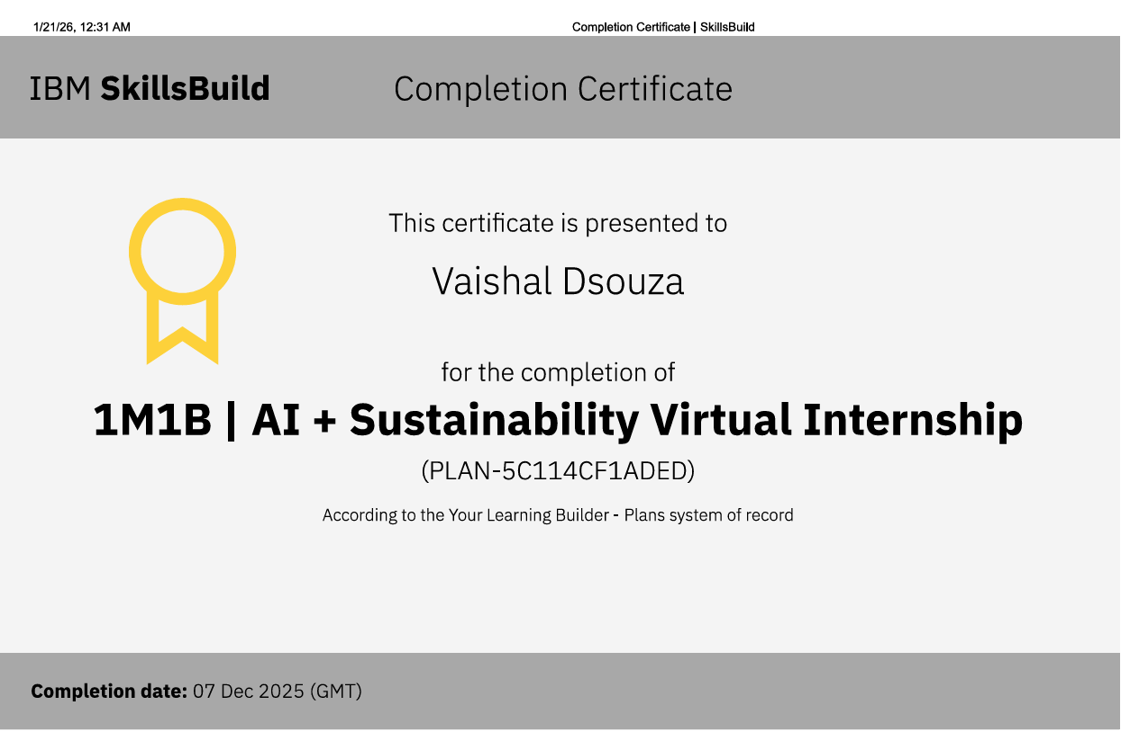
Certificate

Slide 16
GitHub link
https://github.com/vaishaldsouza/SmartCrop-AI-Sustainability
Google Colab link
https://colab.research.google.com/drive/1wlnr8IDLW2fHvQN3N-WXtHZY3iESzmdV?usp=sharing
Google Drive link
https://drive.google.com/drive/folders/1tBnWB-iBuO666V_cepi8OnyawEP1ceU1?usp=sharing

Slide 17
Thank you
.
.

