Slide 1
COMP237 NLP Project
Analysis & Modelling of comments on Katy Perry’s videos
-By Group 2
Vaishali, Niyanta, Divyanshu, Shivam & Gagandeep

Slide 2
Agenda
Introduction
Data Analysis
Data Preprocessing
Training
Evaluation
Conclusion

Slide 3
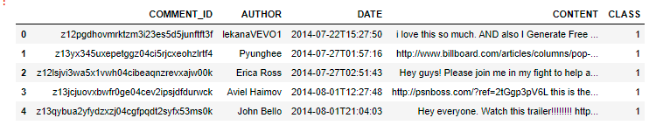
Introduction
Features | DataType | # of missing values
COMMENT_ID AUTHOR DATE CONTENT CLASS | Unique ID String Date String Binary (0/1) | 0 0 0 0 0
Format : CSV
Shape : 350 x 5

Slide 4
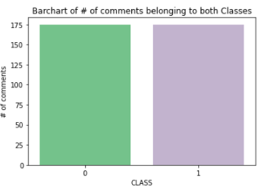
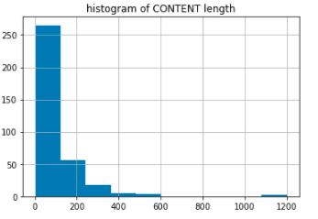
Data Analysis
~98% of authors have left only 1 comment
Only 3 duplicate comments
dataset is “Balanced”.
Right skewed
2 comments that are long. They belong to Class1

Slide 5
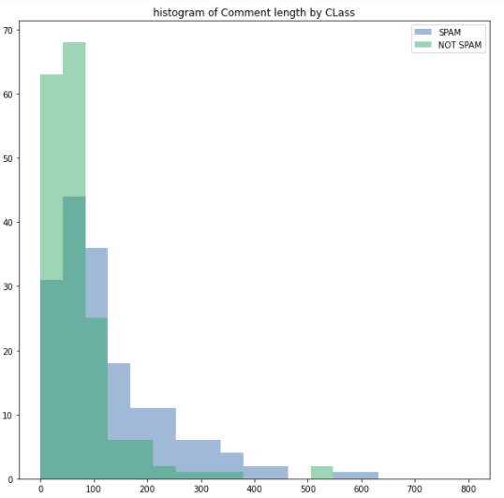
Data Analysis
SPAM Class have longer comments
their median length = 99 characters than the NOT SPAM Class ( 58 characters).

Slide 6
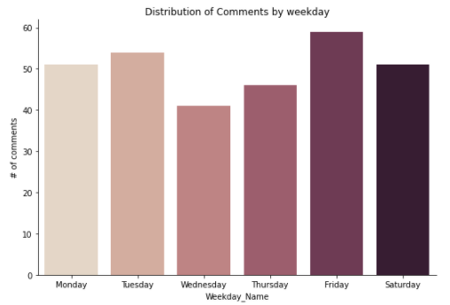
Data Analysis
Number of comments by Weekday
People commented more during Fridays but not much on Wednesday.

Slide 7
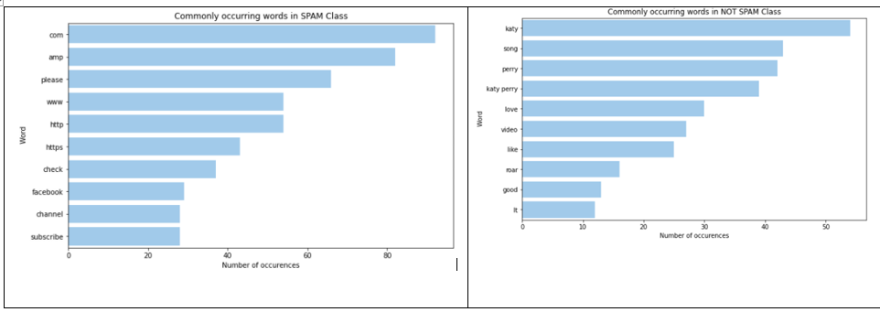
Data Analysis
Unigrams of SPAM and HAM Class Content

Slide 8
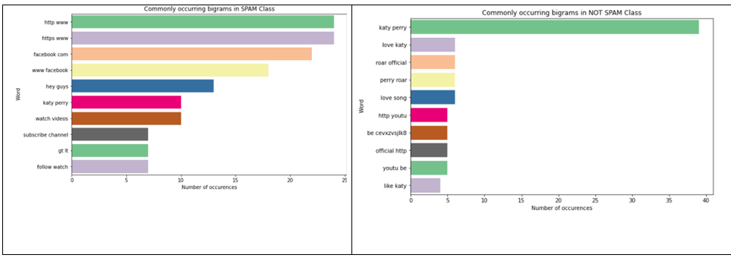
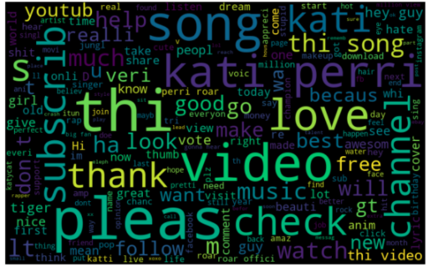
Data Analysis
Bigrams of SPAM and HAM Class Content

Slide 9
Data Preprocessing
Out of 5 columns, 2 columns are used- Content & Class
Removed special characters & white spaces that are prevalent in SPAM comments.
Data stemming
Convert to lowercase

Slide 10
Modelling
Model used – Naïve Bayes
Train shape = 262 X 1630
Test shape = 88 X 1630
Test size = 25%
CV Fold = 5

Slide 11
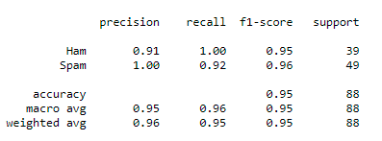
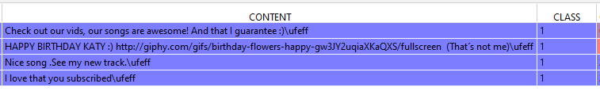

Evaluation
FN & FP are very low.
High Precision and Recall of 0.91 and 1 respectively.
Therefore a good model.
Accuracy is 95.45%

Slide 12
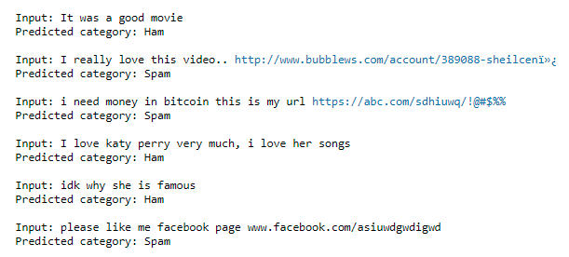
Evaluation
Sample predictions

Slide 13
Conclusion
Spam Comments are longer with URLs & special characters.
A Naïve Bayes Model predicts Spam/Ham comments with accuracy of ~95%.

Slide 14
Thank You

