Slide 1
Yelp Data Analysis
3252 - 019
By VaishalI

Slide 2
Introduction
Data Description
Data Analysis
Trend in cities
Reviews
Users
Prediction
Conclusions
Agenda

Slide 3
Data Description
Source: Yelp
Format: JSON
Objective
assess the public perception of businesses
make decisions regarding new business or business expansion
Filename | Shape
business.json | 192,609 X 14
review.json | 1,637,138 X 9
user.json | 6,685,900 X 22
checkin.json | 161950 X 2

Slide 4
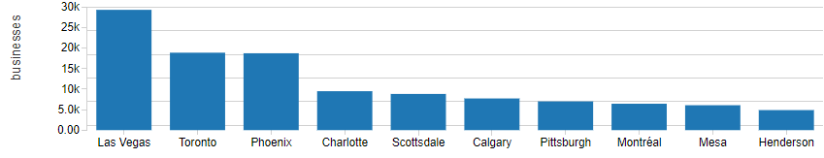
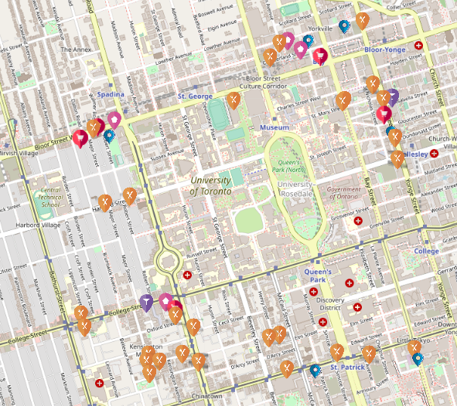
Trends In Cities
Toronto hosts the second highest number of businesses.
average rating = 3.3 - 3.6
In Toronto
Majority of reviews for Food industry
Average rating = 2.2 to 3.4
There exist ~5000 businesses within 10 miles radius of UofT

Slide 5
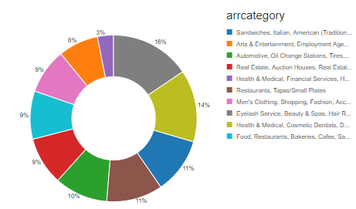
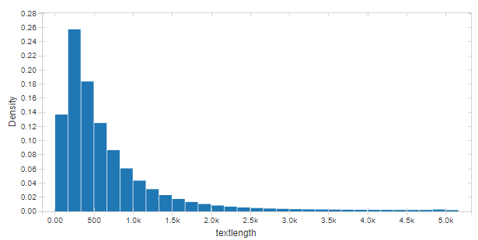
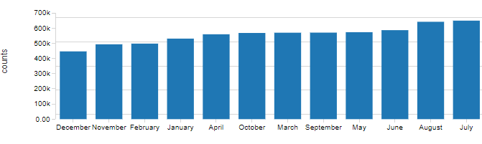
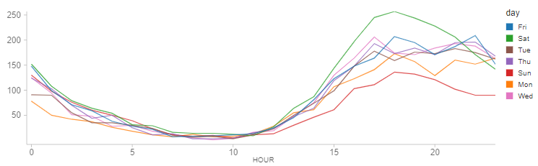
EXPLORING REVIEWS
user gives 3.5 or 4 stars
Beauty Salons and restaurants have mostly positive reviews
Casinos have low rating
average review is around 160 to 300 words.
As expected, Fridays and Saturday between 3pm to 8 pm has the highest number of check-ins

Slide 6
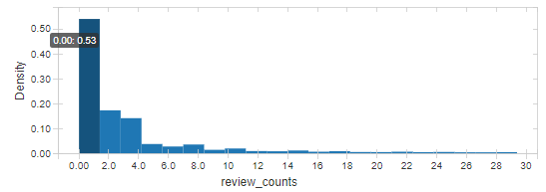
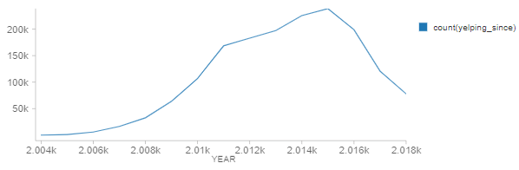
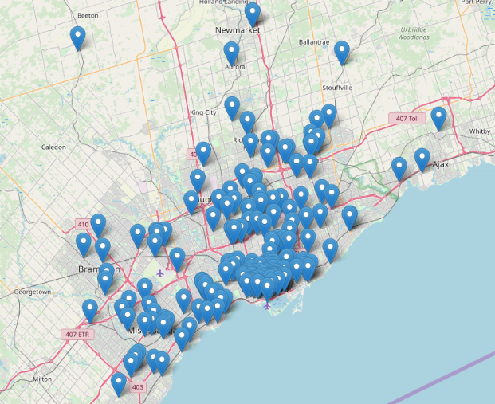
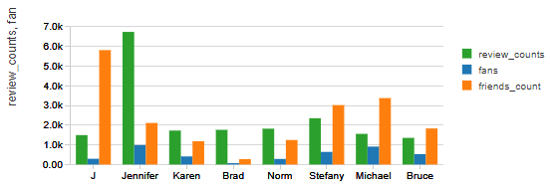
EXPLORING Users
~80% of the users write about 2-4 reviews.
User growth is constantly dropping to ~10% YoY in 2017.
a user has given 4129 reviews on most of the businesses in GTA.
Reviews have no pattern between user's review counts, number of his friends and fans.
Found no user who gave a high rating & has a friend who also gave a high rating to the same business.

Slide 7
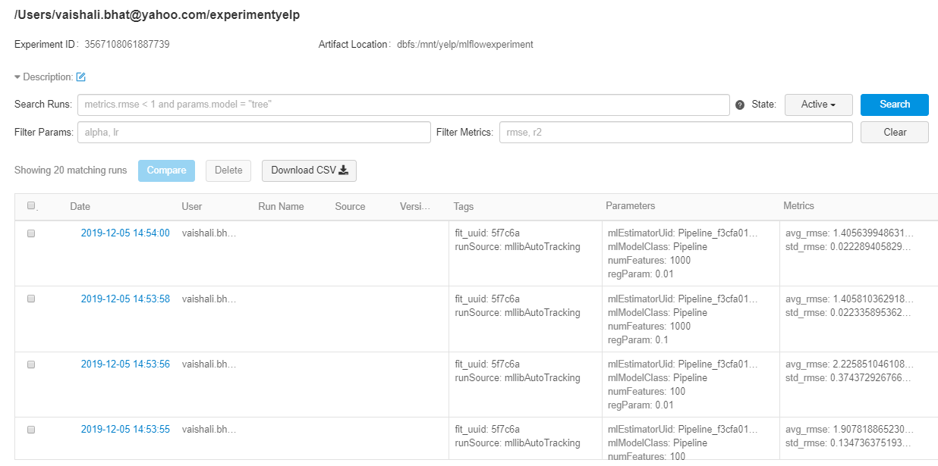
Prediction
Predict the rating as a continuous variable using a review.
Transformed sequence of words into a feature vector.
MLFLow tracked RMSE metric
best model has an RMSE of 0.004

Slide 8
Las Vegas, Toronto and Phoenix have highest number of businesses.
Good idea to invest in Restaurants and beauty salons.
Users constantly dropping since 2016
Reviews are solely based on a user’s satisfaction with business services.
Conclusion

Slide 9
Thanks

