Slide 1
Java File Handling
Learn how to work with files in Java
Presented by: Vaishali Sonanis

Slide 2
Introduction to File Handling
- File handling allows reading/writing data to files stored on disk.
- Useful for:
- Saving data permanently
- Reading configuration files
- Logging

Slide 3
Important Classes in java.io Package
- File
- FileReader
- BufferedReader
- FileWriter
- BufferedWriter
- PrintWriter
- Scanner (from java.util)

Slide 4
File Class
File file = new File("example.txt");
file.createNewFile(); // Creates file
file.exists(); // Check if exists
file.delete(); // Delete file

Slide 5
Writing to a File (FileWriter)
import java.io.FileWriter;
FileWriter writer = new FileWriter("output.txt");
writer.write("Hello, File Handling!");
writer.close();

Slide 6
Reading from a File (FileReader)
import java.io.FileReader;
import java.io.IOException;
FileReader reader = new FileReader("output.txt");
int data;
while ((data = reader.read()) != -1) {
System.out.print((char) data);
}
reader.close();

Slide 7
BufferedWriter & BufferedReader
BufferedWriter bw = new BufferedWriter(new FileWriter("file.txt"));
bw.write("Buffered Writing");
bw.close();
BufferedReader br = new BufferedReader(new FileReader("file.txt"));
System.out.println(br.readLine());
br.close();

Slide 8
Using Scanner to Read File
import java.util.Scanner;
Scanner sc = new Scanner(new File("file.txt"));
while (sc.hasNextLine()) {
System.out.println(sc.nextLine());
}
sc.close();

Slide 9
Exception Handling
try {
// file handling code
} catch (IOException e) {
e.printStackTrace();
}

Slide 10
File Methods Overview
| Method | Description |
|------------------|-----------------------|
| exists() | Checks if file exists |
| createNewFile() | Creates a new file |
| getName() | Returns file name |
| getPath() | Returns file path |
| delete() | Deletes the file |

Slide 11
Best Practices
- Always close streams.
- Use try-with-resources in Java 7+.
- Validate file paths.
- Handle exceptions properly.

Slide 12
Summary
- Java provides various classes for file handling.
- Use readers/writers for character streams.
- Use buffers for performance.
- Handle exceptions to avoid runtime crashes.

Slide 13
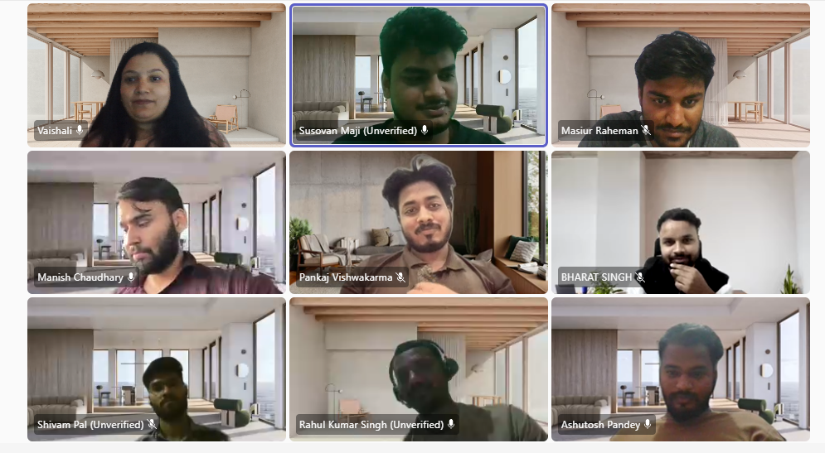
Thank You
Questions?
Feel free to ask!

Slide 14
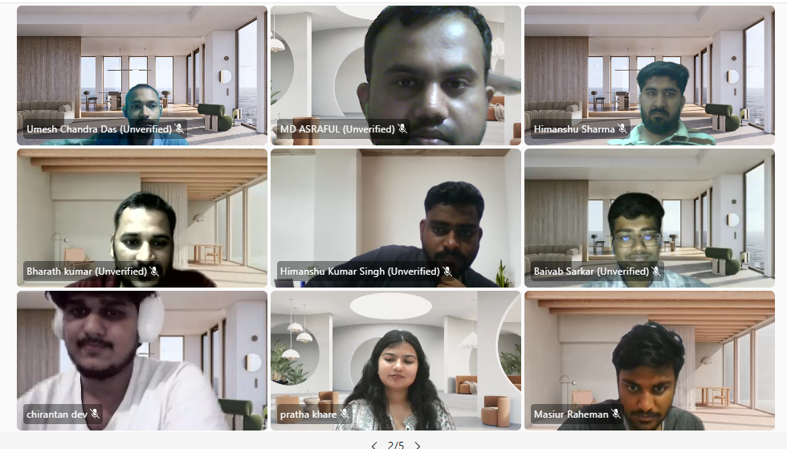

Slide 15
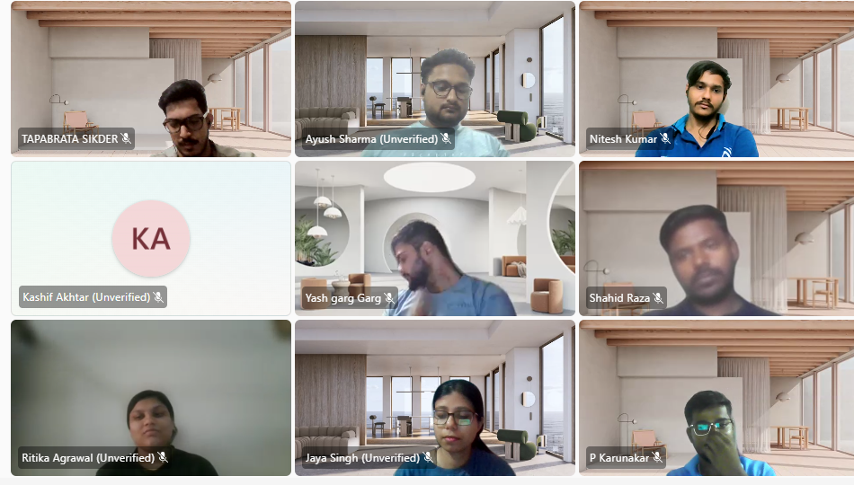

Slide 16
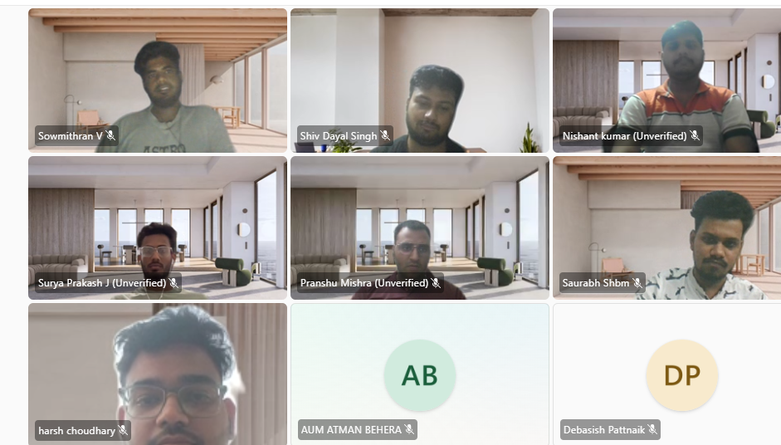

Slide 17
