Slide 1
Java Multithreading
Efficient Concurrent Programming in Java
Presented by : Vaishali Sonanis

Slide 2
Introduction to Multithreading
Multithreading is the ability of a program to execute multiple threads simultaneously to perform task concurrently
Threads not dependent on each other
Benefits: Efficient CPU utilization, Faster program execution

Slide 3
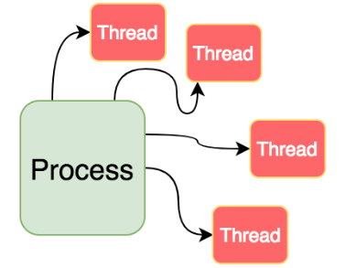
Process vs Thread
Process: Independent execution unit with its own memory
Thread: Subset of process, shares memory with other threads

Slide 4
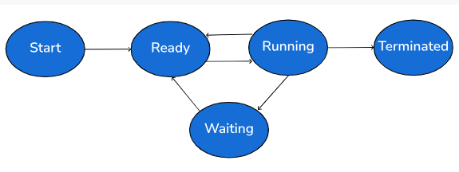
Life Cycle of a Thread
New
Runnable
Running
Blocked/Waiting
Terminated

Slide 5
Creating Threads in Java
Extending the Thread class
Implementing the Runnable interface

Slide 6
Thread Class Methods
start(),
run(),
sleep(),
join(),
yield(),
setPriority(),
getName()

Slide 7
Synchronization
Problem of data inconsistency
synchronized keyword

Slide 8
Inter-thread Communication
wait(),
notify(),
notifyAll()

Slide 9
Thread Priorities
MIN_PRIORITY (1)
NORM_PRIORITY (5)
MAX_PRIORITY (10)
Impact on thread scheduling

Slide 10
Advantages and Disadvantages
Advantages: Better resource use, faster execution
Disadvantages: Complex debugging, synchronization issues

Slide 11
Real-world Applications
Web servers
Gaming
Chat applications
File downloading

Slide 12
Questions and Answers
Any Questions?

Slide 13
Thank You
Contact Info (optional)
Acknowledgment

