Slide 1
Strings in Java
Strings in java(Topic 9)
Trainer: Vaishali Sonanis|

Slide 2
Introduction
Java offers three string-handling classes:
String – Immutable, thread-safe
String Buffer – Mutable, thread-safe (synchronized)
StringBuilder – Mutable, not thread-safe, faster than String Buffer

Slide 3
What is String
Immutable sequence of characters
Stored in the String Pool, memory-efficient for reuse
Good for static text; poor performance when modified repeatedly

Slide 4
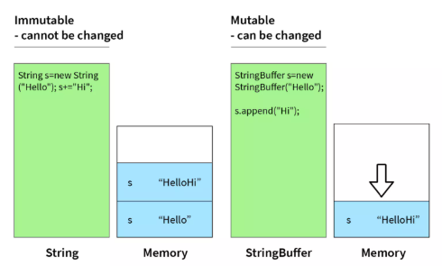
Memory Management for String

Slide 5
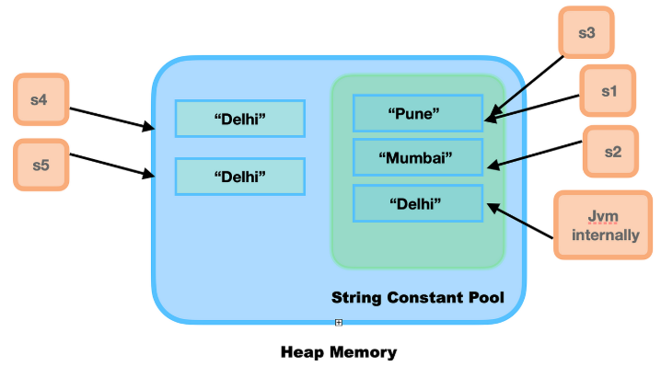
STRING CONSTANT POOL AND HEAP MEMORY MANAGEMENT

Slide 6
String buffer
Mutable + synchronized → thread-safe, but slower
.
Good for multi-threaded string processing.
Legacy class available since JDK 1.0.
StringBuffer sb = new StringBuffer("Hello");
sb.append(" World");
Output:=>Hello world

Slide 7
String builder
Introduced in JDK 1.5: mutable but not thread-safe.
Fastest string manipulation.
Ideal for loops, dynamic content in single-threaded context.
StringBuilder sb = new StringBuilder("Hi");
sb.append(" Java");
Output:=> Hi Java

Slide 8
Choosing the Right Class
Use String: immutable, safe, when no heavy modifications.
Use StringBuilder: fast and efficient in single-threaded scenarios.
Use StringBuffer: only when you need synchronized access from multiple threads.

Slide 9
Conversions for string
StringBuilder sb = new StringBuilder(str);
// String → StringBuilder
String str = sb.toString();
// StringBuilder → String
StringBuffer sbf = new StringBuffer(str);
// Cross conversion

Slide 10
Questions & Support
Practice
Repeat
learn

