Slide 1
PRESTASHOP / MY SHOP MODULE
Under Guidance of Mrs. Vaishali Sonawane Mam.

Slide 2
Introduction :
My shop is one of the part of PrestaShop platform where users can see a demo of there online store .
PrestaShop is An online platform that allows users to create an e-commerce presence, enabling them to sell products and services through the web to an online audience .

Slide 3
Members of Team
Mrunal Shinde - Test lead
Samrudhi Sakoji - Team member
Mayuri Patil - Team member
Akansha Jain - Team member

Slide 4
Responsibilities
Assign the sub-module and tasks to the team member.
Review the test cases of team members and guide them.
Execute all the test cases.
Create defect report.

Slide 5
Overview
What is prestashop?
Prestashop is an ecommerce platform that allows usere to create their online store.
My shop is demo store page of Prestashop.
It will help the user for creating their online store.
My shop also help user to understand how their store looks like for customer.
Launch your ecommerce website, customize your online store and start selling your products with the prestashop ecommerce platform.
My shop is demo shop layout.

Slide 6
Modules
Module 1 : Sign in page
Checked all the functionalities on Sign in page which included personal info as email
address, password.
Module 2 : Women page
Checked all the functionalities on Women page which included item details, Quantity, Filters, compare button, Add to cart button, product info , grid , list button.
Module 3 : T-shirt page
Checked all the functionalities on T-Shirt page which included item details, Quantity, Filters, compare button, Add to cart button, product info,grid,list button.
Notes:
Module 1: Signn in page
Checked all the functionalities on Sign in page which included personal info as email
address, password
Module 2: Women page
Checked all the functionalities on Women page which included item details, Quantity, Filters,compare button,Add to cart button,product info,grid,list button
Module 3: Tshirt page
Checked all the functionalities on T-Shirt page which included item details, Quantity, Filters,compare button,Add to cart button,product info,grid,list button
Module 4: All Buttons and Drop Down Arrow :
team checked if all the buttons and drop down arrows of different fields are functioning properly or not

Slide 7
Module 4 : All Buttons and Drop Down Arrow
team checked if all the buttons and drop down arrows of different fields are functioning properly or not.
Module 5 : Dresses page
Checked show all available products on screen Show category.
Module 6 : Blog page
Check that open blog page about site.
Module 7 : Header And footer
Show all valid details on header and footer like ,logo of shop, contact us, sign in, add to cart, all info about site(terms and conditions, about us, contact us)

Slide 8
Defects
While running a testcase at certain point some fields are not working as it is expected which is nothing but a defect, so the my team have created a Defect report on those defects.

Slide 9
Defect identifier :- B_001
Defect summary :- Our Store link is clickable but does not show nearest shop on google map
Ø Test Id :- TC_020
Ø Test case name :- TC_information_our_stores_cilikable
Ø Module name :- footer
Ø Reproducible :-
Ø Severity :- high
Ø Priority :- high
Ø Raised by :- Team lead
Ø Assigned to :- developer Team lead
Ø Date of assignment :-
Ø Status :- pending
Ø Snap shots :-
Ø Fixed by :- developer
Ø Date of fixing :-

Slide 10
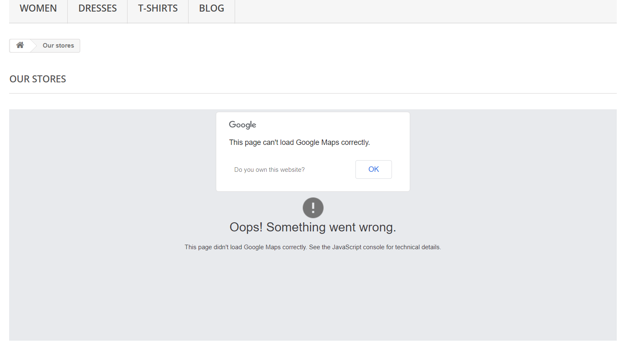

Slide 11
Defect identifier :- B_002
Ø Defect summary :- password filed accepting wrong format and dose not open sign in page
Ø Test Id :- TC_007
Ø Test case name :- TC_Already Registered?
Ø Module name :- Sign in page
Ø Reproducible :-
Ø Severity :- high
Ø Priority :- high
Ø Raised by :- Team lead
Ø Assigned to :- developer Team lead
Ø Date of assignment :-
Ø Status :- pending
Ø Snap shots :-
Ø Fixed by :- developer
Ø Date of fixing :-

Slide 12
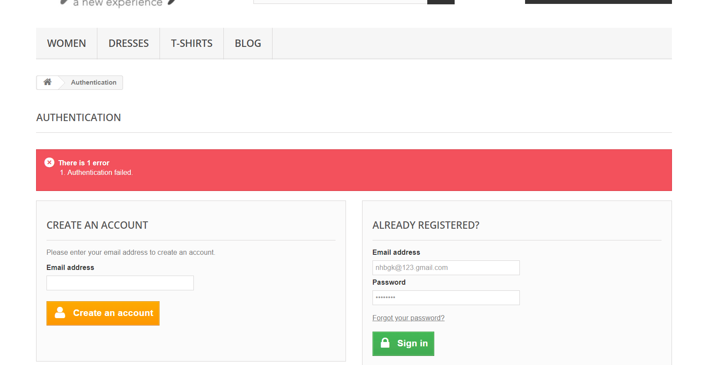

Slide 13
Challenges
While testing big website which contains huge data we faced some challenges about:
There is comes difference in writing a test case and while running it.
During meeting with members faces language issue
Suitable time for meeting for everyone leads an issue
Sometimes Different ideas for test cases may leads to an arguments during discussion.

Slide 14
Experience
Because of lot of communication And discussion with members it’s helps everyone to write taste case in easy way.
Help to find out bugs.
Less work because of Divdedation of modules.
Manual testing needs strong observation and in that testers needs to apply all possibilities in test cases.

Slide 15
Thank You!!!
Vaishali Mam For Guiding Us through out the Project.

