Slide 1
JVM Architecture
JVM Architecture for Beginners(Topic 2)
Trainer: Vaishali Sonanis|
Date:21 July 2025

Slide 2
What is JVM?
JVM = Java Virtual Machine
Executes Java bytecode on any platform
Part of the Java Runtime Environment (JRE)

Slide 3
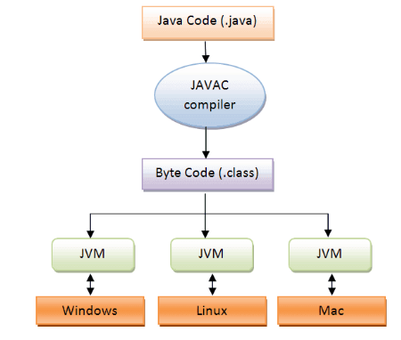
JVM Architecture

Slide 4
JVM Architecture Overview
Class Loader Subsystem:
Load .class file, Linking (Verify, Prepare, Resolve),Initialization
Runtime Data Areas:
Method area, Heap, java Stack
3. Execution Engine:
Interpreter – Executes bytecode line by line
Garbage Collector – Frees unused memory automatically
Native Interface:
Call native support like c/c++

Slide 5
Summary
JVM runs Java programs across platforms
Handles loading, execution, and memory
Key for Java’s platform independence & security
Includes Loader, Runtime Areas, Engine, Native Interface

Slide 6
Questions & Support
Practice
Repeat
learn

