Slide 1
Java Keywords
Java Keywords (Topic 4)
Trainer: Vaishali Sonanis|
Date:21 July 2025

Slide 2
What are Java Keywords?
Java keywords are reserved words that have predefined meanings in Java.
They cannot be used as identifiers (e.g., variable or method names).
Form the basic syntax and structure of Java programs.
There are around 50+ keywords in Java.

Slide 3
Categories of Java Keywords
Access Modifiers: public, private, protected
Class-related: class, interface, extends, implements, enum
Control Flow: if, else, switch, for, while, break, continue
Exception Handling: try, catch, throw, throws, finally
Primitive Types: int, float, boolean, char, etc.
Others: static, final, return, void, import, package

Slide 4
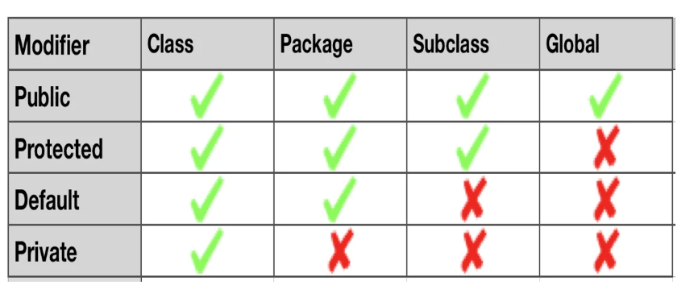
Access Modifiers
Define visibility of classes, methods, and variables:
- public
- private
- protected

Slide 5
Class Related Keywords
Define structure and relationship of classes:
- class
- interface
- extends
- implements
- enum

Slide 6
Control Flow Keywords
Control program execution flow:
- if
- else
- switch
- case
- default
- for
- while
- do
- break
- continue

Slide 7
Exception Handling Keywords
Handle errors and exceptions:
- try
- catch
- finally
- throw
- throws

Slide 8
Primitive Data Types
Used to declare variables of basic data types:
- int
- byte
- short
- long
- float
- double
- boolean
- char

Slide 9
Other Important Keywords
Miscellaneous but commonly used keywords:
- static
- final
- return
- void
- import
- package
- this
- super
- instanceof

Slide 10
Summary
Java keywords are essential to write any Java program.
Cannot be used as names for variables, classes, or methods.
Each keyword has a specific purpose in Java syntax.
Mastering keywords helps in writing better and efficient code.

Slide 11
Questions & Support
Practice
Repeat
learn

