Slide 1
Control Statements in Java
Control statements statements in java(Topic 8)
Trainer: Vaishali Sonanis|

Slide 2
Control statements types
1.Condition statements
If
If-else
If-else-if(Ladder)
Nested if
Switch case
2.Looping statements
While loop
Do-while loop
For loop
3.Jumping statements
Break
continue

Slide 3
What are Conditional Statements?
Conditional statements allow decision-making based on conditions.
They control the program's flow based on true/false results.

Slide 4
Types of Conditional Statements
1. if Statement=TRUE
2. if-else Statement=TRUE /FALSE
3. if-else-if Ladder=MULTIPLE CONDITION
4. switch Statement= MULTIPLE CASES AT A TIME
5. Nested if Statement=CONDITION(CONDITION(CONDITION))

Slide 5
if Statement
Syntax:
if (condition) {
// code if true
}
Example:
if (age >= 18) {
System.out.println("Eligible to vote");
}

Slide 6
if-else Statement
Syntax:
if (condition) {
// if block
} else {
// else block
}
Example:
if (num % 2 == 0)
Even
else
Odd

Slide 7
if-else-if Ladder
Syntax:
if (cond1) {
} else if (cond2) {
} else {
}
Example:
if (marks >= 90) A
else if (>= 75) B
else C

Slide 8
switch Statement
Syntax:
switch (value) {
case val1:
break;
default:
}
Example:
switch(day) {
case 1: Monday; break;
}

Slide 9
Nested if Statement
Example:
if (age >= 18) {
if (hasID) {
Entry allowed
} else {
ID required
}
} else {
Not allowed
}

Slide 10
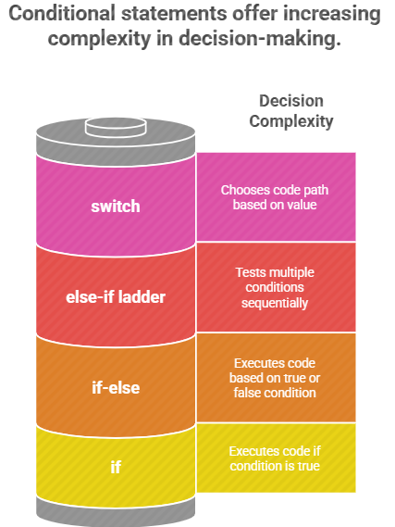
Summary

Slide 11
What Is a Loop?
Repeats a block of code until a condition is met—ideal for handling repetitive tasks efficiently, reducing errors and complexity
COMMON LOOP TYPES
While Loop (Entry‑controlled)
Do‑While Loop (Exit‑controlled)
For Loop (Counter-controlled)
For‑Each Loop (Collection‑driven)

Slide 12
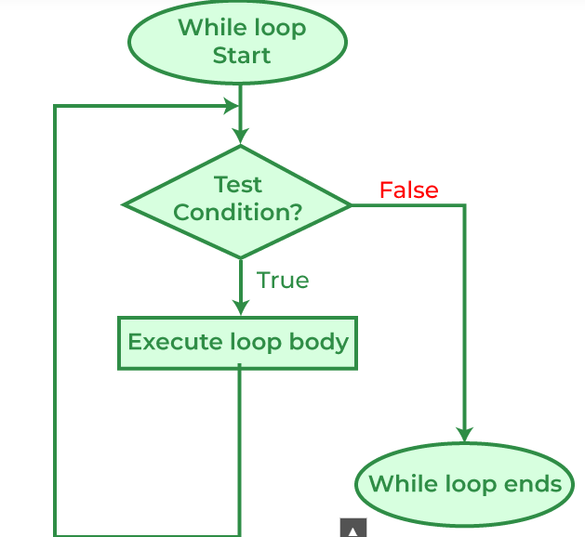
While Loop (Entry‑controlled)
A while loop repeatedly executes a block of code as long as a specified Boolean condition is true. If the condition is false at the start, the loop body won’t execute even once

Slide 13
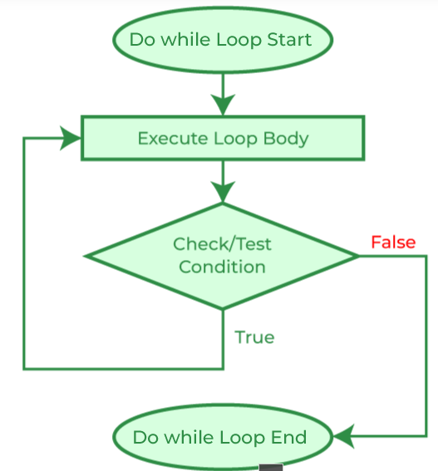
Do‑While Loop (Exit‑controlled)
A do‑while loop (also known as a post‑test loop or exit‑controlled loop) is a control flow structure that guarantees its loop body is executed once before the loop’s condition is evaluated. After the first run, it continues executing as long as the Boolean condition remains true

Slide 14
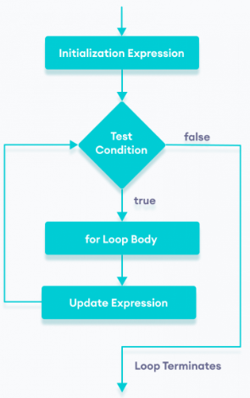
For loop
A for loop is an entry-controlled control flow statement that repeatedly executes a block of code until a specified condition is no longer true. It’s typically used when the number of iterations is known in advance and often involves a loop counter managing the repetition

Slide 15
3. What are Jump Statements?
Jump statements allow diversion in the normal flow of program execution by "jumping" to different points. Java includes three main types:
break,
continue,
return

Slide 16
Break statement
Purpose:
Immediately exits the closest enclosing loop(for,
while, do-while) or switch block, resuming execution right
after it
E.g.…
for (int i = 0; i < 10; i++) {
if (i == 5) {
break; // loop stops when i = 5
}
System.out.println(i);
}

Slide 17
Continue statement
Purpose:
Skips the rest of the current loop iteration and immediately proceeds to the next iteration
E.g.
for (int i = 0; i < 10; i++) {
if (i == 5) continue; // skip printing 5
System.out.println(i);
}

Slide 18
Return statement
Purpose:
Exits the current method and optionally returns a value to the caller. In void methods, return; exits without returning anything
E.g.
int add(int a, int b) {
return a + b; // returns sum of two numbers
}

Slide 19
Questions & Support
Practice
Repeat
learn

