Slide 1
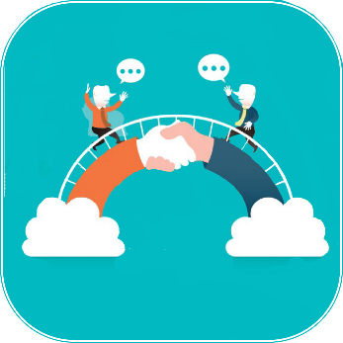
BRIDGE

Slide 2
PROBLEM STATEMENT
Event Mobility Hack
Create and bundle new technology and smart mobility services to make it easier for event attendees to reach events and move around the city during events and travel home happily.

Slide 3
CURRENT SCENARIO
Whenever a large scale event is organized, people from different linguistic backgrounds are expected to attend.
This creates a problem for the event organizers, as communication gap is the first barrier which is encountered in the smooth functioning of the event.
They are not able to successfully convey the instructions nor are the attendees able to understand them.
This leads to an increase in the difficulties of the attendees too.

Slide 4
SOLUTION
During the event, our solution will enhance the event experience.
Our app will provide a platform for the event organizers as well as the attendees, to “Bridge” this communication gap.
This would lead to smooth functioning of the event and help the attendees reach events and move around.

Slide 5
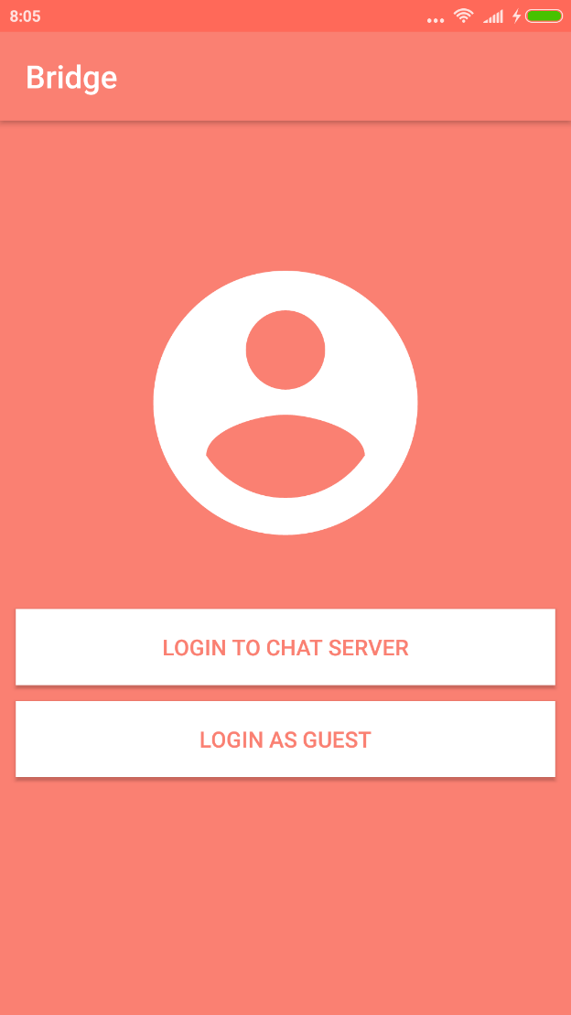
BRIDGE

Slide 6
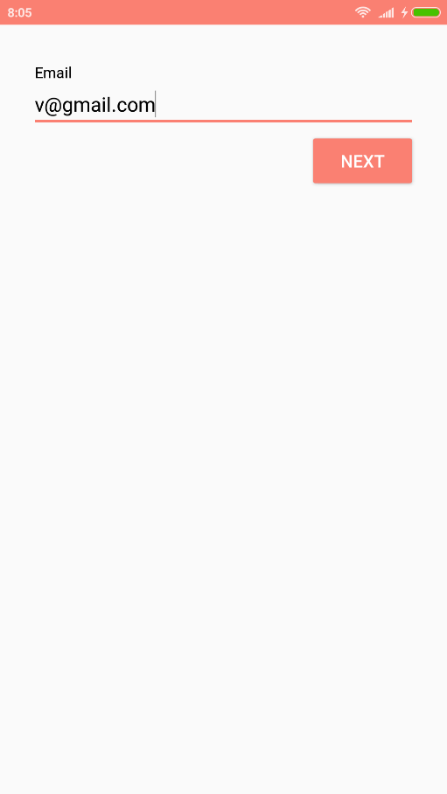
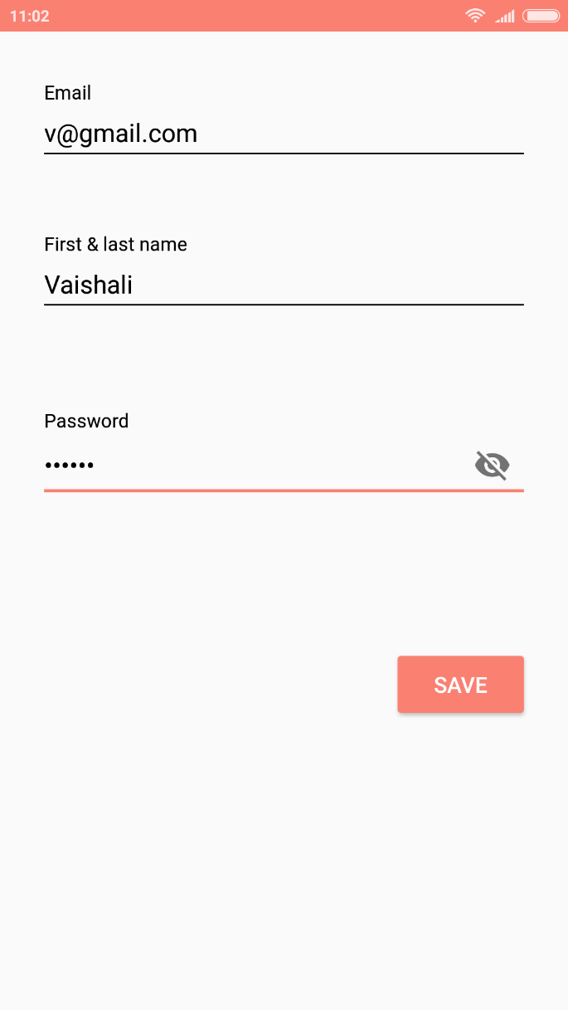
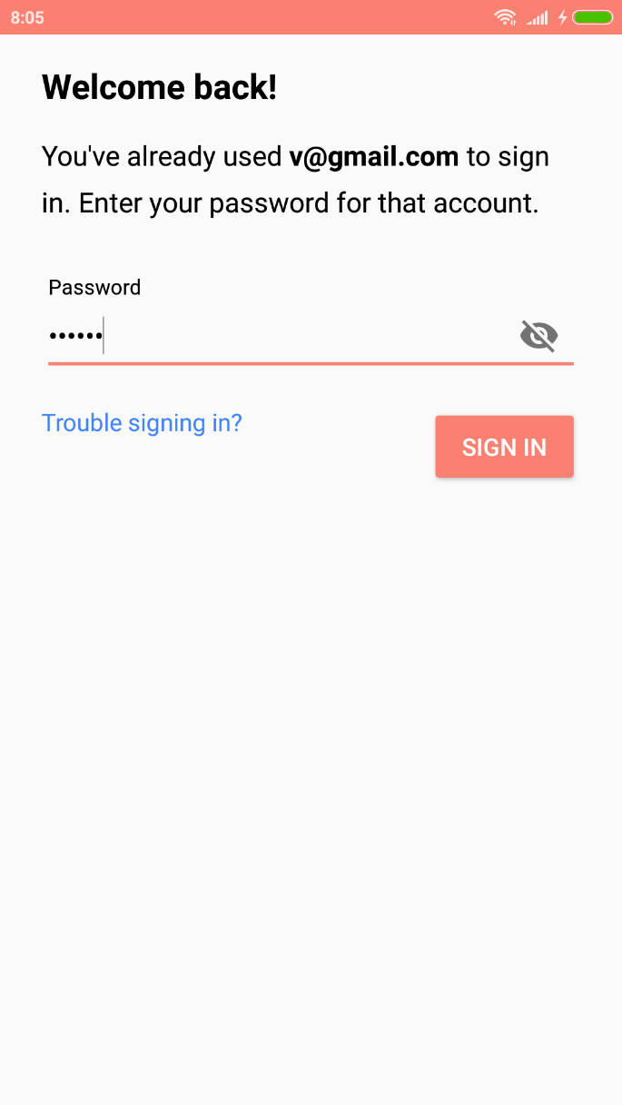
Login Screens

Slide 7
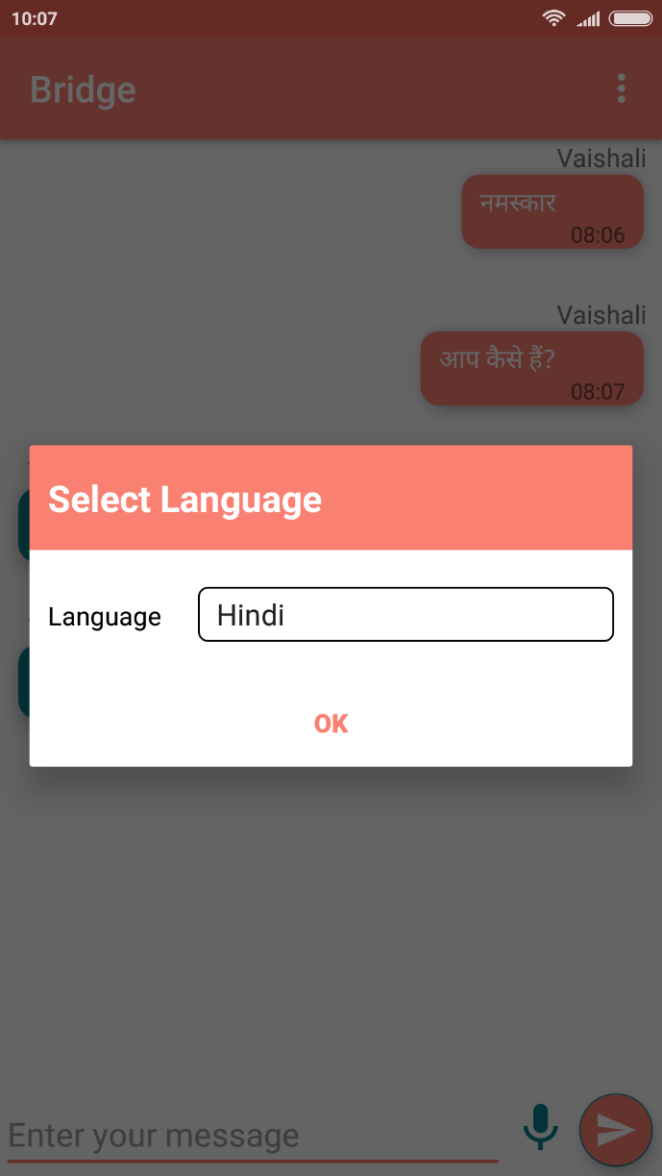
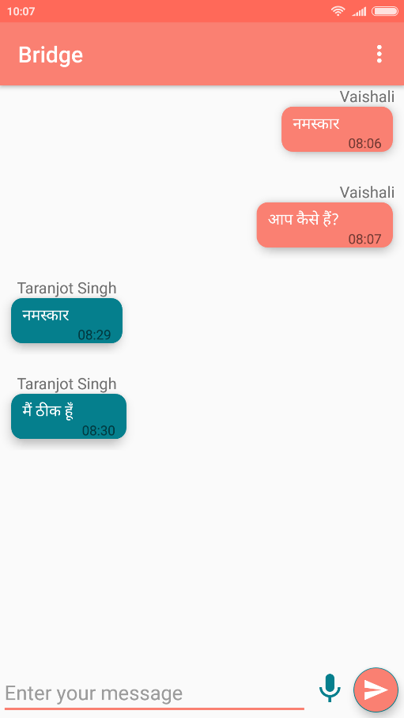
Chat Screen (1st Phone)

Slide 8
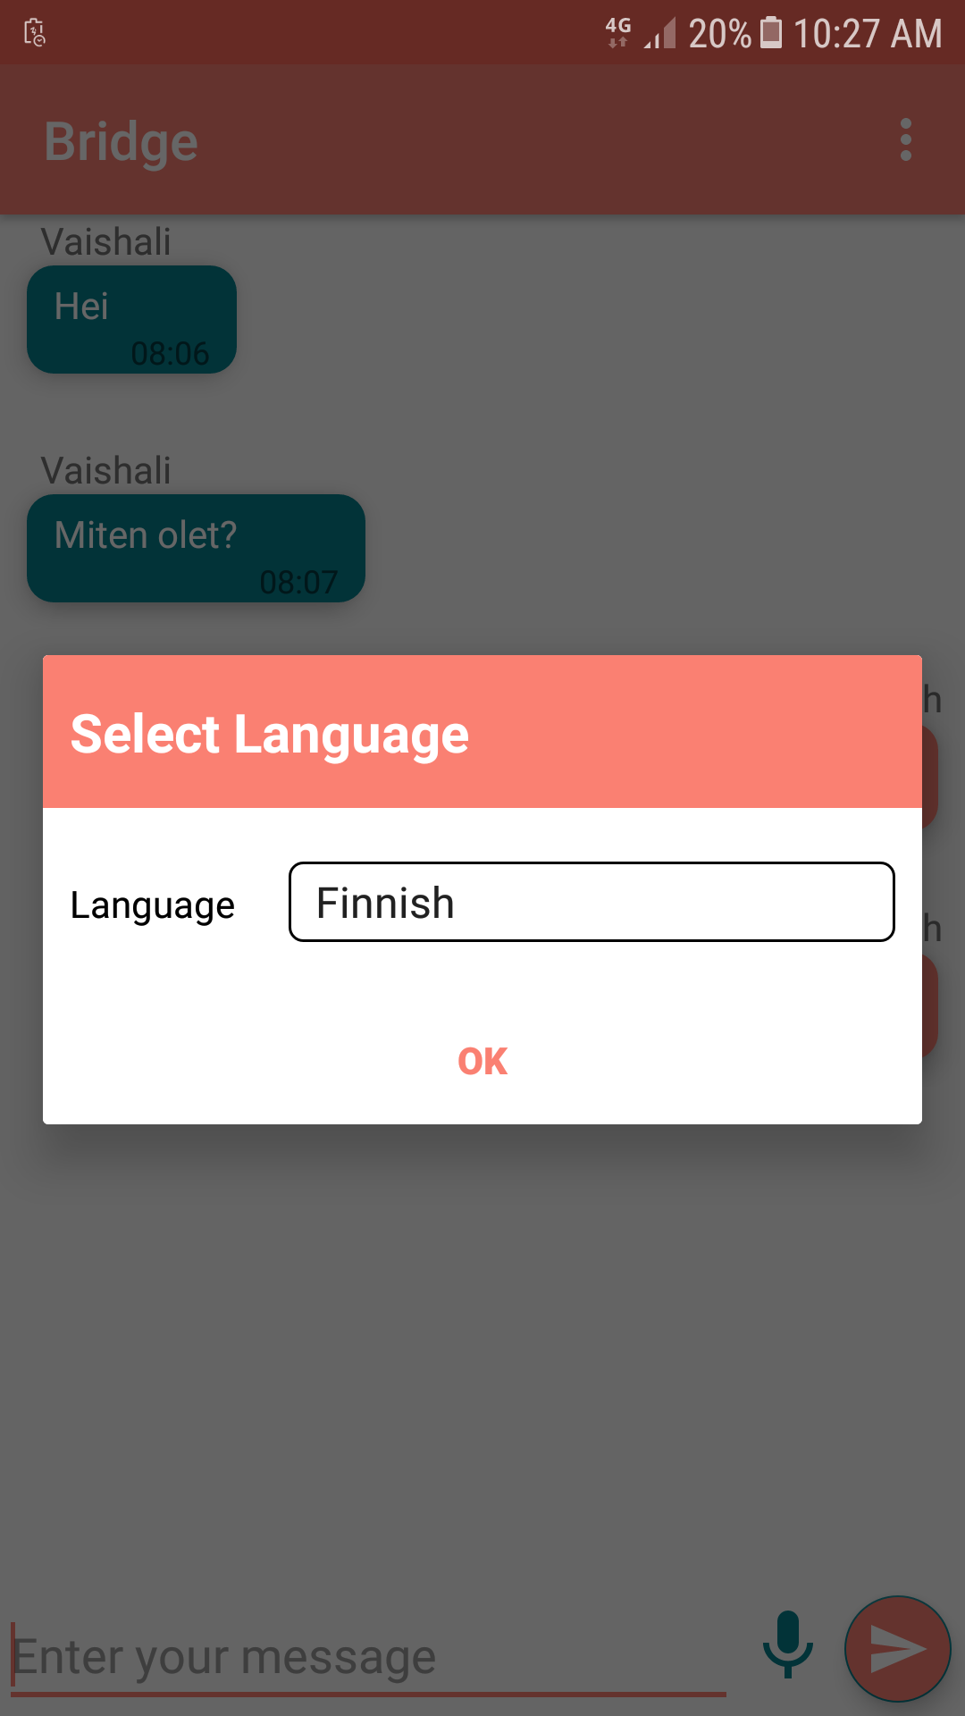
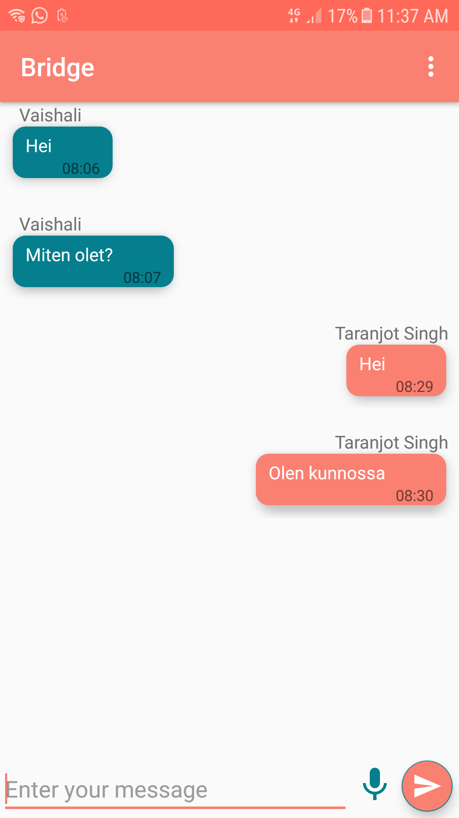
Chat Screen (2nd Phone)

Slide 9
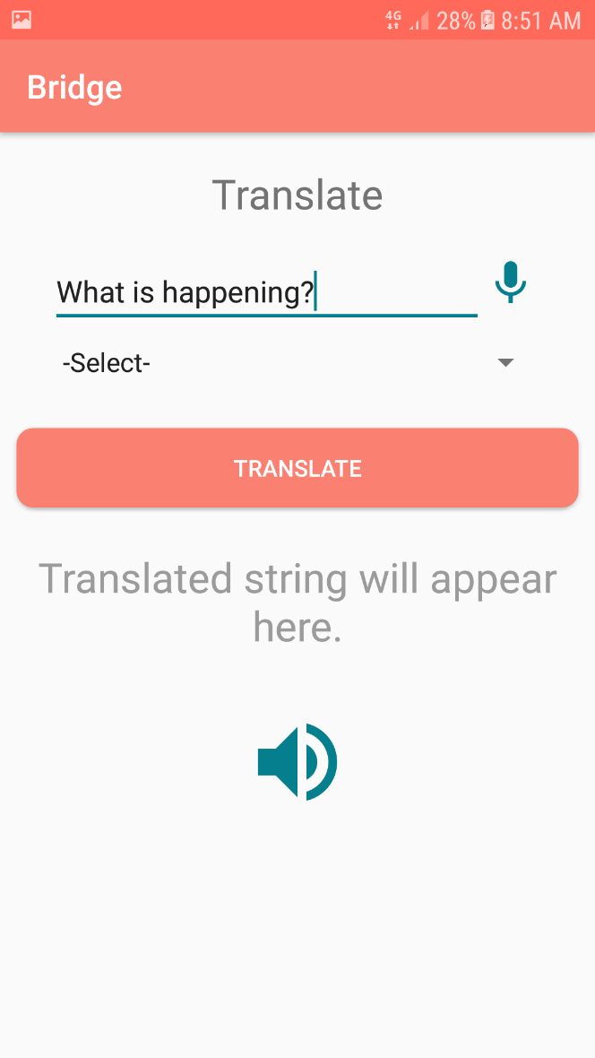
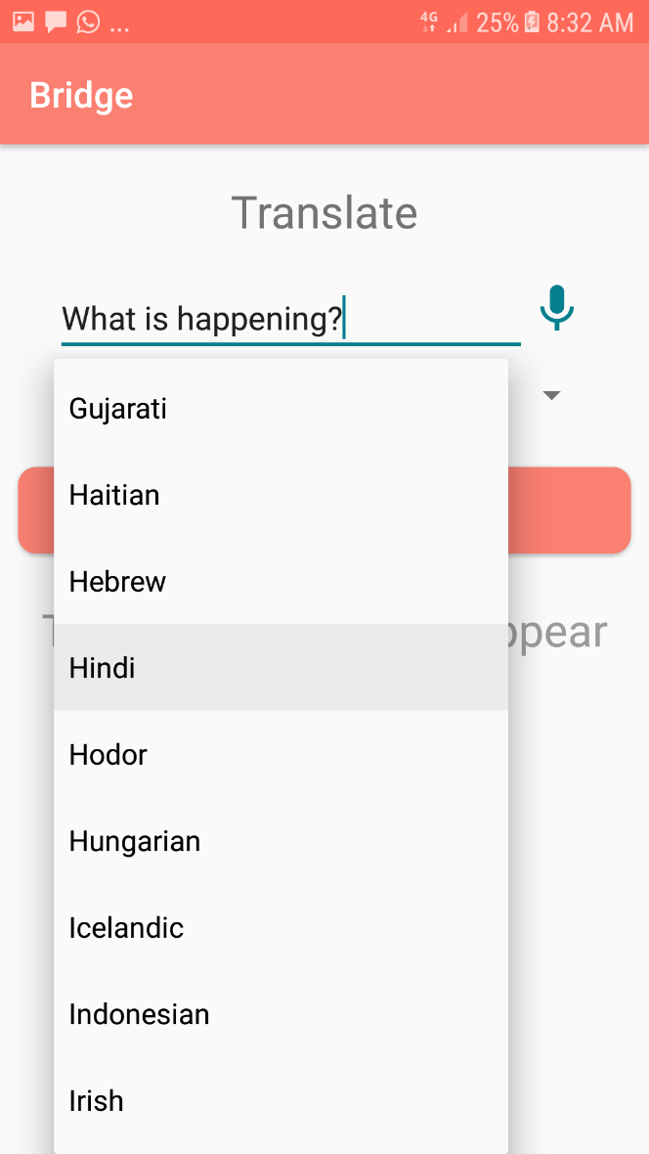
Guest Screen

Slide 10
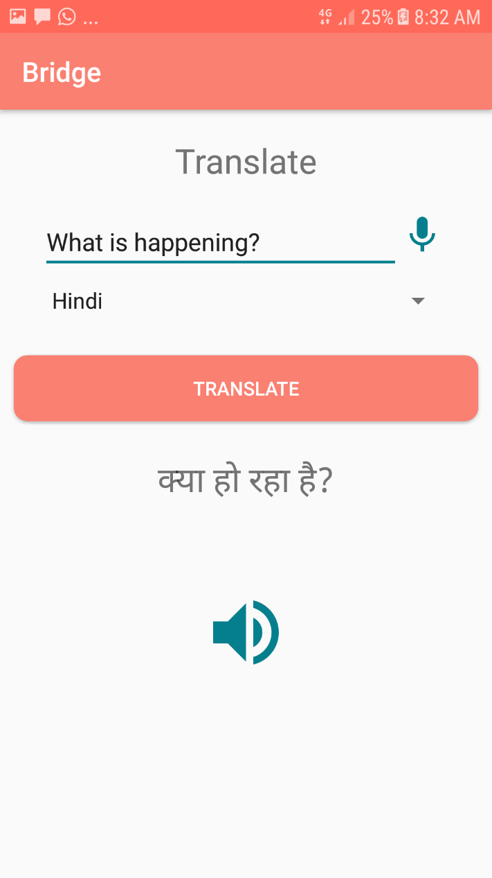
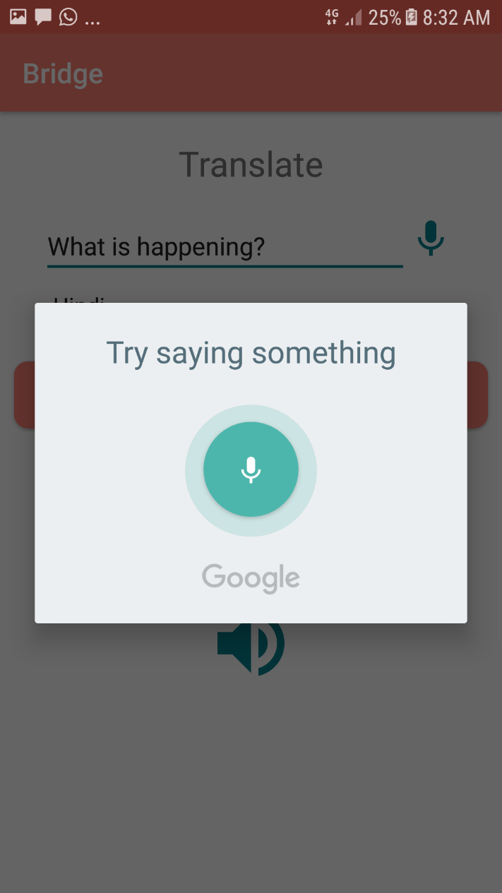
Voice Support
What is happening?

Slide 11
Technologies Used
Android Studio
Firebase
Yandex API

Slide 12
Future Scope
Broadcast Feature could be added so that the attendees can subscribe to the required list and can receive important messages from the event managers in their preferred language.

Slide 13
FEEDBACK

Slide 14
Thank You
Project by:
Shubhpreet Kaur
Tanmay Singh
Taranjot Singh
Vaishali Gupta

