Slide 1

Walmart Sales Analysis
Vaishali Maheshwari
MSDS 670 Final Project

Slide 2

Project Overview
t
Explore the two data sets for 45 Walmart stores and weekly sales data.
Sales during holidays and non-holiday weeks.
Holiday weeks (Christmas, Thanksgiving, Super Bowl and Labour Day) impact.
Stores with maximum sales.
Monthly sales analysis.
Day-wise sales analysis
Impact of other features on Walmart Sales.
Feature engineering
Final Dashboard to present insights into data.

Slide 3

Walmart Dataset details
Walmart Sales data is downloaded from from “https://data.world/tommywilczek/walmart”. I have taken a dataset with 500K records.
Two datasets are:-
Data set with details for 45 Walmart stores.
weekly sales data across these stores and departments.
Joined these datasets based on store ID to get all the features.
Data set is for years 2010 to 2012.
Field details:-
Store id, Size and type of stores.
Temperature, Fuel Price, Weekly sales, Date, Holiday, Department, 5 Markdowns, CPI, and unemployment.

Slide 4
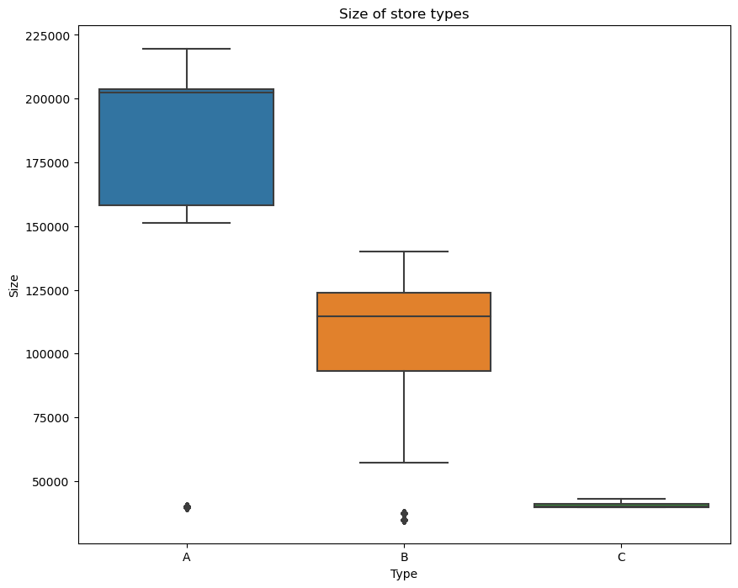
Exploratory Data Analysis Store Type
Three types of stores are considered in the data that are Type A, Type B and Type C.
Type A stores are most big.
Type B are medium-sized stores and type C are small-scale stores for Walmart.
Sales recorded for each store type are in sync to the size of the store.
Type A has recorded the highest sales of more than 4300 M.
Type B stores have more than 2000M sales.
Type C stores have the lowest total sales of less than 500M.

Slide 5
Total Sales by Stores
The dataset has a total of 45 stores numbered from 1 to 45.
Store number 20 has recorded the maximum sales of around 300M followed by store number 4.
Other stores who have top most sales are 14, 13, 2, 10, 27, 6, 1 and 39.

Slide 6
Weekly sales by Department
We have 81 unique departments across the dataset.
Department 92 and 95 have recorded the highest total sales of around 480M across all types of stores types that is A, B and C.
Store 14 has the maximum sales with these 5 departments of around 90M.

Slide 7
Seasonal Impacts based on temperature
The highest sales occur for most store types between the range of 40 to 80 degrees Fahrenheit.
Observation is pleasant weather encourages higher sales so quarter 3 records highest sales.
Sales are relatively lower for very low and very high temperatures but seem to be adequately high for favourable climate conditions.

Slide 8
Impact Of Unemployment on Sales
we see a visible decrease in sales when the median unemployment index is higher than 8.
We observe an ambiguity in data here when the unemployment index is 7 have recorded highest sales.

Slide 9
Impact of Fuel Price On Sales
A decrease in sales is observed when fuel price is higher than 4.25 dollars.
Sales are higher when the fuel price ranges between 2.75 to 3.75 dollars.
We don’t observe any direct relation between sales and fuel prices.

Slide 10
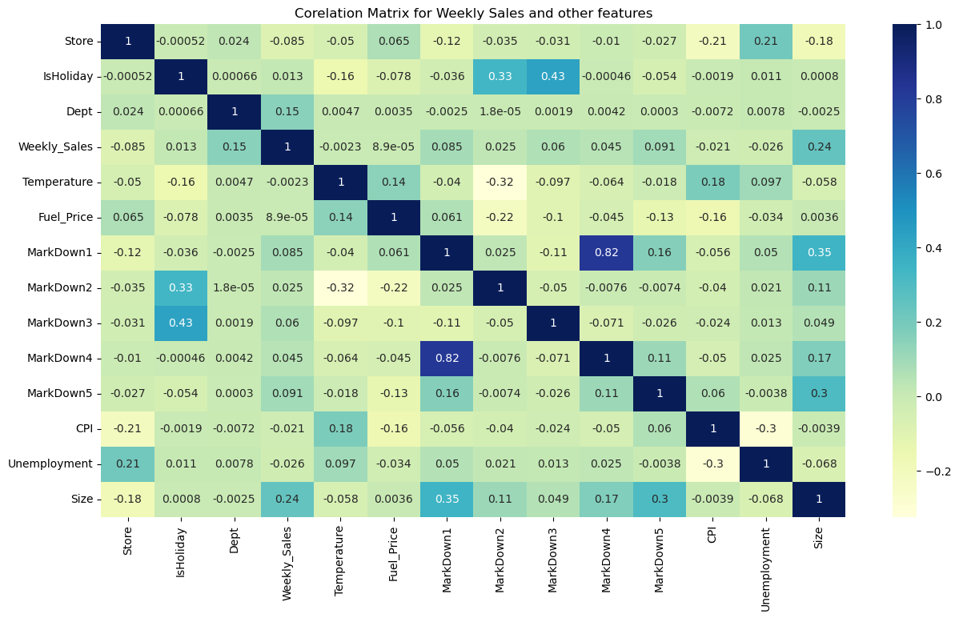
Corelation Matrix for Weekly sales and other features
Department and IsHoliday flag has a maximum dependency on the Weekly Sales values.
The size of the store also has an impact which is as expected.
MarkDown1 and MarkDown5 have no direct impact on the Weekly Sales.
Fuel Price, Temperature and CPI have the least correlation with the Weekly Sales hence they are not important while predicting the sales.

Slide 11
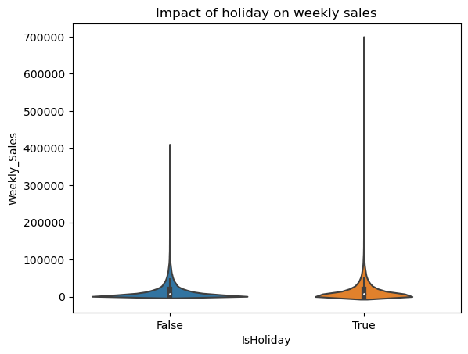
Holiday impact
Holidays have higher weekly sales than the rest of the year combined.
We have 13 days marked as holiday in the dataset.
We will split these holidays to super bowl, Labor Day, Thanksgiving and Christmas to analyze further.

Slide 12
Data Clean Up
Deleted the unnamed columns that were not required for analysis.
Records with weekly sales less than 0 were removed.
Temperature outliers are identified but can be ignored.
Markdown columns have null values.
Imputed all the 5 markdown missing fields with the mean of the available column values.
Any remaining null values are replaced with zero.

Slide 13
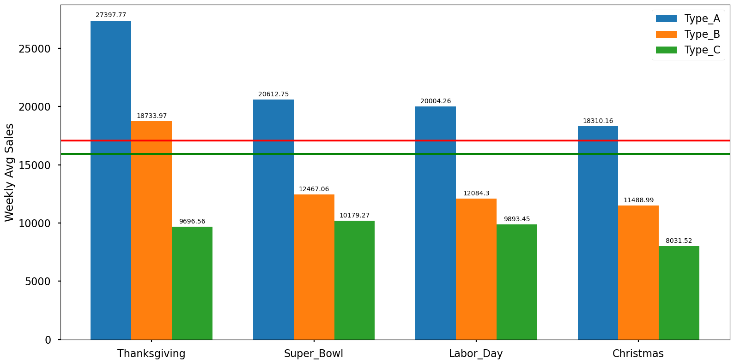
Feature Engineering
Considering four holiday weeks in the data, added the columns for super_bowl, Thanksgiving, Labor_Day and Christmas.
Highest Sales are observed during Thanksgiving for store type A and B. Store A average sale is more than 25K and store B have around 18.5K.
Holiday average sales are 17K
Non-Holiday average sale is 15.5 K

Slide 14

Feature engineering
Split the date field to get more insights about monthly or yearly sales.
Added the column Holiday_month to explore the sales. The holiday months marked are February, September, November and December.
Days left for Thanksgiving and Christmas.

Slide 15
Store Wise Total and Average Sales
Store Type A observed highest sales in the month of July of more than 417 M.
Store Type B also observed maximum sales in the month of July of 193 M.
Store type C observes almost similar sales throughout the year. However, October recorded maximum of 37M.
Average sales are not impacted by holidays in any month.

Slide 16
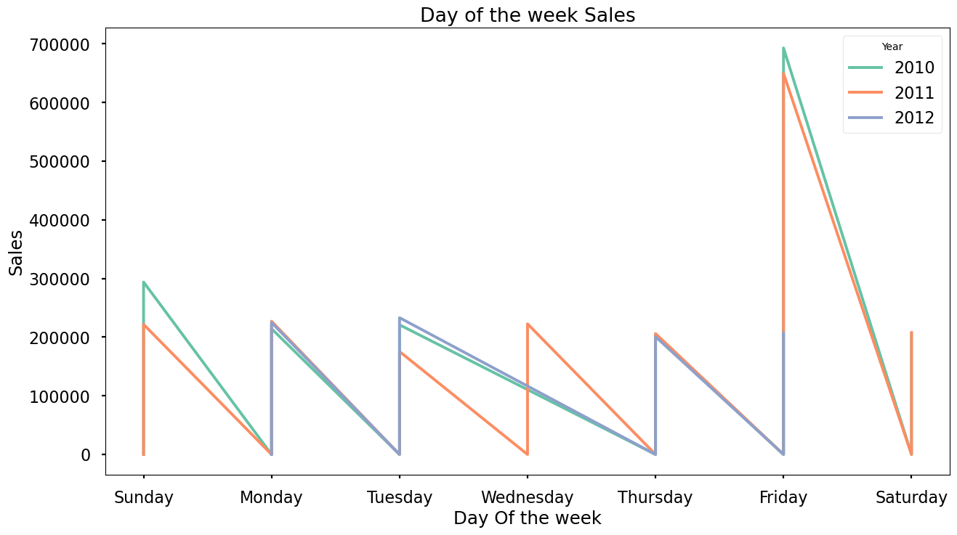
Day Wise sales across Years
Observation is Fridays have the highest sales across all three years.
Sunday and Saturday have the next highest sales.
Weekdays have recorded low sales of around 200K.

Slide 17
25 Stores with highest sales quarterly Distribution
The heatmap shows the quarterly data for 25 stores with the highest sales.
Quarter 4 has recorded the maximum sales probably due to the holiday season in this period.
Quarter 2 has the next highest sales which can be due to the pleasant weather during that period of the year.

Slide 18
Dashboard
The top 3 stores with the highest sales are 20, 4 and 14.
Department 92 has observed the highest sales across all three types of stores.
2011 has the maximum sales.
May, October, November and December months see a spike.
November holidays record the highest sales which is around Thanksgiving.

Slide 19

Conclusions
Store size is a great factor that affects sales; the bigger the store, the higher the sales. Store A still has the highest sales, followed by stores B and C.
Stores 20,4 and 14 have the highest sales for Type A, and stores 10, 23 and 18 have the highest sales for Type B.
Departments 95, 92 and 38 generate the highest revenue for Walmart across all the sizes of stores. The stores with these departments will result in higher sales.
Sales are the highest during the holiday season (in November and December month).
Days around the Thanksgiving holidays have recorded higher sales than any other holiday.
Extreme hot and cold weather has a profound impact on sales and pleasant weather encourages higher sales.
Unemployment impacts the sales for bigger stores like type A and B.

Slide 20
References
https://seaborn.pydata.org/generated/seaborn.heatmap.html
https://www.thedataschool.com.au/jason-hu/four-different-methods-to-calculate-the-percent-of-total-in-tableau/
https://www.tableau.com/dashboard-examples

Slide 21

Thank you

